Slide 1

A Technique for Generating Test Data using Genetic Algorithm
Dinh Ngọc Thi, Vo Dinh Hieu, Nguyen Viet Ha
Faculty of Information Technology
VNU University of Engineering and
Technology, Hanoi, Vietnam

Slide 2
Outline
1. Introduction
2. Background
3. Related work
4. Proposed approach
5. Experimental result
6. Conclusion

Slide 3

software is everywhere
errors are expensive
annual cost of software errors to US economy is $ ~60B [NIST’02]

Slide 4
approaches to finding errors
static analysis
automatic, scalable, exhaustive
infinite loops, array, procedure calls and pointer references
dynamic analysis
random testing, local search, and evolutionary methods

Slide 5
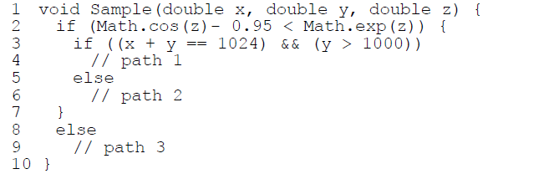
problem
SE can solve the second condition, it cannot for the first, when GA can generate test data for the first condition but it has degraded with the second condition

Slide 6
Outline
1. Introduction
2. Background
3. Related work
4. Proposed approach
5. Experimental result
6. Conclusion

Slide 7
testing as an optimization problem
When using GA, a path coverage test data generation is transformed into an optimization problem.
To cover a test path during execution, find appropriate values for the input variables which satisfy related branch predicates.
Using Korel’s branch distance function: if a branch predicate B is (x ≤ y - 5), then apply the Korel function f(B) = x – (y - 5).

Slide 8
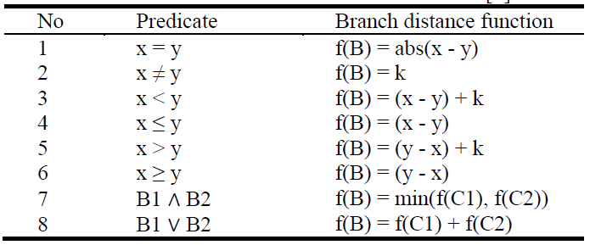
Korel function

Slide 9
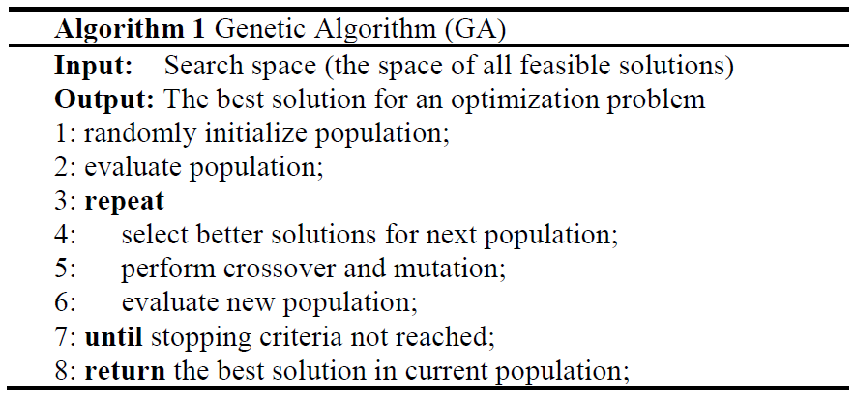
genetic algorithm(GA)

Slide 10
Outline
1. Introduction
2. Background
3. Related work
4. Proposed approach
5. Experimental result
6. Conclusion

Slide 11
related work
The path coverage literature using GA started with Lin and Yeh [14] in 2000. They extended Jones et al.'s work [15] from branch coverage to path coverage.
Chen and Zhong [16] developed a multi-population genetic algorithm for path testing.

Slide 12
related work (cond)
Malburg and Fraser [18] introduced a novel mutation operator for evolutionary search which based on dynamic SE.
Ahmed and Hermadi [21] improved their GA research [22] in 2003 by adding a rewarding scheme and using a more efficient test data generator.

Slide 13
Outline
1. Introduction
2. Background
3. Related work
4. Proposed approach
5. Experimental result
6. Conclusion

Slide 14
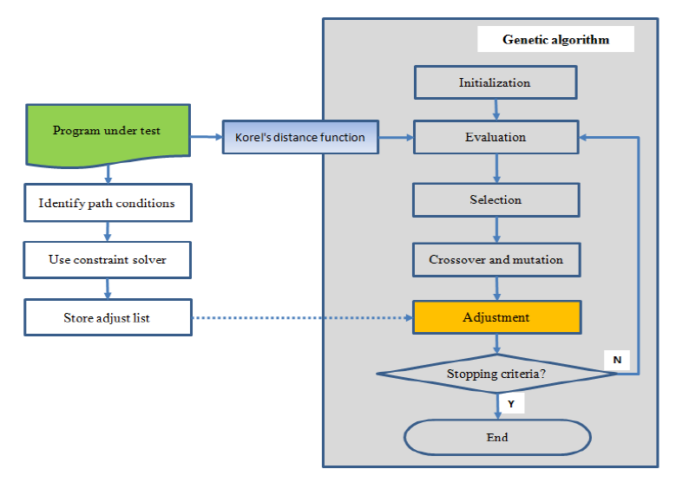
main steps

Slide 15
step 1: static program analysis
Solve path conditions
Store constraint satisfaction

Slide 16
step 1: static program analysis
Solve path conditions
Store constraint satisfaction

Slide 17
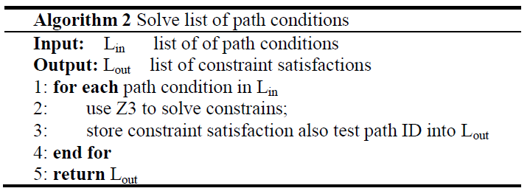
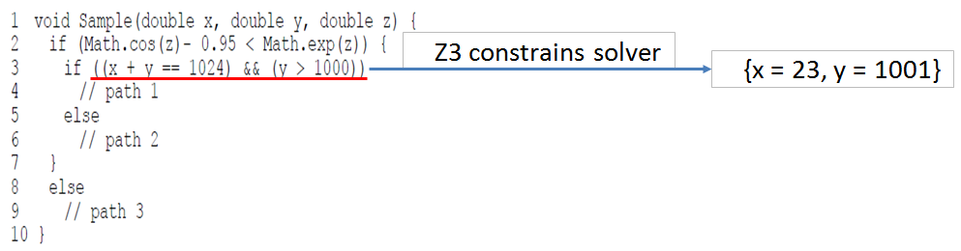
solve path conditions

Slide 18
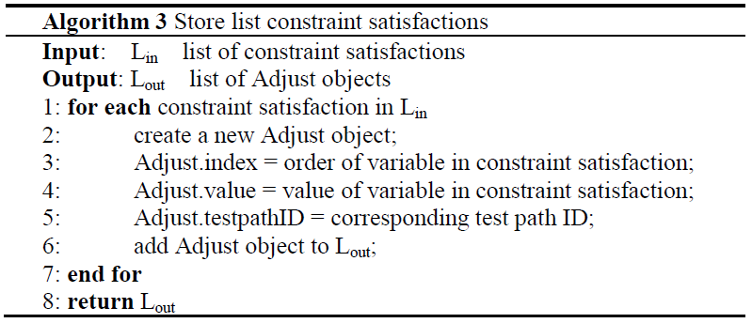
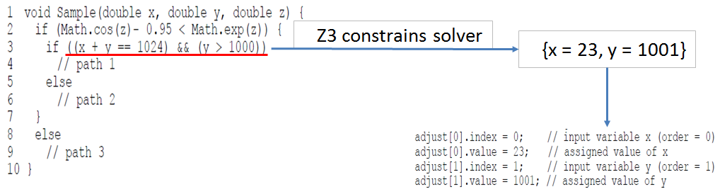
store constraint satisfaction

Slide 19
step 2: execute GA
Create fitness function
Constraint-based adjustment

Slide 20
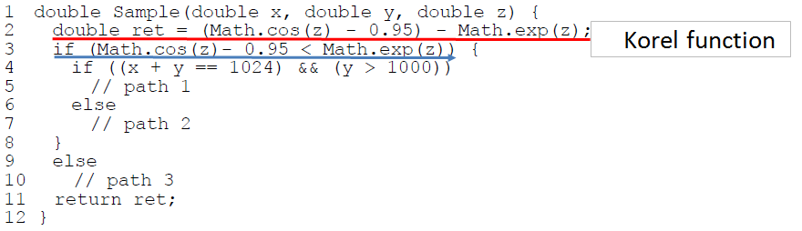
Create fitness function

Slide 21
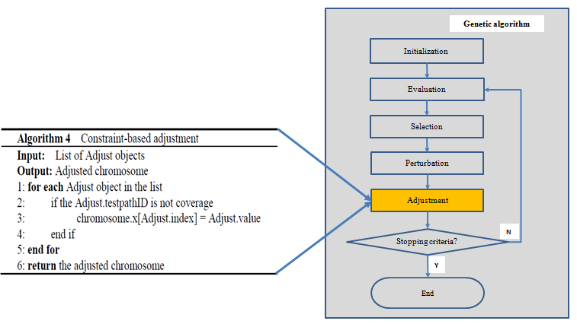
constraint-based adjustment

Slide 22
Outline
1. Introduction
2. Background
3. Related work
4. Proposed approach
5. Experimental result
6. Conclusion

Slide 23
Outline
1. Introduction
2. Background
3. Related work
4. Proposed approach
5. Experimental result
6. Conclusion

