Slide 1

Generating Test Data for Software Structural Testing using Parallel Particle Swarm Optimization
Ngoc-Thi Dinh, Hieu-Dinh Vo, Viet-Ha Nguyen
Faculty of Information Technology
VNU University of Engineering and Technology,
Hanoi, Vietnam

Slide 2
outline
Introduction
Proposed approach
Experimental result
Conclusion

Slide 3
Introduction(1)
Approaches to automated testing:
static analysis
automatic, scalable, exhaustive
infinite loops, array, procedure calls and pointer references
state-of-the-art: symbolic execution (SE)
dynamic analysis
random testing, local search, and evolutionary methods
most widely known: Genetic Algorithm (GA), Particle Swarm Optimization(PSO)

Slide 4
Introduction(2)
Problem statement
int getDayNum(int year, int month) {
int maxDay=0;
if(month≥1 && month≤12) {
if(month=2) {
if(year%400=0||(year%4=0&&year%100=0))
maxDay=29; //path 5
else
maxDay=28; //path 4
}
else if(month=4||month=6||month=9||month=11)
maxDay=30; // path 3
else
maxDay=31; //path 2
}
else
maxDay=-1; // path 1
return maxDay;
}

Slide 5
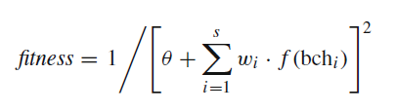

Introduction(3)
Mao [1] used PSO to generate test data through building the one and only fitness function which was the combination of Korel formula [2] and the branch weights

Slide 6
outline
Introduction
Proposed approach
Experimental result
Conclusion

Slide 7
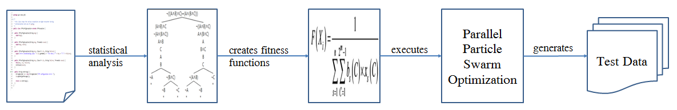
Proposed approach

Slide 8
Proposed approach
Step 1: Generate control flow graph(CFG) from the program under test(PUT)
Algorithm 1: Generate CFG
Input : f : source code
Output: graph: CFG
1: B = a set of blocks by dividing f
2: G = a graph by linking all blocks in B to each other
3: update graph by replacing f with G
4: if G contains return/break/continue statements then
5: update the destination of return/break/continue pointers in the graph
6: end if
7: for each block M in B do
8: if block M can be divided into smaller blocks then
9: Generate CFG(M)
10: end if
11: end for

Slide 9
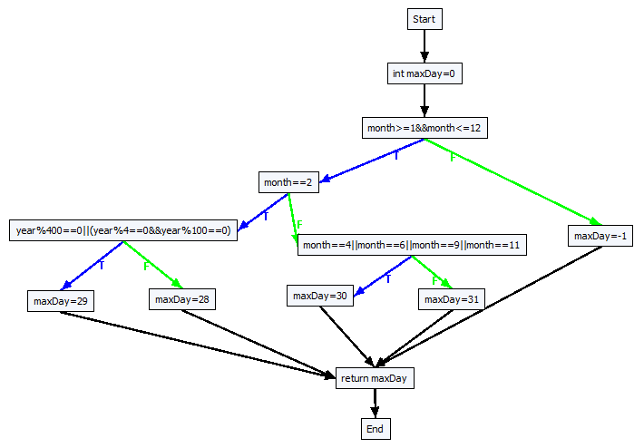
Proposed approach

Slide 10
Proposed approach
Step 2: Generate all test paths from the CFG
Algorithm 2: Traverse CFG
Input : v: the initial vertex of the CFG depth: the maximum number of iterations for a loop path: a global variable used to store a discovered test path
Output: P: a set of feasible test paths
1: if v = NULL or v is the end vertex then
2: add path to P
3: else if the number occurrences of v in path ≤ depth then
4: add v to the end of path
5: if (v is not a decision node) or (v is decision node and path is feasible) then
6: for each adjacent vertex u to v do
7: Traverse CFG(u, depth, path)
8: end for
9: end if
10: remove the latest vertex added in path from it
11: end if

Slide 11
Proposed approach
No | PathID | Path’s decision nodes
1 | path1 | [(month ≥ 1 && month ≤ 12), T], [(month = 2), T], [(year % 400 = 0 | | (year % 4 = 0 && year % 100 = 0)), T]
2 | path2 | [(month ≥ 1 && month ≤ 12), T], [(month = 2), T], [(year % 400 = 0 || (year % 4 = 0 && year % 100 = 0)), F]
3 | path3 | [(month ≥ 1 && month ≤ 12), T], [(month = 2), F], [(month = 4|| month = 6|| month = 9 || month = 11), T]
4 | path4 | [(month ≥ 1 && month ≤ 12), T], [(month =2), F], [(month = 4|| month = 6|| month = 9 || month =11), F]
5 | path5 | [(month ≥ 1 && month ≤ 12), F]

Slide 12
Proposed approach
Korel formula [2]
No | Predicate | Branch distance function f(bch_{i})
1 | Boolean | If true then 0 else k
2 | ¬a | Negation is propagated over a
3 | a = b | If abs(a – b) = 0 then 0 else abs(a − b) + k
4 | a ≠ b | If abs(a − b) ≠ 0 then 0 else k
5 | a < b | If a − b < 0 then 0 else abs(a − b) + k
6 | a ≤ b | If a − b ≤ 0 then 0 else abs(a − b) + k
7 | a > b | If b − a > 0 then 0 else abs(b − a) + k
8 | a ≥ b | If b − a ≥ 0 then 0 else abs(b − a) + k
9 | a and b | f (a) + f(b)
10 | a or b | min(f(a), f(b))

Slide 13
Proposed approach
Step 3: Base on Korel formula, generate fitness function f_{i} for each decision node
Algorithm 3: Branch distance function (fBchDist)
Input: double a, condition type, double b
Output: Branch distance value
1: switch (condition type) 2: case “=”:
3: if abs(a − b) = 0 then retrun 0 else return abs(a − b) + k)
4: case “≠”:
5: if abs(a − b) ≠ 0 then return 0 else return k
6: case “<”:
7: if a − b < 0 then return 0 else return (abs(a − b) + k)
8: case “≤”:
9: if a − b ≤ 0 then return 0 else return (abs(a − b) + k)
10: case “>”:
11: if b − a > 0 then return 0 else return (abs(b − a) + k)
12: case “≥”:
13 if b − a ≥ 0 then return 0 else return (abs(b − a) + k)
14: end switch

Slide 14
Proposed approach
No | Decision node | Fitness function | ID
1 | [(month ≥ 1 && month ≤ 12), T] | fBchDist(month, ≥, 1) + fBchDist (month, ≤, 12) | f₁T
2 | [(month ≥ 1 && month ≥ 12), F] | min(fBchDist (month, <, 1), fBchDist (month, >, 12)) | f₁F
3 | [(month = 2), T] | fBchDist (month, =, 2) | f₂T
4 | [(month = 2), F] | fBchDist (month, ≠, 2) | f₂F
5 | [(year % 400 = 0 || (year % 4 = 0 && year % 100 = 0)), T] | min(fBchDist (year %400, =, 0), (fBchDist (year %4, =, 0) + fBchDist (year %100, =, 0))) | f₃T
6 | [(year %400 = 0 || (year % 4 = 0 && year % 100 = 0)), F] | fBchDist (year %400, ≠, 0) + min(fBchDist (year %4, ≠, 0), fBchDist (year %100, ≠, 0)) | f₃F
7 | [(month = 4 || month = 6 || month = 9 || month = 11), T] | min(fBchDist (month, =, 4), fBchDist (month, =, 6), fBchDist (month, =, 9), fBchDist (month, =, 11)) | f₄T
8 | [(month = 4 || month = 6 || month = 9 || month = 11), F] | fBchDist (month, ≠, 4) + fBchDist (month, ≠, 6) + fBchDist (month, ≠, 9) + fBchDist (month, ≠, 11) | f₄F
No | PathID | Test path fitness functions
1 | path1 | F₁ = f₁T + f₂T + f₃T
2 | path2 | F₂ = f1T + f2T + f3F
3 | path3 | F₃ = f1T + f2F + f4T
4 | path4 | F₄ = f1T + f2F + f4F
5 | path5 | F₅ = f1F

Slide 15
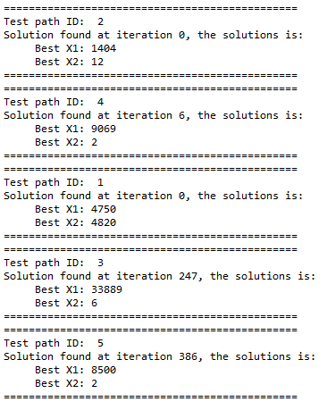
Proposed approach
Algorithm 5: Parallel Particle Swarm Optimization(PPSO)
Input: list of fitness function
Output: test data for each fitness function
1: for each fitness function F_{i} 2: Initialize an object pso_{i} of class PSOProcess
3: Assign a fitness function F_{i} to object pso_{i}
4: Execute object pso: pso.start();
5: end for

Slide 16
outline
Introduction
Proposed approach
Experimental result
Conclusion

Slide 17
Experimental result
Automatic ability:
As there is no need to build the branch weight function, the automatic feature of this proposal will be improved.
The fitness functions are automatically built basing on the decision nodes of each test path, and those decision nodes can be entirely generated automatically from a PUT with above mentioned algorithm 2 and 3. This obviously advanced the automatic ability in our proposal.

Slide 18

Experimental result
Coverage ability:
Success rate (SR): the probability of all branches which can be covered by the generated test data.
Average coverage (AC): the average of the branch coverage achieved by all test inputs in 1,000 runs.

Slide 19
Experimental result
PUT name | Lines of code | Branches | Arguments | Description
triangleType | 31 | 5 | 3 | Type classification for a triangle
computeTax | 61 | 11 | 2 | Compute the federal personal income tax
printCalendar | 187 | 33 | 2 | Print the calendar of a month in some year
line | 92 | 36 | 8 | Check if two rectangles overlap
Program under test | Success rate (%) |  | Average coverage (%)
 | Mao[10]’s PSO | PPSO | Mao[10]’s PSO | PPSO
triangleType | 99.80 | 100.0 | 99.94 | 100.0
computeTax | 99.80 | 100.0 | 99.98 | 100.0
printCalendar | 99.10 | 100.0 | 99.72 | 100.0
line | 99.20 | 100.0 | 99.86 | 100.0

Slide 20
reference
C. Mao: Generating Test Data for Software Structural Testing Based on Particle Swarm Optimization. Arabian Journal for Science and Engineering, vol 39, issue 6, pp 4593–4607 (June 2014).
B. Korel. Automated software test data generation. IEEE Transactions on Software Engineering, vol. 16, 870-879 (1990).

Slide 21


