Slide 1

A Technique for Generating Test Data using Genetic Algorithm
Dinh Ngọc Thi, Vo Dinh Hieu, Nguyen Viet Ha
Faculty of Information Technology
VNU University of Engineering and
Technology, Hanoi, Vietnam

Slide 2
Outline
1. Introduction
2. Background
3. Related work
4. Proposed approach
5. Experimental result
6. Conclusion

Slide 3

software is everywhere
errors are expensive
annual cost of software errors to US economy is $ ~60B [NIST’02]

Slide 4
approaches to finding errors
static analysis
automatic, scalable, exhaustive
infinite loops, array, procedure calls and pointer references
dynamic analysis
random testing, local search, and evolutionary methods

Slide 5
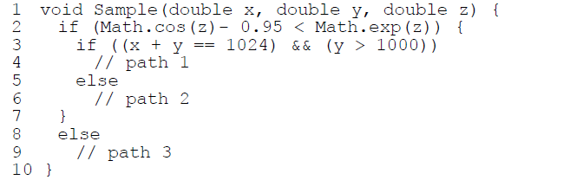
problem
SE can solve the second condition, it cannot for the first, when GA can generate test data for the first condition but it has degraded with the second condition

Slide 6
Outline
1. Introduction
2. Background
3. Related work
4. Proposed approach
5. Experimental result
6. Conclusion

Slide 7
optimization problem
When using GA, a path coverage test data generation is transformed into an optimization problem.
To cover a test path during execution, find appropriate values for the input variables which satisfy related branch predicates.
Using Korel’s branch distance function: if a branch predicate B is (x ≤ y - 5), then apply the Korel function f(B) = x – (y - 5).

Slide 8
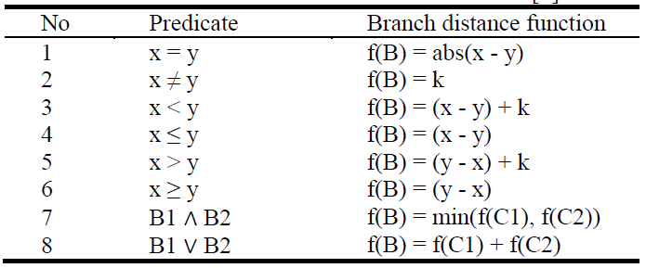
Korel function

Slide 9
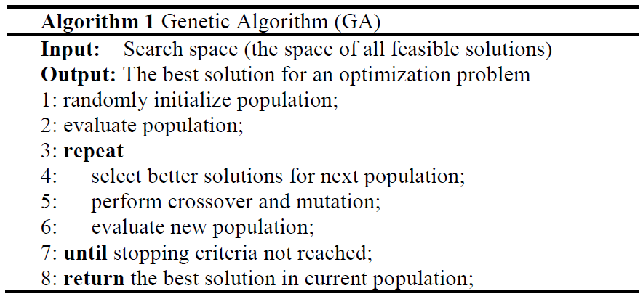
genetic algorithm(GA)

Slide 10
Outline
1. Introduction
2. Background
3. Related work
4. Proposed approach
5. Experimental result
6. Conclusion

Slide 11
Outline
1. Introduction
2. Background
3. Related work
4. Proposed approach
5. Experimental result
6. Conclusion

Slide 12
Outline
1. Introduction
2. Background
3. Related work
4. Proposed approach
5. Experimental result
6. Conclusion

Slide 13
Outline
1. Introduction
2. Background
3. Related work
4. Proposed approach
5. Experimental result
6. Conclusion

