Slide 1

Generating Test Data for Software Structural Testing using Parallel Particle Swarm Optimization
Ngoc-Thi Dinh, Hieu-Dinh Vo, Viet-Ha Nguyen
Faculty of Information Technology
VNU University of Engineering and Technology,
Hanoi, Vietnam

Slide 2
outline
1. Introduction
2. Background
3. Related work
4. Proposed approach
5. Experimental result
6. Conclusion

Slide 3

software is everywhere
Bugs are expensive. Annual cost of bug fixing to US economy is $～60B [1], so automated testing is an efficient way to reduce those effort and costs.

Slide 4
approaches to automated testing
static analysis
automatic, scalable, exhaustive
infinite loops, array, procedure calls and pointer references
state-of-the-art: symbolic execution (SE)
dynamic analysis
random testing, local search, and evolutionary methods
most widely known: genetic algorithm (GA)

Slide 5
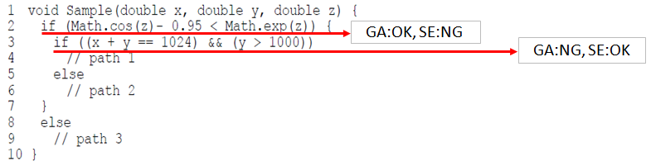
problem statement
SE can solve the second condition, but cannot for the first, when GA can generate test data for the first condition but it has degraded with the second condition

Slide 6
outline
1. Introduction
2. Background
3. Related work
4. Proposed approach
5. Experimental result
6. Conclusion

Slide 7
testing as an optimization problem
When using GA, a path coverage test data generation is transformed into an optimization problem.
To cover a test path during execution, find appropriate values for the input variables which satisfy related branch predicates.
Using Korel’s branch distance function: if a branch predicate B is (x ≤ y - 5), then apply the Korel function f(B) = x - (y - 5).

Slide 8
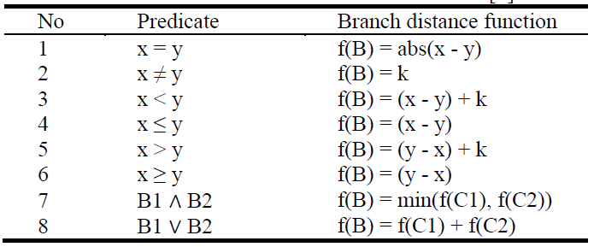
Korel function

Slide 9
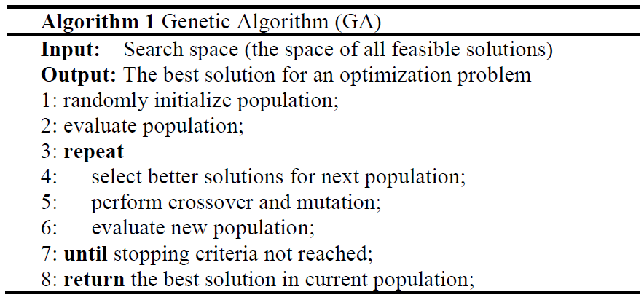
genetic algorithm(GA)
Population is a set of chromosomes.
Each chromosome chrom = (x₁, x₂… x_{n}) to present a test case.

Slide 10
outline
1. Introduction
2. Background
3. Related work
4. Proposed approach
5. Experimental result
6. Conclusion

Slide 11
related work
The path coverage literature using GA started with Lin and Yeh [2] in 2000. They extended Jones et al.'s work [3] from branch coverage to path coverage.
Chen and Zhong [4] developed a multi-population genetic algorithm for path testing.

Slide 12
related work (cond)
Malburg and Fraser [5] introduced a novel mutation operator for evolutionary search which based on dynamic SE.
Ahmed and Hermadi [6] improved their GA research [7] in 2003 by adding a rewarding scheme and using a more efficient test data generator.

Slide 13
outline
1. Introduction
2. Background
3. Related work
4. Proposed approach
5. Experimental result
6. Conclusion

Slide 14
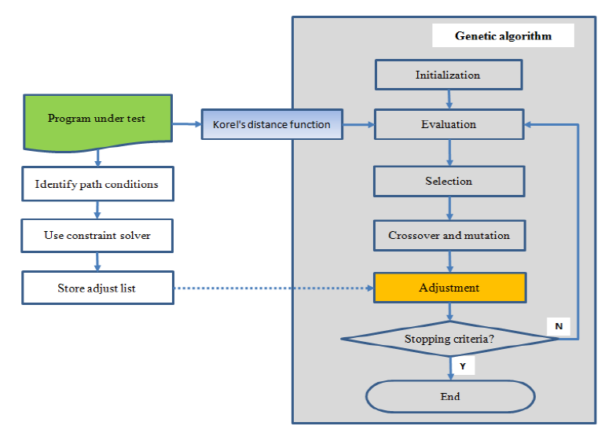
main steps

Slide 15
step 1: static program analysis
Solve path conditions
Store constraint satisfaction

Slide 16
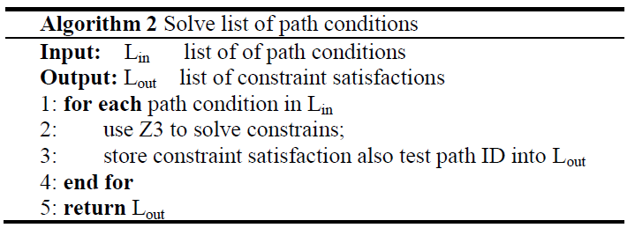
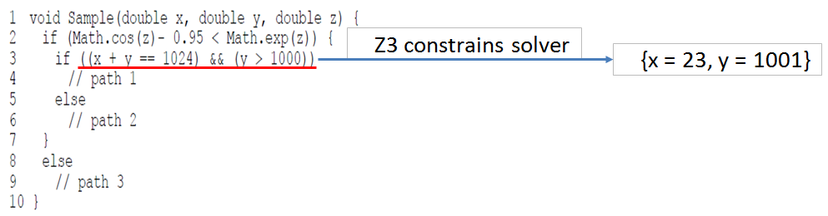
solve path conditions

Slide 17
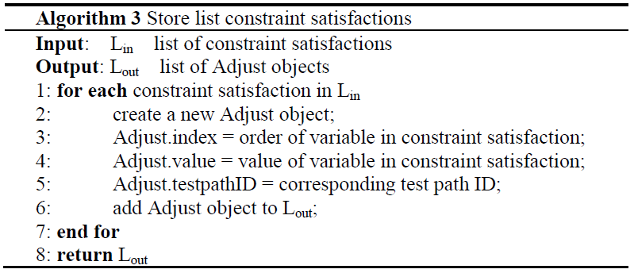
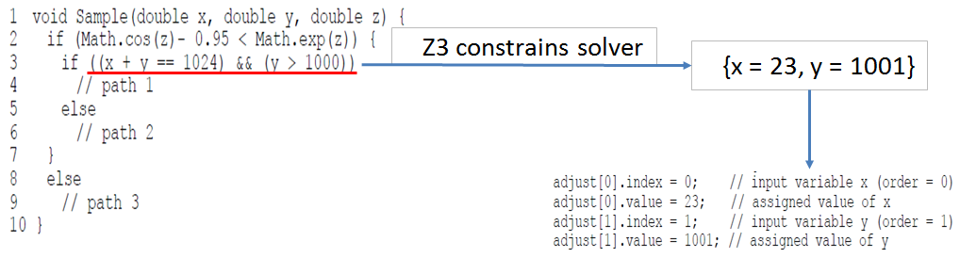
store constraint satisfaction

Slide 18
step 2: execute GA
Create fitness function
Constraint-based adjustment

Slide 19
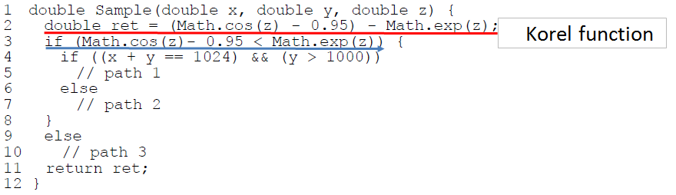
create fitness function
Insert instrument code into program under test

Slide 20
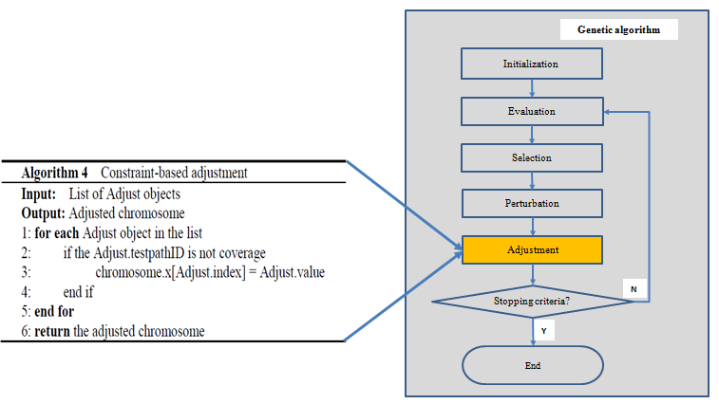
constraint-based adjustment

Slide 21
outline
1. Introduction
2. Background
3. Related work
4. Proposed approach
5. Experimental result
6. Conclusion

Slide 22
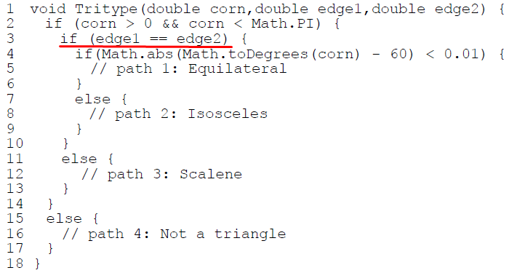
Tritype program under test
Determine if 3 input variables (an angle and two sides) show an equilateral, isosceles, scalene triangle or not.
Z3 constraint solver

Slide 23
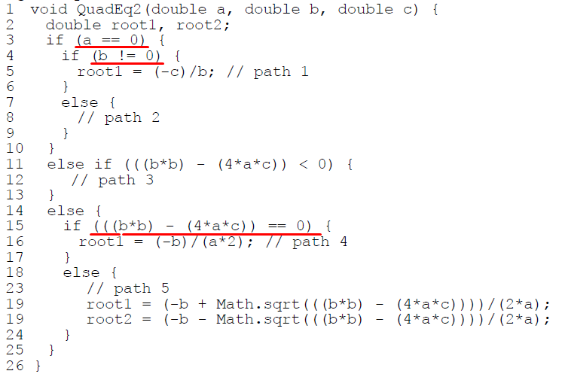
QuadEq2 program under test
Find all roots of a quadratic equation with 3 coefficients
a, b and c being the input variables.
Z3 constraint solver

Slide 24
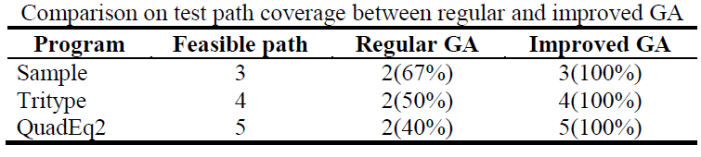
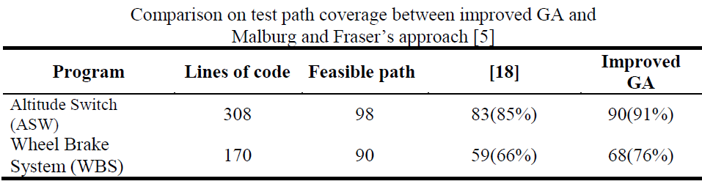
test path coverage

Slide 25
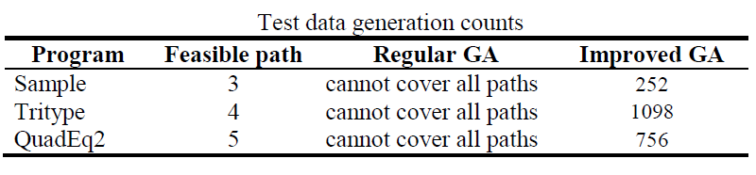
test data generation counts

Slide 26
outline
1. Introduction
2. Background
3. Related work
4. Proposed approach
5. Experimental result
6. Conclusion

Slide 27
conclusion
From a given program under test, we find out the test paths which are difficult or impossible for GA to generate coverage test data, and then use the constraint solver Z3 to solve these path conditions. The constraint satisfaction will be used again in generating population of GA.
The experimental results of some programs under test demonstrate that improved GA generated test data can cover all feasible paths having path conditions which cannot be covered by test data generated from regular GA.
In the future, we will investigate how to automatically insert instrument code into the given program under test. Moreover, we are going to extend our proposed method to apply to the more complex programs under test.

Slide 28
reference
G. J. Myers: The Art of Software Testing, 2nd edition. John Wiley & Sons Inc (2004).
J. C. Lin and P. L. Yeh: Using genetic algorithms for test case generation in path testing. In: 9th Asian Test Symposium, pp. 241--246. IEEE Computer Society, Washington (2000).
B. F. Jones, H. H. Sthamer, and D.E. Eyres: Automatic structural testing using genetic algorithms. Software Engineering, 11(5), 299--306, (1996).
Y. Chen and Y. Zhong: Automatic path-oriented test data generation using a multi-population genetic algorithm. In: 4th International Conference on Natural Computation, vol 1, pp. 566--570, 2008.
J. Malburg and G. Fraser: Search-based testing using constraint-based mutation. Journal Software Testing, Verification & Reliability, vol. 24(6), 472--495 (2014).
I. Hermadi and M. A. Ahmed: Genetic Algorithm based test data generator. In: Congress on Evolutionary Computation (CEC), vol. 1, pp. 85--91. Canberra, Australia (2003).
M. A. Ahmed and I. Hermadi: GA-based Multiple Paths Test Data Generator. Computers & Operations Research, vol. 35, pp 3107--3124 (2008).

Slide 29


