Slide 1

Generation of Test Data using Genetic Algorithm and Constraint Solver
Ngoc-Thi Dinh, Hieu-Dinh Vo, Thi-Dao Vu and Viet-Ha Nguyen
Faculty of Information Technology
VNU University of Engineering and
Technology, Hanoi, Vietnam

Slide 2
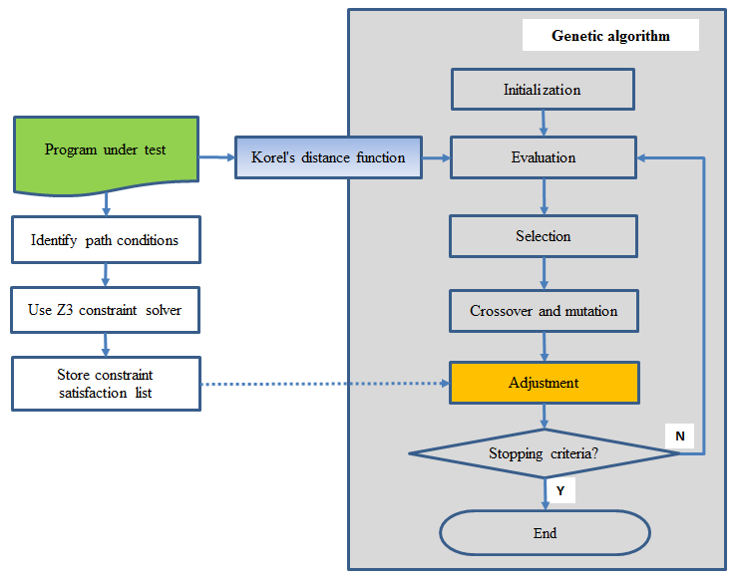
Proposed approach
★Main steps of our proposed approach
We perform static analysis to find and solve conditions that are difficult for using GA, and then transfer the constraint satisfaction to GA to speed up the search process

Slide 3
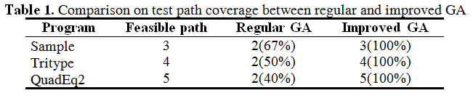
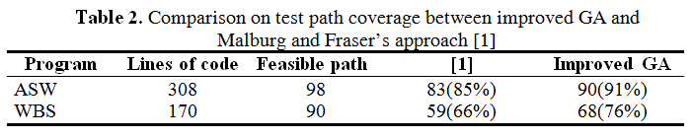
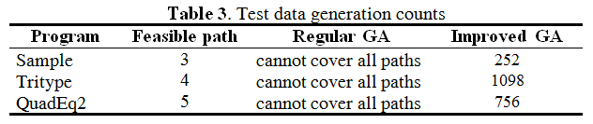
Experimental results
★Test path coverage
★Test data generation counts
[1] J. Malburg and G. Fraser: Search-based testing using constraint-based mutation. Journal Software Testing, Verification & Reliability, vol. 24(6), 472--495 (2014).

