Slide 1


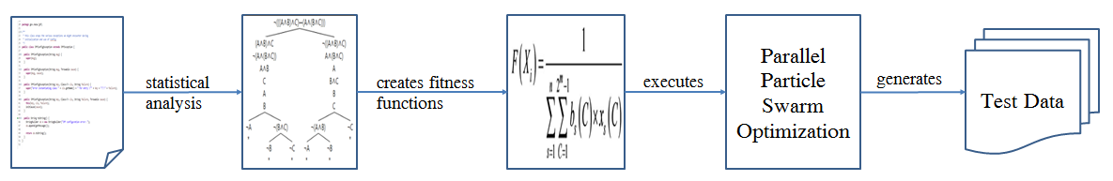
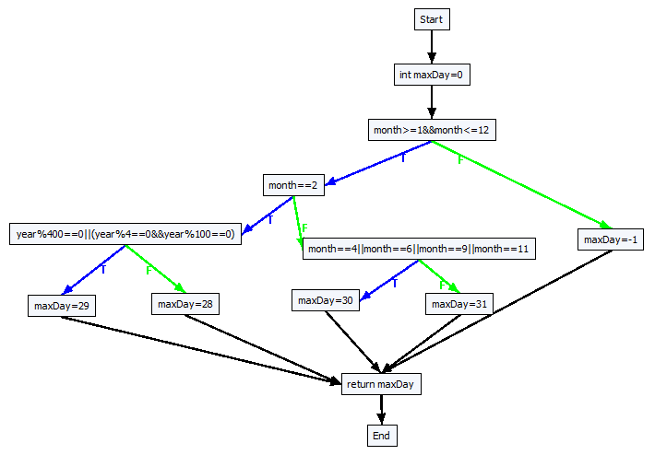
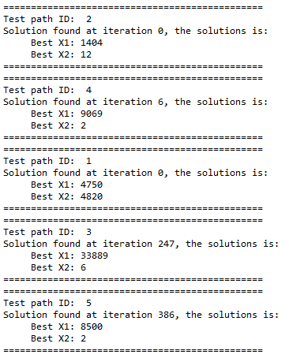
PhD Student Scientific Workshop
Generating Test Data for Software Structural Testing using
Parallel Particle Swarm Optimization
Dinh Ngoc Thi, Vo Dinh Hieu, Nguyen Viet Ha
Abstract
Evolutionary structural testing is an approach to automatically generating test cases that achieve high structural code coverage. In recent
investigations particle swarm optimization (PSO), an alternative search technique, often outperformed other meta-heuristic search techniques
when applied to various problems. This paper proposes the approach of combination of static analysis program and Parallel Particle Swarm
Optimization (PPSO) in order to generate test data simultaneously for each test path of the given program under test (PUT). The proposed
approach is also applied to some PUTs of the given benchmark. Experimental results demonstrate that the proposed PPSO which can
automatically generate suitable test data has higher structural code coverage than the previous one.
Introduction
Proprosed approach
Step 1: Generate control flow graph(CFG) from the program under test(PUT)
Step 2: Generate all test paths from the CFG
No | PathID | Path’s decision nodes
1 | path1 | [(month ≥ 1 && month ≤ 12), T], [(month = 2), T], [(year % 400 = 0 | | (year % 4 = 0 && year % 100 = 0)), T]
2 | path2 | [(month ≥ 1 && month ≤ 12), T], [(month = 2), T], [(year % 400 = 0 || (year % 4 = 0 && year % 100 = 0)), F]
3 | path3 | [(month ≥ 1 && month ≤ 12), T], [(month = 2), F], [(month = 4|| month = 6|| month = 9 || month = 11), T]
4 | path4 | [(month ≥ 1 && month ≤ 12), T], [(month =2), F], [(month = 4|| month = 6|| month = 9 || month =11), F]
5 | path5 | [(month ≥ 1 && month ≤ 12), F]
Step 3: Base on Korel fomular, generate fitness function f_{i} for each decision node
No | Decision node | Fitness function | ID
1 | [(month ≥ 1 && month ≤ 12), T] | fBchDist(month, ≥, 1) + fBchDist (month, ≤, 12) | f₁T
2 | [(month ≥ 1 && month ≥ 12), F] | min(fBchDist (month, <, 1), fBchDist (month, >, 12)) | f₁F
3 | [(month = 2), T] | fBchDist (month, =, 2) | f₂T
4 | [(month = 2), F] | fBchDist (month, ≠, 2) | f₂F
5 | [(year % 400 = 0 || (year % 4 = 0 && year % 100 = 0)), T] | min(fBchDist (year %400, =, 0), (fBchDist (year %4, =, 0) + fBchDist (year %100, =, 0))) | f₃T
6 | [(year %400 = 0 || (year % 4 = 0 && year % 100 = 0)), F] | fBchDist (year %400, ≠, 0) + min(fBchDist (year %4, ≠, 0), fBchDist (year %100, ≠, 0)) | f₃F
7 | [(month = 4 || month = 6 || month = 9 || month = 11), T] | min(fBchDist (month, =, 4), fBchDist (month, =, 6), fBchDist (month, =, 9), fBchDist (month, =, 11)) | f₄T
8 | [(month = 4 || month = 6 || month = 9 || month = 11), F] | fBchDist (month, ≠, 4) + fBchDist (month, ≠, 6) + fBchDist (month, ≠, 9) + fBchDist (month, ≠, 11) | f₄F
Step 4: Generate fitness function F_{j} for each test path by summary all fitness function in each decision node
No | PathID | Test path fitness functions
1 | path1 | F₁ = f₁T + f₂T + f₃T
2 | path2 | F₂ = f1T + f2T + f3F
3 | path3 | F₃ = f1T + f2F + f4T
4 | path4 | F₄ = f1T + f2F + f4F
5 | path5 | F₅ = f1F
★Result: all test paths were covered by generated test data
Step 5: Using Particle Swarm Optimization(PPSO) for each fitness function F_{j,} then execute them in parallel
Algorithm: Parallel Particle Swarm Optimization(PPSO)
Input: list of fitness function
Output: test data for each fitness function
1: for each fitness function F_{j} 2: Initialize an object pso of class PSOProcess
3: Assign a fitness function F_{j} to object pso
4: Execute object pso: pso.start();
5: end for
Results
Conclusions
Advisor: Assoc. Prof. Tran Van A

