Slide 1

Generating Test Data for Software Structural Testing using Parallel Particle Swarm Optimization
Ngoc-Thi Dinh, Hieu-Dinh Vo, Viet-Ha Nguyen
Faculty of Information Technology
VNU University of Engineering and Technology,
Hanoi, Vietnam

Slide 2
outline
Introduction
Proposed approach
Experimental result
Conclusion

Slide 3
Introduction(1)
Approaches to automated testing:
static analysis
automatic, scalable, exhaustive
infinite loops, array, procedure calls and pointer references
state-of-the-art: symbolic execution (SE)
dynamic analysis
random testing, local search, and evolutionary methods
most widely known: Genetic Algorithm (GA), Particle Swarm Optimization(PSO)

Slide 4
Introduction(2)
Problem statement
int getDayNum(int year, int month) {
int maxDay=0;
if(month≥1 && month≤12) {
if(month=2) {
if(year%400=0||(year%4=0&&year%100=0))
maxDay=29; //path 5
else
maxDay=28; //path 4
}
else if(month=4||month=6||month=9||month=11)
maxDay=30; // path 3
else
maxDay=31; //path 2
}
else
maxDay=-1; // path 1
return maxDay;
}

Slide 5
Introduction(3)
Mao [1] used PSO to generate test data through building the one and only fitness function which was the combination of Korel formula and the branch weights

Slide 6
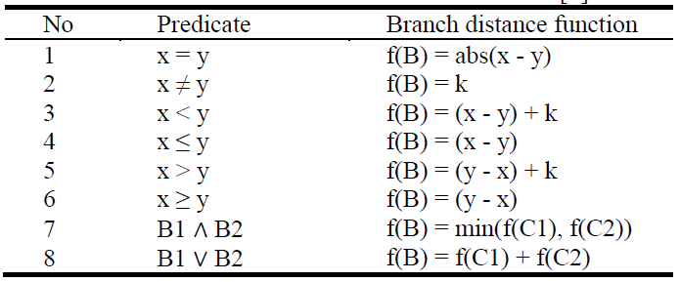
Korel function

Slide 7
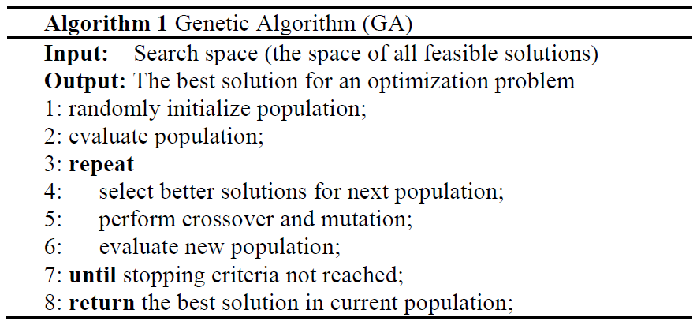
genetic algorithm(GA)
Population is a set of chromosomes.
Each chromosome chrom = (x₁, x₂… x_{n}) to present a test case.

Slide 8
outline
1. Introduction
2. Background
3. Related work
4. Proposed approach
5. Experimental result
6. Conclusion

Slide 9
related work
The path coverage literature using GA started with Lin and Yeh [2] in 2000. They extended Jones et al.'s work [3] from branch coverage to path coverage.
Chen and Zhong [4] developed a multi-population genetic algorithm for path testing.

Slide 10
related work (cond)
Malburg and Fraser [5] introduced a novel mutation operator for evolutionary search which based on dynamic SE.
Ahmed and Hermadi [6] improved their GA research [7] in 2003 by adding a rewarding scheme and using a more efficient test data generator.

Slide 11
outline
1. Introduction
2. Background
3. Related work
4. Proposed approach
5. Experimental result
6. Conclusion

Slide 12
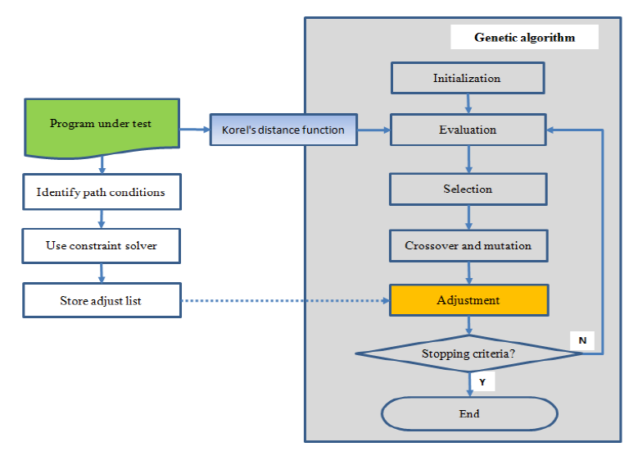
main steps

Slide 13
step 1: static program analysis
Solve path conditions
Store constraint satisfaction

Slide 14
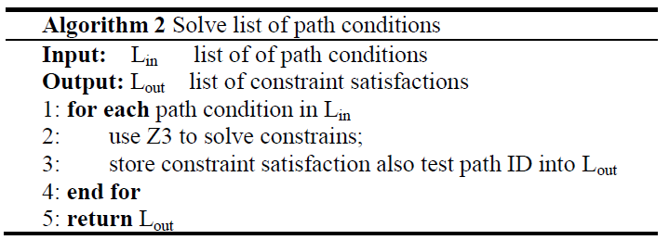
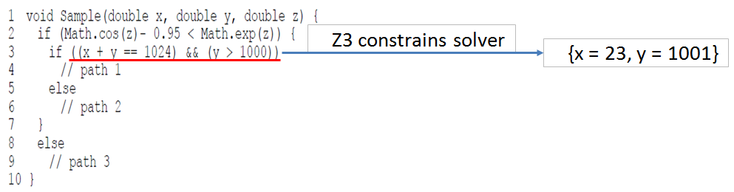
solve path conditions

Slide 15
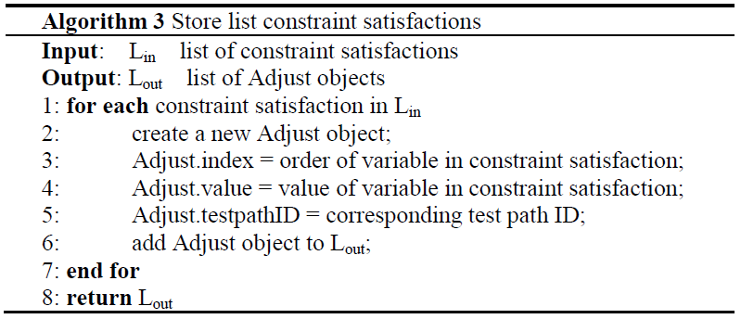
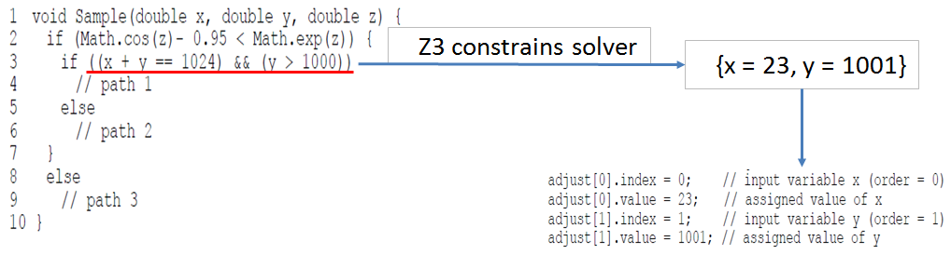
store constraint satisfaction

Slide 16
step 2: execute GA
Create fitness function
Constraint-based adjustment

Slide 17
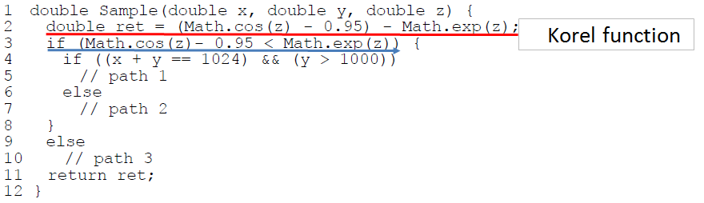
create fitness function
Insert instrument code into program under test

Slide 18
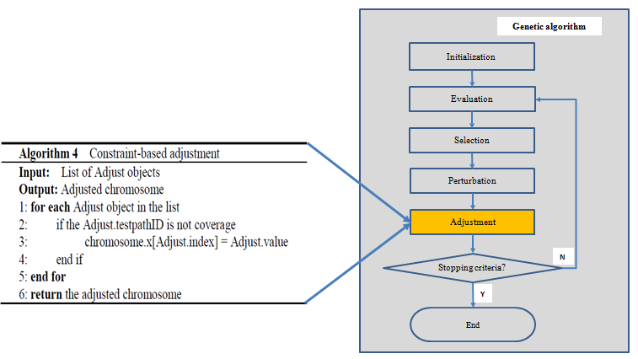
constraint-based adjustment

Slide 19
outline
1. Introduction
2. Background
3. Related work
4. Proposed approach
5. Experimental result
6. Conclusion

Slide 20
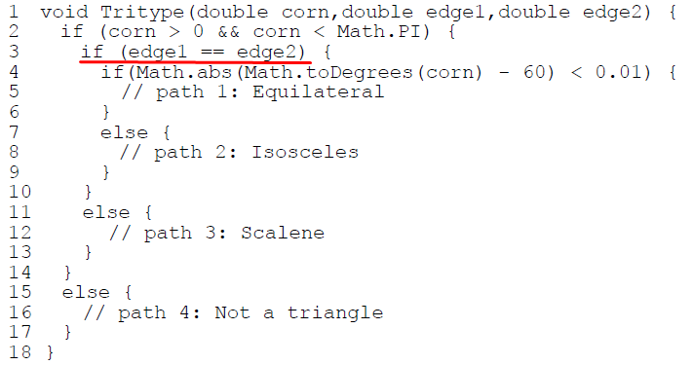
Tritype program under test
Determine if 3 input variables (an angle and two sides) show an equilateral, isosceles, scalene triangle or not.
Z3 constraint solver

Slide 21
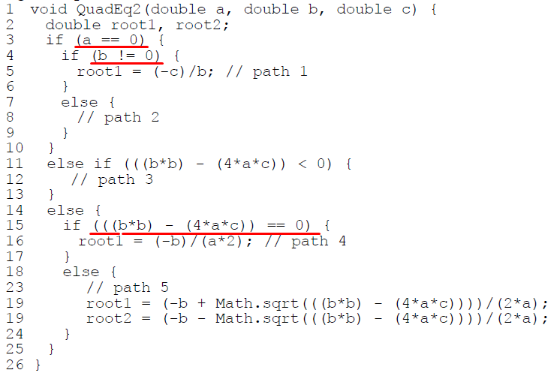
QuadEq2 program under test
Find all roots of a quadratic equation with 3 coefficients
a, b and c being the input variables.
Z3 constraint solver

Slide 22
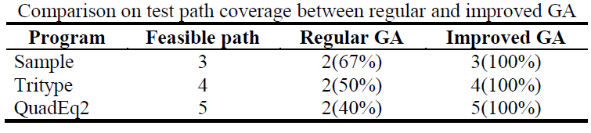
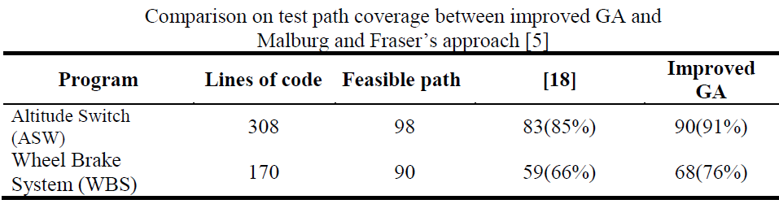
test path coverage

Slide 23
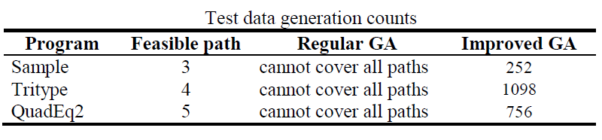
test data generation counts

Slide 24
outline
1. Introduction
2. Background
3. Related work
4. Proposed approach
5. Experimental result
6. Conclusion

Slide 25
conclusion
From a given program under test, we find out the test paths which are difficult or impossible for GA to generate coverage test data, and then use the constraint solver Z3 to solve these path conditions. The constraint satisfaction will be used again in generating population of GA.
The experimental results of some programs under test demonstrate that improved GA generated test data can cover all feasible paths having path conditions which cannot be covered by test data generated from regular GA.
In the future, we will investigate how to automatically insert instrument code into the given program under test. Moreover, we are going to extend our proposed method to apply to the more complex programs under test.

Slide 26
reference
C. Mao: Generating Test Data for Software Structural Testing Based on Particle Swarm Optimization. Arabian Journal for Science and Engineering, vol 39, issue 6, pp 4593–4607 (June 2014).

Slide 27


