Slide 1


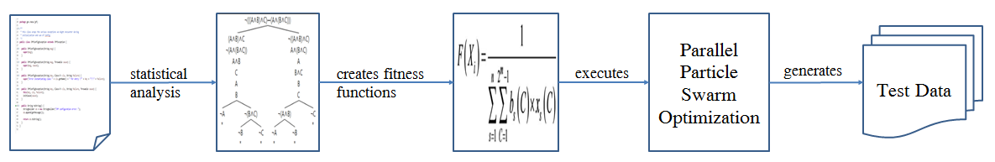
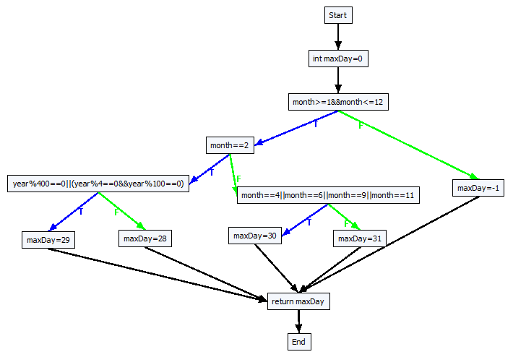
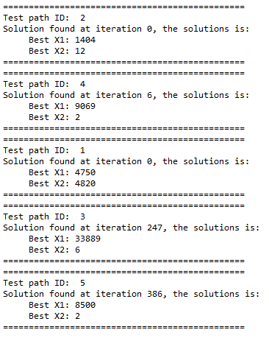
PhD Student Scientific Workshop
Generating Test Data for Software Structural Testing using
Parallel Particle Swarm Optimization
Dinh Ngoc Thi, Vo Dinh Hieu, Nguyen Viet Ha
Abstract
Evolutionary structural testing is an approach to automatically generating test cases that achieve high structural code coverage. In recent
investigations particle swarm optimization (PSO), an alternative search technique, often outperformed other meta-heuristic search techniques
when applied to various problems. This paper proposes the approach of combination of static analysis program and Parallel Particle Swarm
Optimization (PPSO) in order to generate test data simultaneously for each test path of the given program under test (PUT). The proposed
approach is also applied to some PUTs of the given benchmark. Experimental results demonstrate that the proposed PPSO which can
automatically generate suitable test data has higher structural code coverage than the previous one.
Introduction
Proprosed approach
No | PathID | Path’s decision nodes
1 | path1 | [(month ≥ 1 && month ≤ 12), T], [(month = 2), T], [(year % 400 = 0 | | (year % 4 = 0 && year % 100 = 0)), T]
2 | path2 | [(month ≥ 1 && month ≤ 12), T], [(month = 2), T], [(year % 400 = 0 || (year % 4 = 0 && year % 100 = 0)), F]
3 | path3 | [(month ≥ 1 && month ≤ 12), T], [(month = 2), F], [(month = 4|| month = 6|| month = 9 || month = 11), T]
4 | path4 | [(month ≥ 1 && month ≤ 12), T], [(month =2), F], [(month = 4|| month = 6|| month = 9 || month =11), F]
5 | path5 | [(month ≥ 1 && month ≤ 12), F]
No | Decision node | Fitness function | ID
1 | [(month ≥ 1 && month ≤ 12), T] | fBchDist(month, ≥, 1) + fBchDist (month, ≤, 12) | f₁T
2 | [(month ≥ 1 && month ≥ 12), F] | min(fBchDist (month, <, 1), fBchDist (month, >, 12)) | f₁F
3 | [(month = 2), T] | fBchDist (month, =, 2) | f₂T
4 | [(month = 2), F] | fBchDist (month, ≠, 2) | f₂F
5 | [(year % 400 = 0 || (year % 4 = 0 && year % 100 = 0)), T] | min(fBchDist (year %400, =, 0), (fBchDist (year %4, =, 0) + fBchDist (year %100, =, 0))) | f₃T
6 | [(year %400 = 0 || (year % 4 = 0 && year % 100 = 0)), F] | fBchDist (year %400, ≠, 0) + min(fBchDist (year %4, ≠, 0), fBchDist (year %100, ≠, 0)) | f₃F
7 | [(month = 4 || month = 6 || month = 9 || month = 11), T] | min(fBchDist (month, =, 4), fBchDist (month, =, 6), fBchDist (month, =, 9), fBchDist (month, =, 11)) | f₄T
8 | [(month = 4 || month = 6 || month = 9 || month = 11), F] | fBchDist (month, ≠, 4) + fBchDist (month, ≠, 6) + fBchDist (month, ≠, 9) + fBchDist (month, ≠, 11) | f₄F
No | PathID | Test path fitness functions
1 | path1 | F₁ = f₁T + f₂T + f₃T
2 | path2 | F₂ = f1T + f2T + f3F
3 | path3 | F₃ = f1T + f2F + f4T
4 | path4 | F₄ = f1T + f2F + f4F
5 | path5 | F₅ = f1F
Algorithm 5: Parallel Particle Swarm Optimization(PPSO)
Input: list of fitness function
Output: test data for each fitness function
1: for each fitness function F_{i} 2: Initialize an object pso_{i} of class PSOProcess
3: Assign a fitness function F_{i} to object pso_{i}
4: Execute object pso: pso.start();
5: end for
Results
Conclusions
Advisor: Assoc. Prof. Tran Van A

