Slide 1

File Encryption API – Technical sharing session
Dinh Nho Bao – Year 3, Computer Science
nhobao.dinh@u.nus.edu

Slide 2
Contents
How the File Encryption/Decryption API works
2. How the API is built
3. Testing and deployment

Slide 3
File Encryption/Decryption API

Slide 4

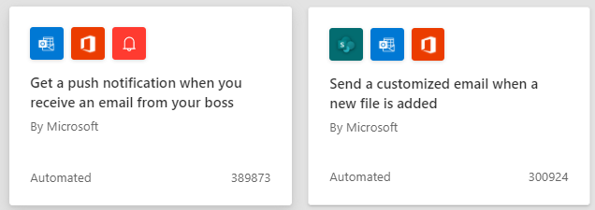
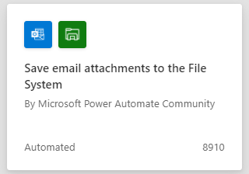
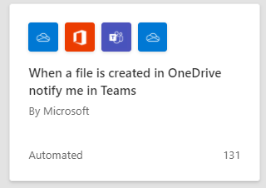
Power Automate is a service that helps users create automated workflows between their favorite apps and services to synchronize files, get notifications, collect data, and more.

Slide 5
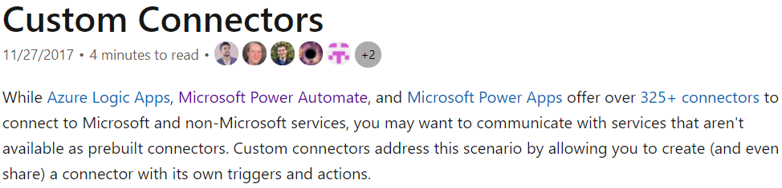
The File Encryption API will be a custom connector as part of a Power Automate flow
Source: Microsoft

Slide 6
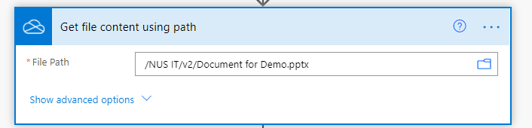


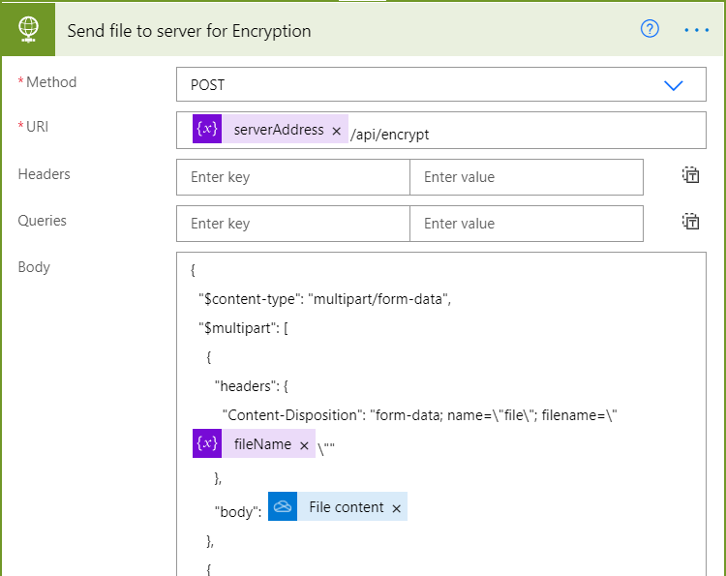


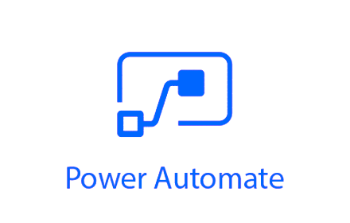
File Encryption/Decryption API
Sending a file
https://de-app1.nus.edu.sg

Slide 7

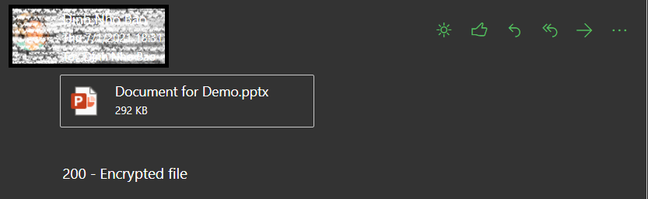
File Encryption/Decryption API
Returning the encrypted file
https://de-app1.nus.edu.sg

Slide 8
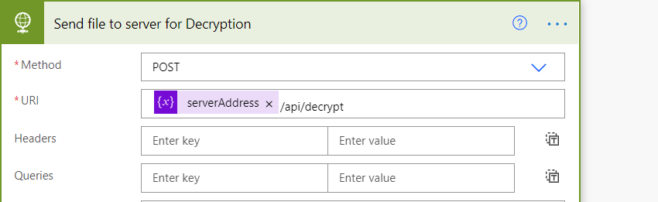
File Encryption/Decryption API
Sending the encrypted file
https://de-app1.nus.edu.sg

Slide 9

File Encryption/Decryption API
Returning the decrypted file
https://de-app1.nus.edu.sg

Slide 10
How the API is built

Slide 11



Slide 12
Steps
Sending the file from Power Automate and receiving the file at the NodeJS server using multer
Encrypting/decrypting the file using cryptify
3. Sending the file back to Power Automate flow

Slide 13
Steps
Sending the file from Power Automate and receiving the file at the NodeJS server using multer
Encrypting/decrypting the file using cryptify
3. Sending the file back to Power Automate flow

Slide 14
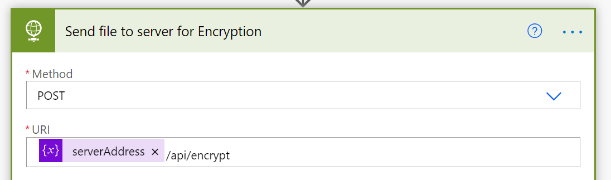
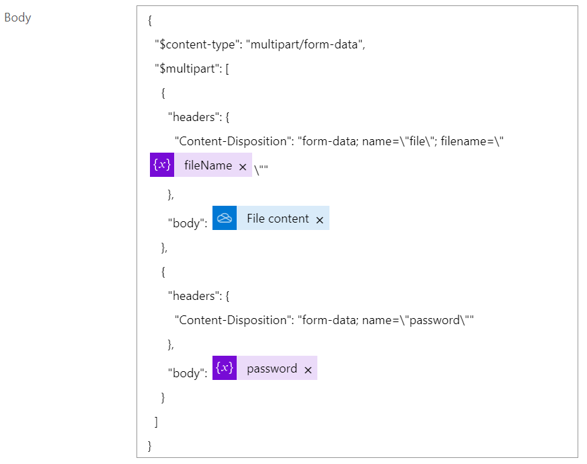
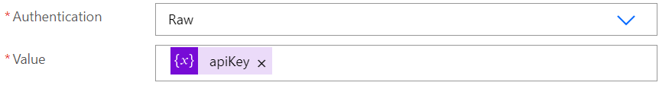

Primarily use for uploading files
Sending the file from Power Automate, and receiving the file at the NodeJS server multer

Slide 15
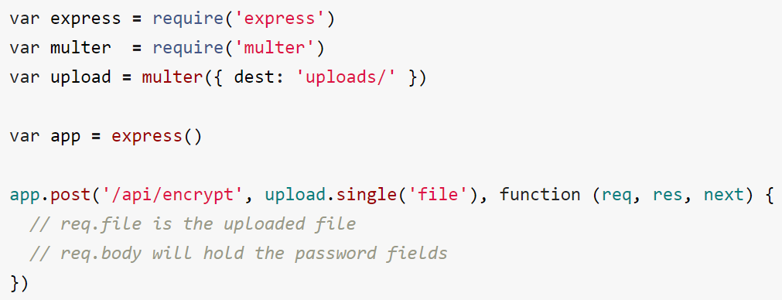
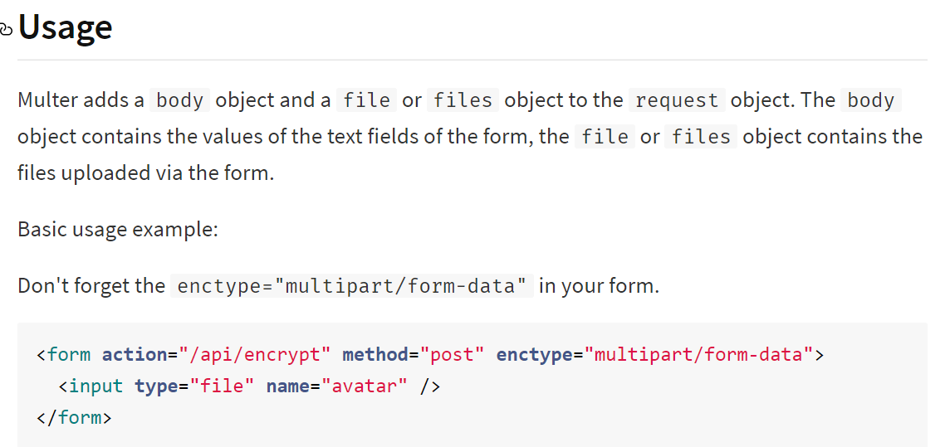
(req.body.password)
Sending the file from Power Automate, and receiving the file at the NodeJS server using multer

Slide 16
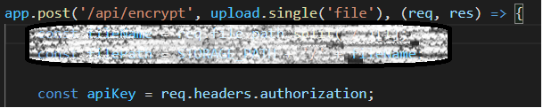
NodeJS server
password
apiKey
Sending the file from Power Automate, and receiving the file at the NodeJS server using multer

Slide 17
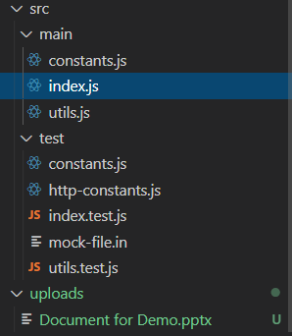
NodeJS server
password
apiKey
Sending the file from Power Automate, and receiving the file at the NodeJS server using multer

Slide 18
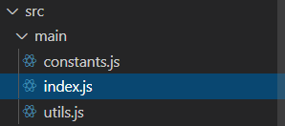
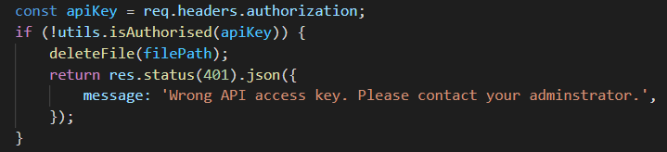
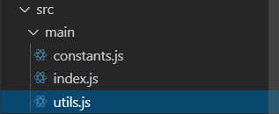

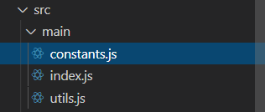
Logic – Authentication
The main entry point of the
NodeJS server
process.env.API_KEY
Multiple valid keys with various level of access is possible.

Slide 19
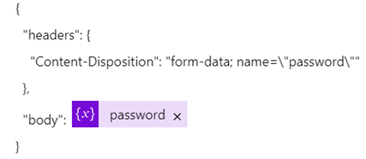
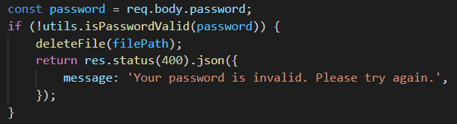

Logic – edge case
More stricter password requirements can be implemented.

Slide 20

Logic – Main Success Scenario
apiKey correct
password valid
Let’s start 2- encrypting/decrypting the file using cryptify!

Slide 21
Steps
Sending the file from Power Automate, and receiving the file at the NodeJS server using multer
Encrypting/decrypting the file using cryptify
3. Sending the file back to Power Automate flow

Slide 22
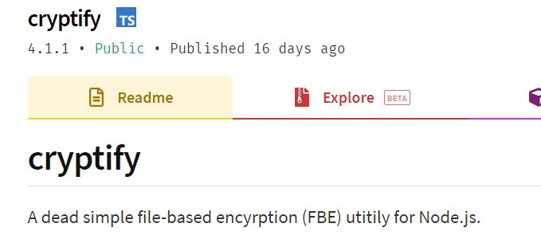
Encrytion/Decryption
cryptify

Slide 23
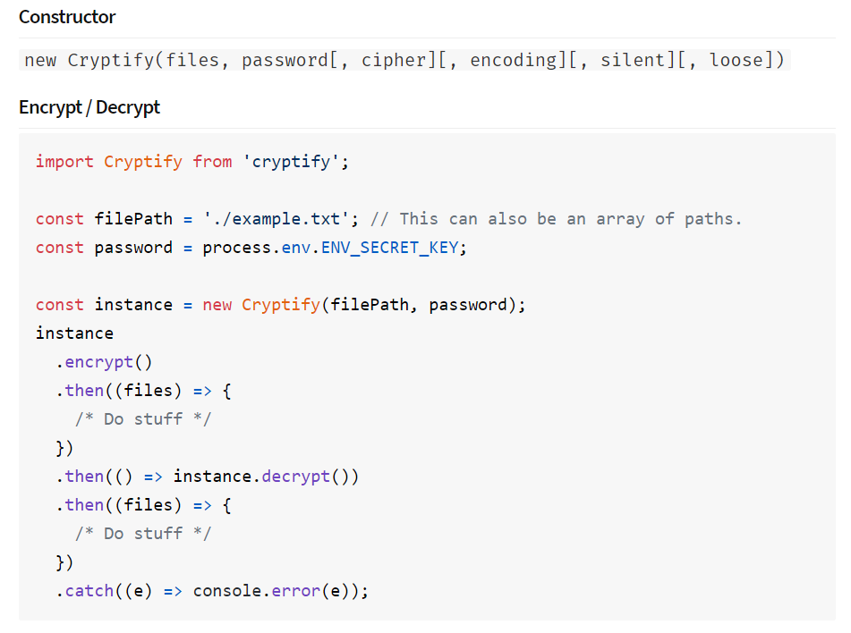

Encryption/Decryption
multer

Slide 24

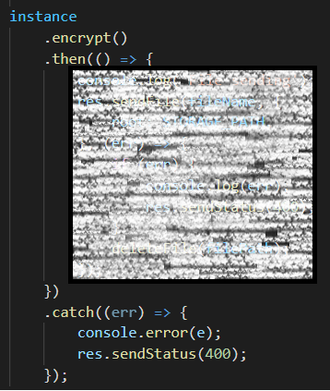
Encryption/Decryption

Slide 25
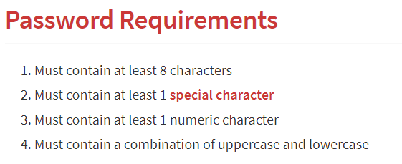
parsePassword
Password requirements of cryptify
What if the user-provided password does not satisfy this?
Disable the password requirements

Slide 26
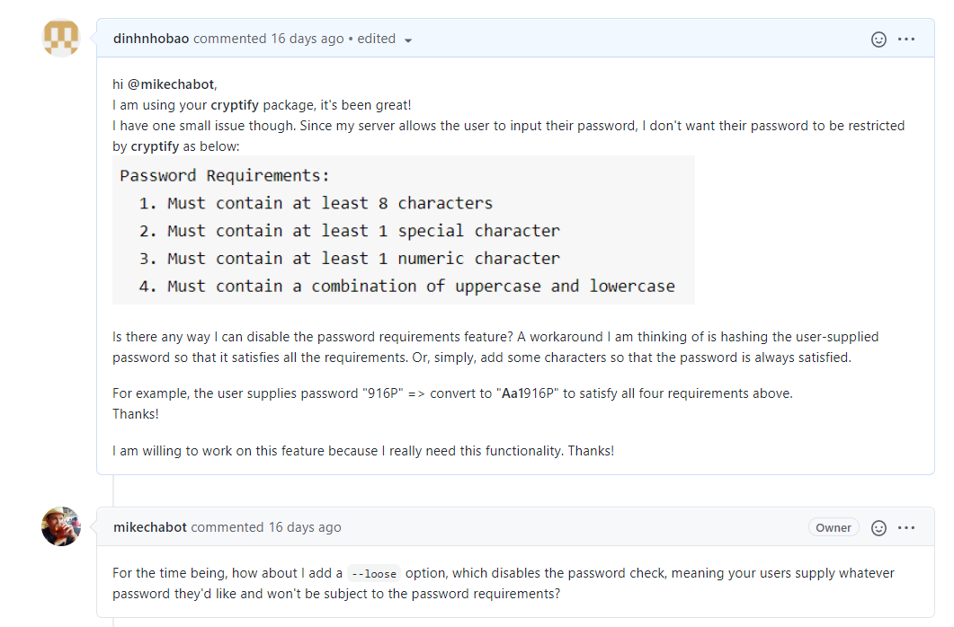
parsePassword
Disable the password requirements – not yet under support (https://github.com/mikechabot/cryptify/issues/6)

Slide 27
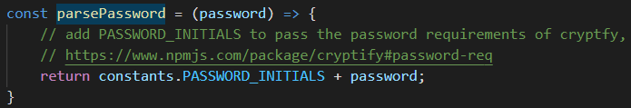
parsePassword
Password requirements of cryptify
What if the user-provided password does not satisfy this?
Workaround

Slide 28
Steps
Sending the file from Power Automate, and receiving the file at the NodeJS server using multer
Encrypting/decrypting the file: cryptify
3. Sending the file back to Power Automate flow

Slide 29
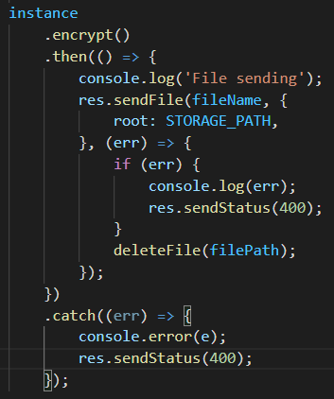
Sending the file back to the flow
How to send the file so that it is not corrupted?
res.download, res.attachment ?

Slide 30
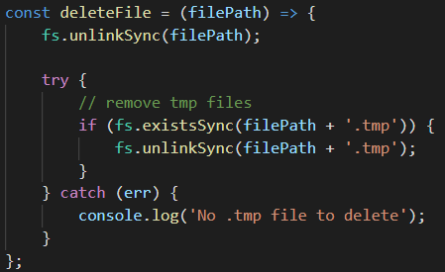
Deleting the file on the server
The server does not store the encrypted/decrypted file in the long run.

Slide 31
Summary of Logic
Input: file, password, apiKey
if apiKey is not valid, returns error
if password is not valid, returns error
“valid” for encryption: not empty
“valid” for decryption: can decrypt the file
otherwise, encrypt/decrypt the file and returns the file to the flow

Slide 32
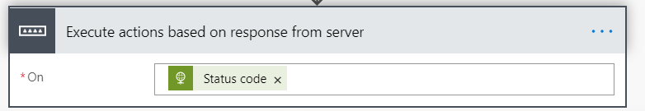



Receiving the file in Power Automate

Slide 33
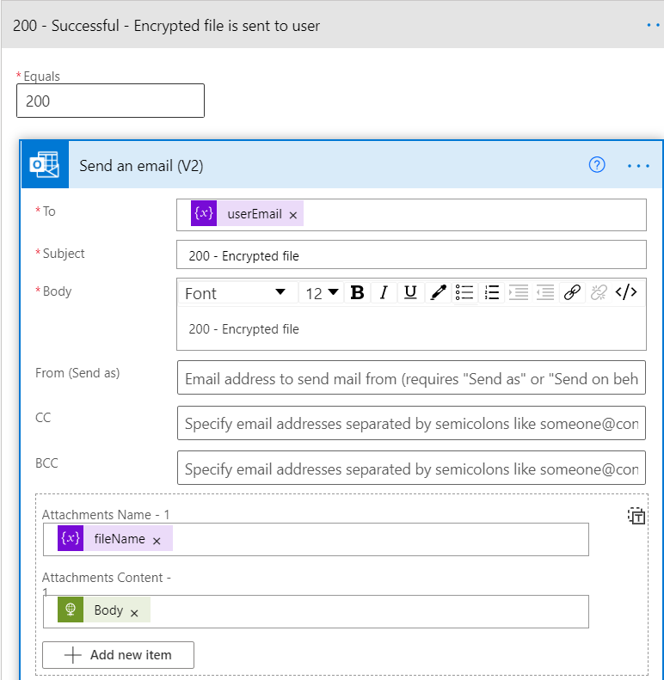
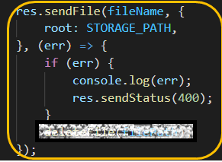

Slide 34
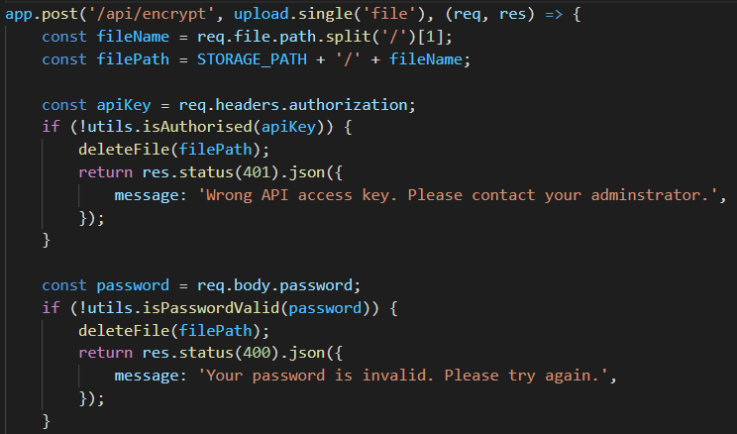
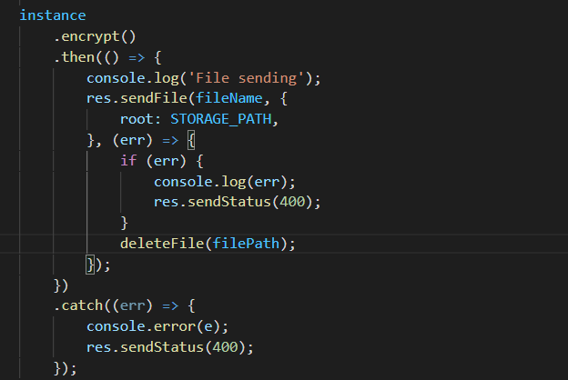

Slide 35
The most time sinker
Lack of documentation from Microsoft Power Automate
Small technical support (Power Automate forum < Stack Overflow)
Familiarity with HTTP/networking concepts
Receive the file correctly from server side using multer

Slide 36
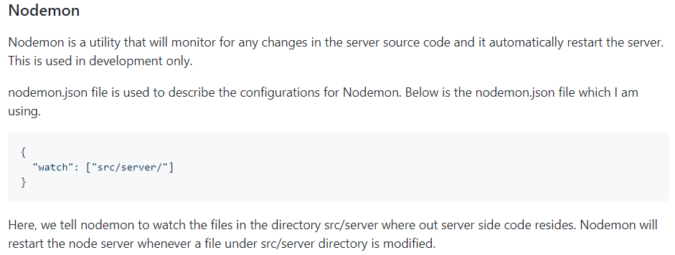
Useful software development tools
Live reloading - nodemon

Slide 37
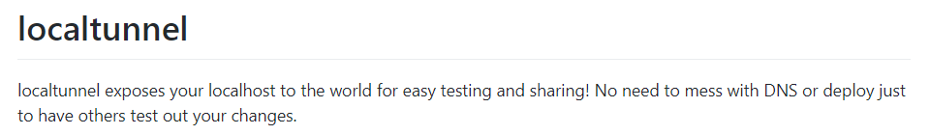

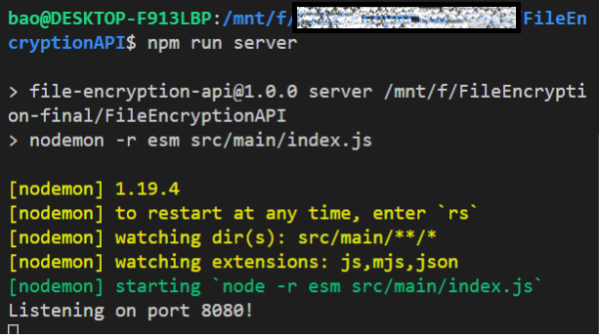

Useful software development tools
File Encryption/Decryption API
http://localhost:8080/
https://chatty-crab-42.loca.lt

Slide 38
Testing and deployment

Slide 39


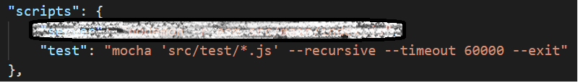
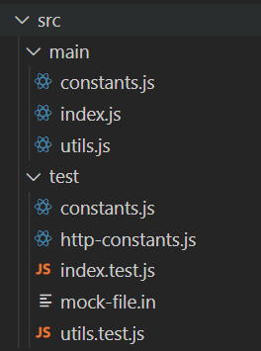
Automated Testing
Integration testing (/api/encrypt, /api/decrypt)
Unit testing (isAuthorised, isPasswordValid, parsePassword)

Slide 40
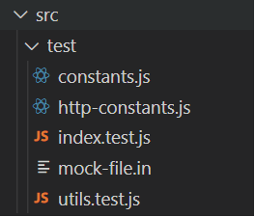

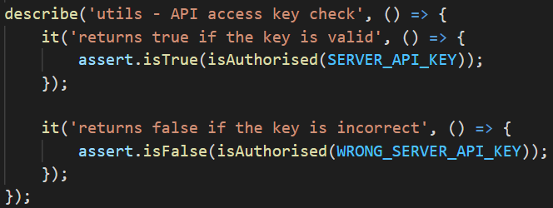
Unit tests

Slide 41
Integration tests

Slide 42
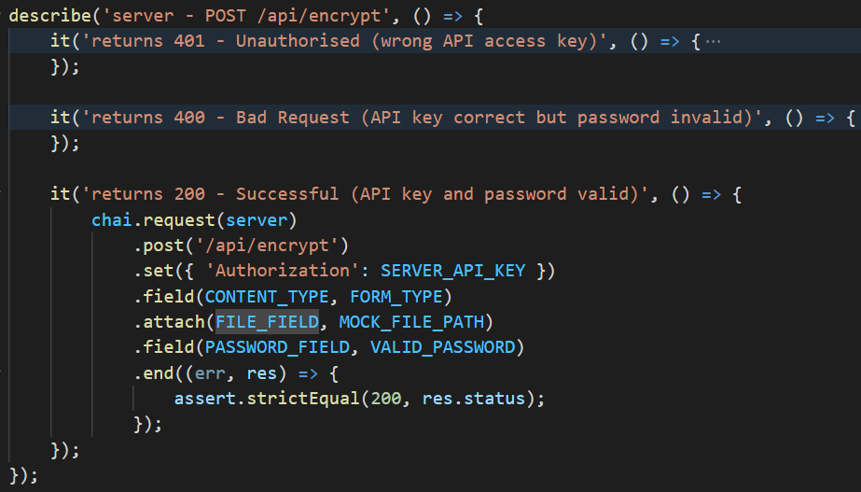
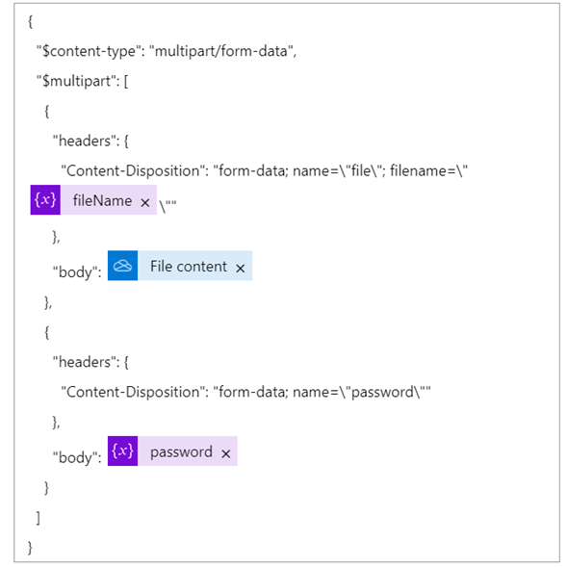
(multer)

Slide 43
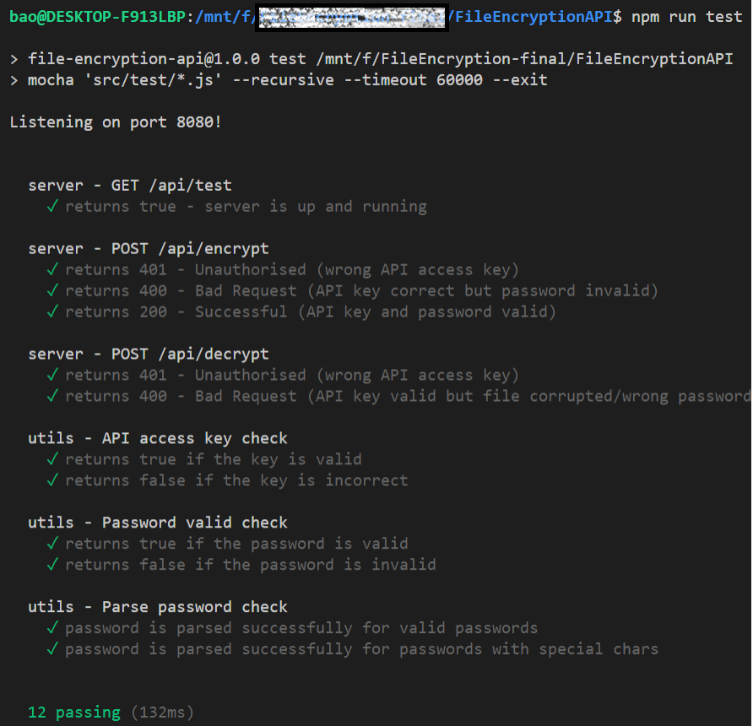

Slide 44
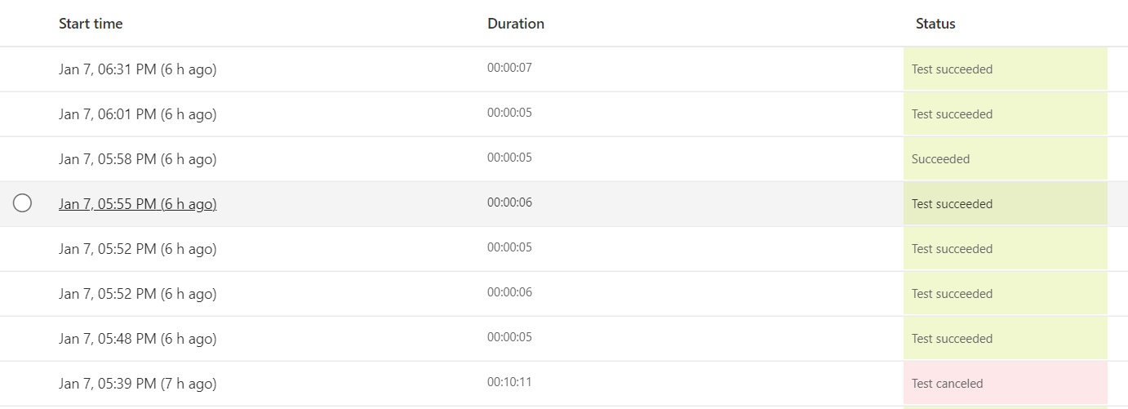
Microsoft Flow testing

Slide 45
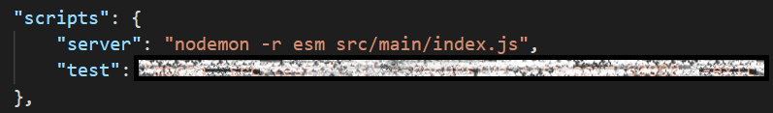
Deployment

Slide 46
Summary
How the File Encryption/Decryption API works
2. How the API is built
3. Testing and deployment

Slide 47

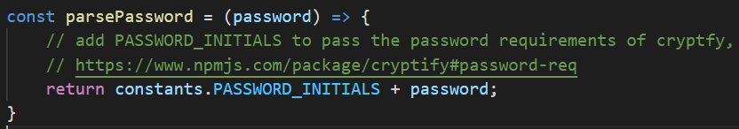
Looking forward
Multiple valid keys with various level of access is possible.
Waiting for cryptify to
allow disabling password
requirements
Should be environment variables

Slide 48

Looking forward
More rigorous testing on Microsoft Flow and the API server (stress testing?)

Slide 49
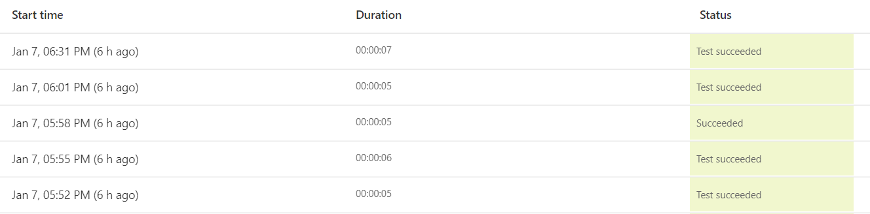
Looking forward
Real user testing

Slide 50
Looking forward
Exception handling: Flow timeout (limitation of Power Automate)
CI/CD process
Security considerations

Slide 51


Thank you!

