Slide 2

YPP4 - Milestone
bbv Software Services AG | 2025

Slide 3
Agenda
Introduction
Achievements & Learnings
Challenges & Solutions
Better Version
Goal
Q&A

Slide 4

Introduction

Slide 5
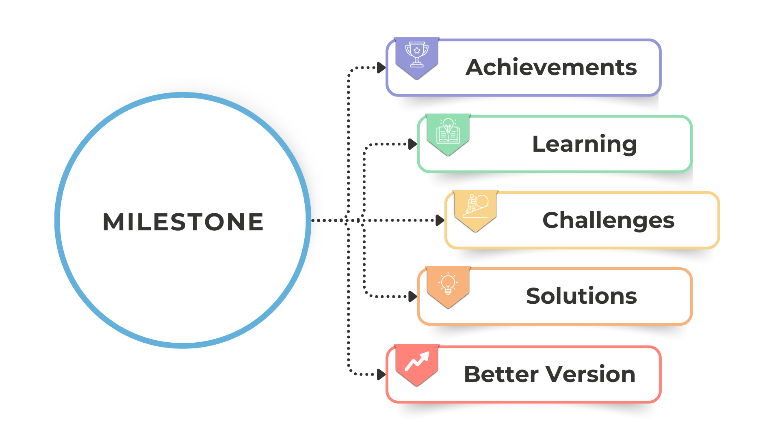
Introduction

Slide 6
Achievements & Learnings

Slide 7
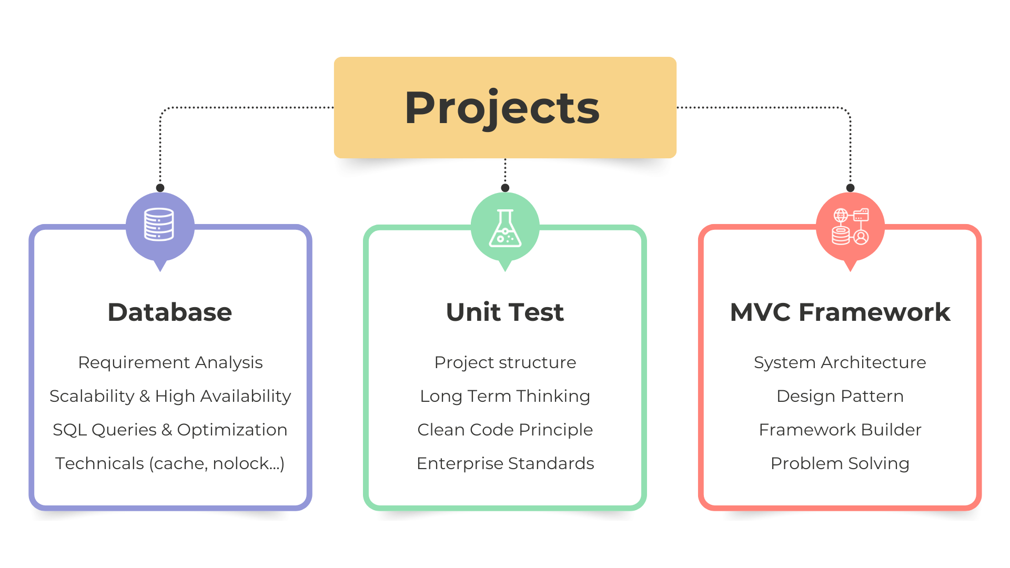
Projects
Notes:
Db:
Hoat dong nhu the nao,
Can luu nhung thu gi
Thiet ke ra lam sao de phat trien ve lau dai
Quy tac thiet ke db: normalization
Toi uu, Cache, nolock, pivot, toi uu hoa perormance
Unit test
- Cau truc du an lon to chuc ntn
Single responsibility, Don’t repeat yourself
Doanh nghiep lon se co nhung quy tac ntn
MVC
Hieu ro duoc cach to chuc cua mo hinh mvc
Hoc va Ap dung nhung design pattern: singletone
Hoc va Ap dung cac ki thuat: DI
hieu duoc cach mot fw hoat dong nhu the nao
Giai quyet duoc nhung van de ma mvc framework can co

Slide 8
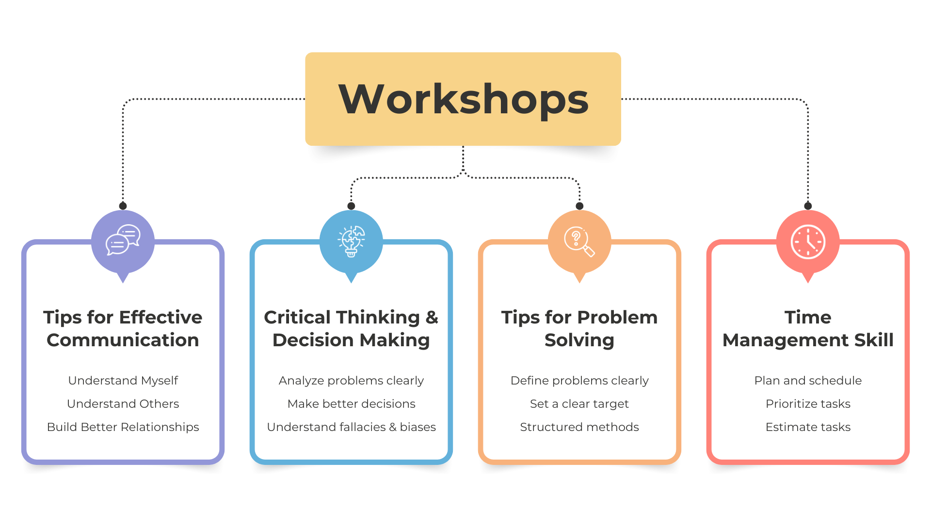
Workshops
Notes:
Thien kien va nguy bien

Slide 9
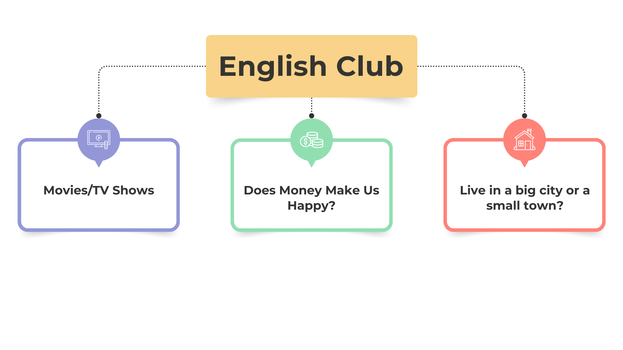
English Club
Notes:
Cai thien ky nang giao tiep
Cai thien ky nang noi tieng anh thong qua tro choi va debate
Noi tieng anh tu tin hon
Mo rong von tu tieng anh

Slide 10
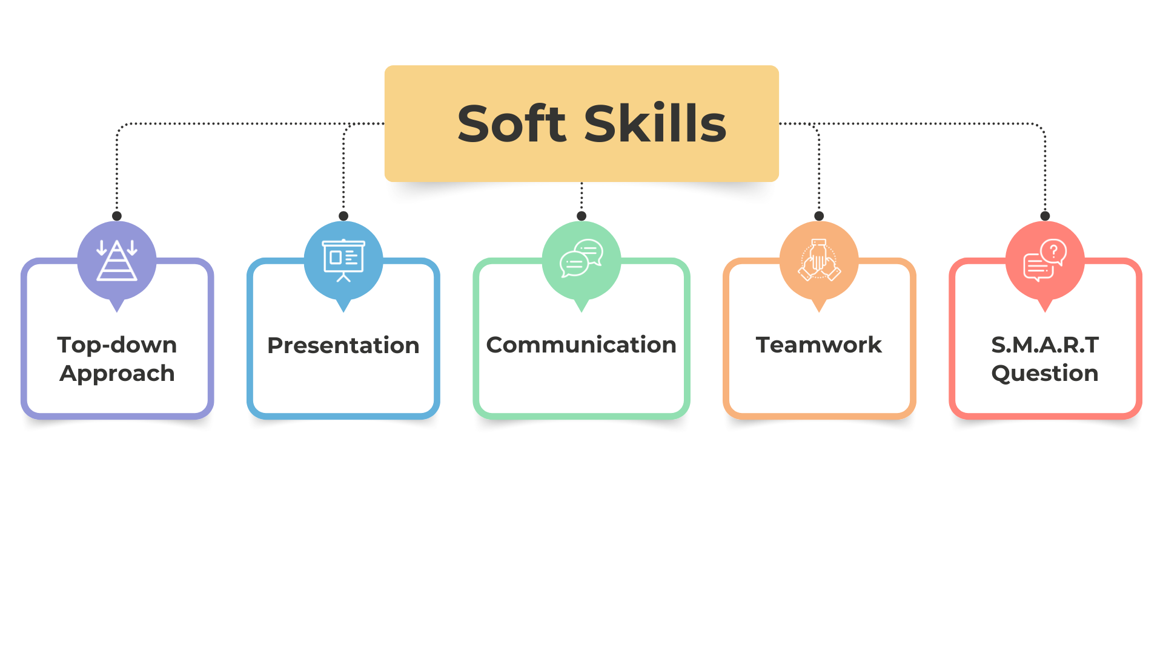
Soft Skills

Slide 11
Challenges & Solutions

Slide 12
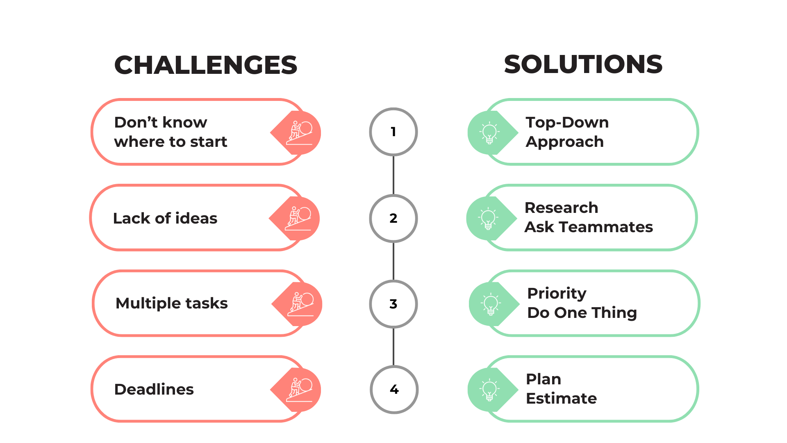
Challenges & Solutions

Slide 13
Better Version

Slide 14
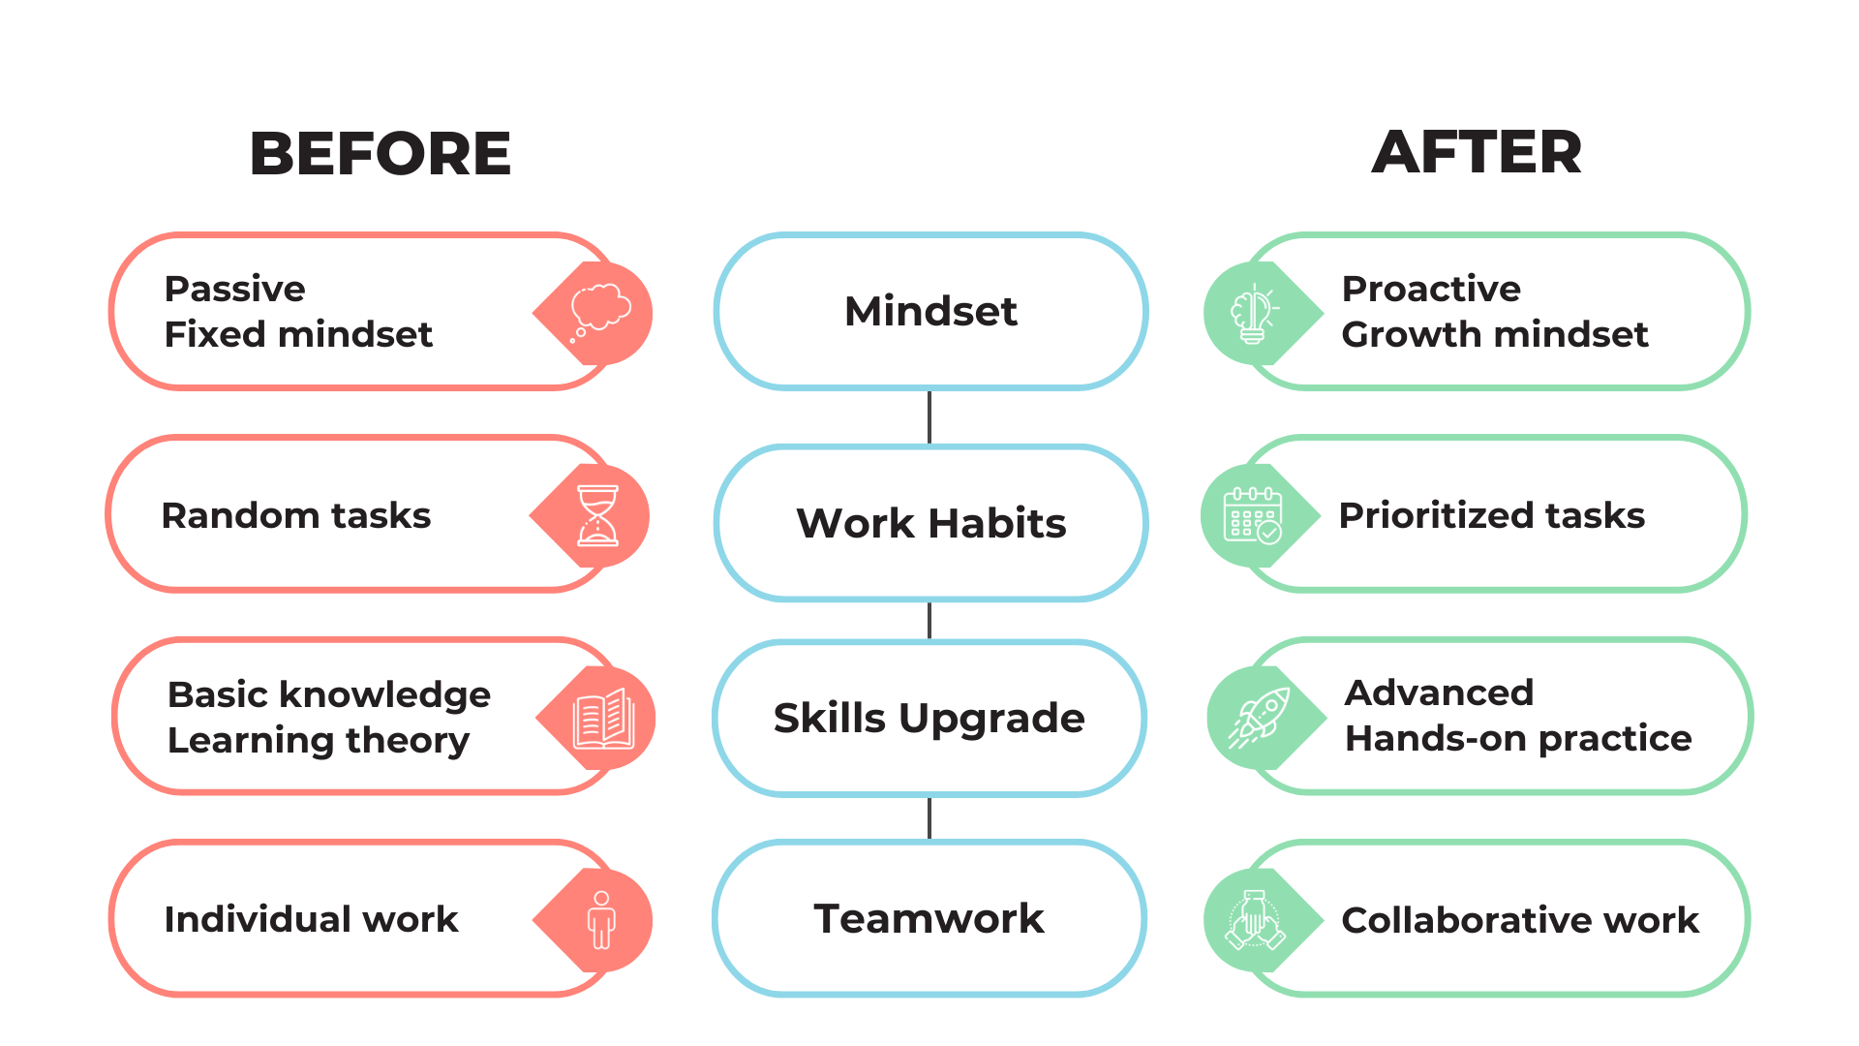
Better Version

Slide 15
Goal

Slide 16
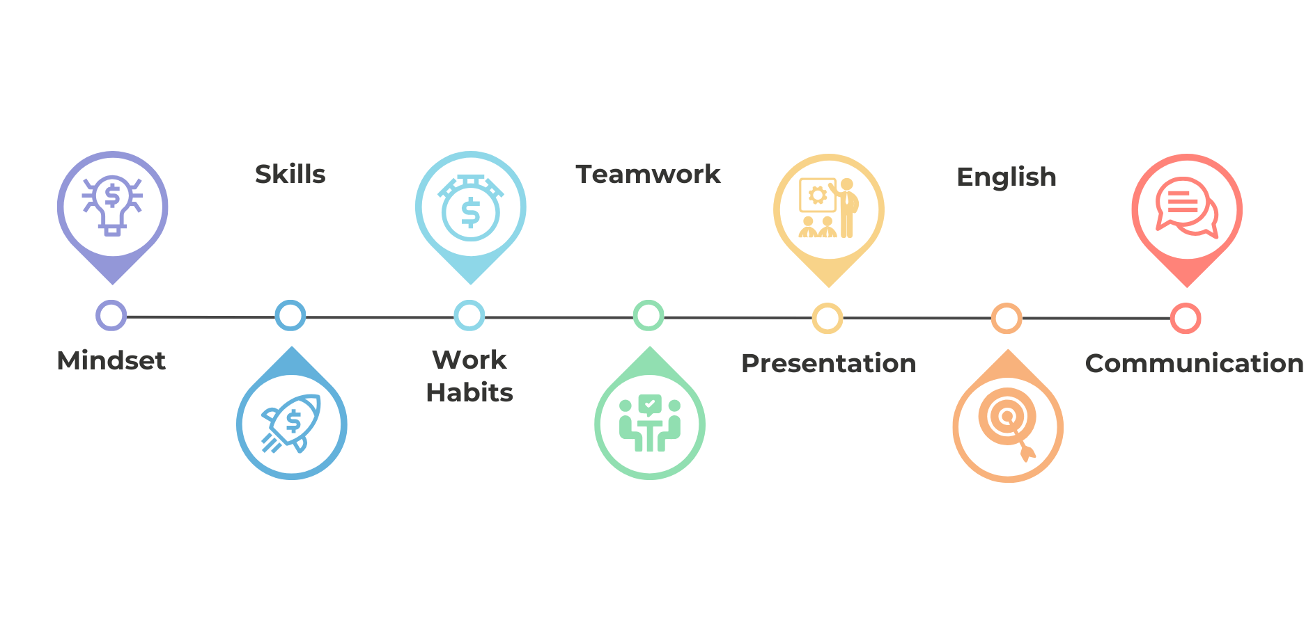
Goal

Slide 17
Q&A

