Slide 1
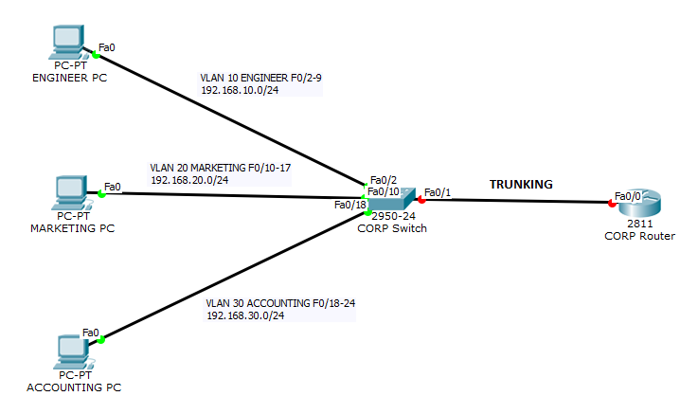
Static VLANs

Slide 2
VLANs Creation
Switch> enable
Switch# configure terminal
Switch(config)# vlan 10
Switch(config-vlan)# name ENGINEER
Switch(config-vlan)# exit
Switch(config)# //similarly to vlan 20 &30

Slide 3
Static VLANs (port-centric)
Switch(config)# interface range f0/2-9
Switch(config-if-range)# switchport access vlan 10
Switch(config-if-range)# exit
Switch(config)# //similarly to vlan 20 & 30

Slide 4
Trunking Configuration
Switch(config)# interface f0/1
Switch(config-if)# switchport mode trunk
Switch(config-if)# end //or Ctrl – Z
Switch# write memory
Switch# show vlan

Slide 5
Inter VLAN Routing
Router(config)# interface f0/0
Router(config-if)# no shutdown
Router(config-if)# interface f0/0.10
Router(config-subif)# encapsulation dot1q 10
Router(config-subif)# ip address 192.168.10.1 255.255.255.0
Router(config-subif)# interface f0/0.20
Router(config-subif)# encapsulation dot1q 20
Router(config-subif)# ip address 192.168.20.1 255.255.255.0
//similarly to F0/0.30

Slide 6
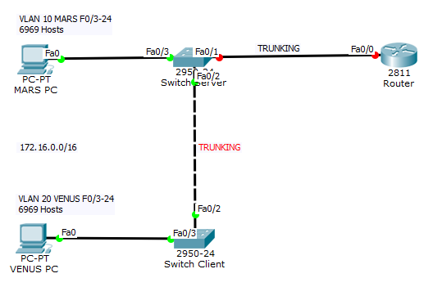
Dynamic VLANs

Slide 7
Dynamic VLANs
Creating VLANs and Enabling VTP Server | Configuring VTP Client
Server(config)# vlan 10 Server(config-vlan)# name MARS Server(config-vlan)# exit Server(config)# vlan 20 Server(config-vlan)# name VENUS Server(config-vlan)# exit Server(config)# vtp mode server Server(config)# vtp domain planet Server(config)# vtp password solar Server(config)# interface range f0/3-24 Server(config-if-range)# switchport access vlan 10 | Client(config)# vtp mode client Client(config)# vtp domain planet Client(config)# vtp password solar Client(config)# interface range f0/3-24 Client(config-if-range)# switchport access vlan 20
VLAN Database transferred via Trunking
Server(config)#interface range f0/1-2 Server(config-if)# switchport mode trunk | Client(config)#interface range f0/1-2 Client(config-if)# switchport mode trunk

