Slide 1
Lecture 11-Chapter 11
Linear Filter, Transformation, and Registration
Dr. Uyen Nguyen

Slide 2
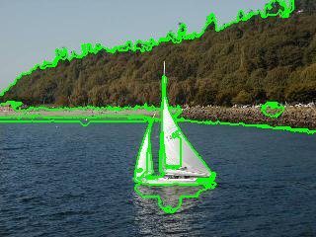
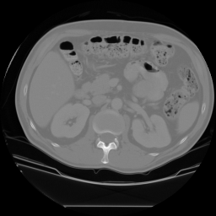
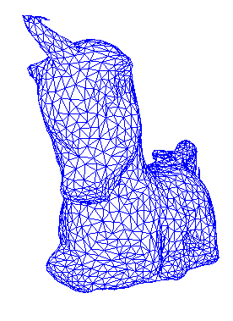
Goals of Image and Video Analysis
Segment an image into useful regions
Perform measurements on certain areas
Determine what object(s) are in the scene
Calculate the precise location(s) of objects
Visually inspect a manufactured object
Construct a 3D model of the imaged object
Find “interesting” events in a video
liver
kidney
spleen

Slide 3
The Three Stages of Computer Vision
low-level
mid-level
high-level
image image
image features
features analysis

Slide 4



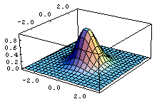
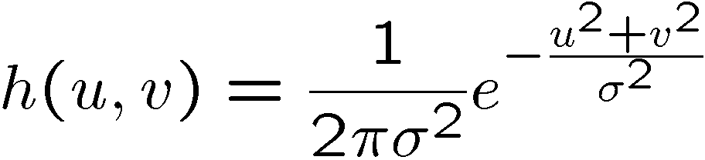
Gaussian filtering
A Gaussian kernel gives less weight to pixels further from the center of the window
This kernel is an approximation of a Gaussian function:
0 | 0 | 0 | 0 | 0 | 0 | 0 | 0 | 0 | 0
0 | 0 | 0 | 0 | 0 | 0 | 0 | 0 | 0 | 0
0 | 0 | 0 | 90 | 90 | 90 | 90 | 90 | 0 | 0
0 | 0 | 0 | 90 | 90 | 90 | 90 | 90 | 0 | 0
0 | 0 | 0 | 90 | 90 | 90 | 90 | 90 | 0 | 0
0 | 0 | 0 | 90 | 0 | 90 | 90 | 90 | 0 | 0
0 | 0 | 0 | 90 | 90 | 90 | 90 | 90 | 0 | 0
0 | 0 | 0 | 0 | 0 | 0 | 0 | 0 | 0 | 0
0 | 0 | 90 | 0 | 0 | 0 | 0 | 0 | 0 | 0
0 | 0 | 0 | 0 | 0 | 0 | 0 | 0 | 0 | 0
1 | 2 | 1
2 | 4 | 2
1 | 2 | 1

Slide 5

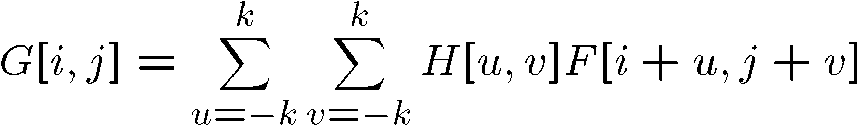
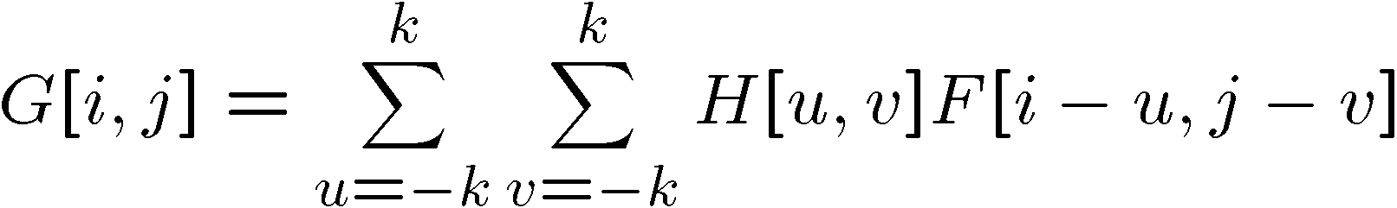

Convolution
Remember cross-correlation:
A convolution operation is a cross-correlation where the filter is flipped both horizontally and vertically before being applied to the image:
It is written:
Suppose H is a Gaussian or mean kernel. How does convolution differ from cross-correlation?

Slide 6
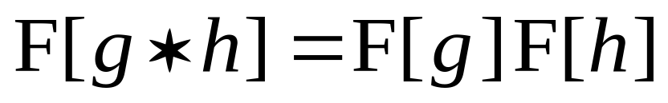
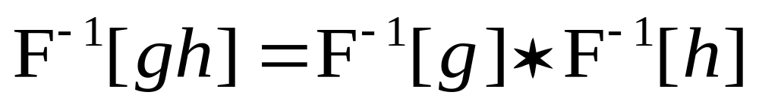
The Convolution Theorem
The greatest thing since sliced (banana) bread!
  The Fourier transform of the convolution of two functions is the product of their Fourier transforms
  The inverse Fourier transform of the product of two Fourier transforms is the convolution of the two inverse Fourier transforms
  Convolution in spatial domain is equivalent to multiplication in frequency domain!

Slide 7
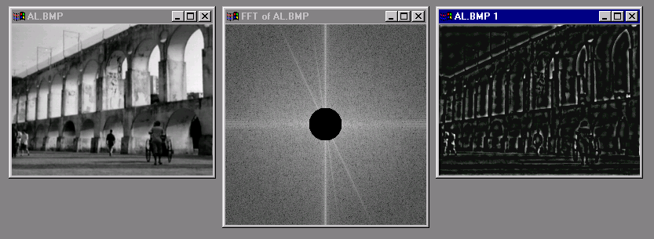
Edges in images

Slide 8
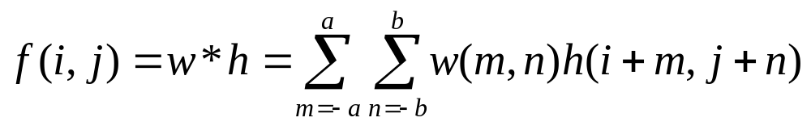
Linear Image Filters
  Linear operations calculate the resulting value in the output image pixel f(i,j) as a linear combination of brightness in a local neighborhood of the pixel h(i,j) in the input image.
  This equation is called to discrete convolution:
Function w is called a convolution kernel or a filter mask. In our case it is a rectangle of size (a+b-1)x(a+b-1).

Slide 9
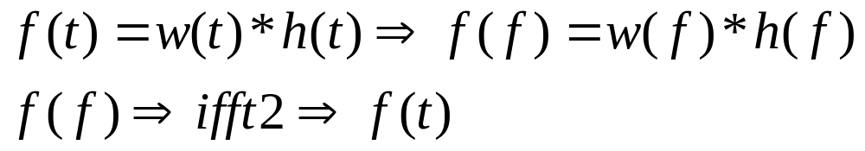
Linear Image Filters
  Linear operations can be converted into frequency domain using Fast Fourier Transform.
  Using inverse FFT to convert the results back into time domain

Slide 10
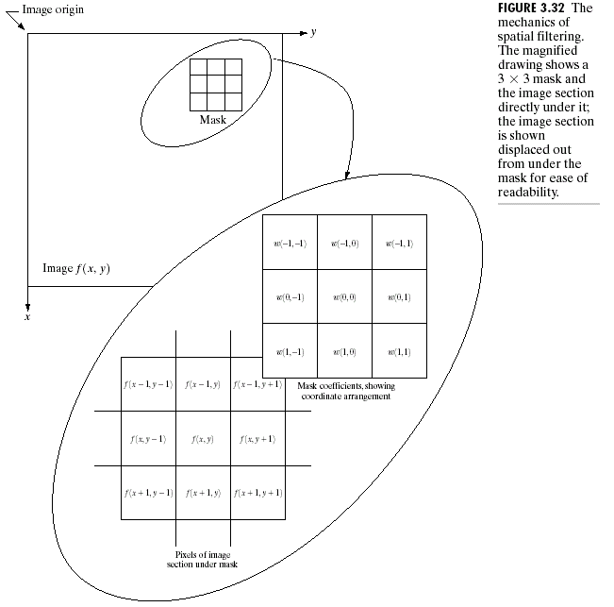
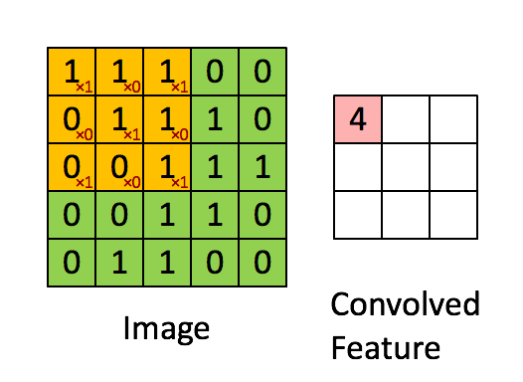

Slide 11
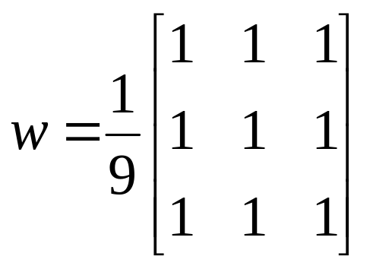
Image smoothing = image blurring
Averaging of brightness values is a special case of discrete convolution. For a 3 x 3 neighborhood the convolution mask w is
Applying this mask to an image results in smoothing.
Matlab command is w=fspecial(‘average’,3)
Local image smoothing can effectively eliminate impulsive noise or degradations appearing as thin stripes, but does not work if degradations are large blobs or thick stripes.

Slide 12
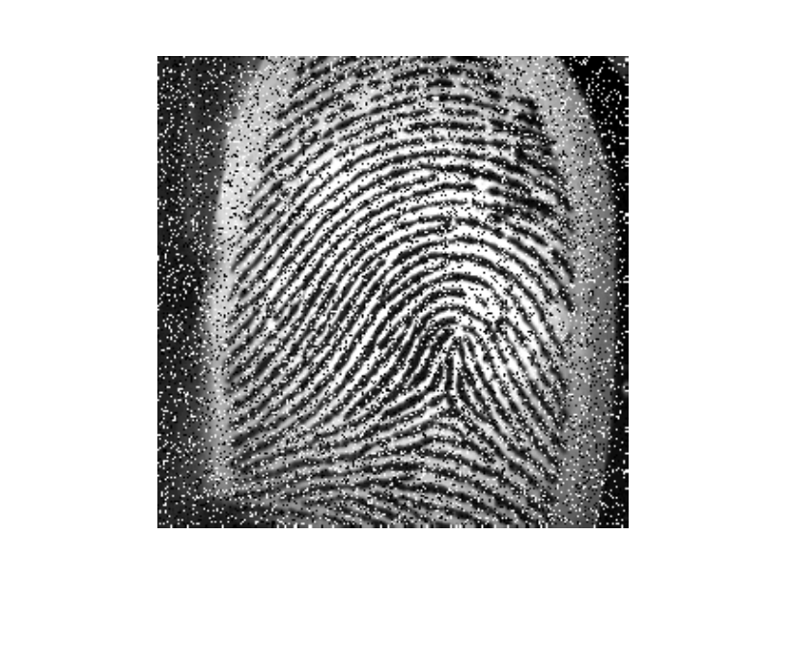
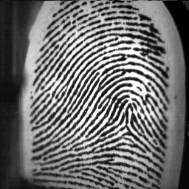
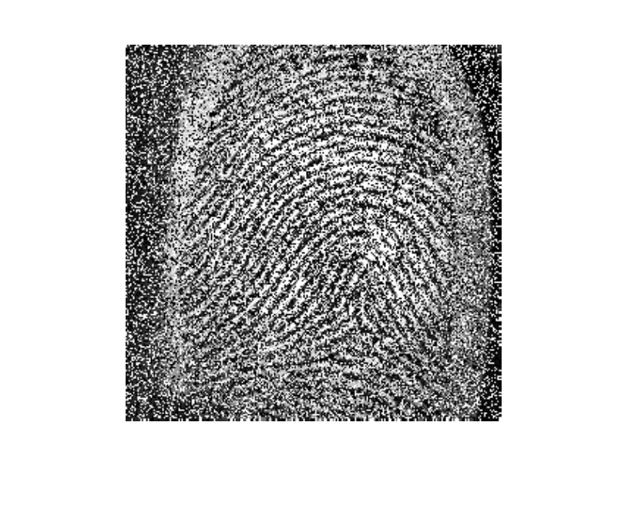
Noise in Image
Salt and Pepper Noise

Slide 13
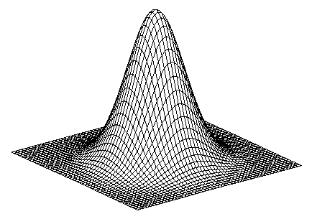
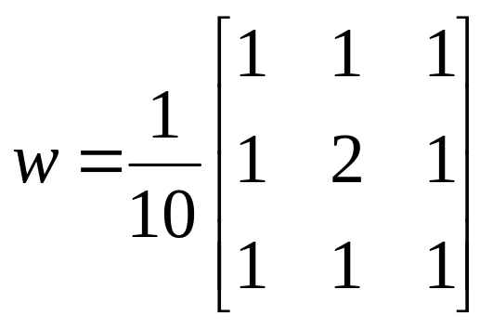
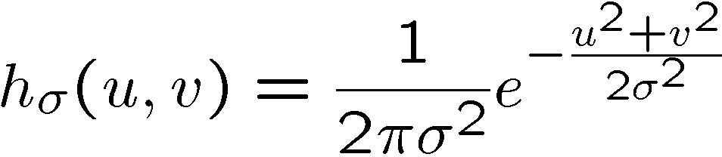
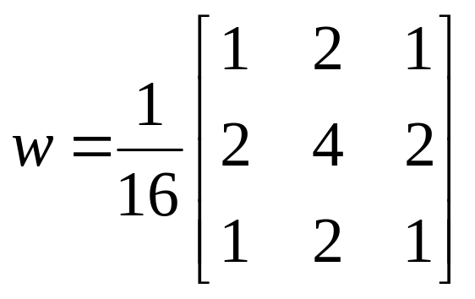
2D edge detection filters
Gaussian
Notes:
How many 2nd derivative filters are there? There are four 2nd partial derivative filters.
In practice, it’s handy to define a single 2nd derivative filter—the Laplacian

Slide 14
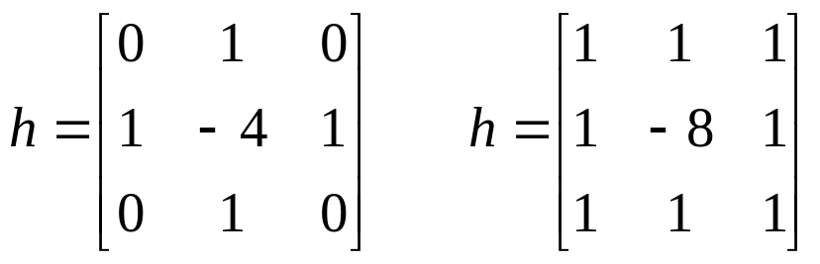
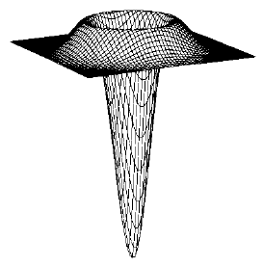
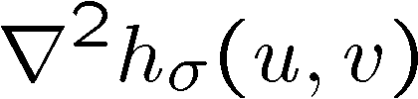
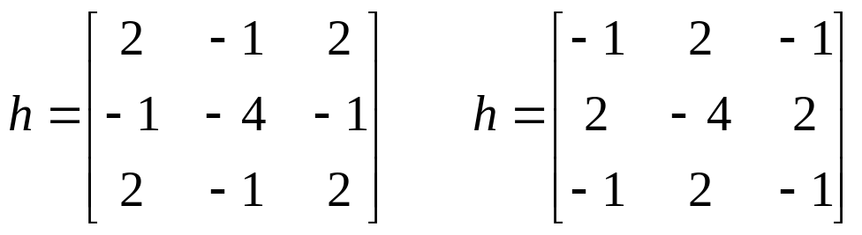
2D edge detection filters
Laplacian of Gaussian
  A Laplacian operator with stressed significance of the central pixel or its neighborhood is sometimes used. In this approximation it loses invariance to rotation
Notes:
How many 2nd derivative filters are there? There are four 2nd partial derivative filters.
In practice, it’s handy to define a single 2nd derivative filter—the Laplacian

Slide 15
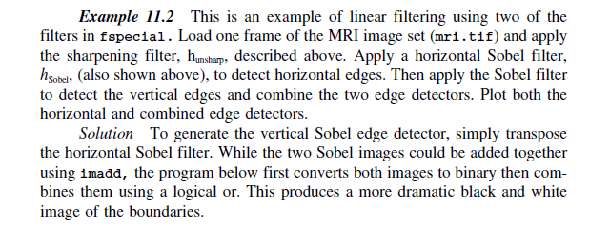
In Class Exercise 1
Example 11.2

Slide 16
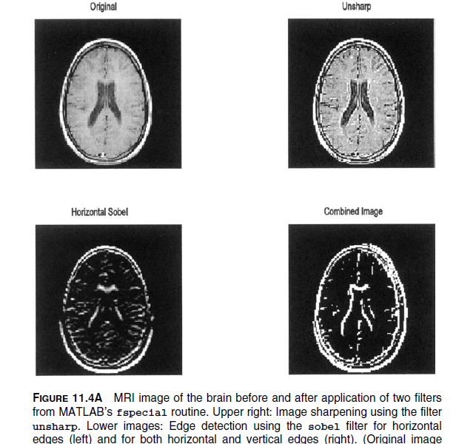
In Class Exercise (example 11.2)
Image 17 of the MRI images from last week

Slide 17
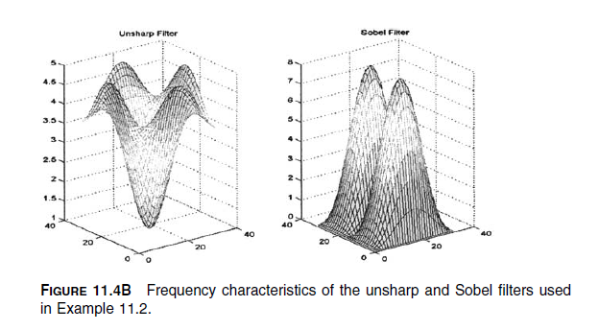
In Class Exercise (example 11.2)
The book uses the command Fspecial to generate the two filters:
1- Unsharp
2- Sobel

Slide 18
In Class Exercise (example 11.2)
The book uses the command imfilter to perform both the fft2, conv2, and inverse
Note: this image is the combination of both horizontal and vertical Sobel

Slide 19
In Class Exercise (example 11.2)
Repeate the example 11.2, however, you need to use edge command
In help: Find edges in intensity image
Quiz:
1- Find the edge for MRI image using the following method:
- Sobel
- Canny
- Prewitt

Slide 20
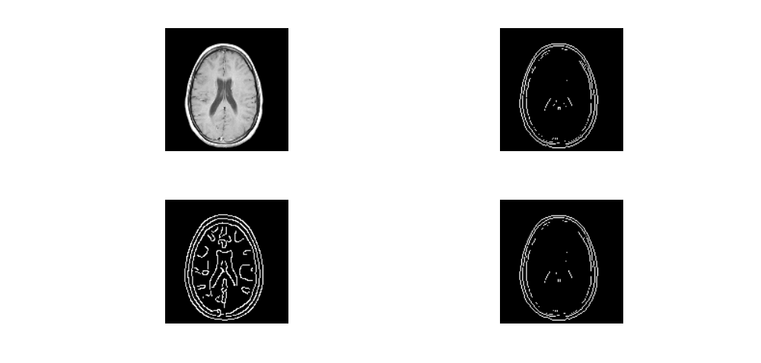
Edge example
Original
Sobel
Canny
Prewitt

Slide 21
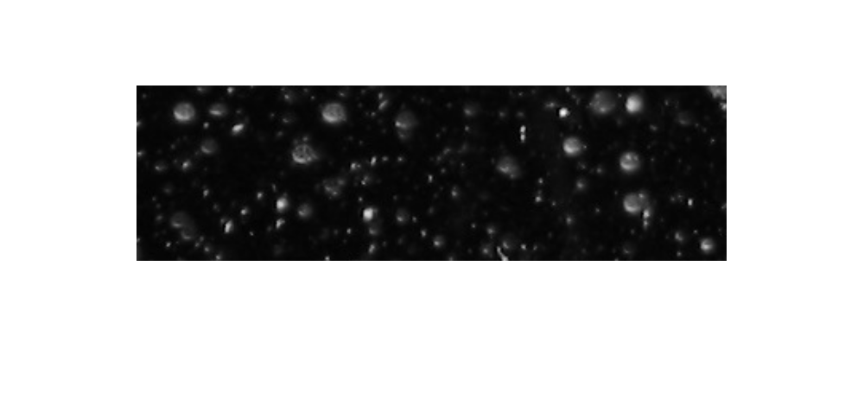
In class Exercise 2
Help: Granulometry of Snowflakes example

Slide 22
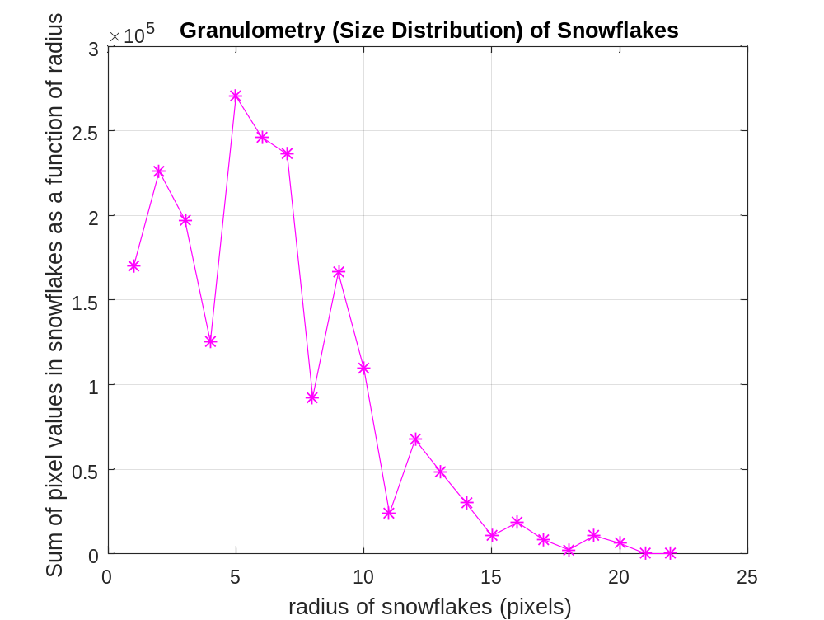
In class Exercise 2
We can count the number of snowflakes based on their size.

Slide 23
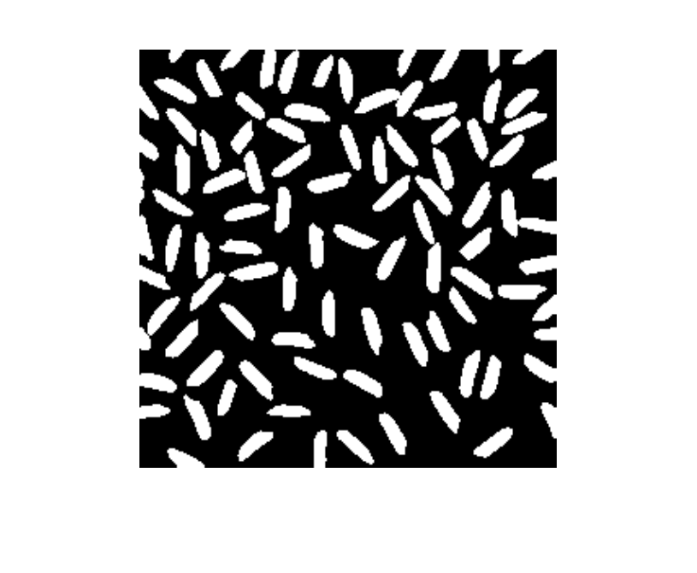

In Class Exercise 3
(part of the HW)
Basic Image Enhancement and Analysis Techniques

Slide 24
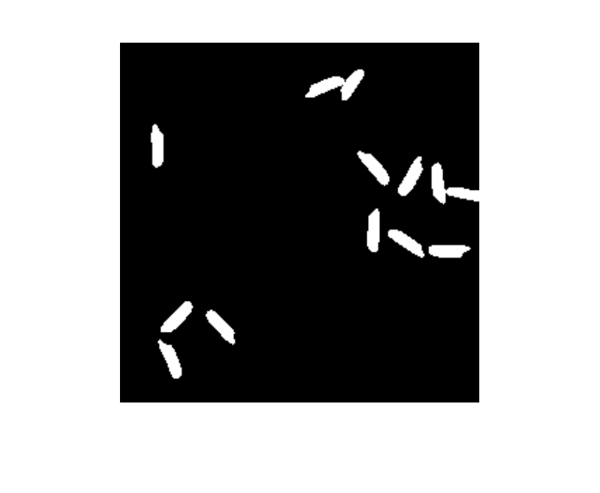
HW
  Determine the “cancer” rice that is greater than 220 pixels in size
  Plot the image with only “cancer’ rice with area greater than 220 pixels

