Slide 1
Recognition open door
Member Group:
ĐINH HOÀNG SÁNG BEBEIU17022
QUÁCH NGỌC THẢO NGÂN BEBEIU17013
VÕ MINH NHẬT BEBEIU17063

Slide 2
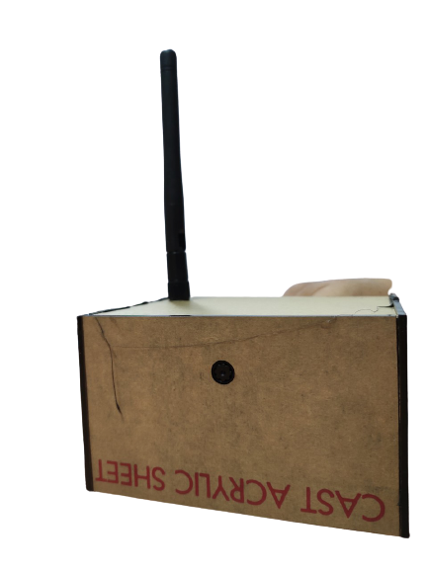
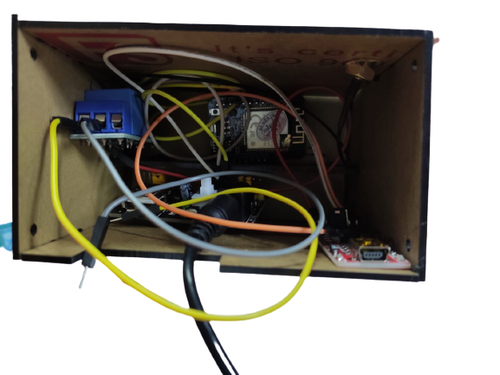
PROTOTYPE
ANTENA
CAMERA

Slide 3
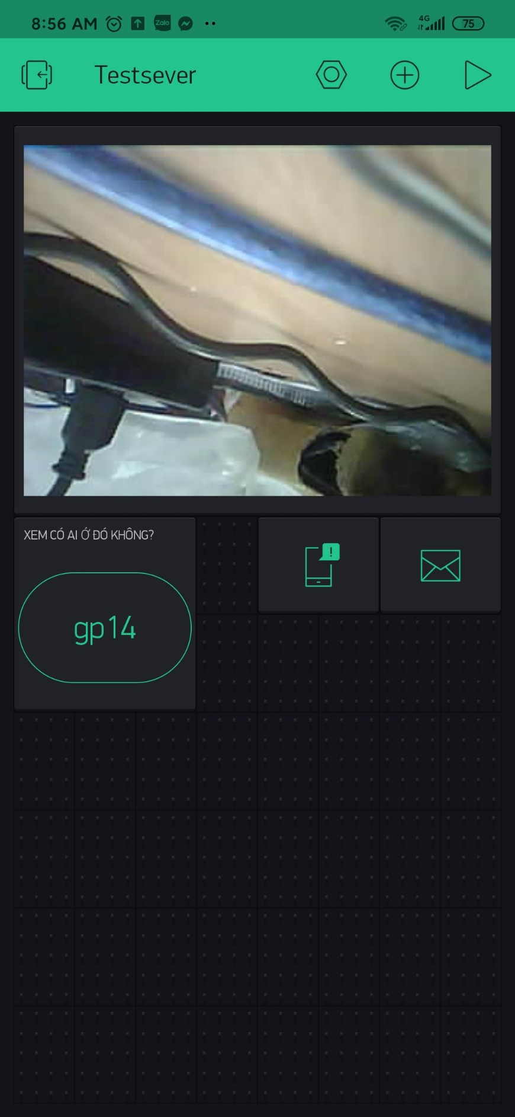

APP
SCREEN
SENDING EMAIL
TURN ON THE FLASH
Checking WHO IS THERE?
NOTIFICATION

