Slide 1



Sugarcane Juice Extractor
MACHINE DESIGN COURSE
Instructor: Assoc. Prof Pham Thi Thu Hien
Teaching Assistant: Nguyen Hoang Tan

Slide 2
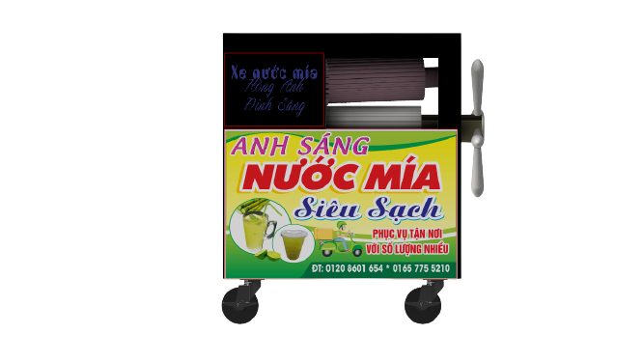
Table of Contents
1
2
3
Sugarcane Juice Extractor
Introduction
Structure
MACHINE DESIGN COURSE
Instructor: Assoc. Prof Pham Thi Thu Hien
How to work?
Teaching Assistant: Nguyen Hoang Tan

Slide 3
INTRODUCTION
A sugarcane juice extractor machine is a machine used to extract the juice from sugarcane.
The sugarcane juice extractor machines were built to help human extract the juice from sugar cane through crushing and rolling process

Slide 4
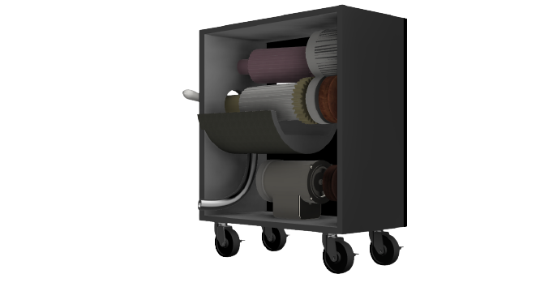
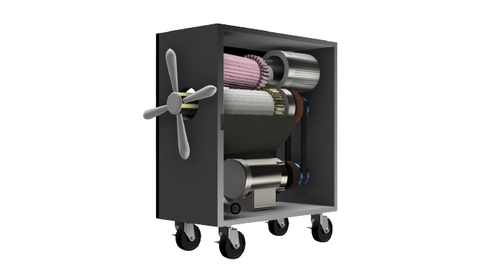
STRUCTURE
A sugarcane juice extractor machine is a machine used to extract the juice from sugarcane.
The sugarcane juice extractor machines were built to help human extract the juice from sugar cane through crushing and rolling process

Slide 5
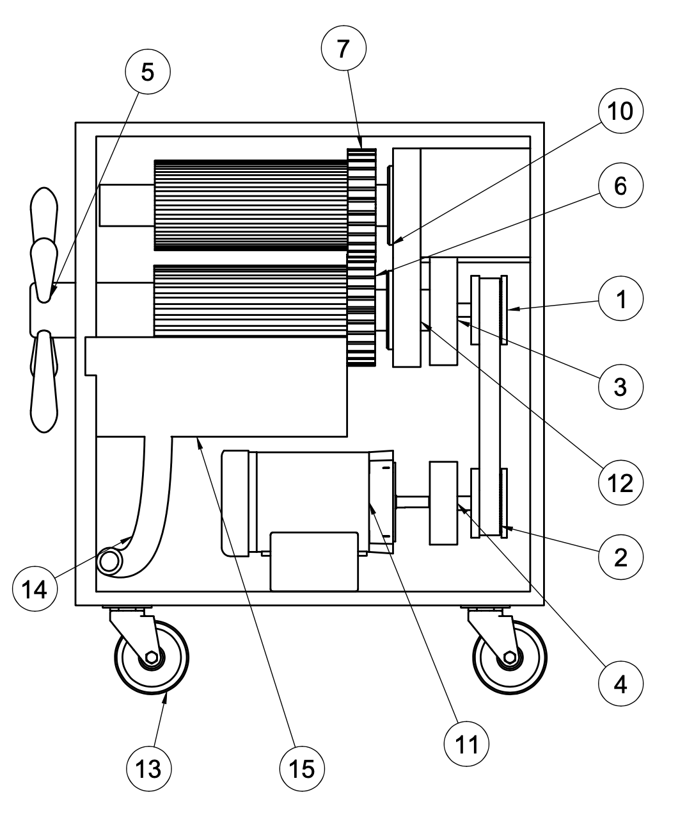
No | Component | No | Component
1 | Spocket | 8 | Pipe
2 | Belt | 9 | Trough
3 | Noice cancellation 1 | 10 | Bearing 1
4 | Noice cancellation 2 | 11 | Motor AC
5 | Hand-rotate | 12 | Bearing 2
6 | Spur Shear 1 (30 teeth) | 13 | Wheel
7 | Spur Shear 2 (30 teeth)
8
9

Slide 6
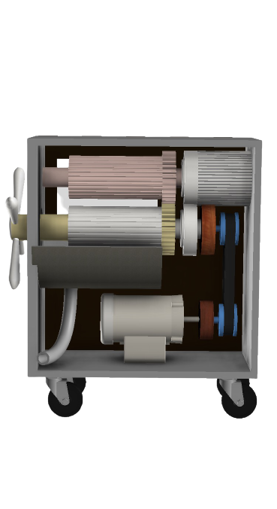
HOW TO WORK?
No | Component | No | Component
1 | Spocket | 8 | Pipe
2 | Belt | 9 | Trough
3 | Noice cancellation 1 | 10 | Bearing 1
4 | Noice cancellation 2 | 11 | Motor AC
5 | Hand-rotate | 12 | Bearing 2
6 | Spur Shear 1 (30 teeth) | 13 | Wheel
7 | Spur Shear 2 (30 teeth)
Spur Gear (30 teeth)
Hand-rotate
Motor AC

Slide 7


CONCLUSION
Spur Gear (30 teeth)
Hand-rotate
Motor AC
Dinh Hoang Sang
Pham Hong Anh

Slide 8
GROUP MEMBER
Thanks!
Dinh Hoang Sang
Pham Hong Anh

Slide 9
Thanks!
Do you have any questions?
youremail@freepik.com
+91 620 421 838
yourcompany.com
Please keep this slide for attribution

