Slide 1
CultureTrail - Du lich van hoa
Toan bo giao dien website (14 man hinh / 11 trang)

Slide 2
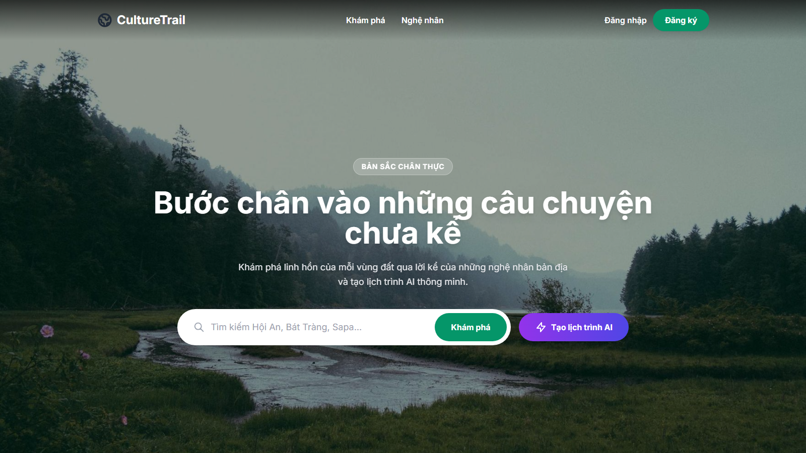
Notes:
Trang chu (index.html) | luot cuon #0 | 01_index__00.png

Slide 3
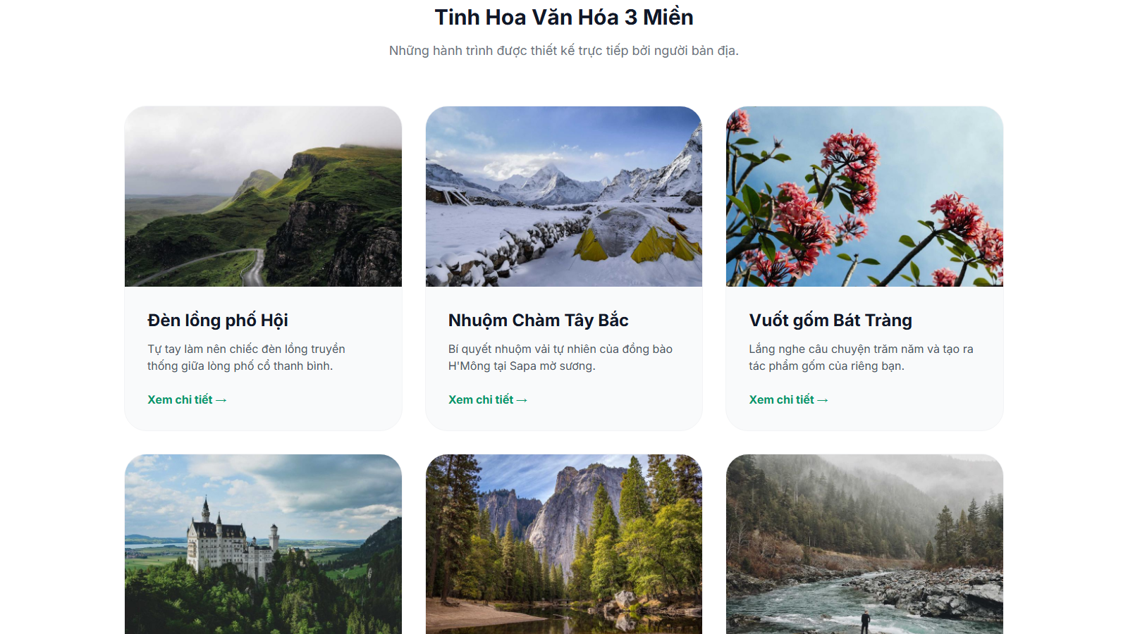
Notes:
Trang chu (index.html) | luot cuon #1 | 01_index__01.png

Slide 4
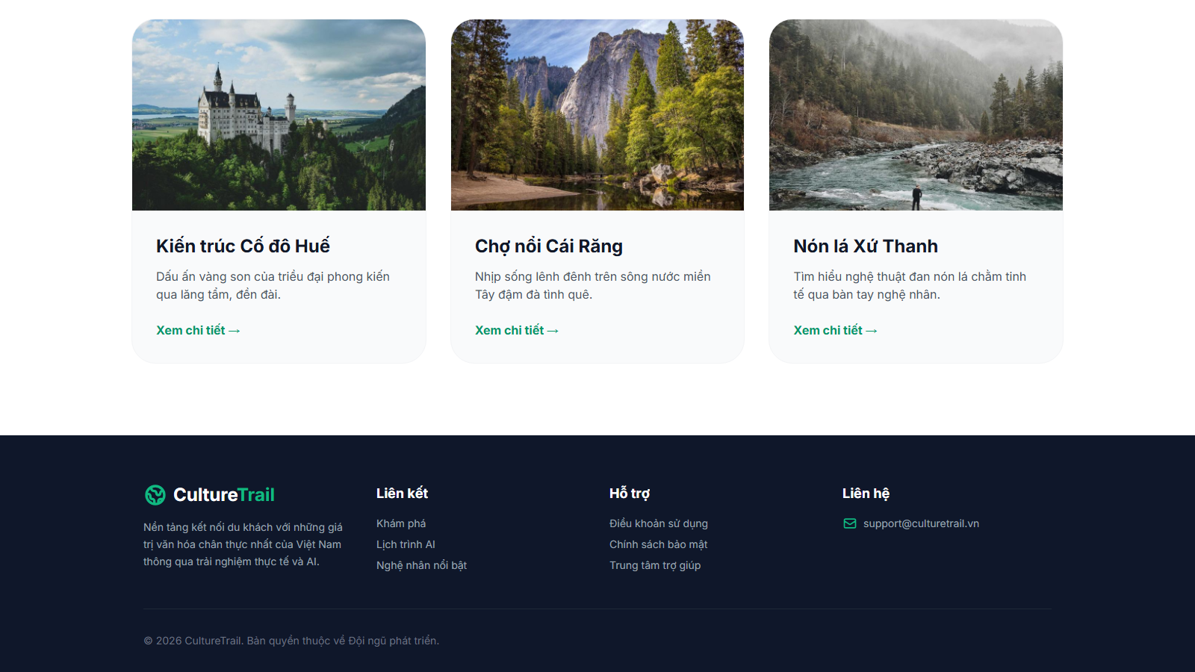
Notes:
Trang chu (index.html) | luot cuon #2 | 01_index__02.png

Slide 5
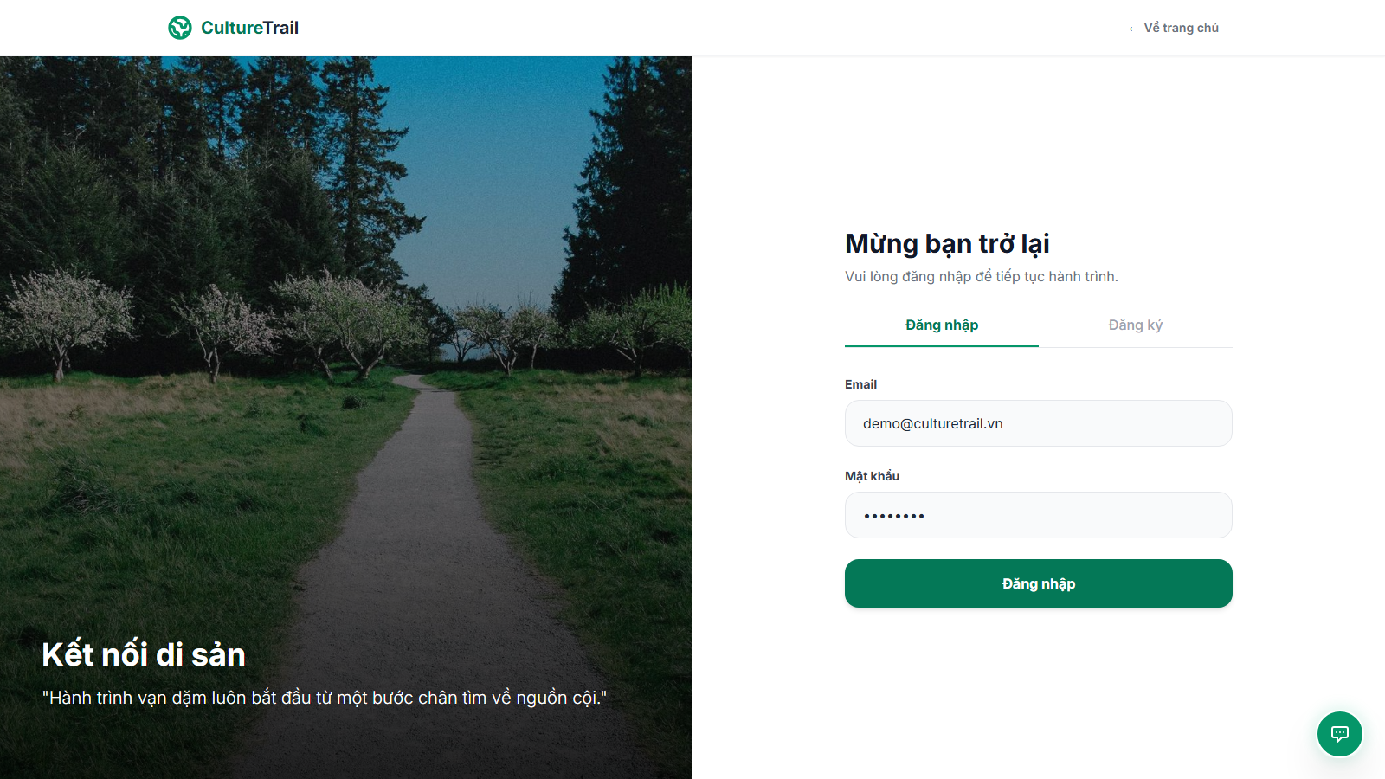
Notes:
Dang nhap / Dang ky (login.html) | luot cuon #0 | 02_login__00.png

Slide 6
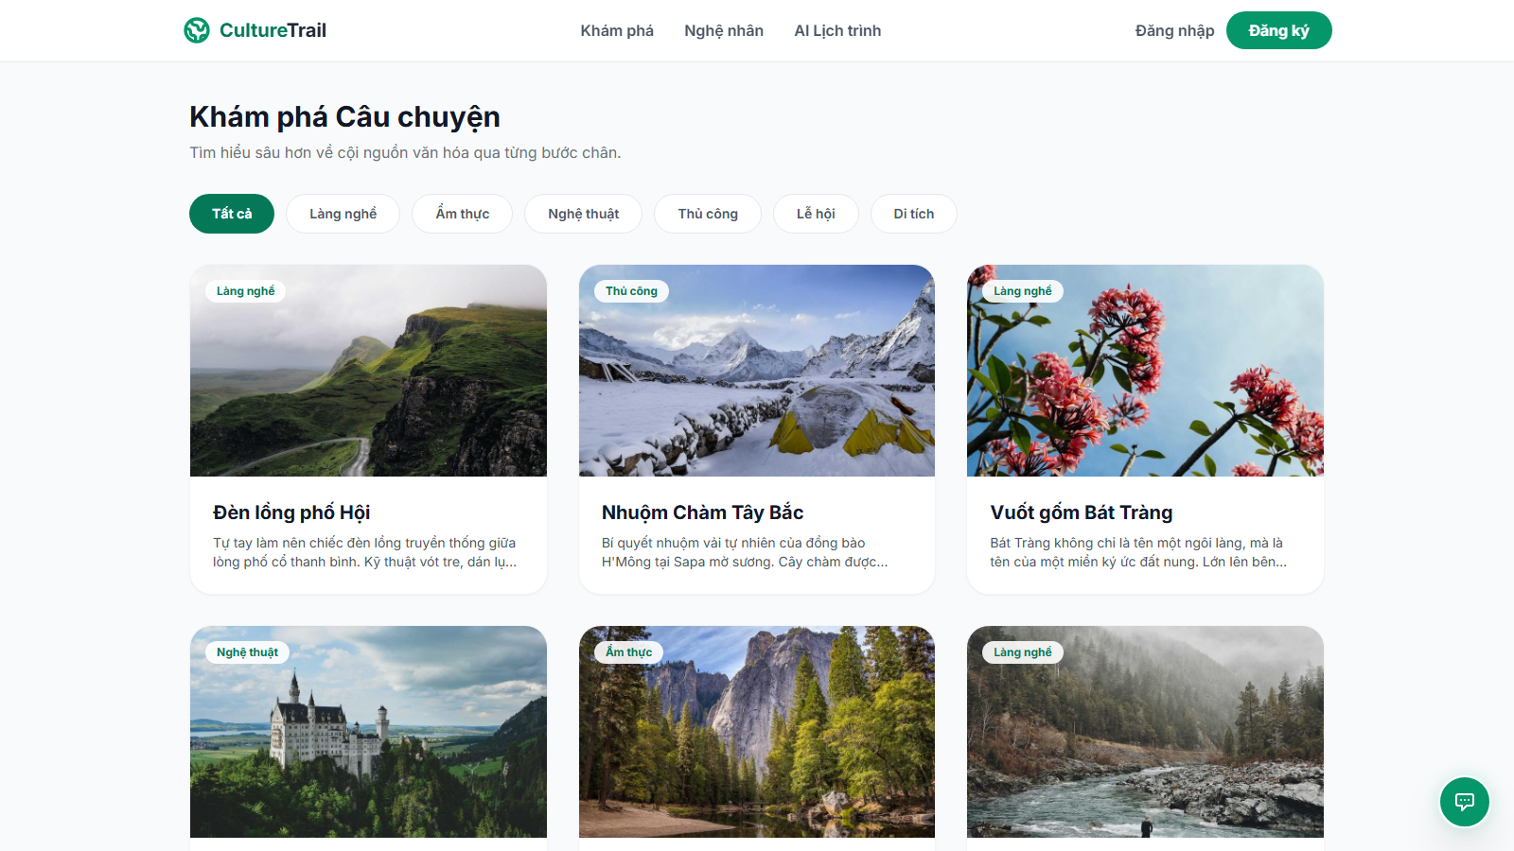
Notes:
Kham pha (discover.html) | luot cuon #0 | 03_discover__00.png

Slide 7
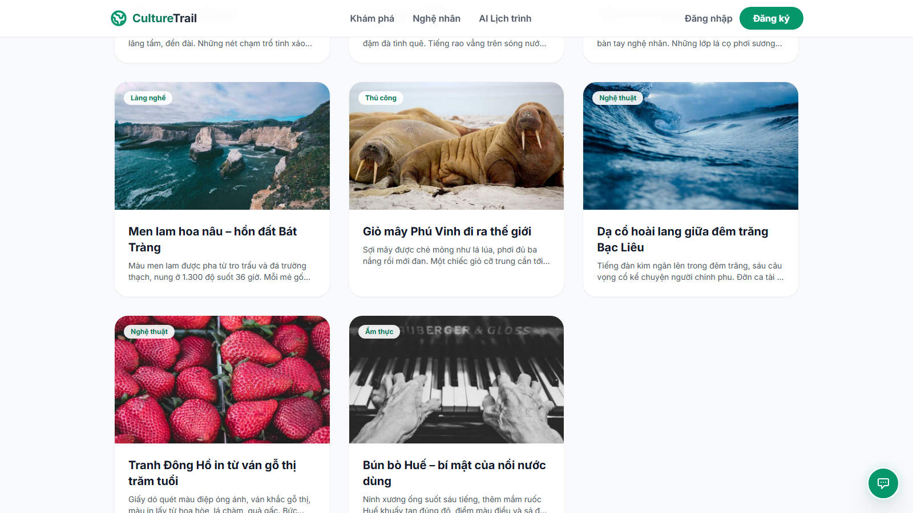
Notes:
Kham pha (discover.html) | luot cuon #1 | 03_discover__01.png

Slide 8
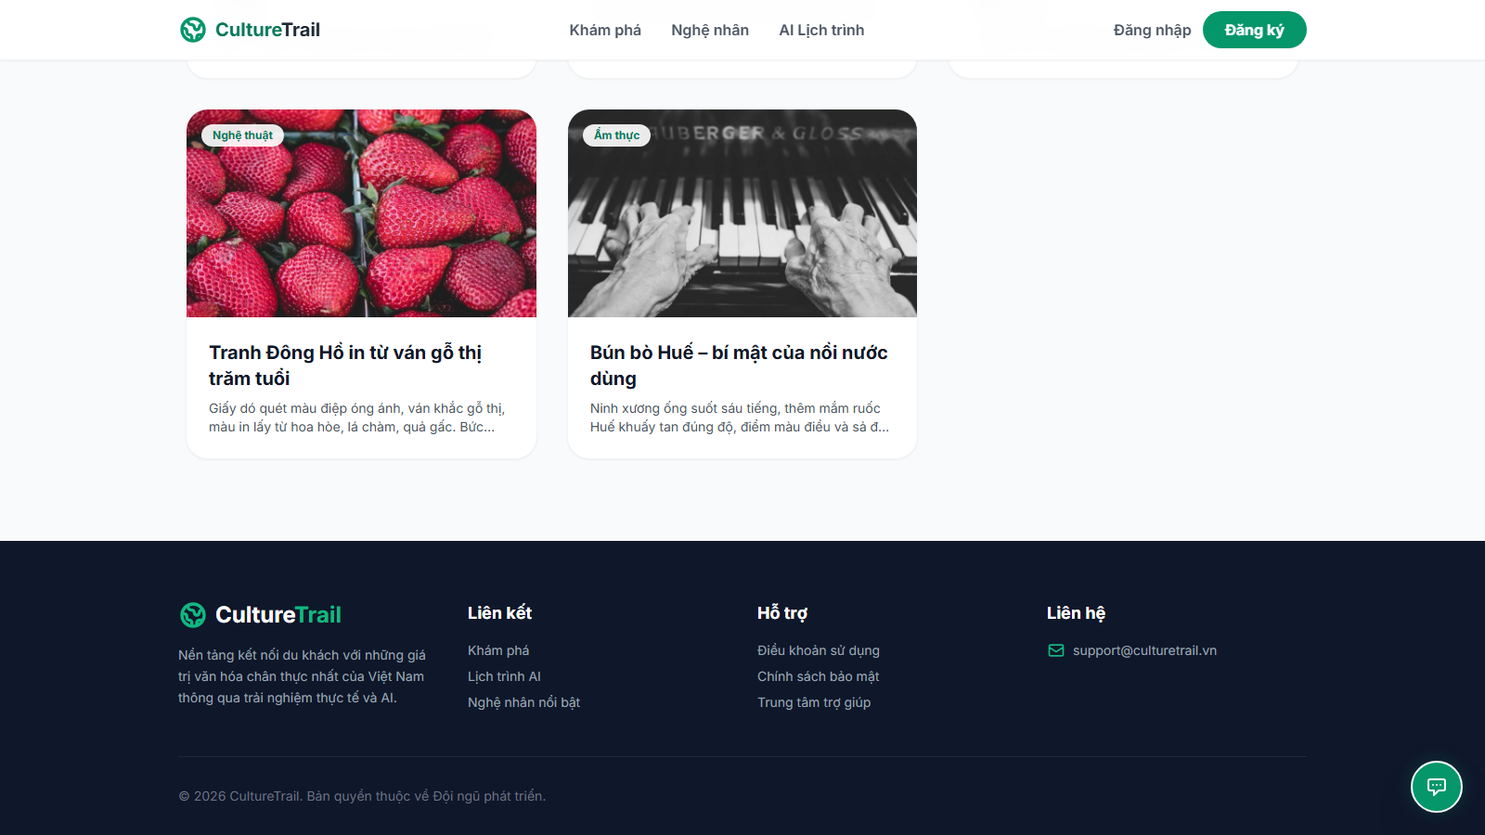
Notes:
Kham pha (discover.html) | luot cuon #2 | 03_discover__02.png

Slide 9
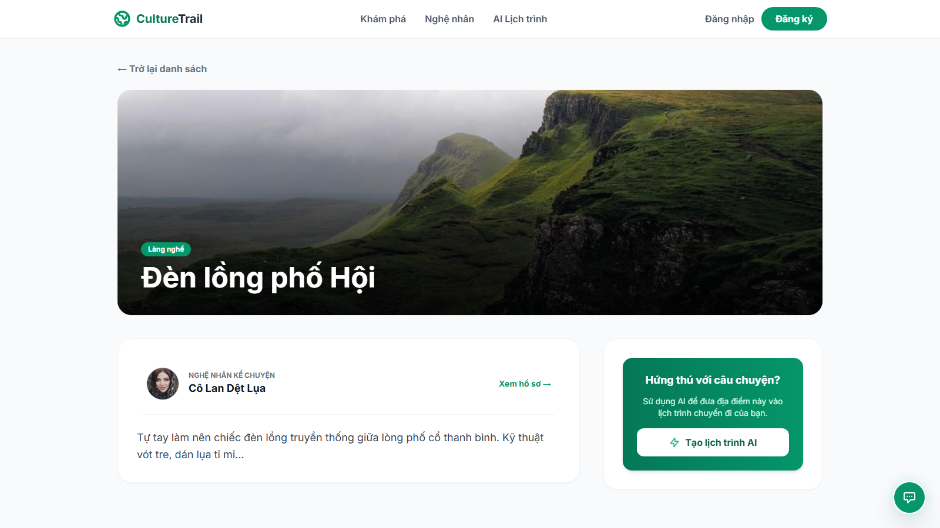
Notes:
Chi tiet dia diem (post-detail.html) | luot cuon #0 | 04_post-detail__00.png

Slide 10
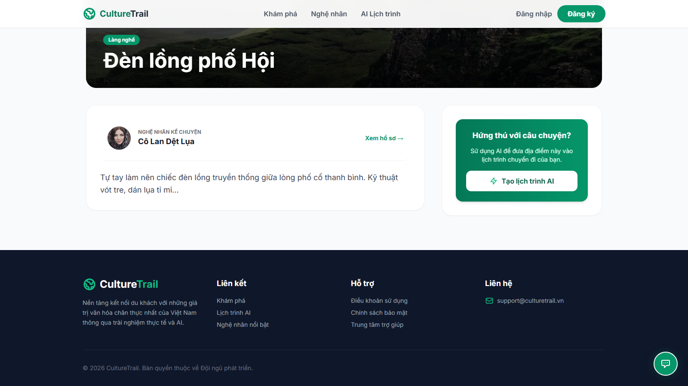
Notes:
Chi tiet dia diem (post-detail.html) | luot cuon #1 | 04_post-detail__01.png

Slide 11
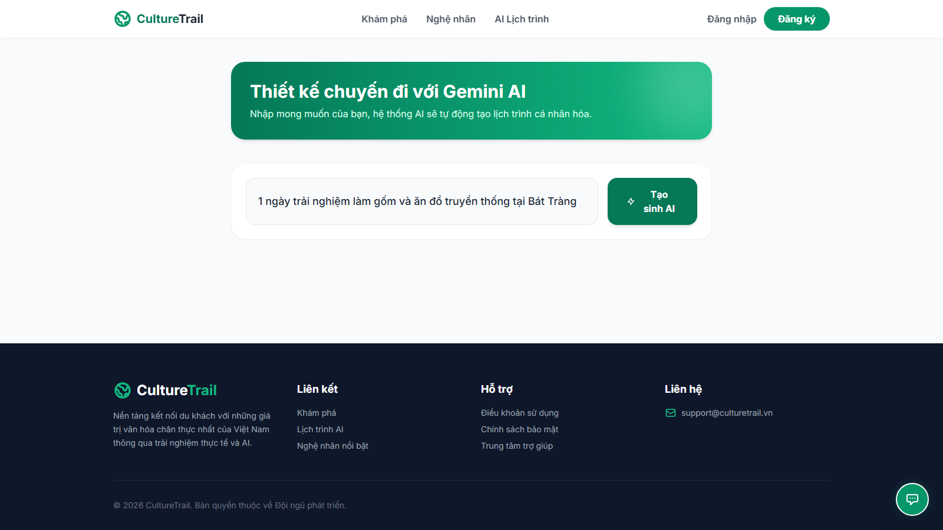
Notes:
AI Lich trinh (ai-trail.html) | luot cuon #0 | 05_ai-trail__00.png

Slide 12
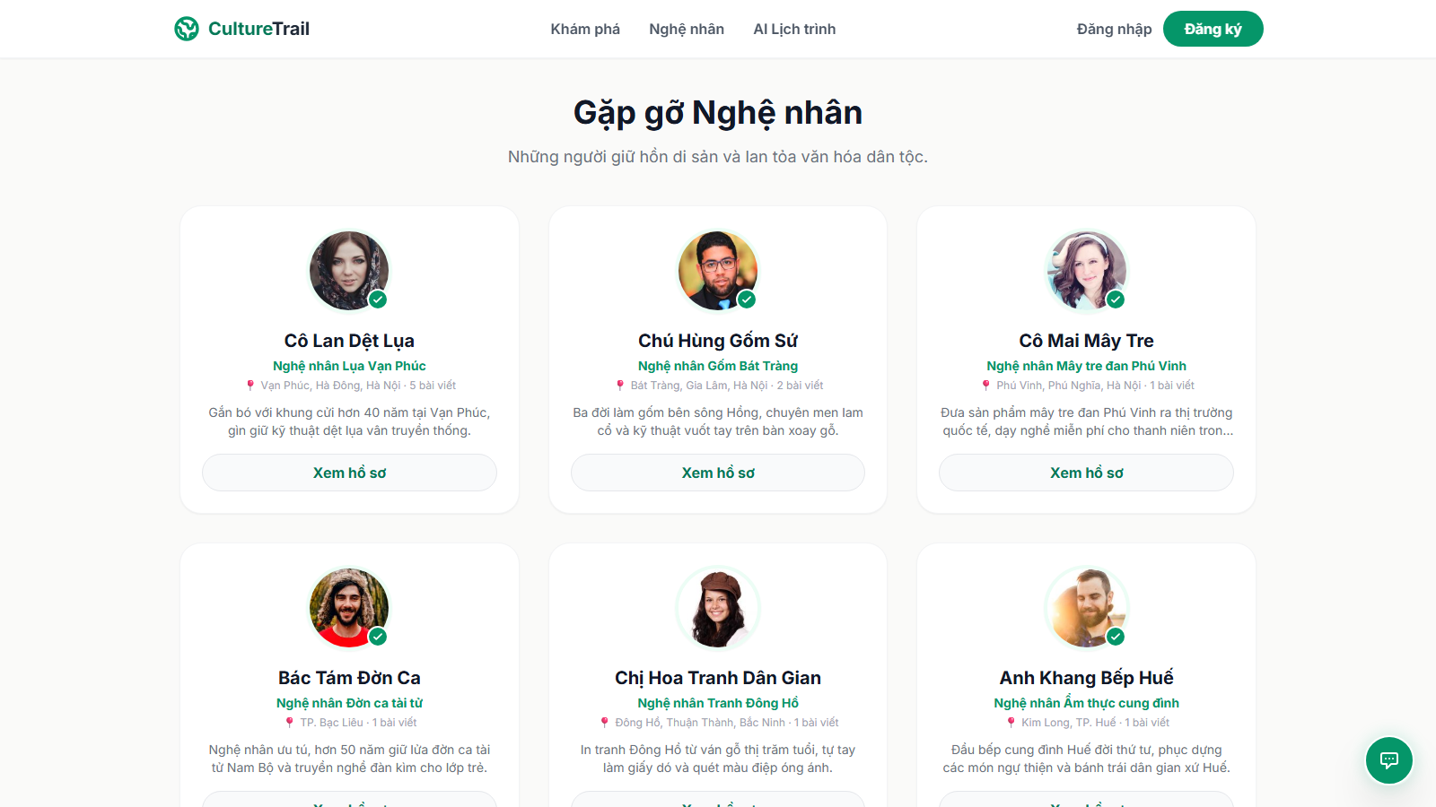
Notes:
Danh sach nghe nhan (creators.html) | luot cuon #0 | 06_creators__00.png

Slide 13
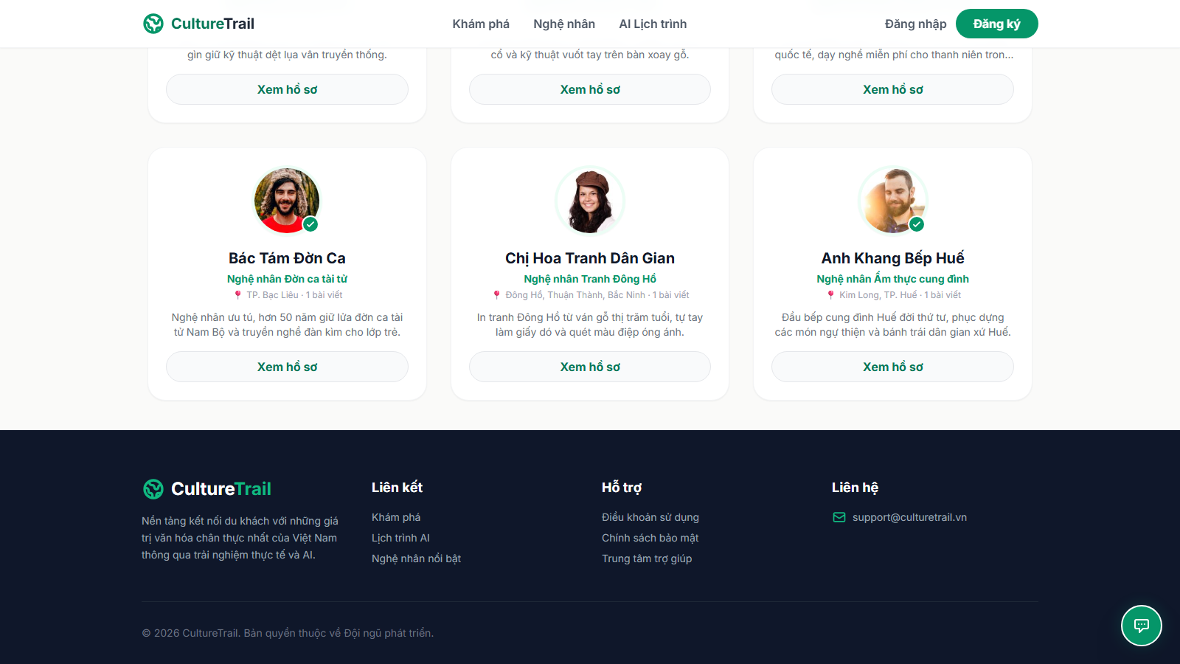
Notes:
Danh sach nghe nhan (creators.html) | luot cuon #1 | 06_creators__01.png

Slide 14
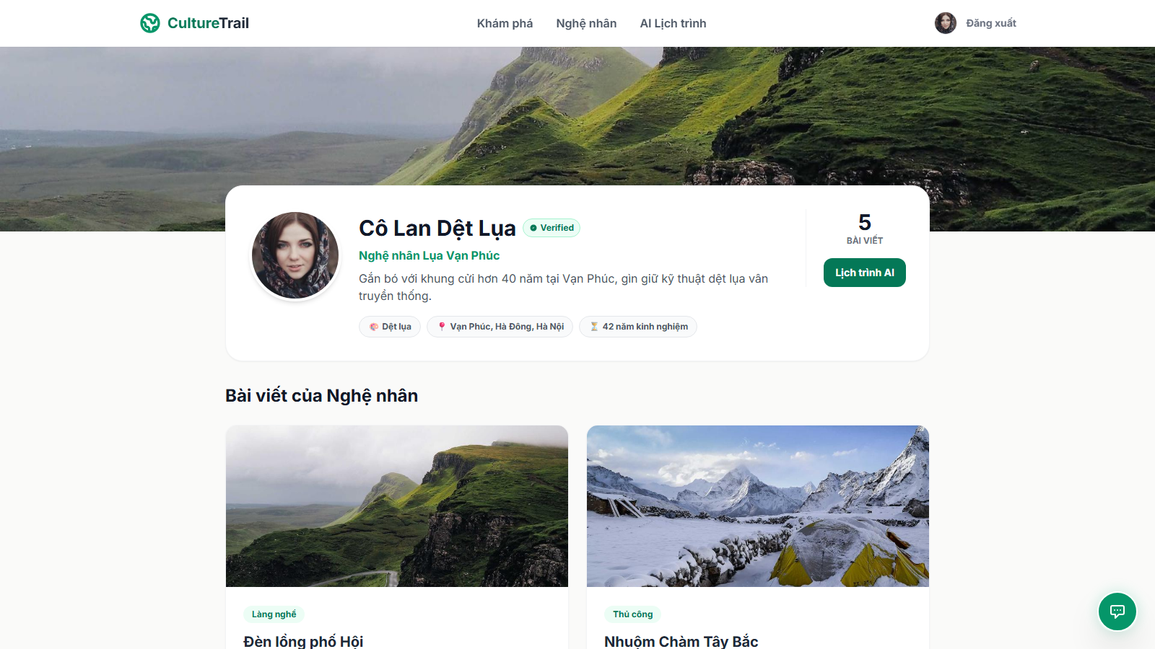
Notes:
Ho so nghe nhan (creator-profile.html) | luot cuon #0 | 07_creator-profile__00.png

Slide 15
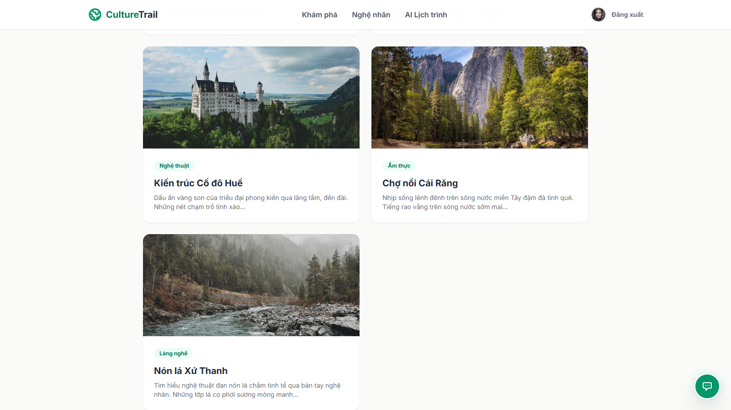
Notes:
Ho so nghe nhan (creator-profile.html) | luot cuon #1 | 07_creator-profile__01.png

Slide 16
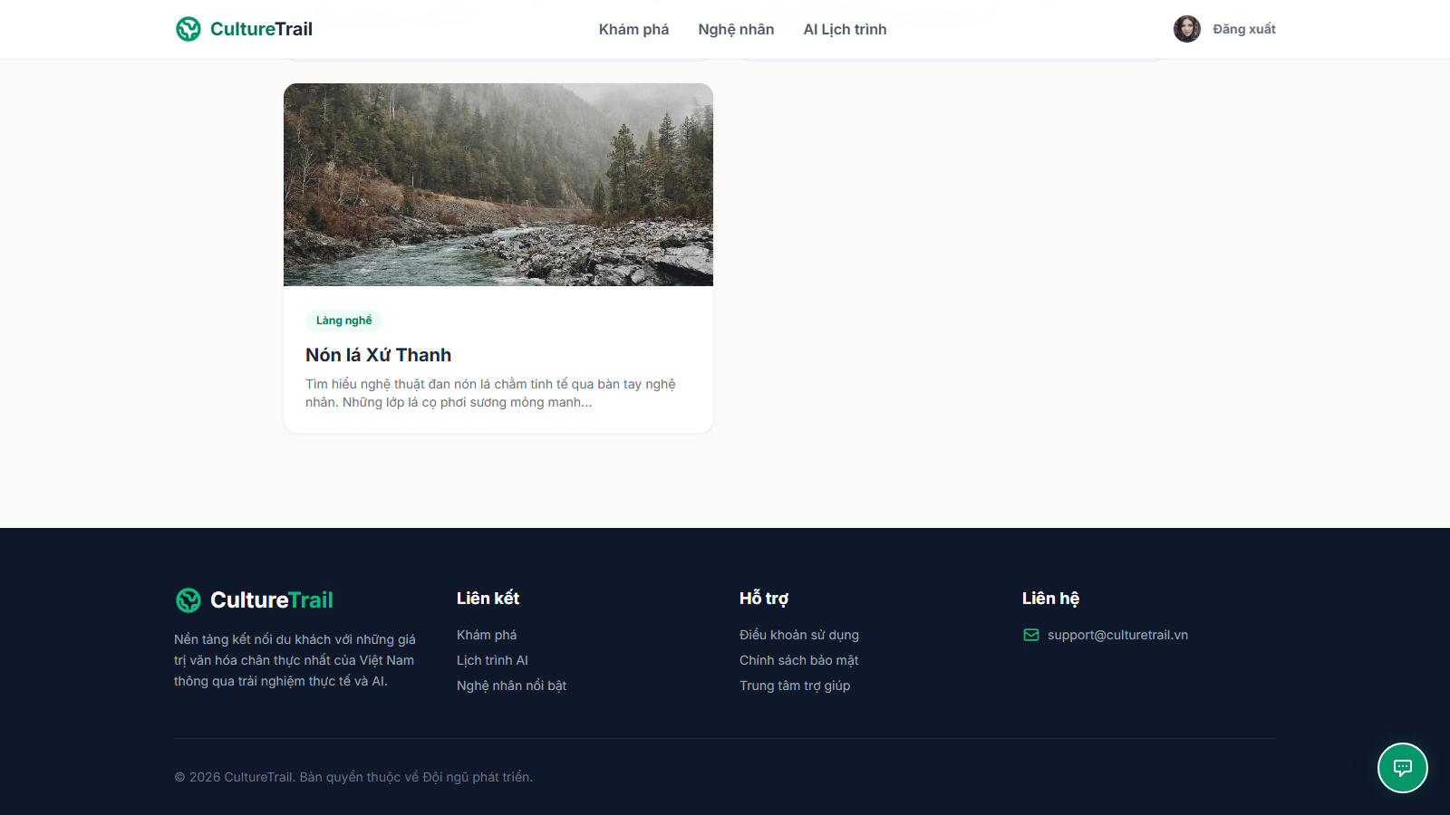
Notes:
Ho so nghe nhan (creator-profile.html) | luot cuon #2 | 07_creator-profile__02.png

Slide 17
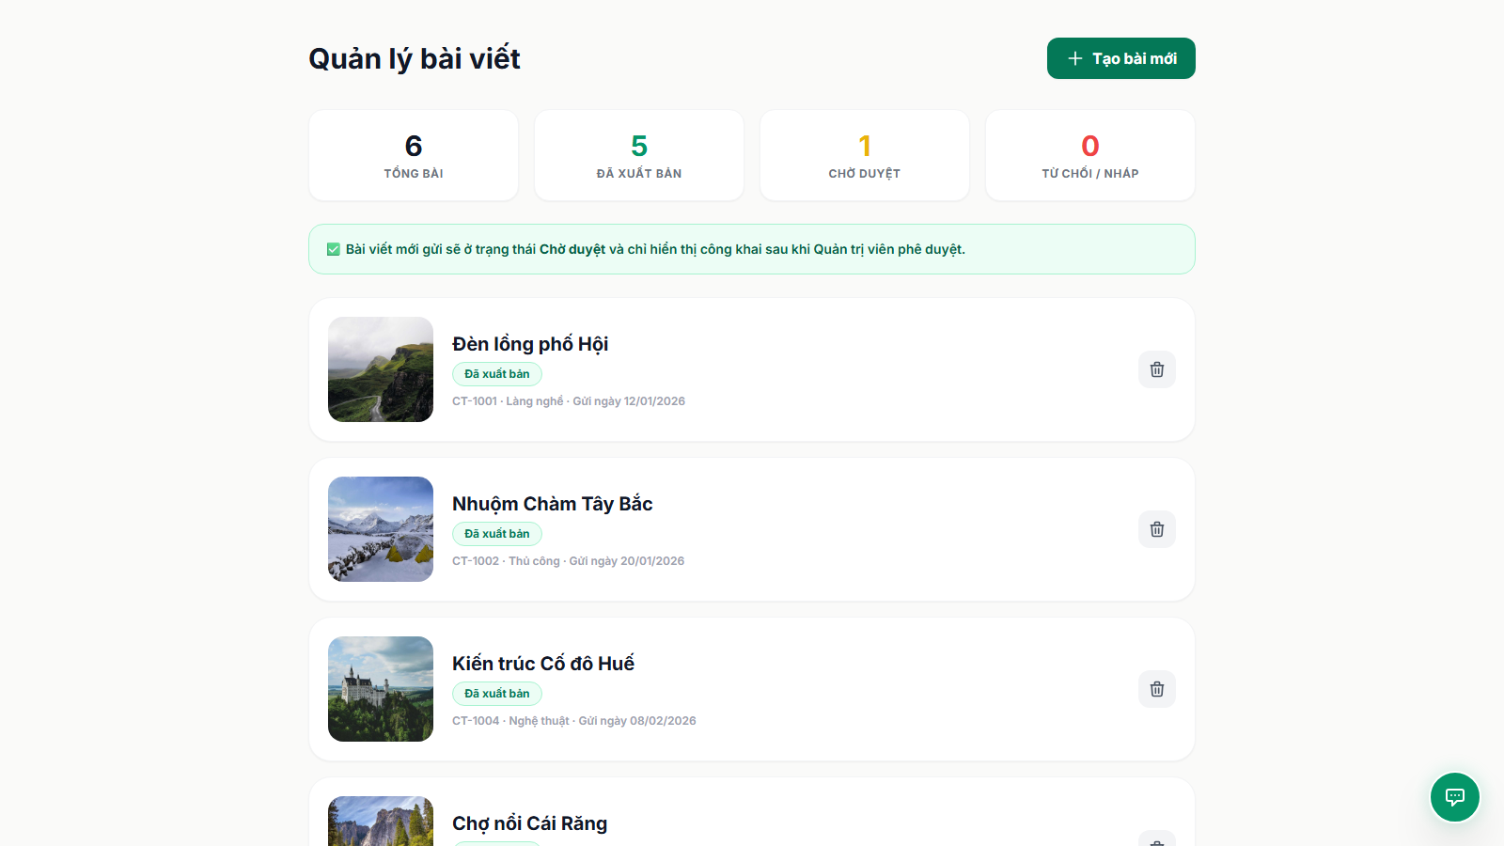
Notes:
Nghe nhan - Quan ly bai viet (creator-posts.html) | luot cuon #0 | 08_creator-posts__00.png

Slide 18
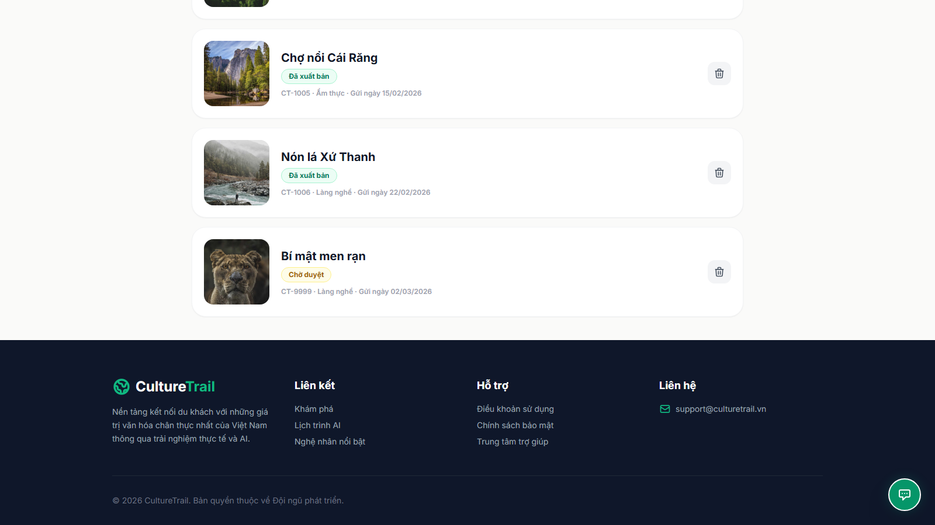
Notes:
Nghe nhan - Quan ly bai viet (creator-posts.html) | luot cuon #1 | 08_creator-posts__01.png

Slide 19
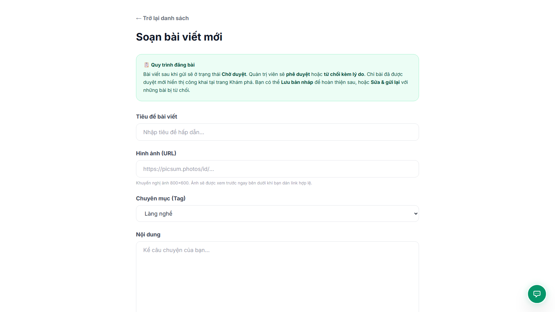
Notes:
Nghe nhan - Tao bai viet moi (creator-post-new.html) | luot cuon #0 | 09_creator-post-new__00.png

Slide 20
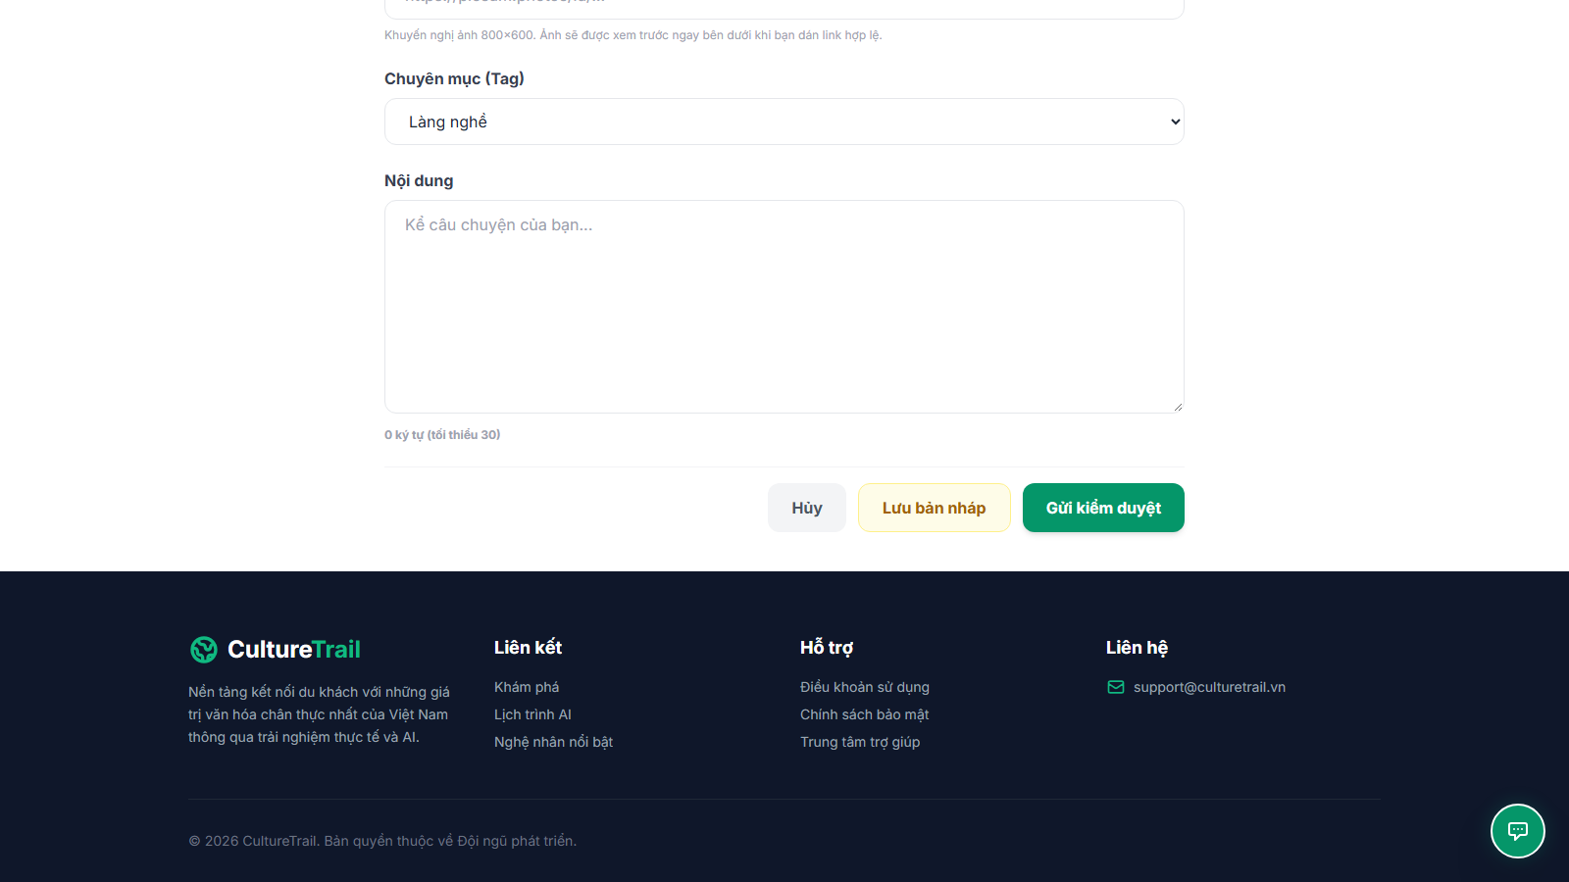
Notes:
Nghe nhan - Tao bai viet moi (creator-post-new.html) | luot cuon #1 | 09_creator-post-new__01.png

Slide 21
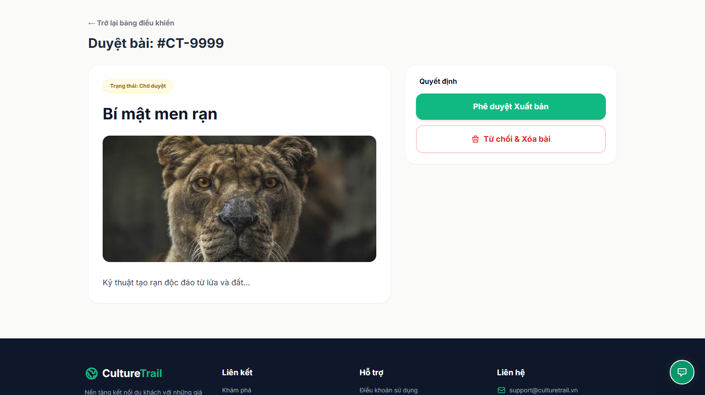
Notes:
Kiem duyet bai viet (curator-review.html) | luot cuon #0 | 10_curator-review__00.png

Slide 22
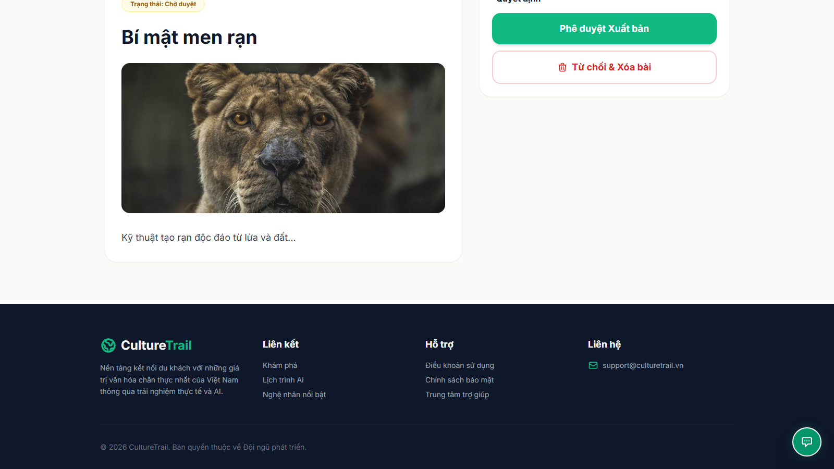
Notes:
Kiem duyet bai viet (curator-review.html) | luot cuon #1 | 10_curator-review__01.png

Slide 23
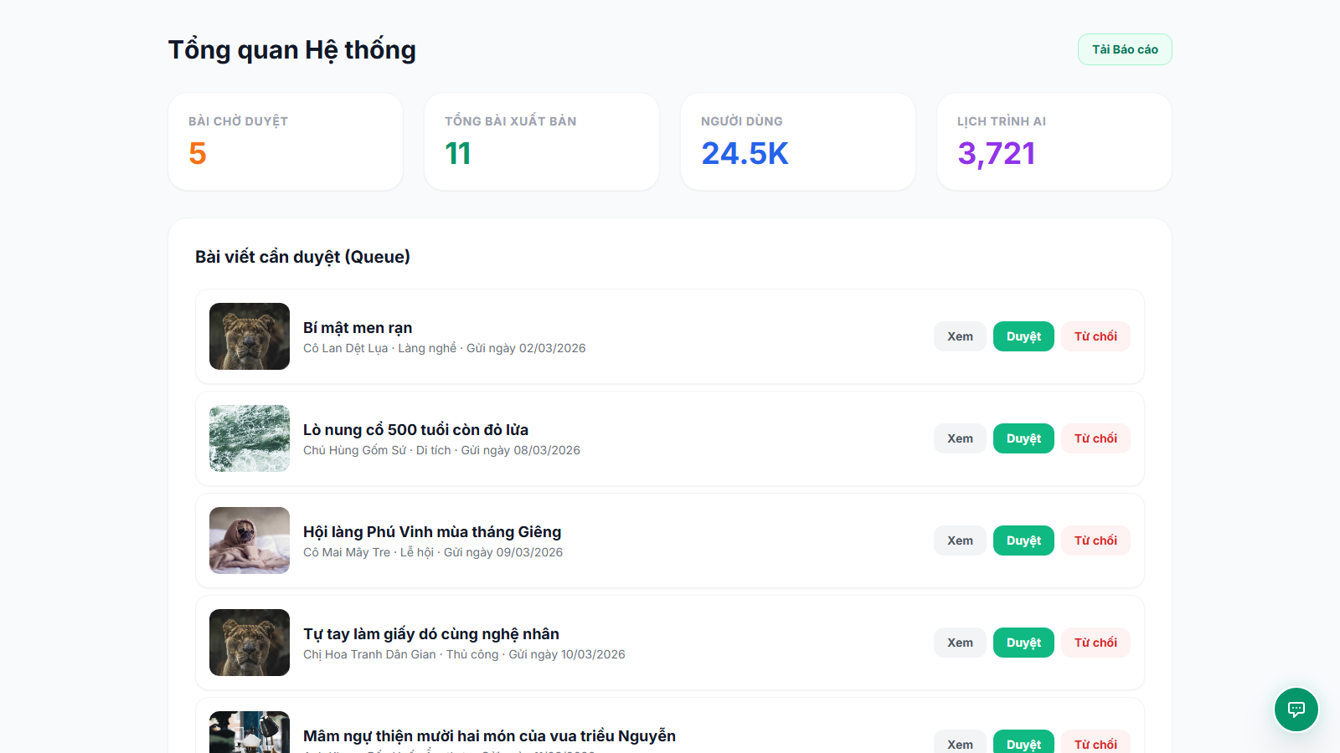
Notes:
Admin - Tong quan (admin.html) | luot cuon #0 | 11_admin-dash__00.png

Slide 24
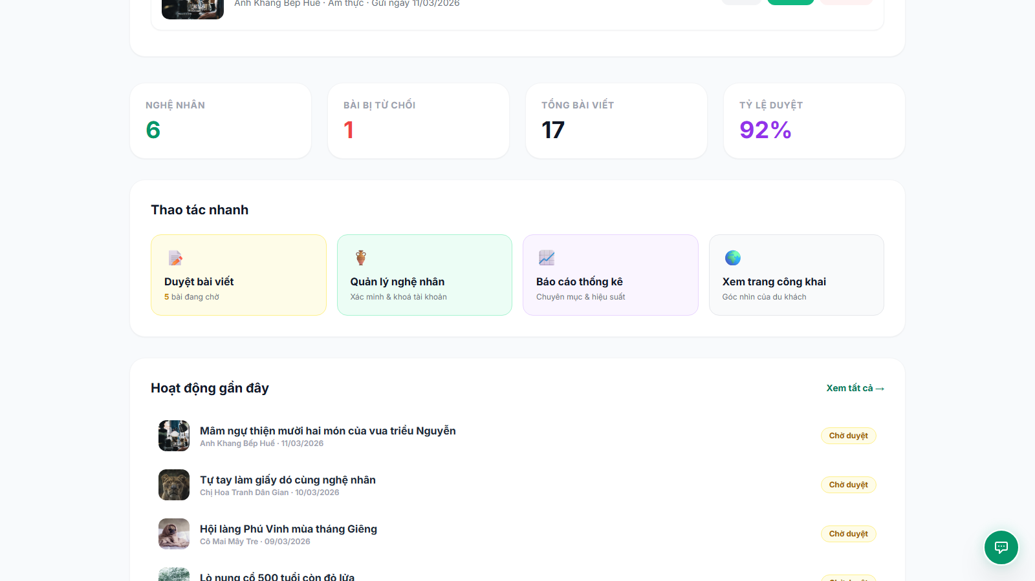
Notes:
Admin - Tong quan (admin.html) | luot cuon #1 | 11_admin-dash__01.png

Slide 25
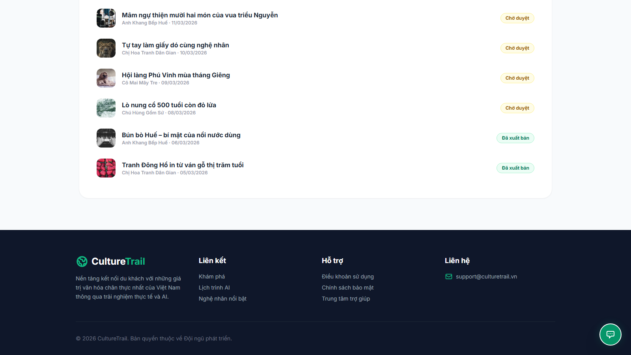
Notes:
Admin - Tong quan (admin.html) | luot cuon #2 | 11_admin-dash__02.png

Slide 26
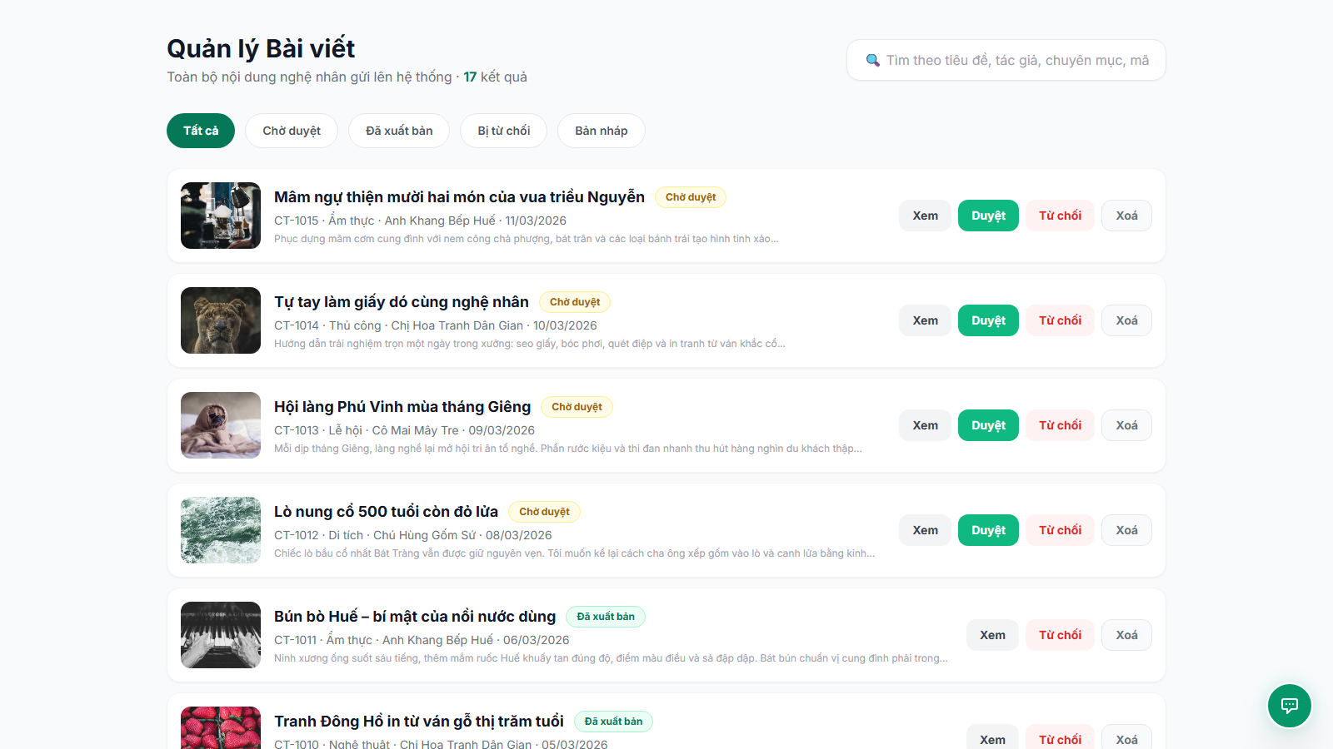
Notes:
Admin - Quan ly bai viet (admin.html) | luot cuon #0 | 12_admin-posts__00.png

Slide 27
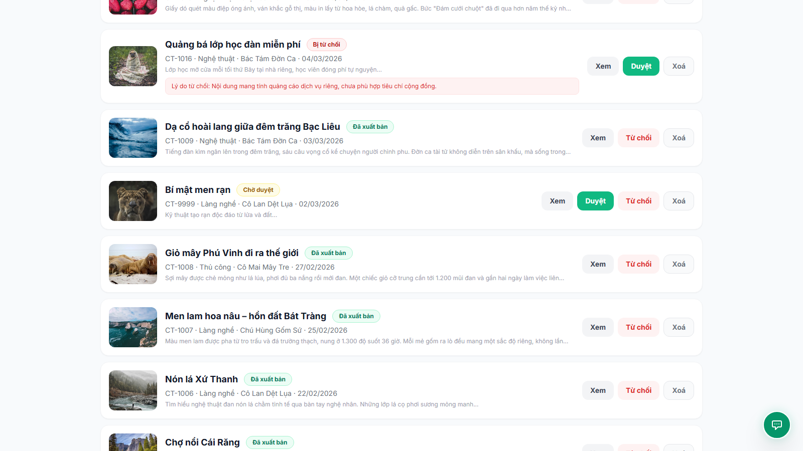
Notes:
Admin - Quan ly bai viet (admin.html) | luot cuon #1 | 12_admin-posts__01.png

Slide 28
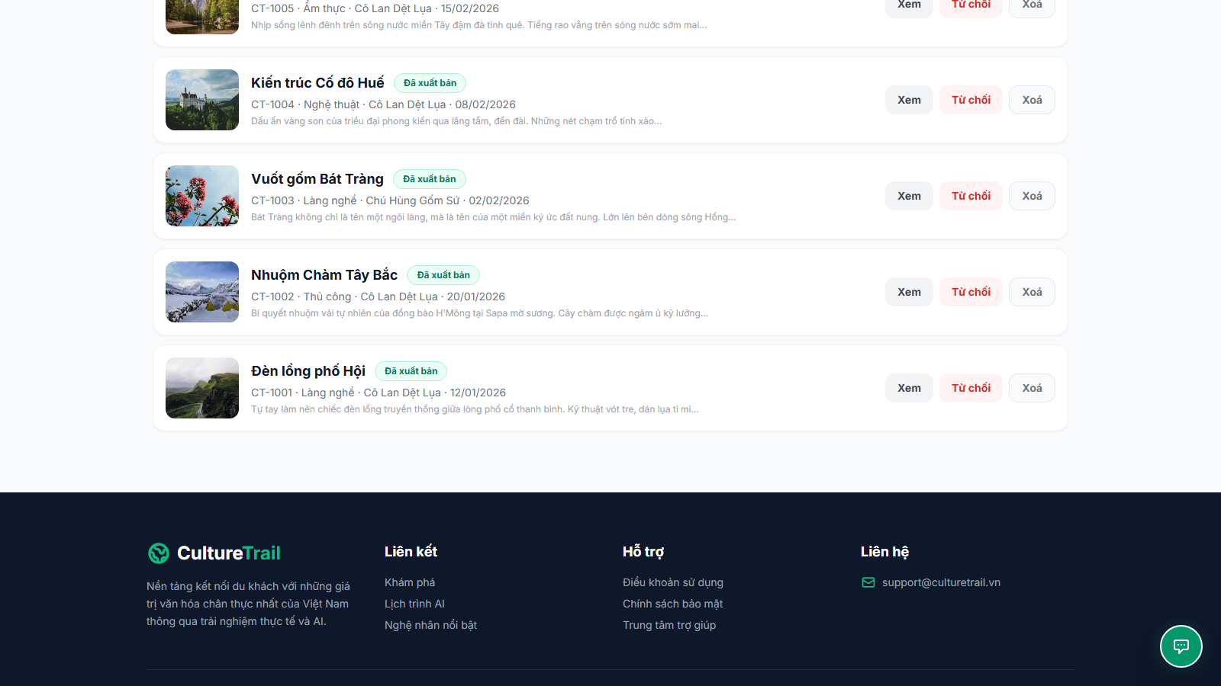
Notes:
Admin - Quan ly bai viet (admin.html) | luot cuon #2 | 12_admin-posts__02.png

Slide 29
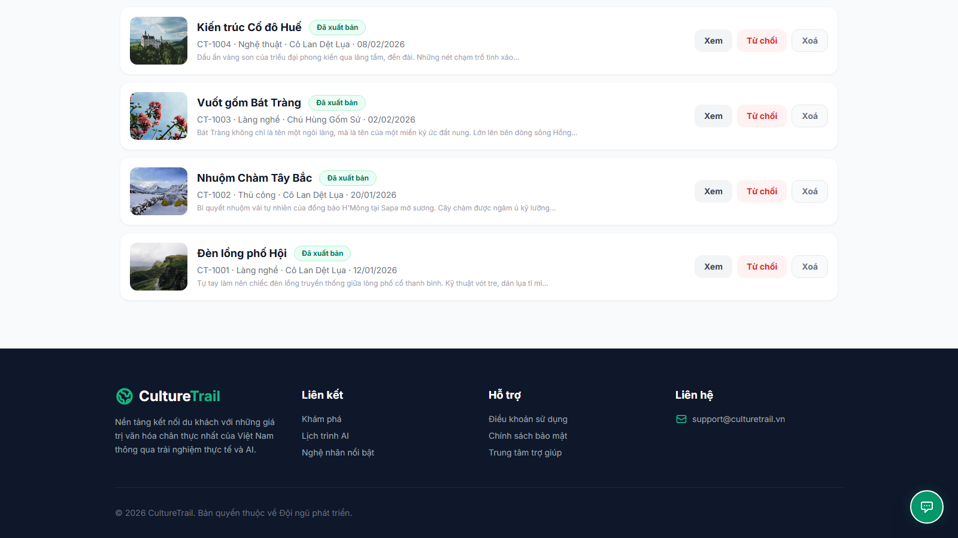
Notes:
Admin - Quan ly bai viet (admin.html) | luot cuon #3 | 12_admin-posts__03.png

Slide 30
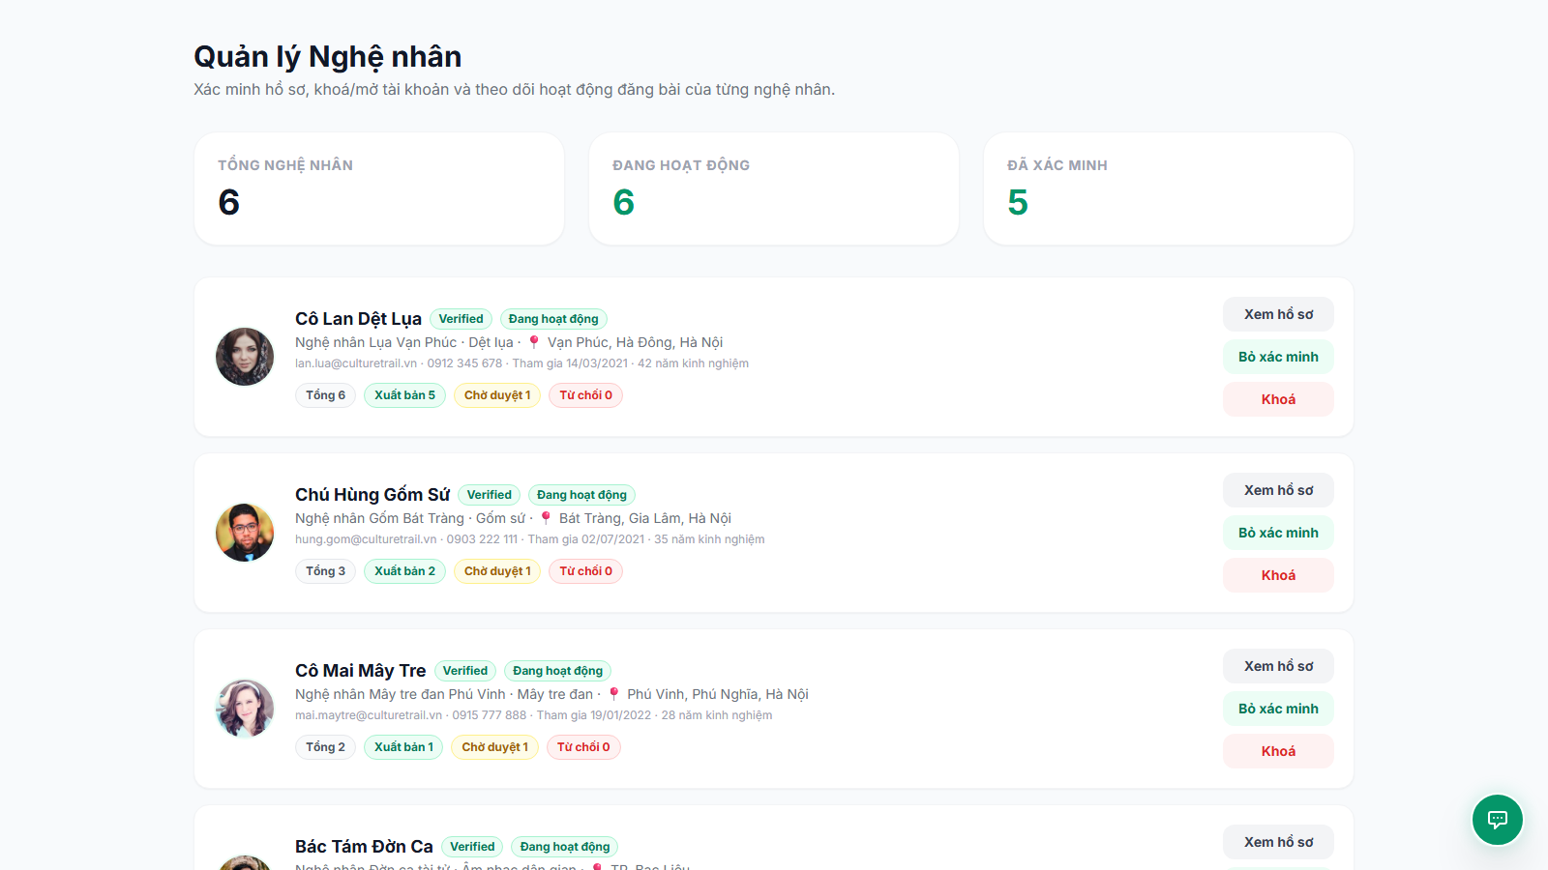
Notes:
Admin - Quan ly nghe nhan (admin.html) | luot cuon #0 | 13_admin-creators__00.png

Slide 31
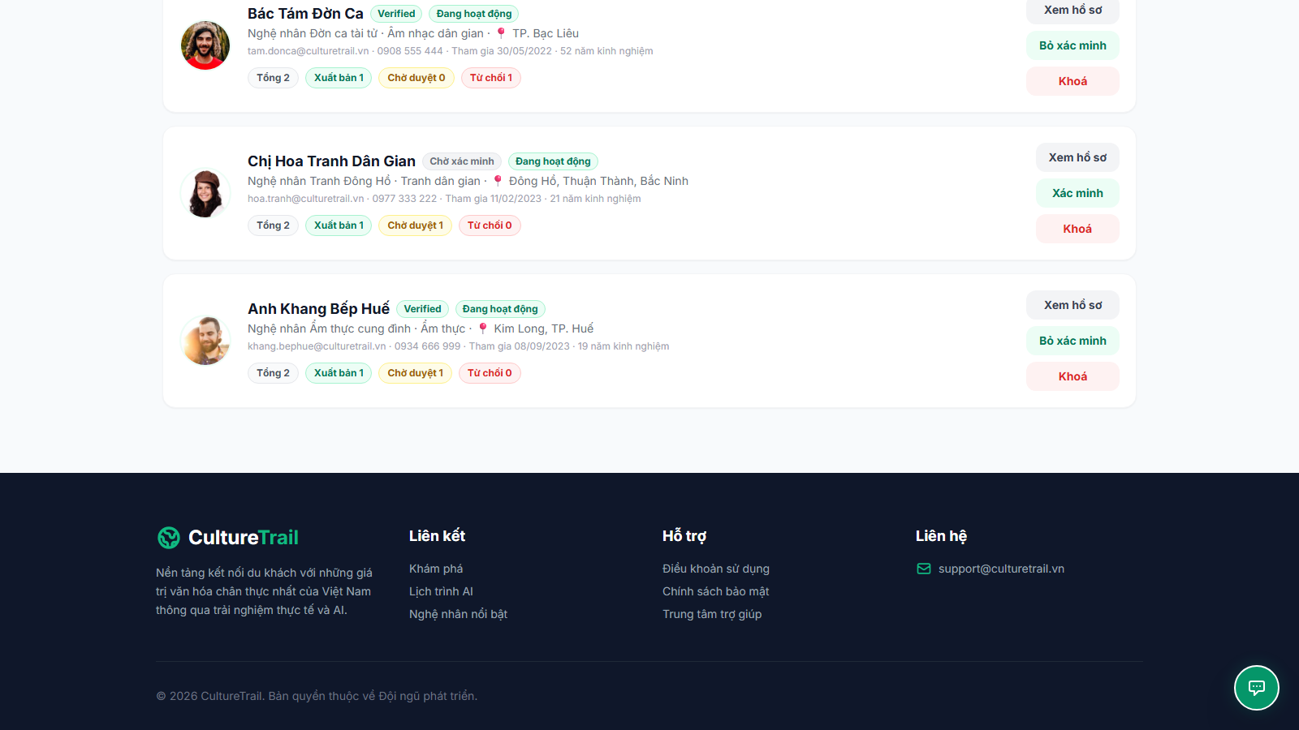
Notes:
Admin - Quan ly nghe nhan (admin.html) | luot cuon #1 | 13_admin-creators__01.png

Slide 32
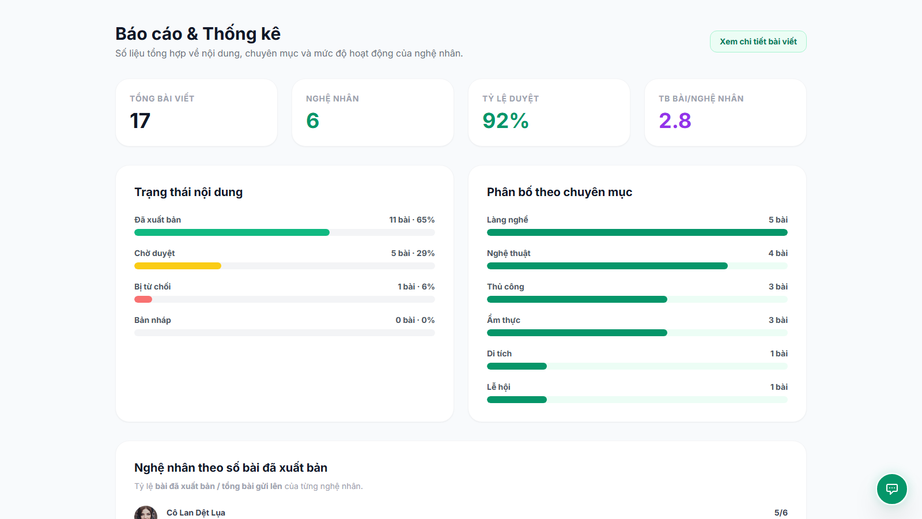
Notes:
Admin - Bao cao & thong ke (admin.html) | luot cuon #0 | 14_admin-reports__00.png

Slide 33
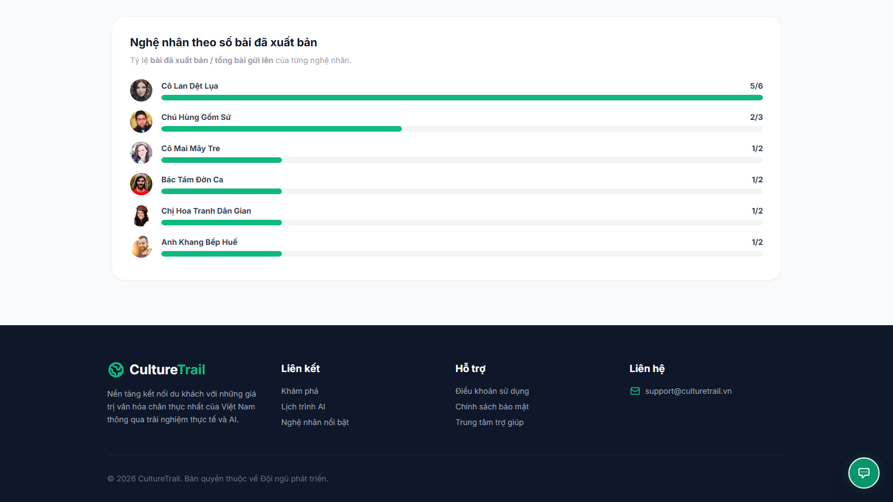
Notes:
Admin - Bao cao & thong ke (admin.html) | luot cuon #1 | 14_admin-reports__01.png

