Slide 1
Local and Global Attention Fusion Network For Facial Emotion Recognition
Minh-Hai Tran², Nhu-Tai Do¹, Tram-Tran Nguyen-Quynh², Soo-Hyung Kim ¹
¹ Chonnam National University, Department of Artificial Intelligence Convergence
² HCMC University of Foreign Language and Information Technology, Department of Information Technology,
tranminhhai1506@gmail.com, donhutai@gmail.com, tramtnq@huflit.edu.vn,
shkim@jnu.ac.kr

Slide 2
Agenda
1. Motivation
……………………………………………………………………………………………………………………………………………………………………………………….
2. Proposed method
……………………………………………………………………………………………………………………………………………………………………………………….
3. Experiments and Results
……………………………………………………………………………………………………………………………………………………………………………………….
4. Conclusion
……………………………………………………………………………………………………………………………………………………………………………………….

Slide 3
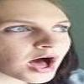
1. MOTIVATION
Problem definition:
Input: an facial image
Output: probabilities of seven classes
Model 1
Angry: 0%
Disgust: 0%
Fear: 0%
Surprise: 99%
Happy: 0%
Sad: 0%
Neutral: 0%
Fusion method
Model 2

Slide 4
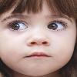
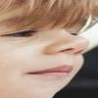
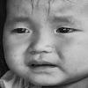
1. MOTIVATION
Late fusion
Problems: Fusion method
- Late fusion [1]: If both models are incorrect on one image, the outcome will be incorrect.
Model 1
Model 2
Question: How can Fusion model still learn?
Prediction
Prediction
Output
Output
Averaged
False , True, True, False
True , False, True, False
7 emotions
True , False, True, False
[1] K.Gadzicki, R.Khamsehashari, and C.Zetzsche ,“Early vs Late Fusion in Multimodal Convolutional Neural Networks ,”in 2020 IEEE 23rd International Conference on Information Fusion (FUSION), Jul. 2020, pp.1–6.doi:10.23919/FUSION45008.2020.9190246

Slide 5
1. MOTIVATION
Problems: Fusion method
- Early Fusion [1]: After the features are combined, the features will be further trained (learned) through the MLP layer and given the final result.
Model 1
Model 2
Question: But what if the features are already optimized?
512 feature
512 feature
Concatenation
MLP
Still learning
7 emotions
[1] K.Gadzicki, R.Khamsehashari, and C.Zetzsche ,“Early vs Late Fusion in Multimodal Convolutional Neural Networks ,”in 2020 IEEE 23rd International Conference on Information Fusion (FUSION), Jul. 2020, pp.1–6.doi:10.23919/FUSION45008.2020.9190246

Slide 6
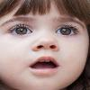
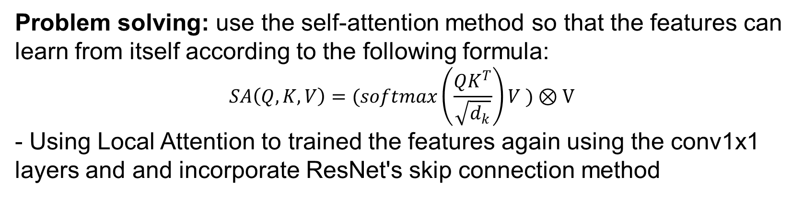

2. PROPOSED METHOD
Problem solving: use the self-attention method so that the features can learn from itself according to the following formula:
$$SA\left(Q,K,V\right)=(softmax\left(\frac{QK^{T}}{\sqrt{d_{k}}}\right)V )⊗V$$
- Using Local Attention to trained the features again using the conv1x1 layers and and incorporate ResNet's skip connection method
Feature Extraction
Model 1
Model 1’s Features
Key
concat
average
MLP
MLP
Value
Self-
Attention
$$⊗$$
Conv1D
7 emotions
+
a
Dense
Dense
Mean Features
Model 2’s Features
Query
Local attention
Model 2
Notes:
Our proposed method appears in the picture below, and it employs self-attention and local attention to address the problems outlined above.
We use a fusion method to combine the final features of two already trained emotion recognition models. The purpose of this combination is to reduce each model's errors while increasing their strengths.
This self-attention system can only be controlled by three parameters, Key, Query, and Value, and is calculated as follows.
It will be the softmax of Q multiplied by K transposition, then divided by the root of batch size d and multiplied by V again, and finally use element wise multiplication with V again.
The values Key, Query, and Value will be introduced in the next slide.
And We employ skip connections such as ResNet for local attention.
The following slide I'll go over the selt attention mechanism we employed.

Slide 7
2. PROPOSED METHOD
Features Extractor Details: include VGG11 [1], VGG13 [1], ResNet18[2], ResNet34 [2]
Self-attention Details:
Model1's features were a Key, while Model2's features were a Query.
The Value is the combination of two features from the two models, and it will be averaged again after going through the MLP with the model's two features.
Feature Extraction
Model 1
Model 1’s Features
Key
concat
average
MLP
MLP
Value
Self-
Attention
$$⊗$$
Conv1D
7 emotions
+
a
Dense
Dense
Mean Features
Model 2’s Features
Query
Local attention
Model 2
[1] K. Simonyanand A. Zisserman,“ Very Deep Convolutional Networks for Large-Scale Image Recognition,” in 3rd International Conference on Learning Representations, ICLR 2015-Conference Track Proceedings, Sep.2015, vol.3, no.1, pp.1–14, doi:10.1016/j.infsof.2008.09.005
[2] K. He, X. Zhang, S. Ren, and J. Sun,“ Deep Residual Learning for Image Recognition, ”presented at the Proceedings of the IEEE Conference on Computer Vision and Pattern Recognition, 2016, pp.770–778.

Slide 8
2. PROPOSED METHOD
Local attention details:
The model learn and comprehend information more effectively from a local spatial context and removes noises with two fully connected layers (Dense) and a Conv1D layer
The residual connection is used to prevent the loss of unintended input features
Feature Extraction
Model 1
Model 1’s Features
Key
concat
average
MLP
MLP
Value
Self-
Attention
$$⊗$$
Conv1D
7 emotions
+
a
Dense
Dense
Mean Features
Model 2’s Features
Local attention
Model 2

Slide 9
3. EXPERIMENTS AND RESULTS
Dataset:
- RAF-DB [1] : 3,068 images for testing and 12,271 for training in Basic emotions set
Training features extractor model and Fusion model
Image size: 224x224x3
Input Fusion model: 1x512
Learning: 0.001
Optimizer: RAdam
Loss: Categorical_CrossEntropy
ReduceLROnPlateau
50 epochs
[1] S. Li, W. Deng, and J. Du, “Reliable Crowd sourcing and Deep Locality – Preserving Learning for Expression Recognition in the Wild , ” in 2017 IEEE Conference on Computer Vision and Pattern Recognition (CVPR), Honolulu, HI:IEEE, Jul.2017, pp.2584–2593.doi:10.1109/CVPR.2017.277

Slide 10
3. EXPERIMENTS AND RESULTS
Baseline results on testing set
Model | Resnet18 | Resnet34 | VGG11 | VGG13
Accuracy on Raf-DB | 85.3% | 85.5% | 85.23% | 85.2%
→ Results of the models are very comparable.
[1] S. Li, W. Deng, and J. Du, “Reliable Crowd sourcing and Deep Locality – Preserving Learning for Expression Recognition in the Wild , ” in 2017 IEEE Conference on Computer Vision and Pattern Recognition (CVPR), Honolulu, HI:IEEE, Jul.2017, pp.2584–2593.doi:10.1109/CVPR.2017.277

Slide 11
3. EXPERIMENT AND RESULTS
Fusion results on testing set
Fusion method | Model 1 | Model 2 | Accuracy
Late Fusion | Resnet18 | Resnet34 | 86.35%
 | VGG11 | VGG13 | 86.08%
 | VGG13 | Resnet34 | 85.98%
 | VGG11 | Resnet34 | 86.08%
Early Fusion | Resnet18 | Resnet34 | 86.66%
 | VGG13 | Resnet34 | 85.49%
 | VGG11 | Resnet34 | 86.08%
Joint Fusion | Resnet18 | Resnet34 | 86.05%
 | VGG13 | Resnet34 | 86.63%
 | VGG11 | Resnet34 | 86.40%
Our method | Resnet18 | Resnet34 | 90.95%
 | VGG13 | Resnet34 | 90.92%
The results reveal that our method outperforms all of the other fusion methods by roughly 4%.
Other methods have results ranging from about 85.5% to 86.60%

Slide 12
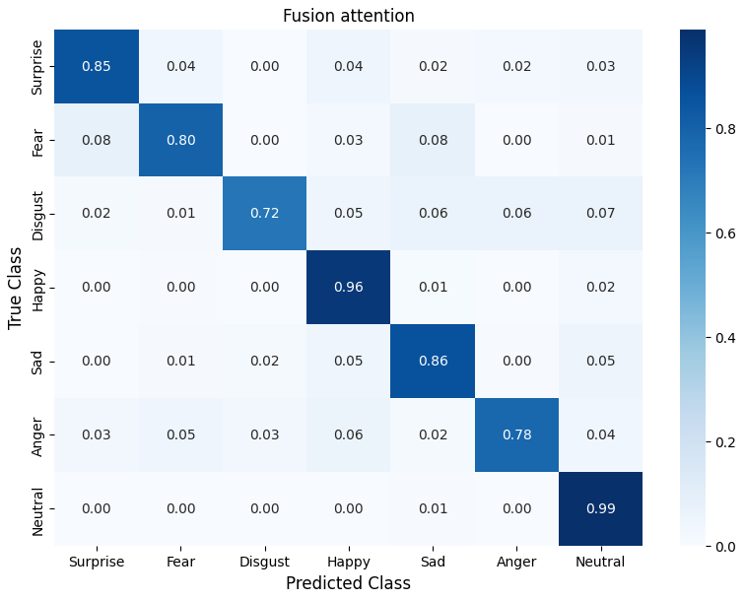
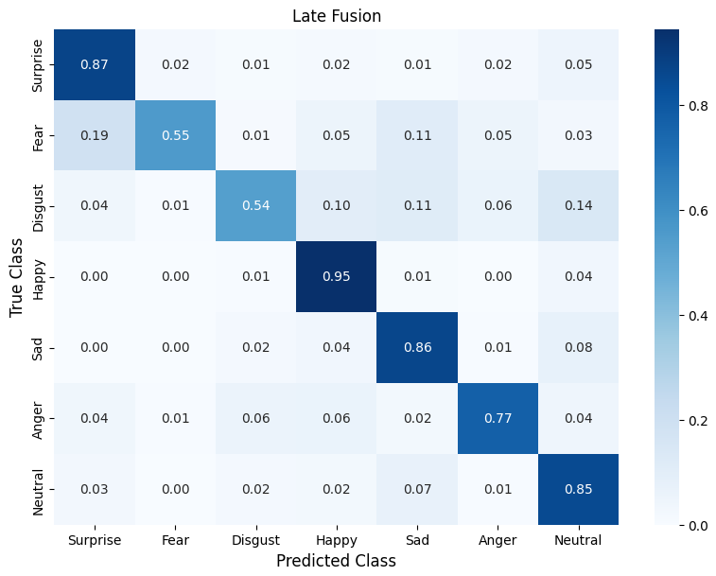
3. EXPERIMENTS AND RESULTS
Confusion Matrix of two fusion methods using ResNet18 and ResNet34
We can see the Disgust and Fear classes are greatly improved, up to 80%

Slide 13
3. EXPERIMENTS AND RESULTS
Ablation Study
 | Model 1 | Model 2 | Accuracy
Late Fusion without attention | Resnet18 | Resnet34 | 86.66%
Late Fusion without attention | VGG13 | Resnet34 | 85.49%
Using both attention | Resnet18 | Resnet34 | 90.95%
 | VGG13 | Resnet34 | 90.92%
Using only Self attention | Resnet18 | Resnet34 | 90.55%
 | VGG13 | Resnet34 | 90.50%
It can be seen that without Local attention, the model still works well. Local attention is used, the model has a small difference of 0.4%.

Slide 14
4. Conclusion
We successfully addressed the problem of being able to continue training by each feature separately when utilizing the Fusion method.
We have successfully compared with the old association models and made an amazing improvement on the RAF-DB dataset
Future research may focus on how effectively the suggested approach works with other datasets and related tasks
- In addition, we will proceed to combine more models instead of two models

Slide 15
THANK YOU FOR LISTENING

