Slide 1


Project :Prius Car Sharing LLC
Prius Team:
Dinh Thang Nguyen - 616940
Giao Hieu Tran - 616944

Slide 2
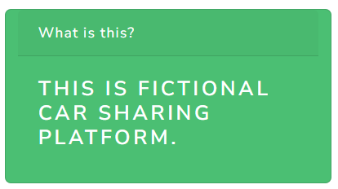
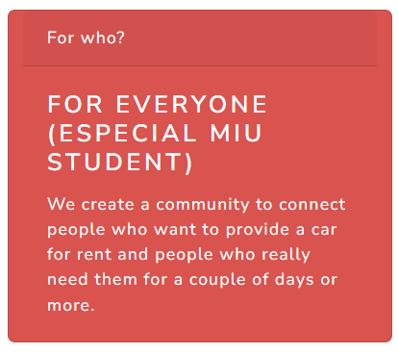
About Project

Slide 3
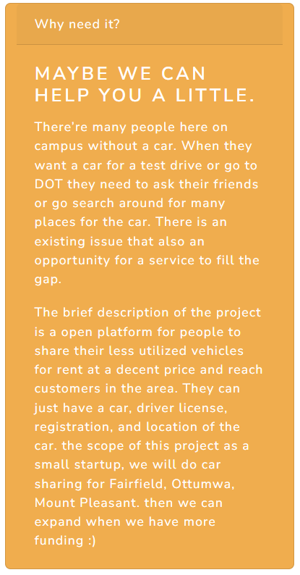
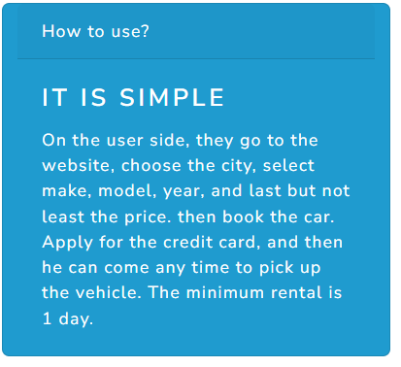
About Project

Slide 4
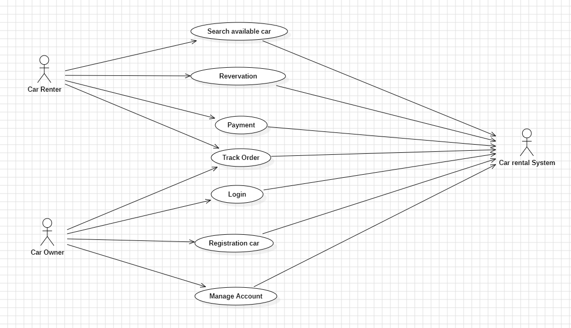
Use case Diagram

Slide 5
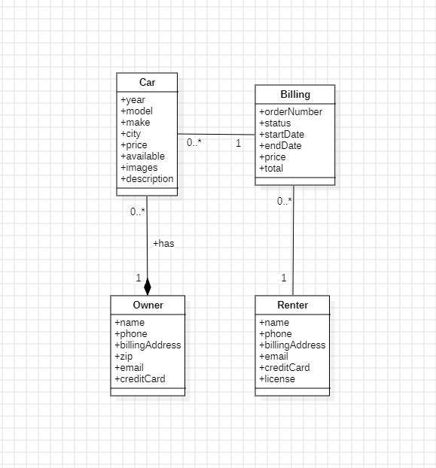
Class Diagram

Slide 6
Architecture Overview
Back-End Architecture(MVC) use node.js with express
User Interface (UI) use html, css, javascript and bootstrap
API Listing
SOLID Principles

Slide 7
BE MVC architecture
Models: Car.js, Renter.js, Owner.js, Billing.js
Controllers: renterController.js, carController.js, ownerController.js, billController.js
Routers: renterRouter.js, carRouter.js, ownerRouter.js, billRouter.js

Slide 8
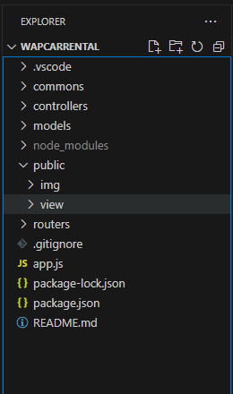
Source code structure
commons: contains Helper, Extensions, Tools
controllers: contains Controllers
models: contains Models
public
/img: contains images
/view:contains file html, css and js
routers: contains Routers
app.js: start up & config app

Slide 9
API listing
Car Router /car/api/cities GET all available cities
/car/api/makes GET all available makes based on city
/car/api/models GET all models based on user user preference of city and make
/car/api/years GET all model years based on preference of city, make, model
/car/api GET available cars based on city, make, model, year
/car/api POST create new car
/car/api/:id GET a car based on id
/car/api/:id PUT update the car information
/car/api/:id DELETE car by id
/car/api/:id/images POST new image to car
/car/api/:id/images: DELETE remove image from car
/car/api/today-pick/:limit GET get top pick today for home page
/car/api/affordable/:limit GET get cheapest cars on the site
/car/api/hot-pick/:limit GET get most booked cars on the site
/car/: id GET get html file

Slide 10
API listing
Billing Router
/billings/api/:id GET a bill based on id
/billings/api/track-order/:email/:order GET bill by order number and email
/billings/api/track-email/:email/:license GET all bills of this renter with license and email
/billings/api/:id/:orderId/ GET bill by renter id order id
/billings/api/pay POST pay for current bill and release the car afterward
/billings/api/cancel POST cancel the current bill and release the car as well
/billings/track-order GET get html file for track order
/billings/track-email GET get html file for track email

Slide 11
API listing
Owner Router /owners/api/login POST login for owner
/owners/api/:id GET get owner by Id
/owners/api/:od POST create owner
/owners/api/:id PUT update owner by Id
/owners/api/:id DELETE delete owner by Id
/owners/api/:id/cars GET get car list by owner id
/owners/api/:id/billings GET get billing list by owner id
/owners GET get Owner Login page
/owners/register GET get Owner Register page
/owners/:id GET get Owner Detail page
/owners/:id/cars GET get Owner Car Management page
/owners/:id/cars/:carId GET get Car Detail’s Owner page
/owners/:id/cars/add GET get Car Registation’s Owner page
/owners/:id/billings GET get Owner Billings Management page
/owners/:id/billings/:bilingid GET get Billing Detail’s Owner page

Slide 12
API listing
Renter Router
/ rent/api POST a user credit card and information, save it and create a bill based on this renter information. And put the car as unavailable for others
/rent GET get html file for rent page
/rent/:renterId/billing/:billId GET page for detail billing

Slide 13
API listing
App
/ GET get Homepage
/upload POST upload image

Slide 14
API listing
About Router
/abouts GET get About page

Slide 15

Dependencies
Express: acts as a middleware to help with the creation of web servers and the definition of routes.
Multer: is a middleware for handling multipart/form-data, which is primarily used for uploading files in forms

Slide 16
Features for Car Owner
Car Owner
Manage Account
Registation
Delete Account
Manage Cars
Add car
Edit car
Delete car
Manage Billings
Update Information

Slide 17
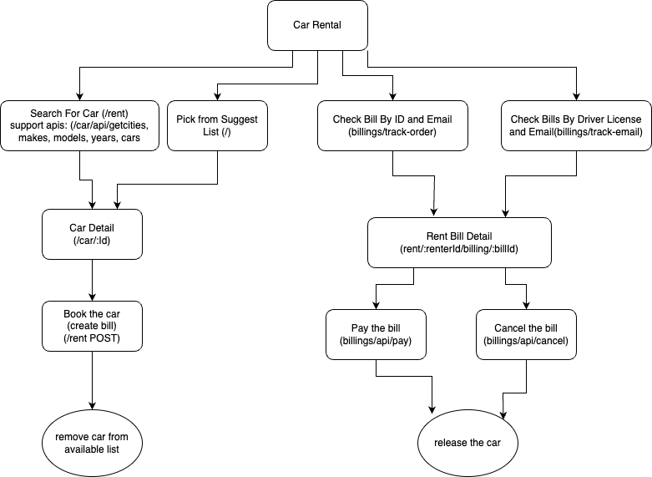
Features for Car Renter

Slide 18
Challenges Faced
Some features need to access multiple data tables, or the data must go through some queries such as : get billings for the owner. Filter the cars to match user preferences
UI must be user-friendly and easy to use and operate.
Rent a car should be frictionless, as less steps as possible

Slide 19
Future Enhancements
Website needs more security for user
Real Database
Improve search capabilities for renter user

Slide 20
Demo

Slide 21
THANK YOU!

