Slide 1
CSS Basics
Web Full Stack

Slide 2
Introduction: What is CSS?
CSS stands for Cascading Style Sheet
It determines how a HTML document is presented.
CSS is crucial in designing and creating websites. It allows you to control the layout, looks and feel, visual effects and even allow websites to adapt dynamically on different screen sizes and devices.

Slide 3
Brief summary of today yay!
Introduction (last slide)
This slide
CSS Syntax
Common CSS Selectors
Common CSS Properties
Styling our very romantic love letter

Slide 4
p { color: red; }

Slide 5
p { color: red; }
Selector
Property
Value

Slide 6
#nav-bar p:hover {
color: red;
text-align: center;
width: 520px;
}

Slide 7
4. Common CSS Selectors
Tag Selector:
h5 { … }
p { … }
Class Selector:
.main_menu { … }
.container { … }
ID Selector
#popup { … }
#wrapper { … }
Attribute Selector
[title] { … }
input[type=text] { … }

Slide 8
4. Common CSS Selectors (2) - Relationship & States
And Selector
.car, .bike { … }
#site_banner, .nav_bar { … }
Child Selector
ul li { … }
.nav_bar a { … }
Direct Child Selector
ul>li { … }
.nav_bar>a { … }
Pseudo-class
p:hover { … }
a:active { … }

Slide 9
A detailed list of CSS Selectors is available at
http://www.w3schools.com/cssref/css_selectors.asp

Slide 10
5. Common CSS Properties
font
font-family
font-size
font-style
font-weight
text
color
text-align
text-decoration
background
background-color
background-image

Slide 11
5. Common CSS Properties (2)
border
border-color
border-style
border-width
border-radius
size
width
height
padding
margin

Slide 12
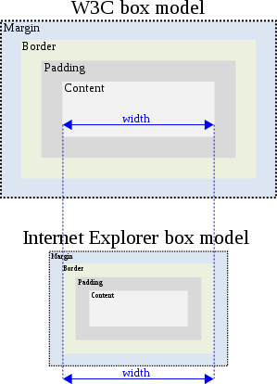
box-sizing: content-box;
box-sizing: border-box;

Slide 13
5. Common CSS Properties (3)
display
inline
block
inline-block
none

Slide 14
A detailed list of CSS Properties is available at
http://www.w3schools.com/cssref/

