Slide 1
Web

Slide 2
Summary brief of today
Introduction
Back end and Front end
What is Nodejs
Hello world app
Npm
Host your CI Project in local

Slide 3
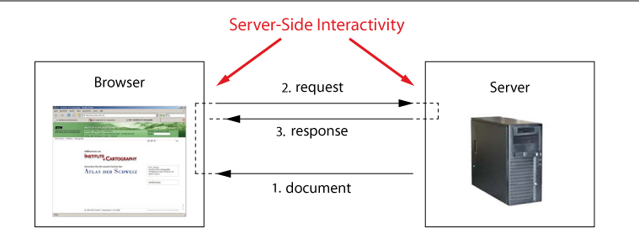
Introduction
A collection of web page
It has client-side and server-side

Slide 4

Front end
The part of the web that you can see and interact with :
Web design
HTML, CSS, Javascript

Slide 5
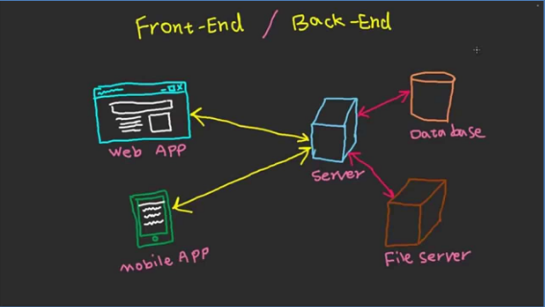
Back end
Server
Application
Database

Slide 6
Node.js
Node.js® is a JavaScript runtime built on Chrome's V8 JavaScript engine.
Javascript, Server-Side
Really fast (dev and performance)
Npm (Node package manager)

Slide 7








Top website build by Node.js

Slide 8
First app
Hello world
Readfile
Require :
Major nodejs
Your own file
Third party library : Npm install

Slide 9
Npm
Node package manager
Basic command :
Npm init (set up npm trong file package.json)
npm install <tên package> (cài đặt 1 hoặc nhiều node modules, nếu không điền tên thì sẽ mặc định cài những thư viện trong file package.json).
Additional parameter :
-g : cài đặt global cho máy
--save : save package vào dependencies

