Slide 1
Restaurant Management
System

Slide 2
Group 9
Dương Đình Trung
1814498
Đặng Gia Lệ
1812791
Vũ Hoàng Anh Khôi
1811013
Vũ Lê Thiện Minh
1852590
About us

Slide 3
ER Model
Normal Forms
Security
Query, Trigger, Index
Demo
Content

Slide 4
1. ER MODEL

Slide 5
Our Purpose
Restaurant
Customer
Store the information of employee, dishes, orders, customers.
Can order the dishes and make reservations.

Slide 6
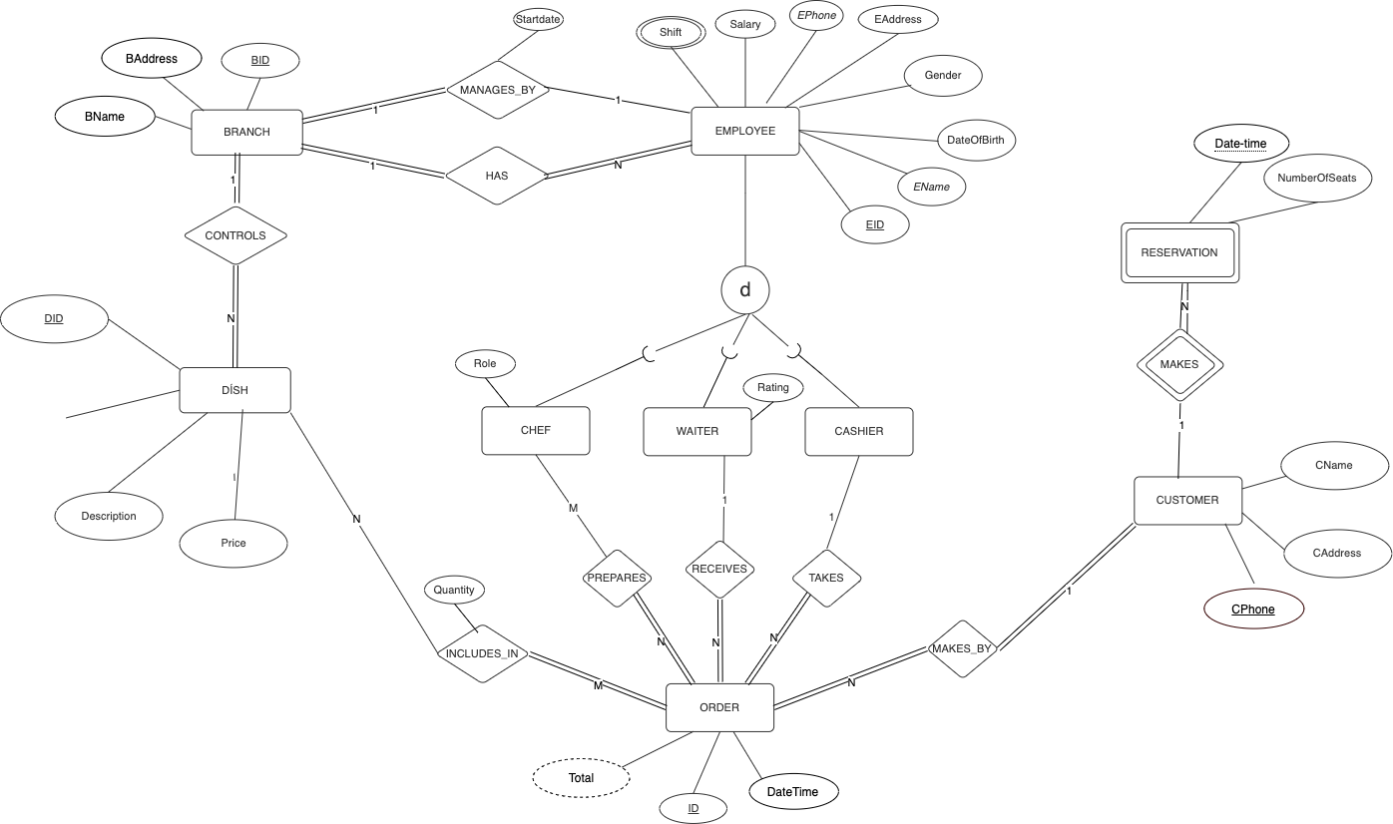
The slide title goes here!
DName

Slide 7
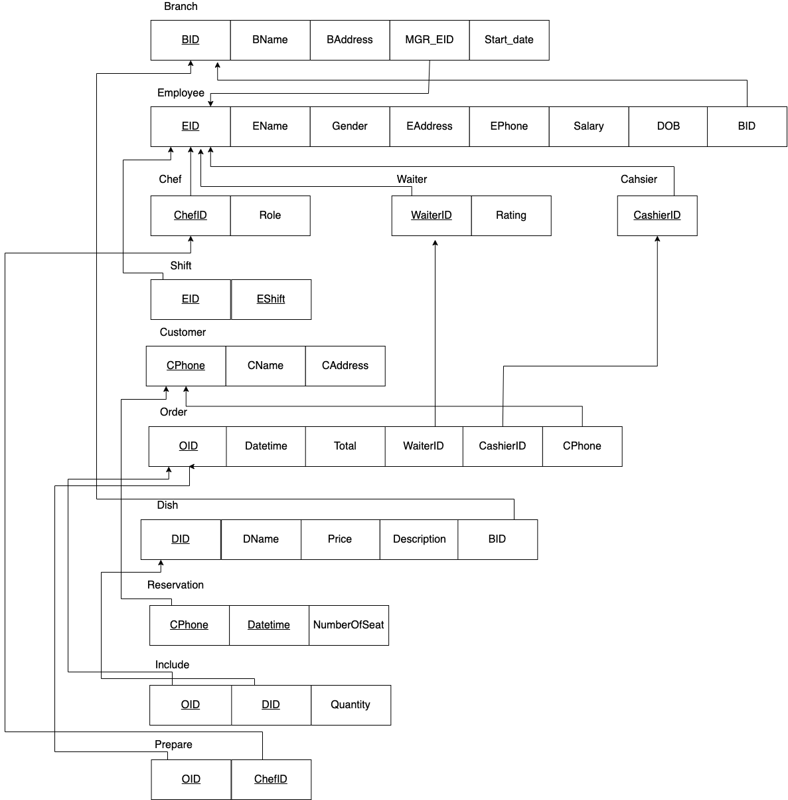
Relational
Mapping
‹#›

Slide 8
2. Normalization

Slide 9
Normalization
Minimize the redundancy in relations
● First normal form(1NF)
● Second normal form(2NF)
● Third normal form(3NF)
● Boyce & Codd normal form (BCNF)

Slide 10
First normal form(1NF)
A relation is in 1NF if:
only have single (atomic) valued attributes

Slide 11
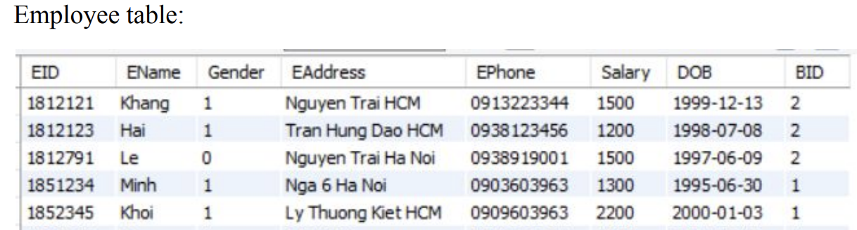

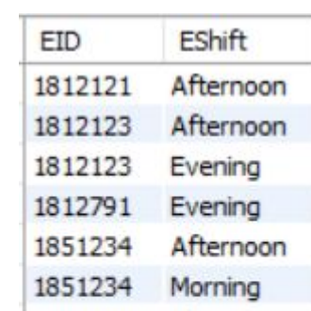

Slide 12
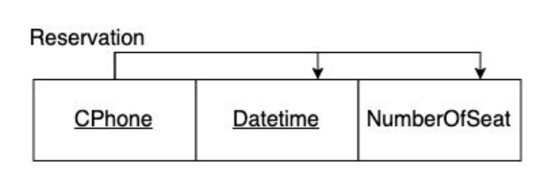
Second normal form(2NF)
A relation is in 2NF if:
be in 1NF
must not contain any partial dependency

Slide 13
Third normal form(3NF)
A relation is in 3NF if:
be in 2NF
no transitive dependency for non-prime attributes

Slide 14
3. Security

Slide 15
Database Security
We use Discretionary Access Control as a database security mechanism.
We create a new ‘Manager’ user and grant all access rights (SELECT, UPDATE, DELETE, INSERT) of all the tables.
We also implement some views and procedures for the Manager to use inside the application.

Slide 16
4. Query, Trigger, Index

Slide 17


Query
Retrieve the EID, names of all cashiers in the branch which are located in HCM
Result:

Slide 18
Employee
Constraints:
Employees in the company must be 18 years old or older.
Gender of Employees must be only 1 (male) or 0 (female).
Solution: Write triggers for table Employee to check every time insert a new employee

Slide 19
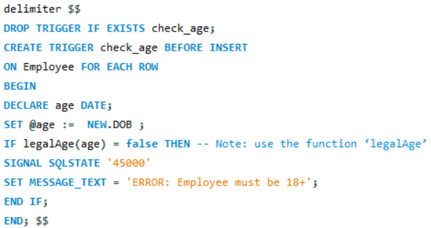
Trigger check_age

Slide 20
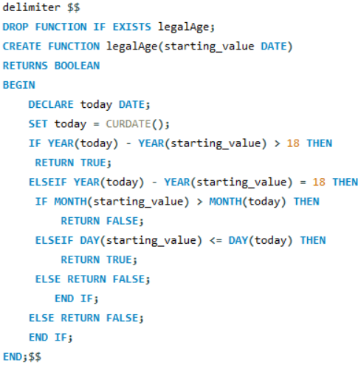
Function legalAge()

Slide 21
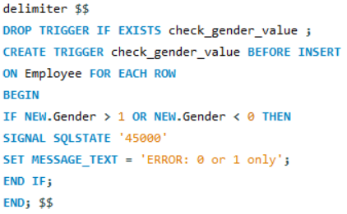
Trigger check_gender_value

Slide 22
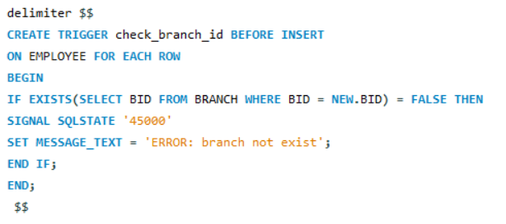
Trigger check_branch_id

Slide 23
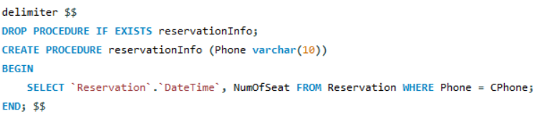
Procedure reservationInfo

Slide 24
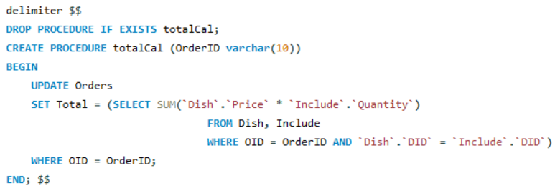
Procedure totalCal

Slide 25
Indexing
Employee
Employee ID (EID)
Employee Name (EName)
Reservation
Customer Phone (CPhone)
‹#›

Slide 26
5. Demo

Slide 27
Thanks!
Does anyone have any questions?

