Slide 1



Workshop on e-Government development

Slide 2
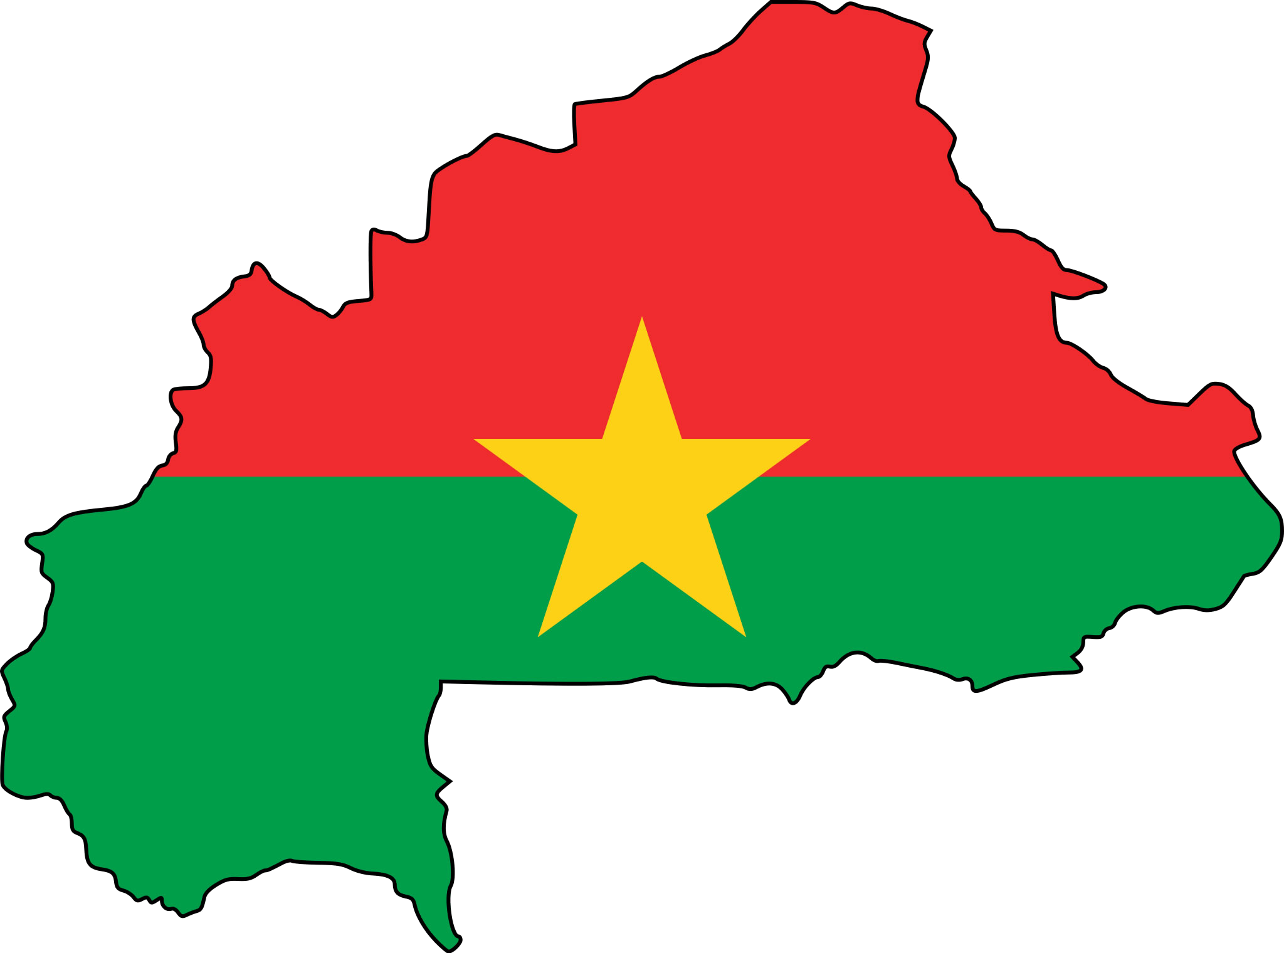
e-Government Report
Burkina Faso

Slide 3
Overview of e-Government development
Outline
Our work
Current problems and challenges
Study case of a successful: "SIGASPE"

Slide 4
Overview of e-Government development

Slide 5
“e-Government” according to the government
Goals
Public administration
ICT
to improve the quality of public services
to promote interaction between companies
to strengthen citizen participation through access to information
to reinvent the administrative processes to achieve good governance

Slide 6
Government vision
The vision of Burkina Faso about e-Government:
“a modern, equitable, transparent, and efficient administration for citizens and users thanks to ICT”

Slide 7
Strategic axes
Five (05) axes :
reinforcement of juridical and institutional environment
reinforcement of communication infrastructures and administration's computation commodities
virtualization of administrative procedures and online services development
development and valorization of public agents’ e-competency
improvement of citizens and users’ accessibility to online services

Slide 8
Related sectorial cyberstrategies
e-Health and social protection,
e-Education,
e-Commerce,
e-Services for rural population
e-Gov
e-Services
e-Commerce
e-Education
e-Health

Slide 9
Our work

Slide 10
Head Office of IT Services (Direction Générale des Services Informatiques,’DGSI’ Fr.)
1/4
The Head Office of IT Services mission is to ensure the coordination and implementation of the computerization policy of Ministry of Economy, Finance and Development.

Slide 11
Head Office of IT Services (Direction Générale des Services Informatiques,’DGSI’ Fr.)
2/4
to develop, to update and to implement the IT Master Plan of the ministry;
to study and to develop software within the department;
to coordinate the monitoring of the operation and maintenance of IT applications within the department;
Duties

Slide 12
Head Office of IT Services (Direction Générale des Services Informatiques,’DGSI’ Fr.)
3/4
to manage the IT infrastructure of the ministry;
to provide training and user support;
to follow the installation and administration of networks and systems infrastructures;
Duties

Slide 13
Head Office of IT Services (Direction Générale des Services Informatiques,’DGSI’ Fr.)
4/4
to ensure consistency, security and development of the computer system of the ministry in accordance with the national scheme;
to enforce technical standards and norms of the computerized information system.
Duties

Slide 14
Current results of e-Governance
Computer softwares (SIGASPE,CID,CIR,SIMP, …)
e-Council
OpenData platform (http://data.gov.bf/)
G-Cloud

Slide 15
Current problems and challenges

Slide 16
Problems
1/2
lack of communication infrastructures
many projects without financial support
security threats
difficulties in the coordination of projects

Slide 17
Problems
2/2
lack of human resources
incompleteness of the existing legislative and regulatory framework in relation to cyberspace
absence of a national Public Key Infrastructure (PKI)

Slide 18
Challenges
1/2
to increase communication infrastructures
to implement a mechanism for financing current and future projects
to improve the global security of information system and infrastructures

Slide 19
Challenges
2/2
to develop ICT skills
to develop the culture of "digital" in all levels of education
further easy access to ICT by the population

Slide 20
Study case of a successful: "SIGASPE"

Slide 21
What is ‘SIGASPE’?
« SIGASPE » is the public employees integrated administrative and salary management system.
The functionalities of ‘SIGASPE’ are:
Career Management
Balance Management

Slide 22
Results about “SIGASPE”
integrated tool for staff management and directly accessible to the actors
single data entry
folders imposed and controlled courses
availability of information in real time with guaranteed confidentiality, integrity, and authenticity .
getting summary or detailed information
better communication among actors in staff management

Slide 23
Thank you!

Slide 24
Question?

Slide 25




Burkina Faso
The Republic Of China (Taïwan)

