Slide 1
Java Streams
Van Quach , Pankaja A

Slide 2
Topics
Introduction to Streams.
Motivation
Collections and Java Streams
Stream Operations
Stream methods
Examples

Slide 3
What is Stream
Abstract layer – java 8.
Process data in declarative way
Leverage Multicore architecture

Slide 4
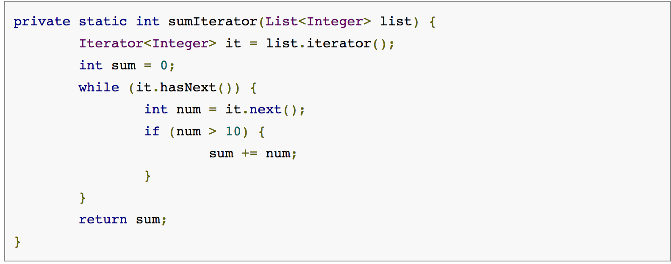
Why Streams
External Iteration
Sequential execution
Lot of Code

Slide 5
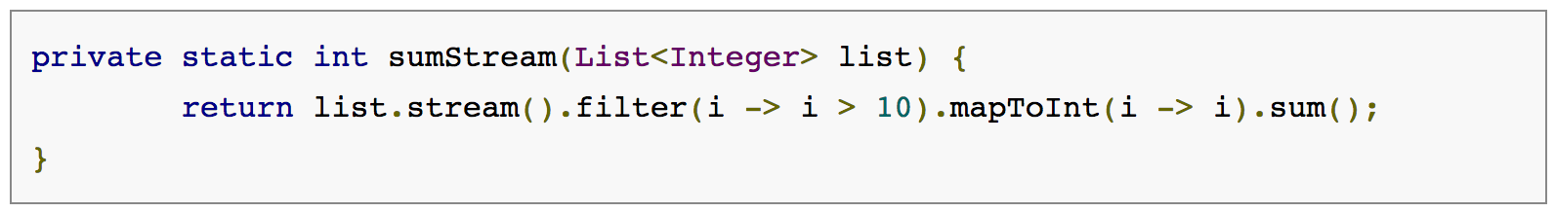
Why Streams
Internal Iteration
Sequential and Parallel execution
Less code

Slide 6
Generating a Stream
Sequential: stream()
Parallel: parallelStream()

Slide 7
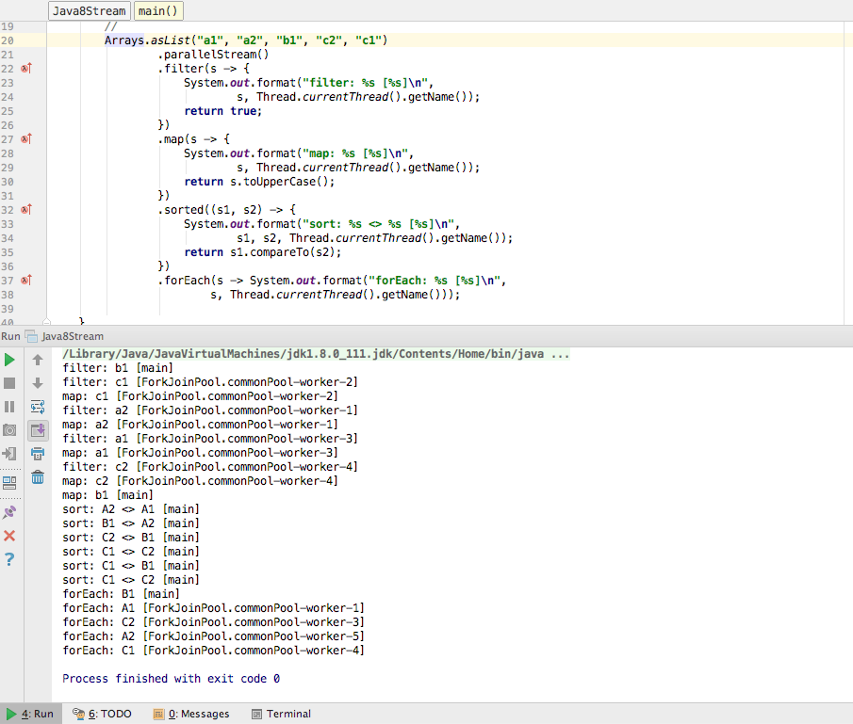
Parallel Stream
Executed in Parallel
ForkjoinPool.commonPool()
Sort done sequentially

Slide 8
Collections and Java Stream
Computed on-demand.
Use of functional interfaces
Internal iteration
Consumable
Sequential and parallel processing
java.util.stream package.

Slide 9
Characteristics of a Stream
Sequence of elements
Source
Aggregate operations
Pipelining
Automatic Iterations

Slide 10
Stream Formula
Source
[.Intermediate Operations]*
Terminal Operation

Slide 11
Creating Streams
Must have a Source
Collections: myList.stream() or myList.parallelStream()
Arrays: Arrays.stream(myArray) or Stream.of(myArray)
Individual values: Stream.of(o1, o2, o3)
Stream Builder: Stream.Builder sb = Stream.builder(); sb.accept(s1); sb.accept(s2); Stream s = sb.build(). …;
Generator functions: Stream.generate(new Random()::nextDouble).forEach(System.out::println);
Notes:
Stream Builder:
Stream.Builder sb = Stream.builder(); sb.accept(s1); sb.accept(s2); Stream s = sb.build(). …;
or
Stream s = Stream.builder().add(s1).add(s2).build();
Generator:
Stream.generate(new Random()::nextDouble).forEach(System.out::println);

Slide 12
Stream operations
Source
Intermediate operations - return another stream, does NOT perform any actions until terminal operations are called
Stateless (filter, map, etc.): retain no state from previously seen elements.
Stateful (distinct, sorted): may incorporate state from previously seen elements
Terminal operations: stream is considered consumed after terminal operation called.
Short-circuiting operations: for infinite input streams
Intermediate short-circuiting operations (limit): MAY produce a finite stream from infinite stream
Terminal short-circuiting operations (findFirst, findAny, etc.): MAY terminate in finite time
Notes:
Stream operations are divided into intermediate and terminal operations, and are combined to form stream pipelines. A stream pipeline consists of a source (such as aCollection, an array, a generator function, or an I/O channel); followed by zero or more intermediate operations such as Stream.filter or Stream.map; and a terminal operation such as Stream.forEach or Stream.reduce.
Intermediate operations return a new stream. They are always lazy; executing an intermediate operation such as filter() does not actually perform any filtering, but instead creates a new stream that, when traversed, contains the elements of the initial stream that match the given predicate. Traversal of the pipeline source does not begin until the terminal operation of the pipeline is executed.
Terminal operations, such as Stream.forEach or IntStream.sum, may traverse the stream to produce a result or a side-effect. After the terminal operation is performed, the stream pipeline is considered consumed, and can no longer be used; if you need to traverse the same data source again, you must return to the data source to get a new stream. In almost all cases, terminal operations are eager, completing their traversal of the data source and processing of the pipeline before returning. Only the terminal operations iterator() and spliterator() are not; these are provided as an "escape hatch" to enable arbitrary client-controlled pipeline traversals in the event that the existing operations are not sufficient to the task.
Processing streams lazily allows for significant efficiencies; in a pipeline such as the filter-map-sum example above, filtering, mapping, and summing can be fused into a single pass on the data, with minimal intermediate state. Laziness also allows avoiding examining all the data when it is not necessary; for operations such as "find the first string longer than 1000 characters", it is only necessary to examine just enough strings to find one that has the desired characteristics without examining all of the strings available from the source. (This behavior becomes even more important when the input stream is infinite and not merely large.)
Intermediate operations are further divided into stateless and stateful operations. Stateless operations, such as filter and map, retain no state from previously seen element when processing a new element -- each element can be processed independently of operations on other elements. Stateful operations, such as distinct and sorted, may incorporate state from previously seen elements when processing new elements.
Stateful operations may need to process the entire input before producing a result. For example, one cannot produce any results from sorting a stream until one has seen all elements of the stream. As a result, under parallel computation, some pipelines containing stateful intermediate operations may require multiple passes on the data or may need to buffer significant data. Pipelines containing exclusively stateless intermediate operations can be processed in a single pass, whether sequential or parallel, with minimal data buffering.
Further, some operations are deemed short-circuiting operations. An intermediate operation is short-circuiting if, when presented with infinite input, it may produce a finite stream as a result. A terminal operation is short-circuiting if, when presented with infinite input, it may terminate in finite time. Having a short-circuiting operation in the pipeline is a necessary, but not sufficient, condition for the processing of an infinite stream to terminate normally in finite time

Slide 13
Stream intermediate operations
Transform
Aggregate
Find

Slide 14
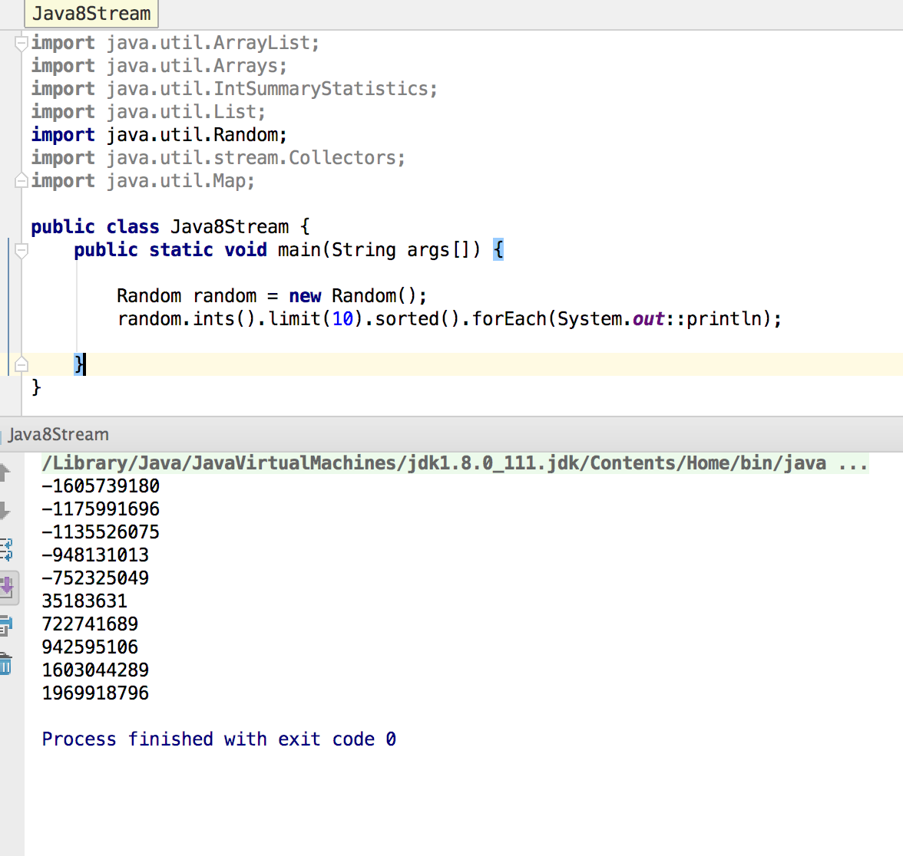
Stream methods
For each – iterates each element of the stream
Limit – Reduces the size of the stream.
Sorted - Sorts the stream.

Slide 15
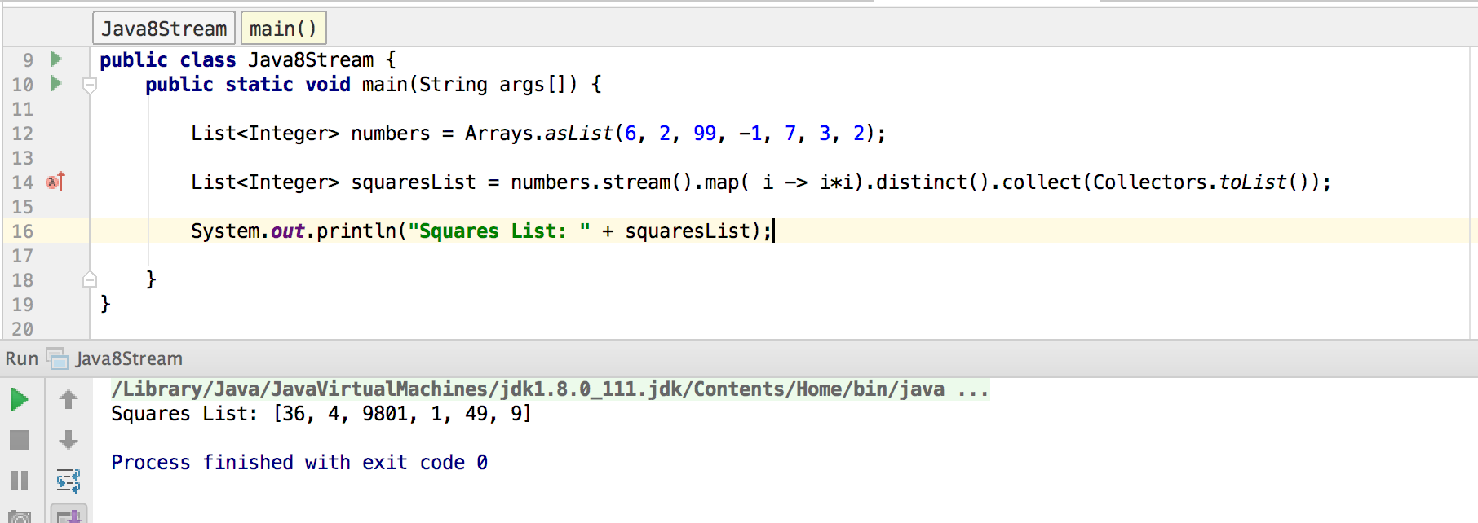
Stream methods
Map – Map each element to its corresponding result.

Slide 16
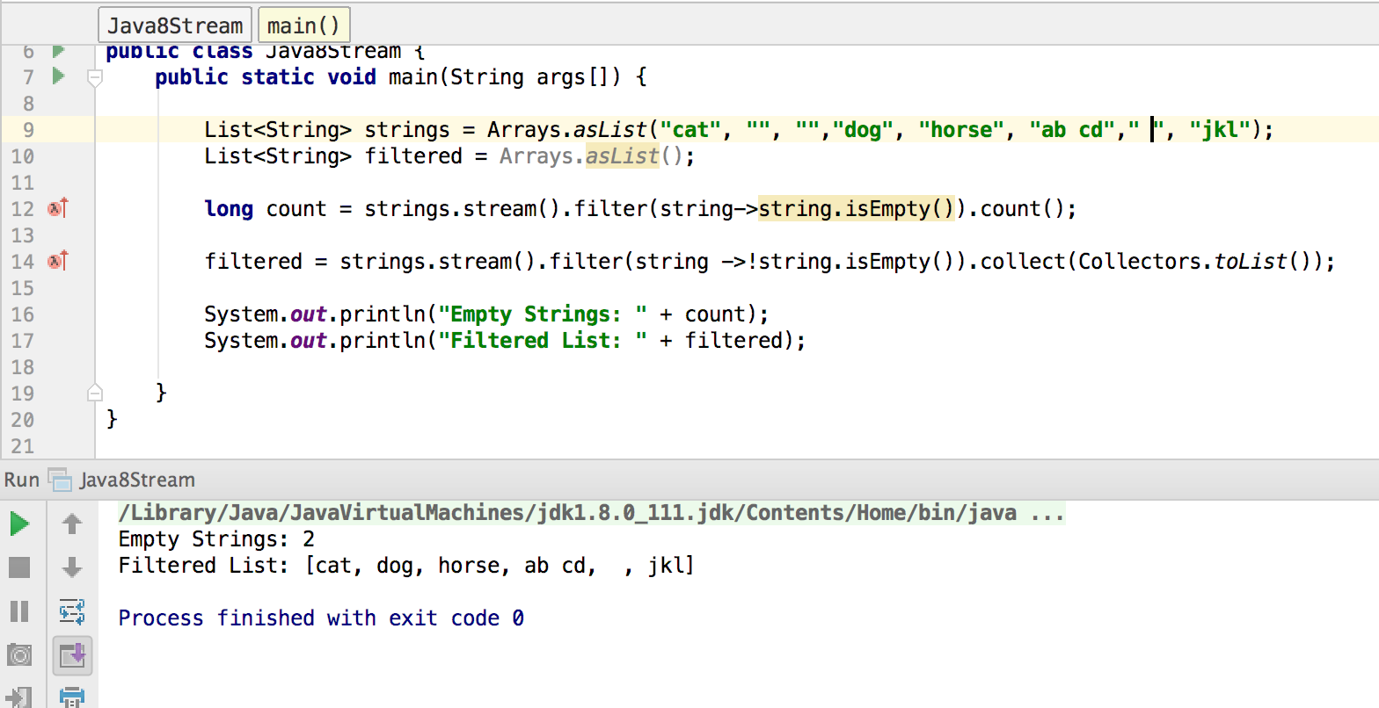
Stream methods
Filter– eliminate elements based on a criteria

Slide 17
Collectors
Stream.collect() - one of terminal operations
Predefined collectors package: stream.Collectors.*
toList()
toMap()
toSet()
etc…
Custom collector – implement interface: interface Collector<T, A, R>

Slide 18
Stream In Actions

Slide 19
References
https://www.tutorialspoint.com/java8/java8_streams.htm
http://winterbe.com/posts/2014/07/31/java8-stream-tutorial-examples/
http://www.journaldev.com/2774/java-8-stream

Slide 20
Thank You

