Slide 1
Voronoi-Based Coverage Control of Pan/Tilt/Zoom Camera Networks
Multirobot Systems - Students presentation

Slide 2

Spatial Sensing Models for PTZ Cameras

Slide 3

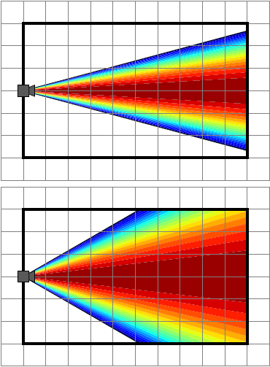
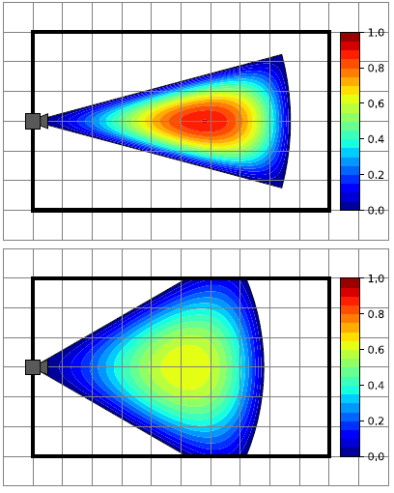
Perspective quality

Slide 4
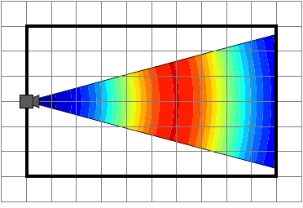
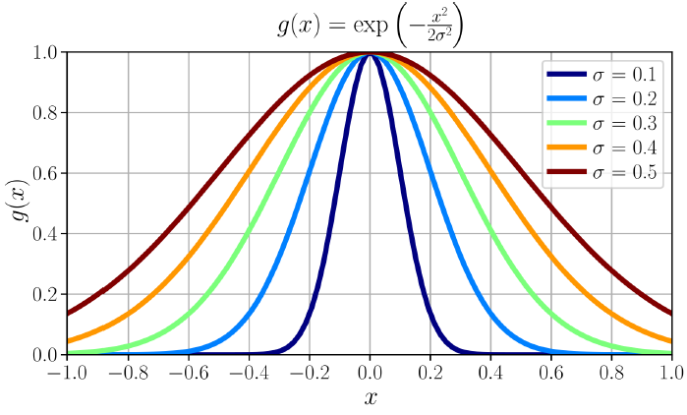
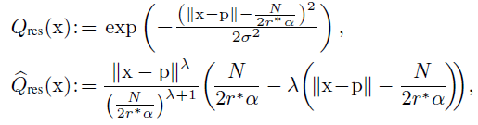
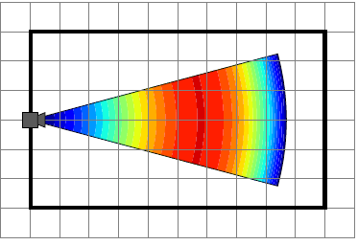
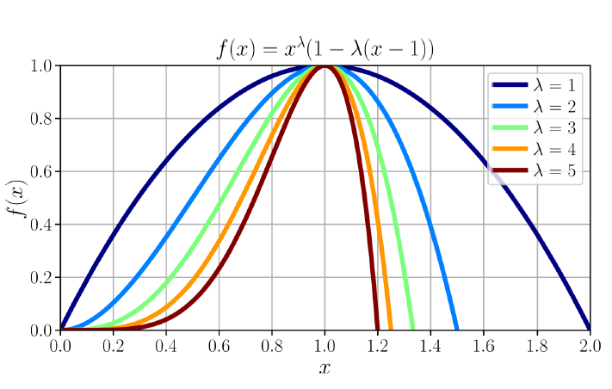
Resolution Quality
Unlimited range
Limited range

Slide 5
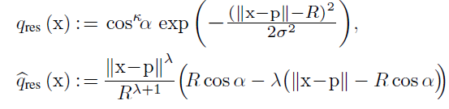
Simplified resolution quality
Unlimited range
Limited range

Slide 6
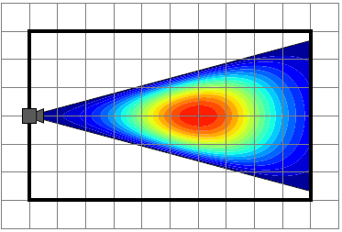

Spatial sensing quality
Unlimited range
Limited range

Slide 7

Optimal Sensor Allocation in PTZ Camera Networks

