Slide 1
Voronoi-Based Coverage Control of Pan/Tilt/Zoom Camera Networks
Multirobot Systems - Students presentation

Slide 2

Spatial Sensing Models for PTZ Cameras

Slide 3

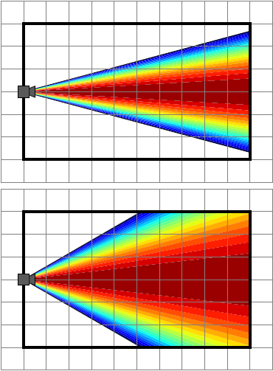
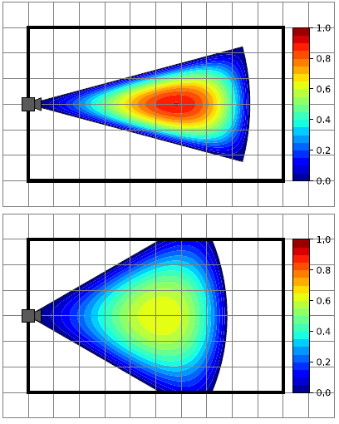
Perspective quality

Slide 4
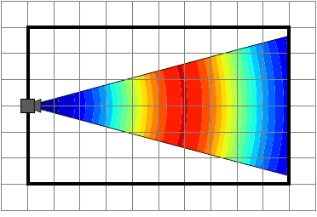
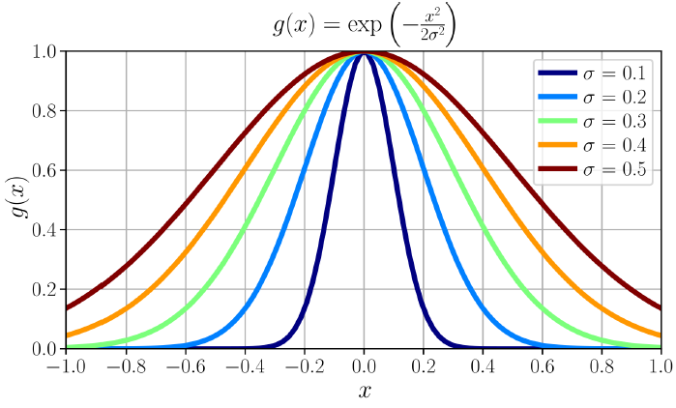
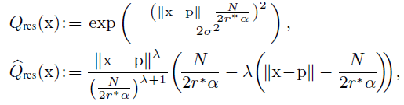
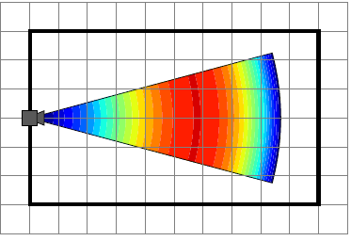
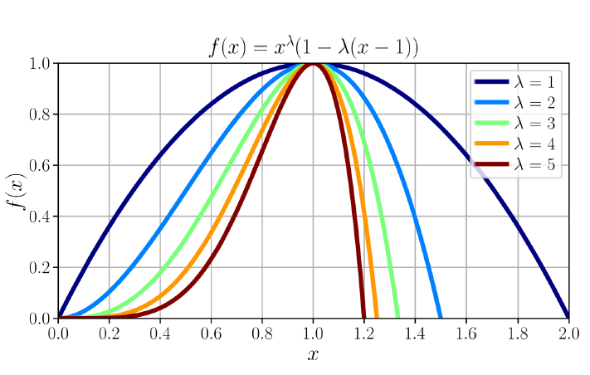
Resolution Quality
Unlimited range
Limited range

Slide 5
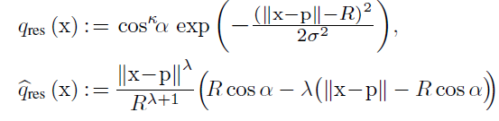
Simplified resolution quality
Unlimited range
Limited range

Slide 6
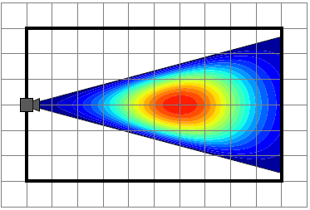

Spatial sensing quality
Unlimited range
Limited range

Slide 7

Optimal Sensor Allocation in PTZ Camera Networks

Slide 8

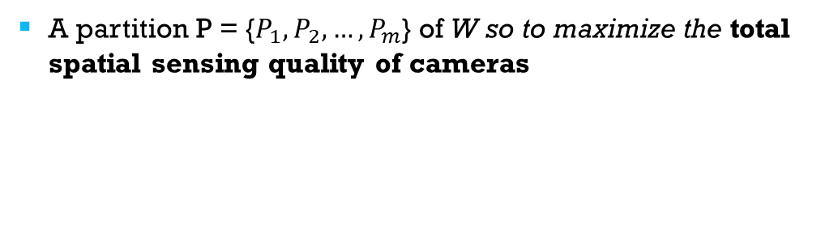
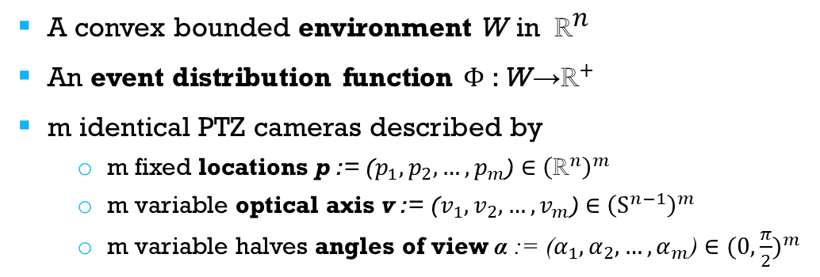
Coverage objective
Given:
A convex bounded environment W in ${ \text{ℝ}}^{\text{n}}$
An event distribution function $\text{Φ}$: W→${\text{ℝ}}^{+}$
m identical PTZ cameras described by
m fixed locations p := ($p_{1}, p_{2}, …, p_{m}$) ∈ ${\left({\text{ℝ}}^{n}\right)}^{m}$
m variable optical axis v := ($v_{1}, v_{2}, …, v_{m}$) ∈ ${\left({\text{S}}^{n−1}\right)}^{m}$
m variable halves angles of view α := ($α_{1}, α_{2}, …, α_{m}$) ∈ ${(0, \frac{π}{2})}^{m}$
Find:
A partition P = {$P_{1}, P_{2},…, P_{m}$} of W so to maximize the total spatial sensing quality of cameras

Slide 9

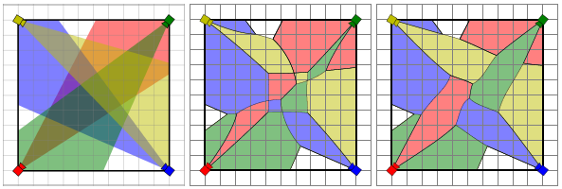
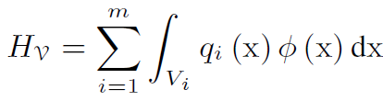
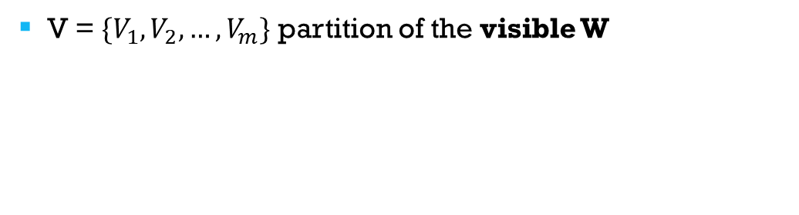
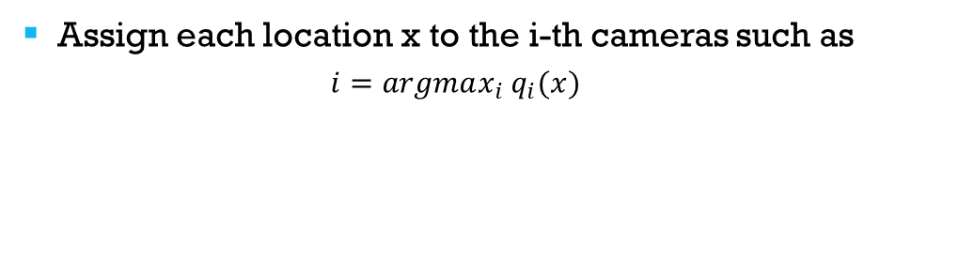
Conic Voronoi diagrams
Optimal allocation strategy
Assign each location x to the i-th cameras such as
$$i=argmax_{i} q_{i}(x)$$
conic Voronoi diagram of W
V = $\{V_{1}, V_{2}, …, V_{m}\}$ partition of the visible W
utility function in new form

Slide 10
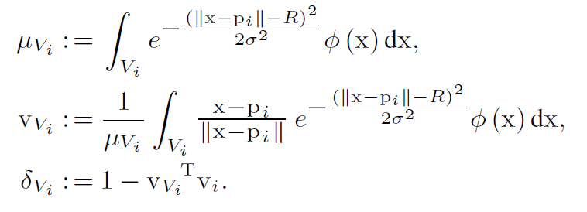
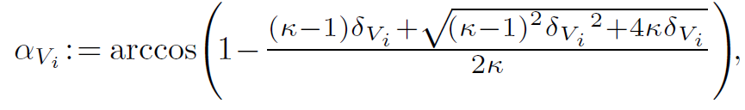
Locally Optimal Coverage Configurations
for Unlimited-Range Visual Sensing
Mass
Centroidal perspective
Centrodial aperture
Centroidal angle of view
Theorem:
For unlimited-range visual sensing (12), a PTZ
camera network configuration is locally optimal in the sense
of HV in (9) if and only if all cameras look towards their
centroidal perspectives with centroidal angles of view,

Slide 11
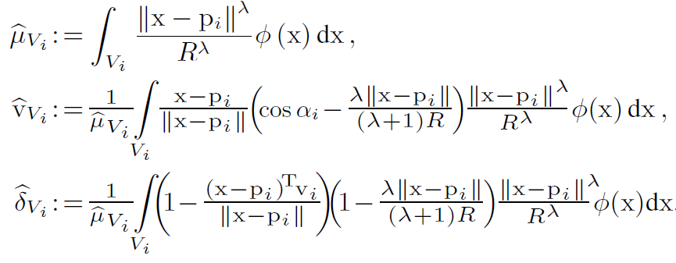
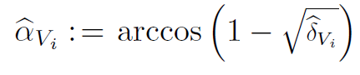
Locally Optimal Coverage Configurations
for limited-Range Visual Sensing
Mass
Centroidal perspective
Centrodial aperture
Centroidal angle of view
Theorem:
For limited-range visual sensing in (17), at a
locally optimal PTZ camera coverage configuration of HV in
(9), all cameras are directed at the centroidal perspectives of
their respective Voronoi cells with the associated centroidalangles-
of-views,

Slide 12

Coverage control of PTZ cameras

Slide 13
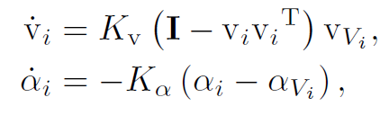
Continuous-Time Camera Dynamics
“move-to-centroidal-perspective” and “move-to-centroidal-angle-of-view” control laws
Theorem:
The continuously differentiable “move-tocentroidal-
perspective” and “move-to-centroidal-angle-ofview”
laws in (22) leave camera’s angles of view, 2i,
positively invariant in (0; ), and asymptotically bring a PTZ
camera network to a locally optimal coverage configuration
of HV in (9) while strictly increasing the total coverage
quality HV along the way.

Slide 14
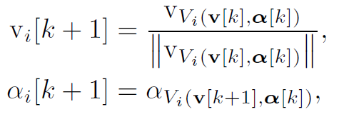
Discrete-time Camera Dynamics
“move-to-centroidal-perspective” and “move-to-centroidal-angle-of-view” control laws
Theorem:
The total coverage quality HV in (9) of a
PTZ camera network increases at each iteration of the
“move-to-centroidal-perspective” and “move-to-centroidalangle-
of-view” laws in (24) until asymptotically reaching a
locally optimal coverage configuration. Further, each iteration
yields a valid camera angle of view, 2i, in (0; ).

Slide 15

Numerical simulations

