Slide 1



Population PK modelling
for clavulanic acid in paediatric patients
Evi Vazakidou
Daily supervisor: Sinziana Cristea
Coordinator: Elke Krekels

Slide 2
Introduction - Prospective clinical study
(De Cock PA et al., 2015)
Patients demographics (26 paediatric patients with amoxicillin & clavulanic):
augmented clearance
ICU with early stage sepsis
15 males & 11 females
Age: 1 month - 15 years old
Weight: 4.6 - 65 kg
Dosing:
2,5-3,5 mg per kg every 6 h intravenously
Sampling:
151 samples clavulanic
median of four samples per dose per individual

Slide 3
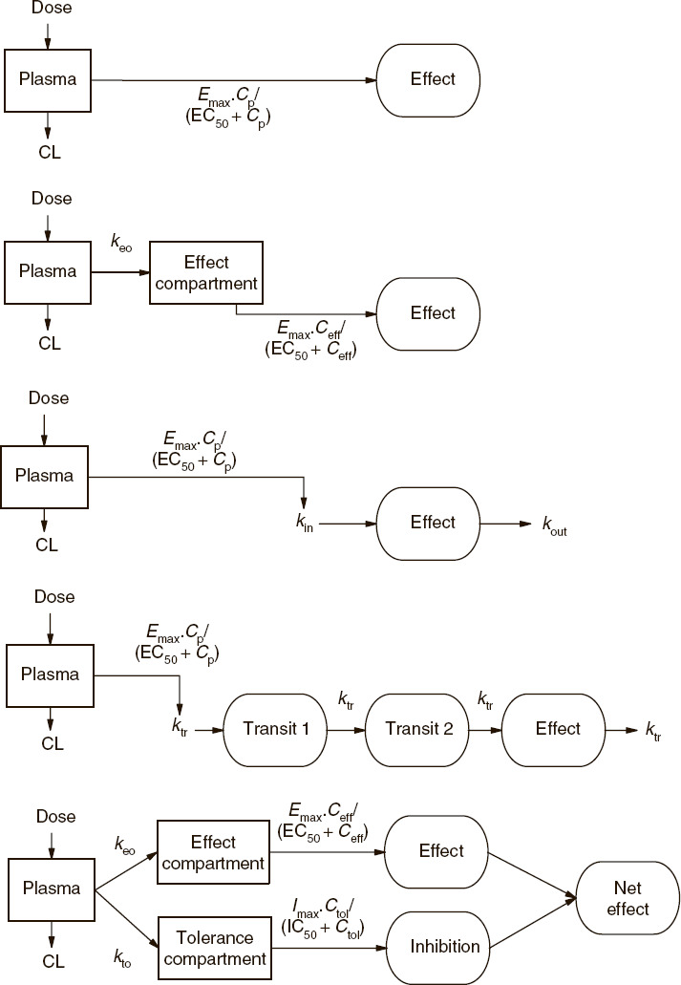
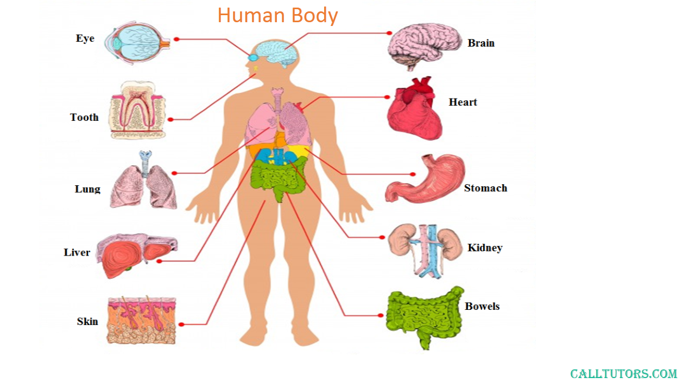

Introduction - Aim
=> Population pharmacokinetic model for clavulanic acid based on this paediatric group, which would be to adjust dosing in the future.

Slide 4
Introduction - Population PK Modelling
Non linear Mixed effects Modelling
“Mixed” = “Fixed” + “Random”
P_{individual} = P_{population}* exp(ΕΤΑ())
C_{observed}= C_{predicted} + EPS()
“Fixed” parameters for all population
“Random effects”: Interindividual variability (IIV)described by ETA() & Random Unexplained Variability (RUV) by EPS()

Slide 5
Methods - Model Development
Model building
Structural (Compartments - same for all population)
Stochastic ( “random effects”: IIV & RUV )
Covariate (Explain “fixed effects”, e.g. weight)
Covariate forward inclusion (dOFV -3.84 for p<0.05)
Backwards elimination (dOFV +7.9 for p<0.005)
Final model
Model Evaluation
Bootstrap (Precision of Parameter estimates)
VPC (Predictability of structural and stochastic model)
Owen JS et al., 2014

Slide 6
Methods - Model Development
Criteria to choose between models:
Numerical
Decrease of OFV (> 3.84 significant with p<0.05)
Relative standard errors (RSEs) (preferably <30%)
Graphical
Goodness of Fit plots (GOF)
Additional Criteria for covariate:
Decrease of interindividual variability after inclusion
Interindividual Variability (ETA()) for a PK parameter against the covariate for the specific parameter
Exploratory to find potential covariates
Decrease of trend upon inclusion for significant covariates

Slide 7
Structural Model
1 CMP clav
2 CMP clav
(dOFV -285)
3 CMP clav
(dOFV -14)
=> predicted
CL3 (35%)
V1 (40%)
V2 is fraction of V1
(dOFV -8)

Slide 8
Stochastic Model
Structural
(2 CMP +IIV on CL1, V2= f(V1))
+ IIV on V1 (dOFV -13)
IIV for V1 (48%) - accepted
+ IIV on CL2 (S/B)
+ IIV on V2 (dOFV -11.9)
CL2 (76%) and V2 (42%)
Notes:
IIV for CL2 = 0.00001 for + IIV on CL2 (S/B)

Slide 9
Structural & Stochastic Model
K12
Central compartment
CL1, V1
Peripheral compartment
CL2,
V2= f(V1)
K21
K10
And Residual Error: Proportional

Slide 10
Covariate Analysis
Parameters with IIV | Tested Continuous Covariates (power functions) | Tested Categorical Covariates (simple)
CL1 | Age | Sex
V1 | Postmenstrual Age (HILL) | Vasoconstrictor
 | Weight | NSAID
 | Cystatin-C (GFR biomarker) | Diclofenac
 | C- Reactive Protein (inflammation marker) | Amikacin
 |  | Postoperative
 |  | Postoperative prophylaxis
 |  | Ventilation

Slide 11
1st Covariate Inclusion
Parameter | Best Covariates | dOFV | GOF | Decrease of IIV on CL1 | High RSEs
CL1 | AGE | -35.99 | Comparable fits | -80%
 | PMA | -38.5 |  | -82% | Estimate of maturation half time (162%)
 | WT | -40.36 |  | -86%
1st Inclusion: CL1 = CL_{pop} * (WT/15)**THETA(1) * EXP(ETA(1))

Slide 12
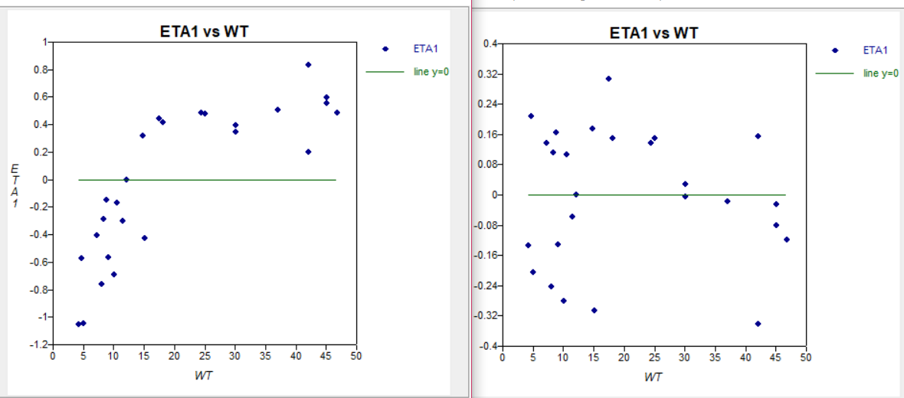
1st Covariate Inclusion
Interindividual variability on CL1 (ETA1) against Weight (kg)
before (left) covariate and after (right) covariate inclusion

Slide 13
2nd Covariate Inclusion:
Description | dOFV | High RSEs | Decrease of IIV
+CYSC power on CL1 | -13.6 | >30% | -26%
+AGE on V1 | -33.7 | >30% | -71%
+PMA HILL on V1 | -35 | half life (123%)) | -70%
+WT power on V1 | -31 | >30% | -61%
2nd Inclusion: V1 = V_{pop} * (AGE/2.75)**THETA(3) * EXP(ETA(3))

Slide 14
3rd Covariate Inclusion:
Parameters with IIV | Tested Continuous Covariates (power) | Tested Categorical Covariates
CL1 | CYSC, CRP | DICLO, NSAID, VASO,SEX, POSTOPP, POSTOP, VENT
V1 | WT, CRP
=> Only + CYSC on CL1 with significant dOFV -7.9
3rd Inclusion: CL1 = CL_{pop} * (CYSC/0.63)**THETA(2) * EXP(ETA(1))

Slide 15
4th Covariate Inclusion
Parameters with IIV | Tested Continuous Covariates (power or linear) | Tested Categorical Covariates
CL1 | AGE, CRP | DICLO, NSAID, VASO,SEX, POSTOPP, POSTOP, VENT
V1 | WT, CRP
No further improvement for the model.

Slide 16
Backwards elimination
Backward elimination
No AGE on V1 : dOFV + 33 (> 7.8 with p<0.005)
No WT on CL1 : +51.5 (same)
No CYSC on CL1: +10 (same)
Thus, covariates added to the model are confirmed.

Slide 17
Final Model
Weight
Cystatin-C
K12
Central compartment
CL1, V1
Peripheral compartment
CL2,
V2= f(V1)
K21
K10
Age
And proportional residual error
CL1 = CL_{pop} * EXP(ETA(1)) * (WT/15)**THETA(1) * (CYSC/0.63)**THETA(2)
V1 = V_{pop} * EXP(ETA(3)) * (AGE/2.75)**THETA(3)

Slide 18
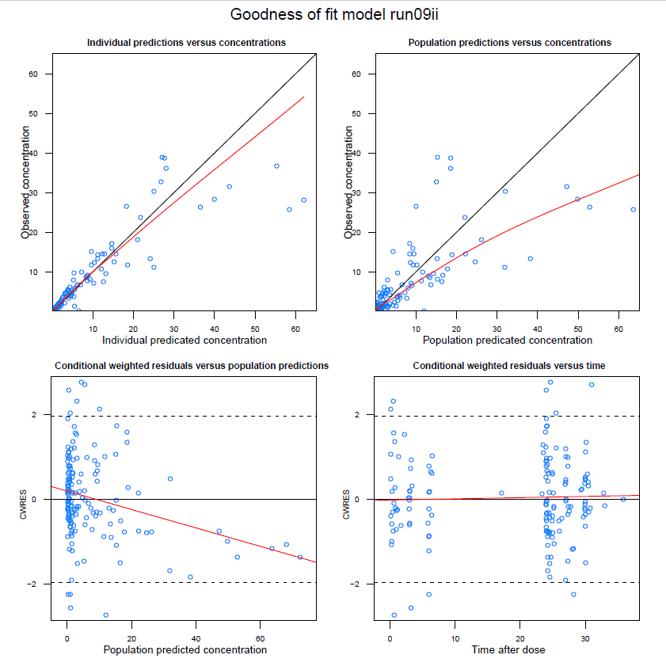
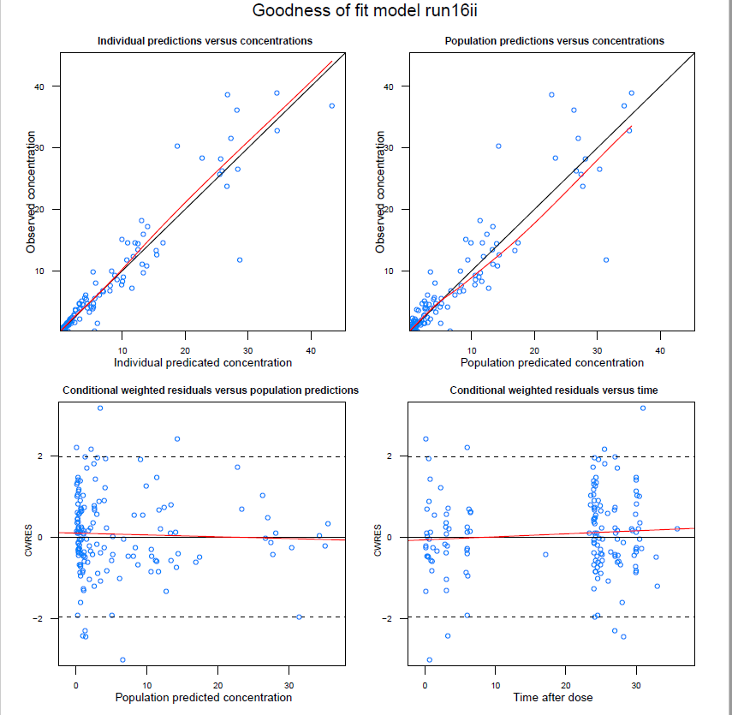
Final Model - GOF comparison
Stochastic Model Final Model

Slide 19
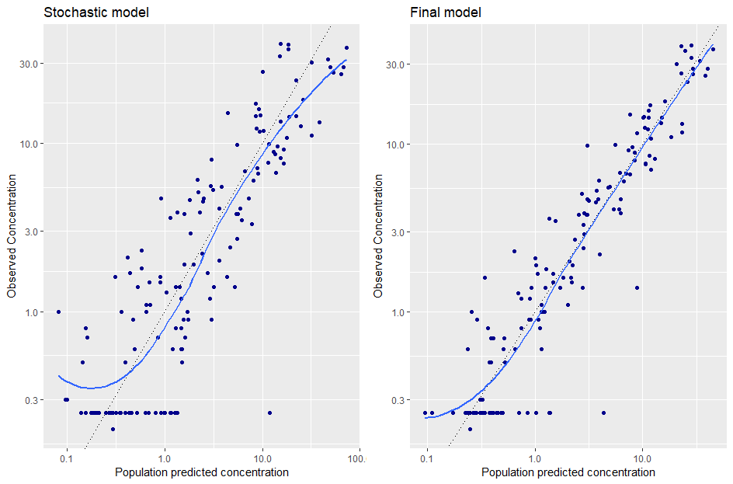
Final Model - GOF comparison
With LOG scaling and “loess” method

Slide 20
Model Evaluation:
Bootstrap
Parameter | Estimate | Median (Bootstrap) | 2.5% percentile from bootstrap (n=1000) | 95% percentile from bootstrap (n=1000)
CL1 (L/h per 15 kg) | 3 | 3.01 | 2.86 | 3.13
CL2 (L/h per 15 kg) | 6.39 | 6.41 | 5.14 | 7.64
V1 (L per 15 kg) | 1.94 | 1.93 | 1.812 | 2.05
V2 (L per 15 kg) | 1.79 | 1.79 | 1.688 | 1.89
WT exponent for CL1 | 0.82 | 0.83 | 0.748 | 0.891
CYSC exponent for CL1 | -0.421 | -0.5 | -0.82 | -0.02
AGE exponent for V1 | 0.376 | 0.378 | 0.343 | 0.408
IIV on CL1 (CV%) | 19.8% | 19.8% | 15.8% | 22.36%
IIV on V1 (CV%) | 17.2% | 17.3% | 13.4% | 20%
Residual error (CV%) | 33.1% | 33% | 29.6% | 36.3%
Notes:
Bootstrap: 1000 simulations of final model after resampling, stratified on Weight
Estimates comparable to median, in between the percentiles
For all estimates good precision in prediction (difference of 0.5 %), except for CYSC exponent

Slide 21
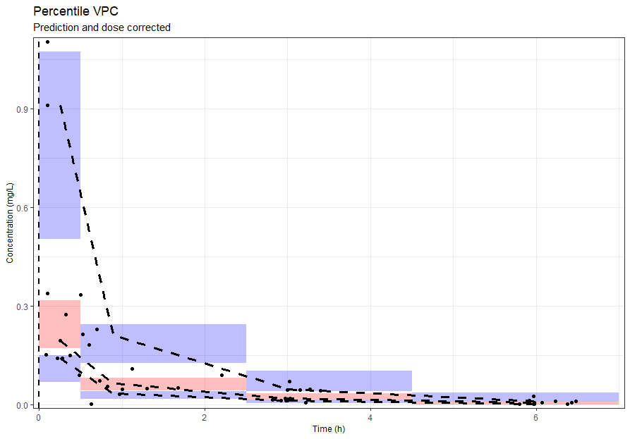
Model evaluation: VPC
VPC: 500 simulations, dose corrected and prediction corrected only for the first dose

Slide 22
Discussion - Benefits
PopPK model that:
fits the data (GOF)
individual predictions are separated from population parameters (small shrinkage)
with good precision (all <0.5%, except for Cystatin-C exponent)
parsimonious
describes the developmental changes and maturation of GFR for children (Weight on CL1) and also the renal function (Cystatin C on CL1).
After covariates inclusion, compared to stochastic:
Interindividual variability for CL1 (ETA1) is decreased by 68%.
Interindividual variability for V1 (ETA3) is decreased by 67%.
Residual error remains the same.

Slide 23
Discussion - Limitations
Interaction with amoxicillin should be taken into account, since there are highly correlated central volumes for clavulanic and amoxicillin, De Cock PA et al., 2015)
Less precision for one parameter prediction - CYSC exponent
External validation with another clinical study dataset with paediatric patients is needed

Slide 24
Future Prospective
After overcoming limitations, it could be used for adjusting dosing of clavulanic in paediatric patients as such:
Maintenance dose (mg/h) = CL_{predicted} (L/h) * C_{desired peak plasma} (mg/L)
Loading dose = Vd_{predicted} * C_{plasma}
Notes:
file:///C:/Users/My%20PC/Downloads/science-direct-topic-clavulanic-acid.pdf
Maintenance dose may be challenging, as clavulanic is known for as a potential drug for Drug Induced Liver Injury (DILI)

Slide 25

Acknowledgements
Special thanks and gratitude for their invaluable support and contribution to my supervisors:
Sinziana Cristea & Elke Krekels
And to all my colleagues for their support and great company! :)

Slide 26
Thank you all!
Q&A

Slide 27
References
Anderson, B., & Holford, N. (2013). Understanding dosing: Children are small adults, neonates are immature children. Archives of Disease in Childhood, 98(9), 737-737. doi:10.1136/archdischild-2013-303720
De Cock PA, Standing JF, Barker CI, de Jaeger A, Dhont E, Carlier M, Verstraete AG, Delanghe JR, Robays H and De Paepe P (2015) “Augmented Renal Clearance Implies a Need for Increased Amoxicillin-Clavulanic Acid Dosing in Critically Ill Children,” Antimicrobial agents and chemotherapy, 59(11), pp. 7027–35. doi: 10.1128/AAC.01368-15.
Krekels, E. H., van Hasselt, J. G., Tibboel, D., Danhof, M., & Knibbe, C. A. (2011). Systematic evaluation of the descriptive and predictive performance of paediatric morphine population models. Pharmaceutical research, 28(4), 797-811.
Mould, D. R., & Upton, R. N. (2012). Basic concepts in population modeling, simulation, and model‐based drug development. CPT: pharmacometrics & systems pharmacology, 1(9), 1-14.
Owen, J. S., & Fiedler-Kelly, J. (2014). Introduction to population pharmacokinetic/pharmacodynamic analysis with nonlinear mixed effects models. John Wiley & Sons.

Slide 28
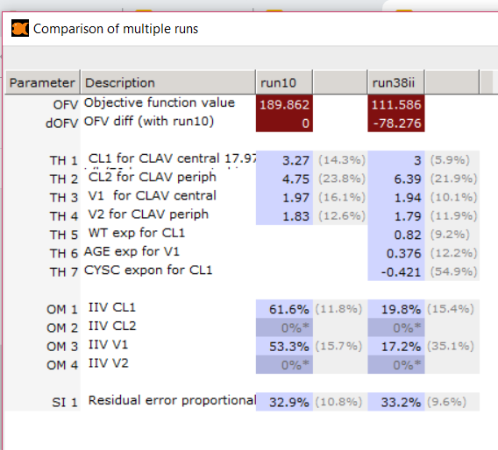
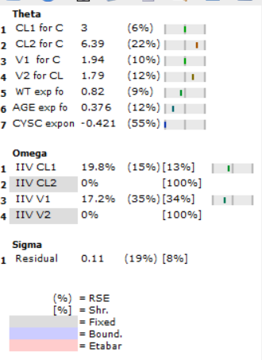
Supplements - Discussion

Slide 29
Parameter | Estimate | De Cock | Carlier 2013 | Jones 1990
CL1 (L/h per 70 kg) | 14 | 12.2 | 6.34 | 17.8 (mean Cl)
CL2 (L/h per 15 kg) | 29.77 | 11.6 | 7
V1 (L per 15 kg) | 9.04 | 9.85 | 10.8 | 30.33 (mean Vd)
V2 (L per 15 kg) | 8.34 | 6.22 | 9.7
WT exponent for CL1 | 0.82
CYSC exponent for CL1 | -0.421 | -0.37
AGE exponent for V1 | 0.376 | BOV-Cl1 8.1%
IIV on CL1 (CV%) | 19.8% | 15.6%
IIV on V1 (CV%) | 17.2% | 12%
Residual error (CV%) | 33.1% | 35%

Slide 30
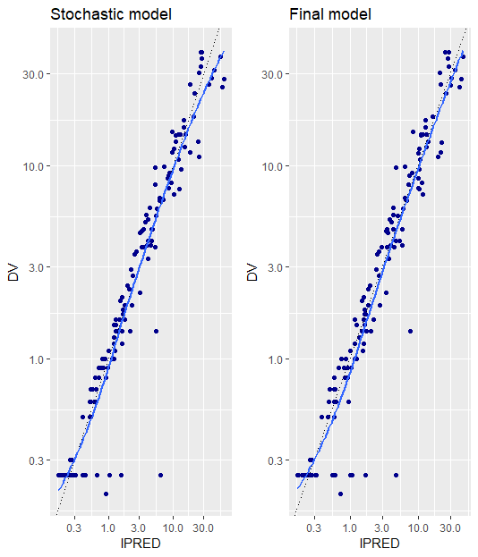
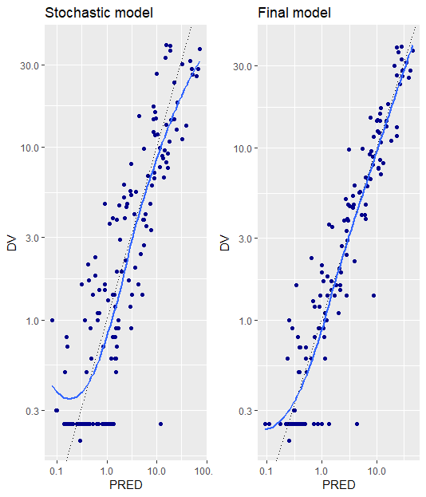
Supplements Final Model - GOF comparison
With LOG scaling and “loess” method

Slide 31
Supplements - Comparison of the two models
PopPK model for clavulanic with Stepwise Covariate Inclusion (no prior assumptions)
Final PK model:
2 CMT model with intra-individual variability on central compartment CL1, V1
V2 is parameterized as a fraction of V1
Covariates relationships identified (p<0.005):
CL1 = CL_{pop} * EXP(ETA(1)) * (WT/15)**THETA(1) * (CYSC/0.63)**THETA(2)
V1 = V_{pop} * EXP(ETA(3)) * (AGE/2.75)**THETA(3)
Comparison with previous findings of De Cock et al.
2 CMT model with intra-individual variability on central compartment CL1, V1
A priori: CL_{i} = CL_{pop} * (WT/WT_{median} )^{0,75} * [PMA ^{THETA(1)}/(PMA ^{THETA(1)} + THETA(2) ^{THETA(1)})]
Vi= Vpop * (WT/WT_{median} ) * THETA(3)

Slide 32
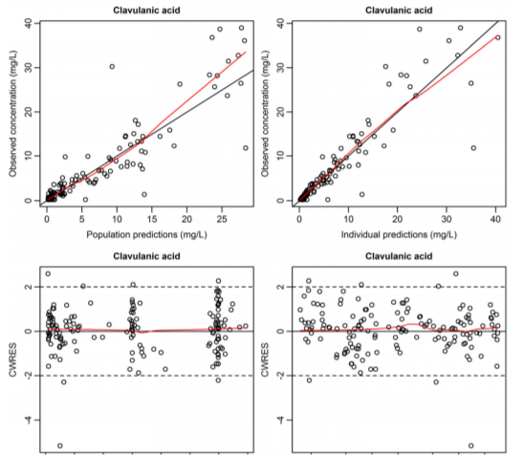
Supplements - Comparison of the two models -GOF of two models
De Cock et al 2015 (A priori PMA and WT inclusion) Final model (Stepwise Covariate Inclusion)

Slide 33
Supplements - Comparison of the two models
A priori allometric scaling (with weight) and maturation function (with PMA):
Measure the contribution of maturation processes for GFR in neonates
Better prediction of CL for young children (<2 years)
Stepwise covariate inclusion:
Parsimony
Possibly better GOF
Both:
Included Cystatin-C marker of GFR as covariate, which describes renal function

Slide 34
Supplements - Comparison of the two models
In comparison to the previous model:
A priori inclusion of WT and PMA as HILL for CL (De Cock PA et al., 2015).
Maturation of GFR that is important for very young children (<2 years) adjusting dosing is not differentiated from developmental changes. However, this model is parsimonious.

Slide 35
Supplements - Discussion
PopPK model was made that describes the PK parameters of the specific paediatric patients population after a systematic search among potential covariates.
Covariates that describe renal function (with Cystatin C on CL1) and developmental changes (with Weight on CL1 and Age on V1) were included.
For very young children (<2 years) for which maturation of GFR is important the a priori method is more beneficial.
For older children for which maturation of clearance of clavulanic is mostly complete, it is possible the stepwise covariate inclusion due to parsimony and GOF for higher concentrations gives more precise predictions. In previous literature, the systematic stepwise covariate inclusion was more beneficial (Krekels et al., 2011).
The current model loses interaction with amoxicillin, which should be taken into account to increase the precision of PK parameter estimates.

Slide 36
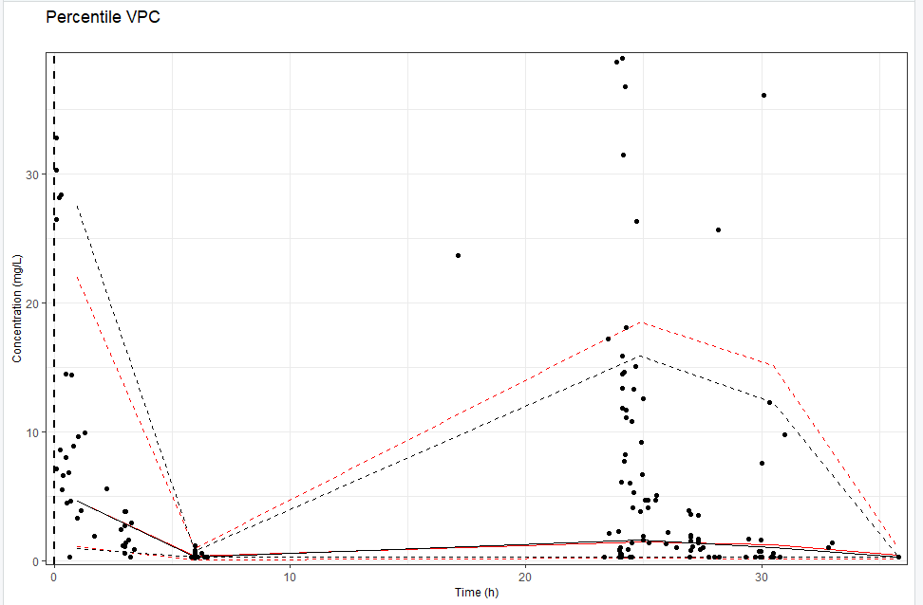
Supplements - VPC all doses

Slide 37
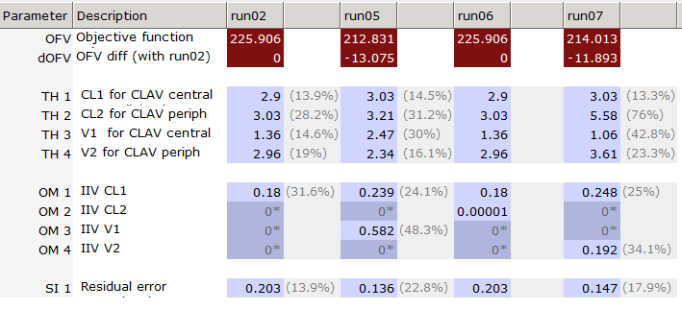
Supplements - Stochastic
02: Structural (2 CMT clav+IIV on CL1)
05: Struct. + IIV on V1
06: Struct.+ IIV on CL2
07: Struct.+ IIV on V2

Slide 38
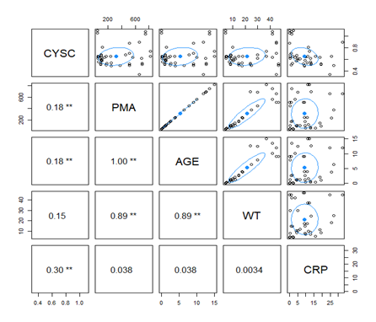
Supplements - Covariate Analysis:
Exploratory Graphs
CYSC: Plasma Cystatin C concentration (GFR marker)
PMA: Postmenstrual Age
WT: Weight
CRP: C - Reactive Protein

Slide 39
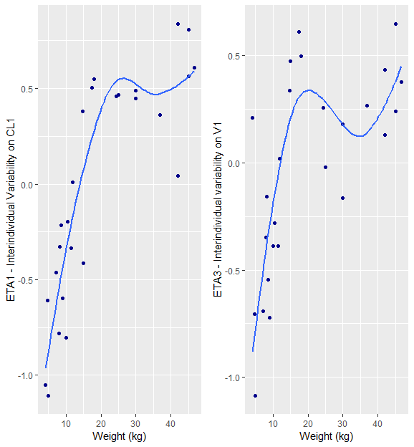
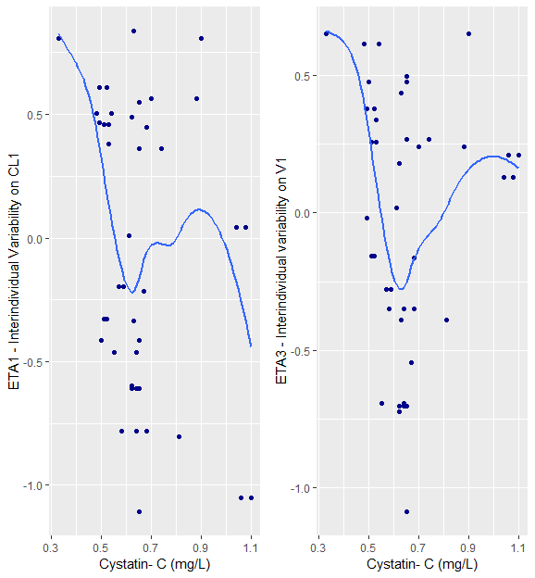
Supplements - Covariate Analysis: Exploratory Graphs

Slide 40
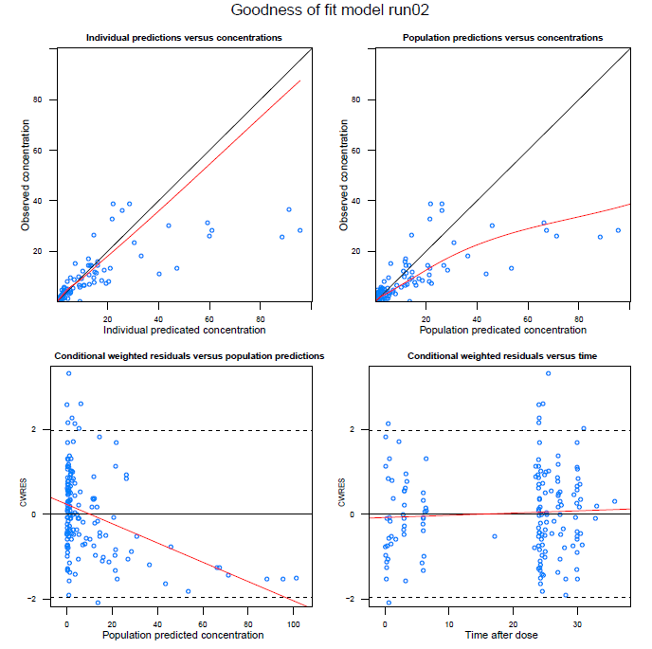
Supplements: Structural

Slide 41
Supplements: Stochastic

Slide 42
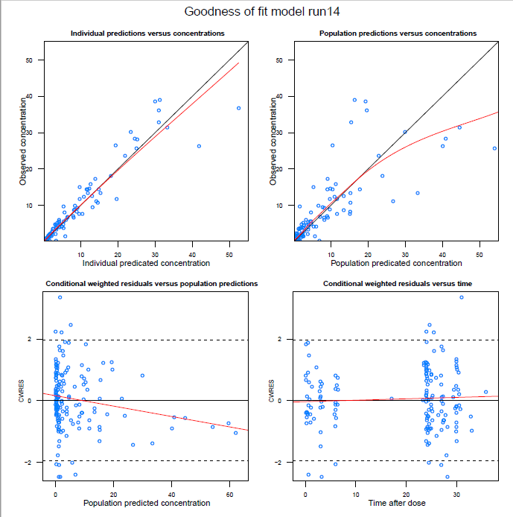
Supplements: 1st Covariate Inclusion (pWT on CL1)

Slide 43
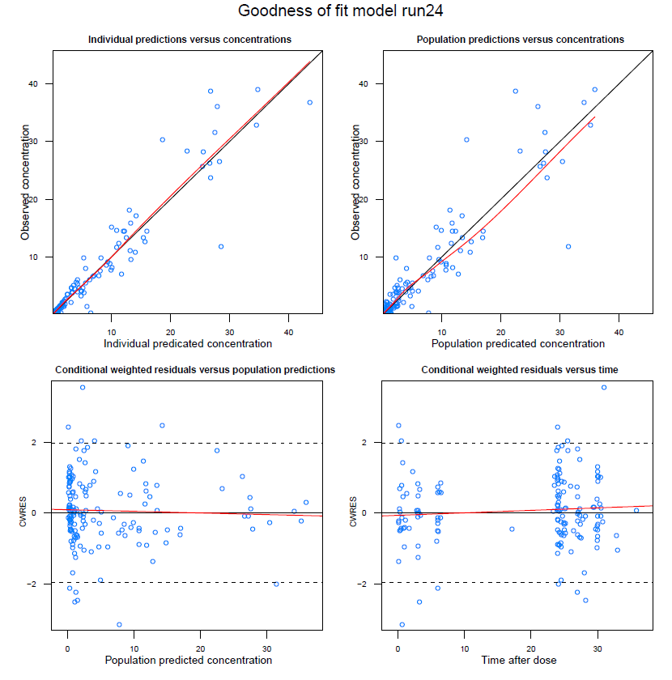
Supplements - 2nd Inclusion

Slide 44
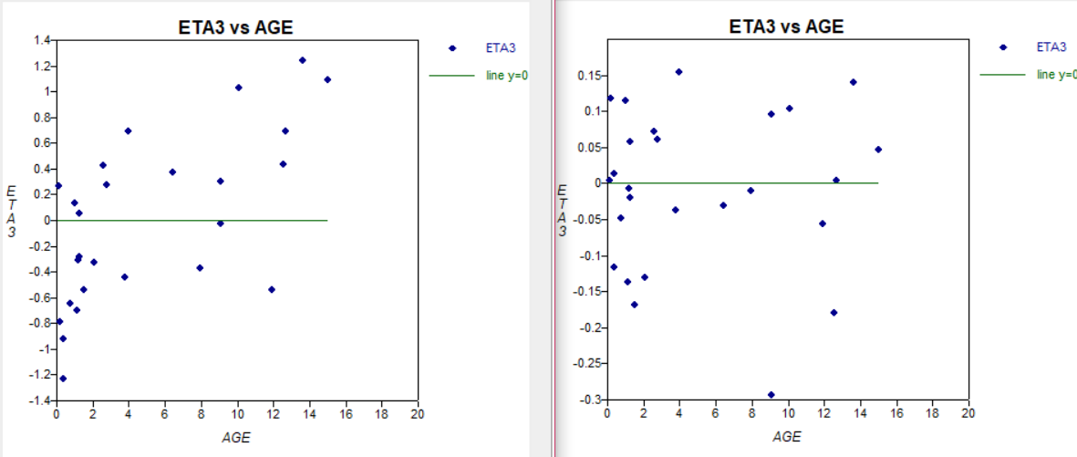
Supplements - 2nd Covariate Inclusion:
Interindividual variability on CL1 (ETA1) against Age (years)
before (left) covariate and after (right) covariate inclusion

Slide 45
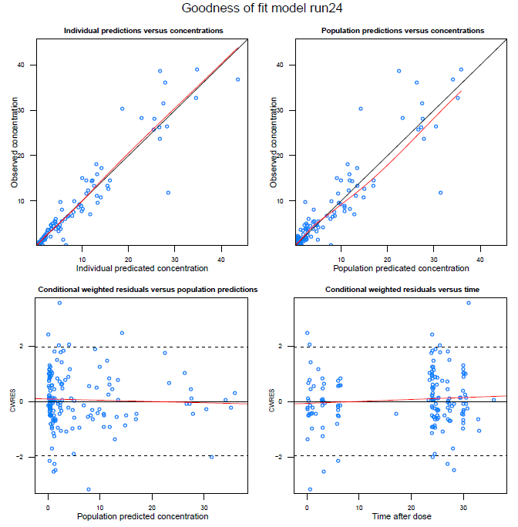
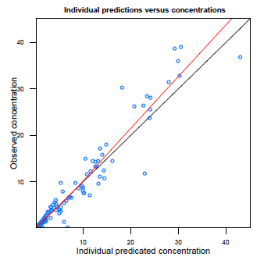
Age on V1 Weight on V1
Supplements - 2nd Covariate Inclusion:

Slide 46
Supplements - 3rd Inclusion

Slide 47
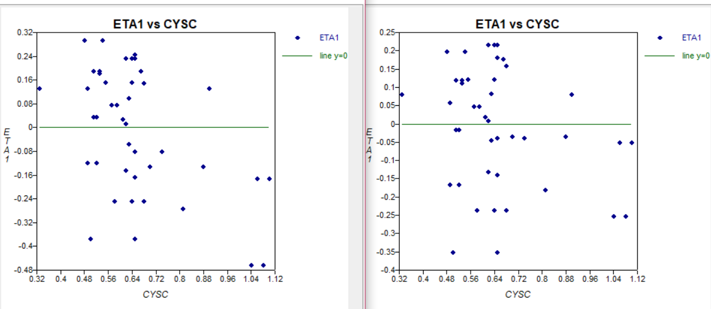
Supplements - 3rd Covariate Inclusion
Interindividual variability on CL1 (ETA1) against Cystatin C (mg/L)
before (left) covariate and after (right) covariate inclusion

