Slide 1
Predicting If
Post Origin is
Keto or Vegan
Using NLP
Nicholas Dinis

Slide 2
Contents
Introduction
Problem Statement
Data Collection and Natural Language Processing
Logistic Regression Classifiers;
  Lemmatized Text Vectorized
  Stemmed Text Vectorized
Multinomial Naive Bayes Classifiers;
  Stemmed Text Vectorized
Insights
Conclusion

Slide 3
Introduction
Reddit is a blog website where users can post information and questions into forums to be discussed openly among followers of those subreddit categories.
I am using two popular diets for my subreddits to model, Keto and Vegan

Slide 4
Providing A Variety Of Foods
Keto
Vegan
Keto is a high fat low carb diet which puts your body into ketosis, a state where your body is depleted of carbs so it begins to burn fat for energy
Vegan is a strict vegetarian who does not use or consumes products that come from animals.

Slide 5
Problem Statement
Only using posts that were web-scraped using pushshift api, can I create a predictive model that accurately categorizes posts based on the words in them?

Slide 6
Data Collection and Processing
Push Shift API
Push Shift API is a powerful application compatible with reddit that I used to collect the data in our chosen subreddits. I collected roughly 350 posts for each subreddit.
Plain Text
Lemmatized Text
Stemmed Text
Will be the raw text within the posts
Process of converting the posts words to their root words
Process of cutting the end or beginning of words to find relative stems

Slide 7
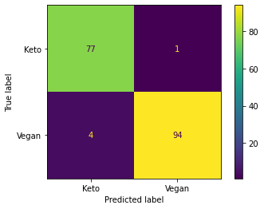
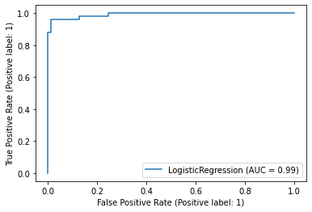
Lemmatized Text Vectorized
Logistic Regression Classifier
Best Performing Model
Accuracy Score;
0.97159
Sensitivity Score;
0.95918
Specificity Score;
0.98717
Precision Score;
0.98947
Overall Average Score;
0.97686

Slide 8
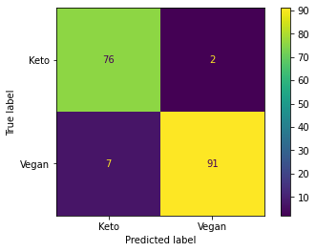

Stemmed Text Vectorized
Logistic Regression Classifier
Accuracy Score;
0.94886
Sensitivity Score;
0.92857
Specificity Score;
0.97435
Precision Score;
0.97849
Overall Average Score;
0.95757

Slide 9
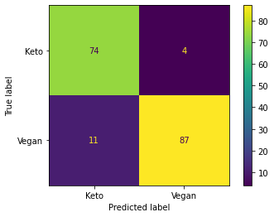
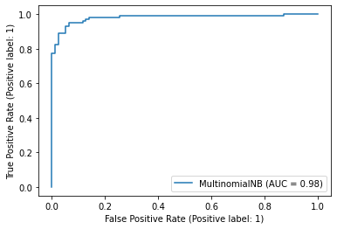
Stemmed Text Vectorized
Multinomial Naive Bayes Classifier
Accuracy Score;
0.91477
Sensitivity Score;
0.88776
Specificity Score;
0.94872
Precision Score;
0.95604
Overall Average Score;
0.92682

Slide 10
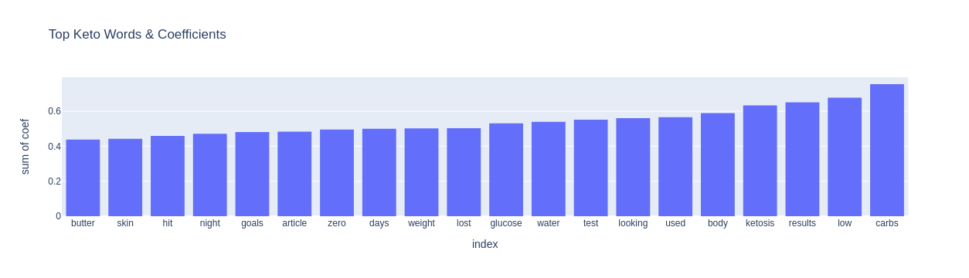
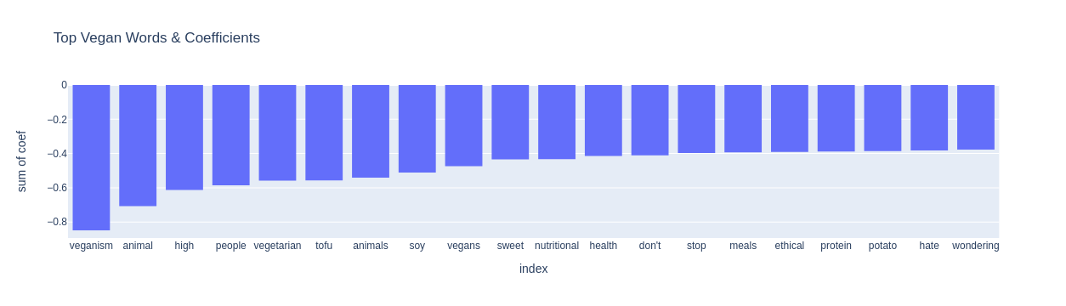
Insights

Slide 11
Logistic Regression Classifier with Lemmatized Text Vectorized
Logistic Regression Classifier with Stemmed Text Vectorized
Multinomial Naive Bayes Classifier with Stemmed Text Vectorized
Conclusion
Based on the model scores below I would say Yes, We can use word to predict subreddits.
Overall Average Score
0.97686
Overall Average Score
0.95757
Overall Average Score
0.92682

Slide 12
Thanks!
Does anyone have any questions?
Nicholas.J.Dinis@gmail.com
LinkedIn
GitHub

