Slide 1
INTELLIGENT VEHICLE PARKING
DONE BY
BURNAPURAM NITHIN REDDY(K18LCB45)
MAMIDI AKHIL KUMAR(K18LCB39).
DINAKAR REDDY(K18LC)

Slide 2
INDEX
ABSTRACT
INTRODUCTION
LIERATURE REVIEW
METHODS
ALGORITHMS
CONCLUSION
REFERENCES

Slide 3
ABSTRACT
Now a day’s more parking space is required as the population of vehicles worldwide continues to increase so the efficient parking management is becoming an important issues. This paper proposes a smart parking system to solve the problem of unnecessary time consumption in finding parking spot in commercial car park areas. Sensors such as IR (infra red) are used in order to detect the entrance or exit of the car at the parking slot. The existing system gives information about the empty slots availability but does not give information about the exact location of parking slot available in such a big area. This is time taking process for the person to search for the empty slot and if the parking area is very big to search for the slot will consume a lot of time which is a major drawback for the pre existing methods. . The parking slots are continuously monitored and the data is continuously updated in the display board. The demonstration has proven the capability of the system to reserve the parking, gain entry to the parking area and hence eliminates the hassle of searching empty parking lots. Key Words:: Smart car, parking system, IR sensor.

Slide 4
introduction
Due to advancement in technology man is leading a comfortable life. But at the same time these advancements are becoming troublesome some times. In past times, people used to travel by public transportation but now a days the number of people using their own vehicles such as cars and motor cycles. In order to reduce the damage caused by illegal parking and parking space shortage problems, many countries try to develop a smart parking system that manages the conditions Users who own cars also want to know the remaining parking space before reaching the parking location. To meet this demand, a parking management system has emerged, and researches on parking management system using various methods have been carried out. Currently, majority of the existing car parks do not have a systematic system. The problem that always occurs at the car park is time being wasted in searching for the available parking spaces. Users will keep on circling the parking area until they found an empty parking spot. This problem usually occurs in urban areas, where number of vehicles is higher as compared to the availability of parking spaces. These ineffective conditions happened because of the lack of implementation in technologies. Car park entrances are controlled by barrier gates whereby parking tickets are used extensively for access purpose. With the growth of technology, these systems have been simplified in many ways

Slide 5
LITERATURE REVEIW
Intelligent parking system based on wireless sensor network technology .using (cctvs)which will be used as a sensing mode to identify vacant parking space
Car parking system cars are placed onto motorized mono –directional or Bi-directional platforms
Concept of micro controller parking systems in which micro controller senses the moment of the car and open the gate I svacancy available

Slide 6
APPROACH AND METHODS
Due to the increase of vehicle exponentially and thus traffic increased a lot so parking became a big problem in highly populated cites. The major issue of parking comes into picture in case of vehicles like cars which required a big area. The main reason for this is increase in population in cites and also security concerned because of thefts in major cities. So parking our vehicle in a safe place with security is very important. To overcome this problem we have introduced such a system that would solve all these issues and will be intelligent too. We have developed a system using software and hardware module which provides an interface to the user and the parking area so that user can easily get access to the parking slots available. Our approach is cost effective and it covers all the features of a complete intelligent car parking management system This system takes the input from IR sensors when ever car enters or leaves the parking area and sends the information to mobile. Lab VIEW process the acquired information and send the information to the display devices using signal. Different LEDs are used in order to indicate the present state of the slot and a display is also present at the entrance which clearly indicates the available and the occupied slot

Slide 7
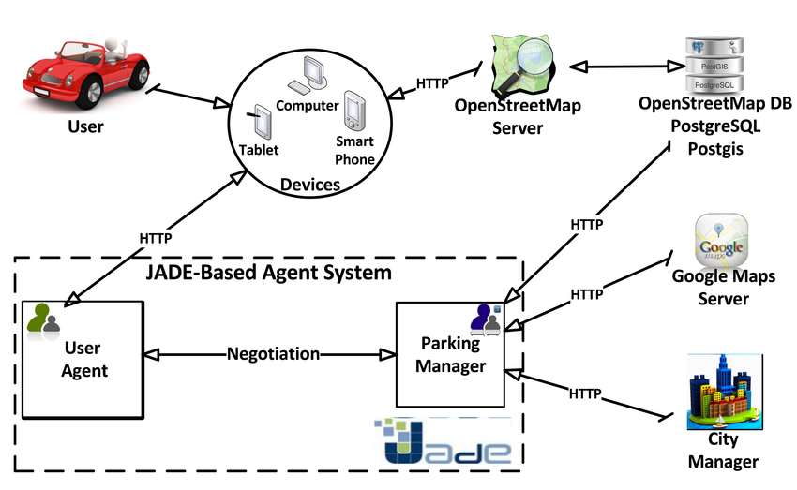

Slide 8
Algorithm . Algorithm of managing the parking space in each area, when a vehicle leaves the parking area.
1: Do
2: While (Reception the availability state of a parking space {IDzi, IDpj})
3: Update the information received in the database 4: Decrease the number of occupied spaces
5: Increment the number of available spaces
6: Save the time when the car left the parking space: Tout
7: Stop parking time Tparkij
8: While (The parking payment is not performed) do 9: If (The current time < Tout + 1H) then
10: Wait 15 min
11: Else
12: Send a notification to the authorities with the registration number of the car for a fine
13: Goto 16
14: End if
15: End
16: Update the database with the available state of the space {IDzi, IDpi}
Algorithm . Algorithm of managing the parking space in each area, when a vehicle arrives in the parking area
. 1: Do
2: While (Reception the occupied state of a parking space {IDzi, IDpj})
3: Update the information received in the database
4: Increment the number of occupied spaces 5: Decrease the number of available spaces 6: If (The RFID tag is detected) then
7: Update occupied space with RFID data received in the database
8: Else
9: Send a message to the parking agents with {IDzi, IDpj} of the parking space that has just been occupied
10: The agent of the area IDzj introduces the registration number of the car parked in IDpj in the database 11: End if 12: Start counting the parking time: Tparkij //j = the parking area i = the parking space in the area j
13: Goto 1

Slide 9
DISCUSSION
There is no system that adapts to the different types of architectures and structures of parking (linear and mass). There are parking systems that only work for linear car parks and do not have the same impact at the deployment level of sensor networks in mass parking, and vice versa. The complexity of the algorithms used in the management of parking spaces plays an important and crucial role in the development and design of a robust and efficient smart parking system. The majority of the algorithms proposed by our system are not complex, they are easy to be implemented, and they are executed at the server level, which minimizes the exhaustion of the sensors and does not overload them, so that they do not consume a large amount of energy in order to increase the duration of the lifetime of their batteries

Slide 10
CONCLUSION
Today, in the information age, the quest is for global economic efficiency in a world economy governed by environmental concerns, economic alliances, and trade agreements . Due to the worldwide spread of motorization and urbanization raises new issues for city-developers. The industrialization of the world, increase in population, slow paced city development and mismanagement of the available parking space has resulted in parking related problems . One of the key concerns of urban traffic is the growing size of the space occupied by parking cars which affect the traffic highly. Development of industrial automation has now reached the level where reliable and efficient solutions can be given into the hands of Smart parking designers

Slide 11
REFERENCES
An Article of Smart Parking from Happiest Minds Technologies Pvt. Ltd.
RESEARCH GATE

