Slide 1
Reverse a stack using recursion
The purpose of this slides is to show how to reverse stack using recursion.
Example-
Input – 10,20,30,40
Output – 40,30,20, 10
Take input stack with the item.
There is a function A, which do recursive function call for each item until stack becomes empty.
Then take item one by one from call stack of A and use helper function B to place this item at bottom of stack.
First function B hold items from stack in call stack.
After putting this item at bottom, function B push all items in the stack from call stack.

Slide 2
Key words and diagram meaning
A – reverseStack()
B- placeItemAtBottom()
B – function call stack, push and pop item from this call stack
Actual stack
empty
 |  |  | Actual stack values
 |  |  | 10(Top)
 |  | 20 | 20
 | 30 | 30 | 30
40 | 40 | 40 | 40
`

Slide 3
Step by step implementation of algorithm
Initial stack after filling input in stack-
Input stack is passed to function A reverse stack
Function A remove all item from stack one by one and puts items in its call stack.
In next step all items are passed to function B from call stack of A 40,30,20 and 10 is passed in function B one by one.
 |  |  | Actual stack values
 |  |  | 10
 |  | 20 | 20
 | 30 | 30 | 30
40 | 40 | 40 | 40

Slide 4
Place 40 via place at bottom function B
Initially stack is empty, 40 is passed in function B
empty
empty
Stack is empty | Push item in stack
empty | 40

Slide 5
Place 30 via place at bottom function B
empty
40
40
empty
Initial stack | Hold item in call stack | Push item in stack | Push item in stack from call stack
 |  |  | 40
40 | empty | 30 | 30

Slide 6
Place 20 via place at bottom function
-
Similarly 10 is placed at bottom of stack and all other items are kept on top
Empty
40
30
40
30
40
40
Empty
Initial stack | Hold item in call stack | Hold item in call stack | Push item in stack | Push item in stack from call stack | Push item in stack from call stack
 |  |  |  |  | 40
40 |  |  |  | 30 | 30
30 | 30 | empty | 20 | 20 | 20

Slide 7
Final stack
Place 10 via place at bottom function, Filling of this value is also same as previous slide.
 |  |  | Final stack values
 |  |  | 40 (Top)
 |  |  | 30
 |  |  | 20
 |  |  | 10
`

Slide 8
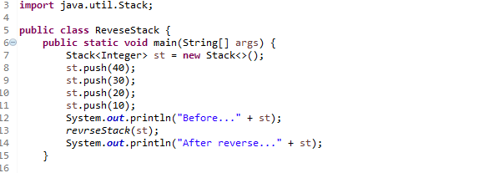
Input stack

Slide 9
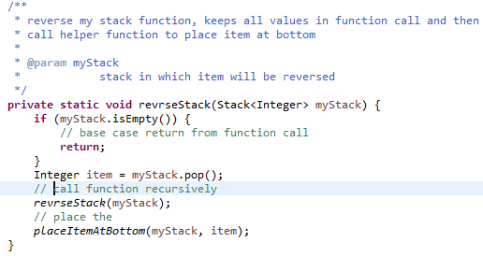
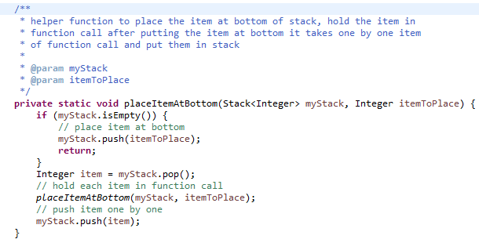
Code snippet

Slide 10
Thank you for watching

