Slide 1

WELCOME
SDLC

Slide 2
CET IILM AHL
Gr.Noida

Slide 3
Software Development Life Cycle
Introduction
The Waterfall Model
Prototyping Model
Spiral Model
Iterative Enhancement Model
Rapid prototyping model

Slide 4
Introduction
Structure imposed on the development of a software product.
A framework that describes the activities performed at each stage of a software development project.
A software lifecycle model is a standardised
format for planning organising, and running a new development project.
It aims to be the standard that defines all the tasks required for developing and maintaining software.

Slide 5
Waterfall Software Development Life Cycle Model
Requirements
Analysis
Design
Implementation
Testing
Delivery and Installation

Slide 6
Waterfall Model
Advantages
Disadvantages
Easy to understand and implement.
Widely used and known (in theory!)
Reinforces good habits: define-before- design, design-before-code
Idealised, doesn’t match reality well.
Doesn’t reflect iterative nature of exploratory development.
Unrealistic to expect accurate requirements so early in project
Software is delivered late in project, delays discovery of serious errors.

Slide 7
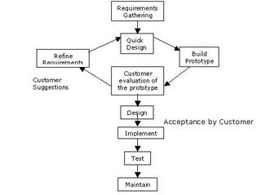
Prototyping Software Development Life Cycle Model

Slide 8
Prototyping Model
Advantages
Disadvantages
Requirement clear and accurate.
New requirement can be easily accepted.
Flexibility of design and development.
Poor documentation.
User demand can force to redesign.

Slide 9
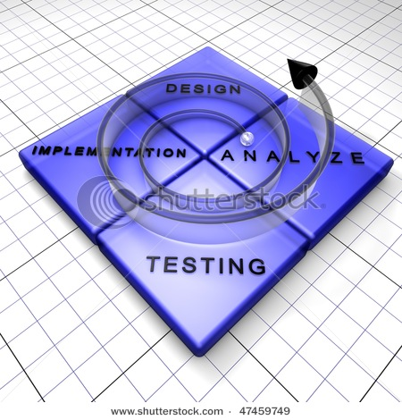
Spiral Model

Slide 10
Spiral Model
Advantages
Disadvantages
Incorporates the iterative nature of software development
Incorporates all the advantages of both the waterfall model and prototyping model
Requires expertise in risk analysis
It is somewhat complicated and not well understood

Slide 11
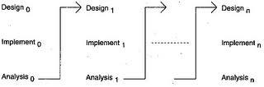
Iterative Enhancement Model

Slide 12
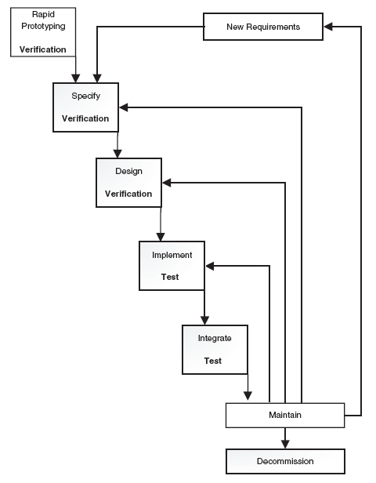
Rapid prototyping model

Slide 13

SDLC
THANK YOU
By:-
Dinkar Prasad Maurya
dinakar.maurya.cs12@iilm.ac.in

