Slide 1

WELCOME
To SEMINAR

Slide 2
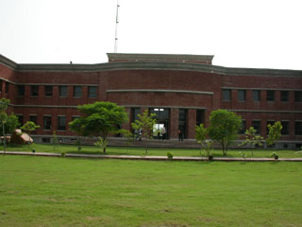
CET IILM AHL
Gr.Noida

Slide 3
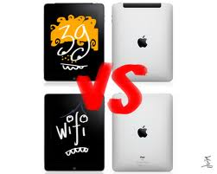
3G vs Wi-Fi

Slide 4
Agenda
Before and After 3G
Introduction to 3G
Significance
Introduction to Wi-Fi
WiFi Working
3G vs Wi-Fi
Functioning
Range and signal
Frequency
Speed
Cost
Security
Advantage of 3G over Wi-Fi
Advantage of Wi-Fi over 3G

Slide 5
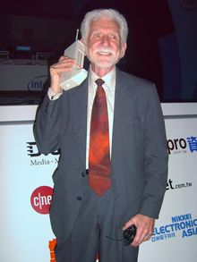
Dr. Martin Cooper of Motorola, made the first US analogue mobile phone call on a larger prototype model in 1973.

Slide 6
Before and After 3G
0G->Mobile radio telephone.
1G ->First-generation wireless analog technology(1979).
2G ->Second-generation wireless digital technology(1990).
2.5G (GPRS) stepping stone between 2G and 3G cellular wireless technologies.
3G->Enabled faster data-transmission speeds, greater network capacity(2000).
4G->A step up from 3G, which is currently the most widespread, high-speed wireless service(2009)

Slide 7

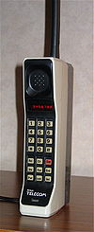
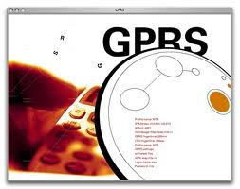
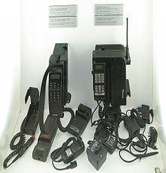
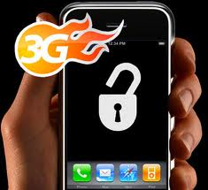
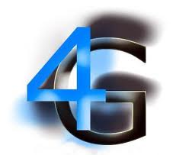

Slide 8
Introduction to 3G
3G refers to the third generation of mobile technology defined by the International Telecommunication Union based on wide area network (WAN)
Access point name
computer protocol
(APN) identifies an IP packet data network (PDN), that a mobile data user wants to communicate with.

Slide 9
Conti…
Suitable for connecting mobile devices to carrier base stations.
The base station provides entry into the carrier's wireless network, and from there into the Internet or public switched telephone network.
Think of 3G as the wireless equivalent of ISDN or DSL.

Slide 10
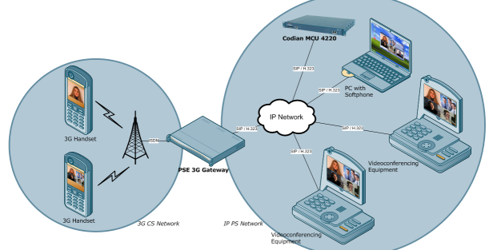
Example

Slide 11
Conti…
3G Standard is created by ITU-T and is called as IMT-2000(International Mobile Telecommunication).
The first pre-commercial 3G network was best launched by NTT DoCoMo in Japan branded FOMA, in May 2001 on a pre-release of W-CDMA technology.
W-CDMA wideband CDMA is an air interface found in 3G mobile telecommunication.

Slide 12
Importance
Higher bandwidth enables a range of new applications.
For the consumer
Video streaming, TV broadcast.
Video calls, video clips – news, music, sports.
Enhanced gaming, chat, location services.
For business
High speed VPN access.
Sales force automation.
Video conferencing.
Real-time financial information.

Slide 13
Significance of 3G in Mobile Phone Sector
Advanced multifunctional instrument.
It possible to achieve large wireless telephony, video calls and broad band wireless data in the mobile phone.
Areas of educational and commercial applications.
The consumer can browse internet and locate a reliable and reputed online dealer to buy the product.
Online entertainment, online messaging, online news network and online security.

Slide 14
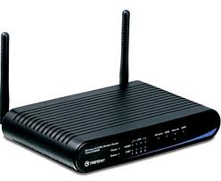
Introduction to Wi-Fi
Wi-Fi (wireless fidelity) is a wireless local area network (LAN) technology.
access point:- A hardware devices(router) that allows wireless communication devices to connect to a wireless network using Wi-Fi, Bluetooth etc.
Suitable for creating workgroups of stations that connect to an access point.
The wireless access point usually
connects to a router
(via a wired network).

Slide 15
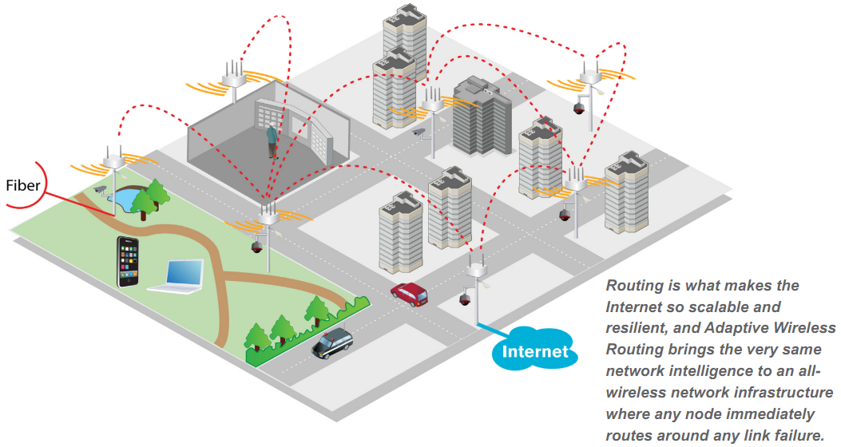

Slide 16
Conti…
The access point provides entry into an adjacent wired network.
The router allows us to connect multiple computers to the network using a single IP address, typically provided by our ISP.
Think of Wi-Fi as the wireless equivalent of Ethernet (defines a number of wiring and signaling standards for the Physical Layer of the OSI networking model).

Slide 17
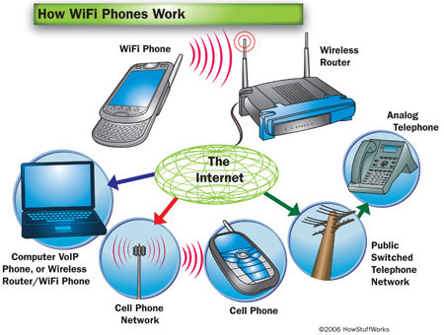
Example

Slide 18
WiFi Phones and how it works
WiFi phones are a lot like cell phones.
The phone translates the number we dial into packets of data.
It uses radio waves a kind of electromagnetic energy(10 kilohertz and 300,000 megahertz) to transmit the packets to a wireless receiver.

Slide 19
Cont…
The receiver passes the information over the Internet to the call processor like an ordinary VoIP call.
When we begin our conversation, the phone transmits our voice in packets of data as well our voice travels just like it does in a VoIP call, although the specifics can differ from one provider to another.
Voice over Internet Protocol, is a method for taking analog audio signal.

Slide 20
3G vs Wi-Fi

Slide 21
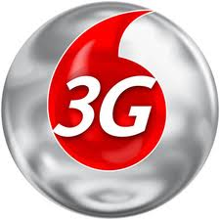

3G Wi-Fi

Slide 22
Speed
3G
Wi-Fi
This technology differs according to the kind of device and also whether it is stationary or in motion.
Maximum speed on 3G network is considered to be about 2.05 mbps.
It is faster and does not depend whether device is stationary or in motion.
The maximum speed of the standard of the latest WiFi technology is reported to be 600 mbps.

Slide 23
Numerical
Question
Solution
Plan Speed=512kbps.
We have to download a 20MB video song.
How much minute will require?
20MB=20*1024*8kb
512kb=1s
1kb=(1/512)s
So 20mb=(1/512)*20*1024*8 s
=320s
=320/60=5.67 MINUTE
If speed is 600mbps
320/600=.53 seconds

Slide 24
Functioning
3G
Wi-Fi
Completely provided by the service provider.
For 3G, we need to get in touch with our service provider(BhartiAirtel, Vodafone, Reliance, Tata DOCOMO, Idea Cellular,
Aircel ).
It’s access can be controlled by a WiFi router located in a specific range from the access .
Today, most malls, cafes, and major streets have WiFi routers for quick Internet access point.

Slide 25
Range and Signal:-
3G
Wi-Fi
Ranges in kilometers.
It depends on the mobile service provider, we will receive signal reception as long as we are in the network range.
While traveling, using 3G access is more appropriate.
Short range .
Receive signal within the range of the router situated in the hotspot.
A hotspot is a node that offers Internet access over a wireless local area network through the use of a router connected to a link to an internet service provider.

Slide 26
Frequency
3G
Wi-Fi
Low frequency.
In the case of a voice signal having a minimum frequency of 300 hertz (Hz) and a maximum frequency of 3,300 Hz.
High frequency.
Wi-Fi operates in 2.4GHz or 5GHz.

Slide 27
Cost
3G
Wi-Fi
The cost of 3G is high.
The cost of 3G access depends on the plan we have chosen from our service provider.
Compare to low.
WiFi at some hotspots is free, while others may charge a certain amount.

Slide 28
Security
3G
Wi-Fi
We need a VPN to protect our data over it's entire path beyond the mobile network and across the Internet.
Virtual Private Network. A software application that creates a secure connection between a public computer network and a private one.
Wifi depends on the network to which we connect.
Public WiFi in hotels etc is generally run with no security and is easily intercepted within the range of the WiFi signal.

Slide 29
Advantage of 3G over Wi-Fi
Wide area Technology.
More Secure.
Availability.

Slide 30
Advantage of Wi-Fi over 3G
Low cost.
High speed.

Slide 31
3g VS Wi-fi
THANK YOU
By:-
Dinkar Prasad Maurya
dinakar.maurya.cs12@iilm.ac.in

