Slide 1
Introduction of Xamarin
Xamarin.Forms
Presented by:
Dinkar Kumar
Notes:
Intro, welcome and other PMD things

Slide 2
Introductions
Name
Profession: Student/Android/IOS Developer etc.
Xamarin experience
Expectations (if any ☺ )

Slide 3
Agenda
What is Xamarin?
Why Xamarin ?
Xamarin.Forms .
Xamarin Studio.
Xamarin.Native vs Xamarin.Forms.
Pros and Cons of Xamarin.Forms
Demos (wherever needed)

Slide 4
What is Xamarin?

Slide 5
What is Xamarin?
Xamarin brings open source .NET to mobile development, enabling every developer to build truly native apps for any device in C# and F# as it provides wrapper over platform specific SDKs.

Slide 6
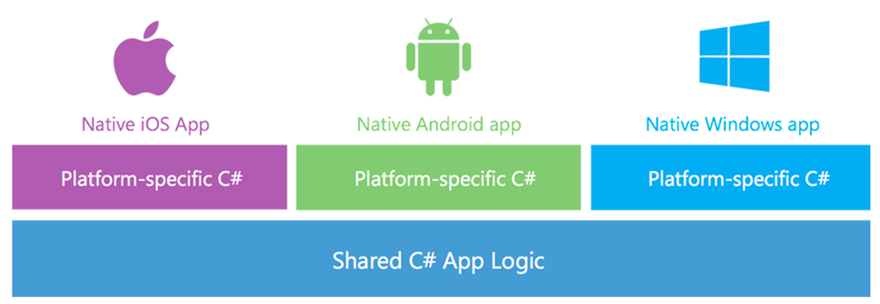
Xamarin

Slide 7
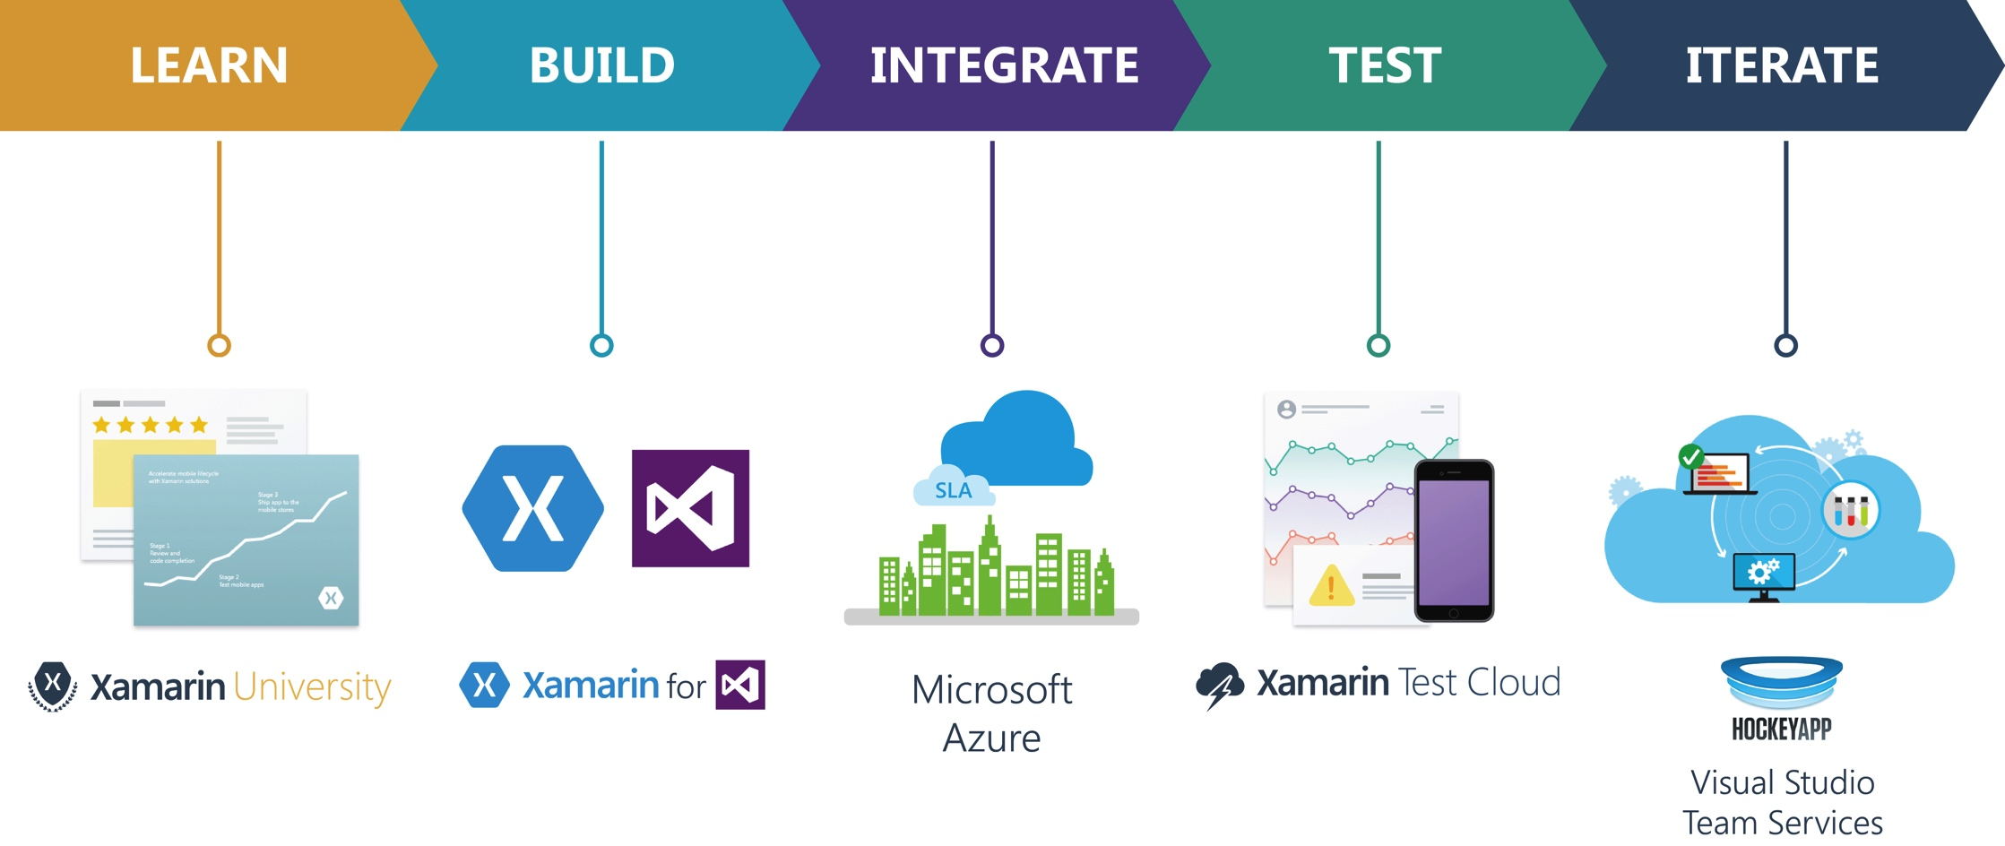
Xamarin ecosystem

Slide 8
Xamarin Products
Domain | Product | Open/Licensed
Build | Xamarin SDK | Open
IDE | Xamarin Studio/Visual studio plugin | Only Community Edition free
Test | Xamarin Test Cloud | Licensed
Distribute/Reporting | Xamarin Insight/HockeyApp | Free for limited Apps only
Learn | Xamarin University | Few Self learning Tutorials are free

Slide 9

Xamarin Customers

Slide 10
Xamarin vs Web based
 | Xamarin | Web Based(Ionic)
SDK | Open source | Open source
UI | Native | Web UI
Development Speed | Relatively slower | Relatively faster
Access to Device API | Full | Limited
Language | C# | HTML,CSS,JS
Performance | Like Native | Relatively slower/slaggy
Maintainability | Very efficient | Complex for large projects
User experience | Great | Just ok
Notes:
Memory related issues are there in ionic

Slide 11
Why Xamarin?

Slide 12
Why Xamarin?
Native UI in all three platforms.
Provide code sharing
Full access to all Native APIs.
Gradual learning curve.

Slide 13
Why Xamarin?
Development Time and cost will be less.
Not limited to mobile app development.
Mac apps
Wears
tvOS
OpenGL Games

Slide 14
When to Choose Xamarin
When to choose | Native(Android/IOS) | Xamarin(Form/Native)
Targeting only one platform | Native makes sense | Xamarin if you are planning to release on other platform soon enough
Basic enterprise app (more than one platform) | No need to waste resource | Xamarin Form will be good choice(nearly 90+% code sharing)
Basic enterprise app (one platform) | Native make sense if already have Native Developer | Xamarin if C#/.NET developer is there
Daily Average App (evenly distributed UI and logical code) | If only one platform is targeted | Xamarin Native will make sense with around 50-60% code sharing
Heavy UI based App | Native will be always better for best performance and community support in case of heavy customized UI based App | Xamarin Native will also do but there will be less code sharing. But good thing is only C#/.NET will enough

Slide 15
Parameters
Platforms targeted
End user
UI complexity
Cost
Developer expertise

Slide 16
Case Study
Client A want to create NFC based App
Client B wants to create Leave management system for their enterprise
Client C wants to create Survey App to get feedback from their customer

Slide 17
Xamarin.Forms

Slide 18
Xamarin.Forms
Xamarin.Forms allows developers to easily create user interfaces that can be shared across Android, IOS, Windows.

Slide 19
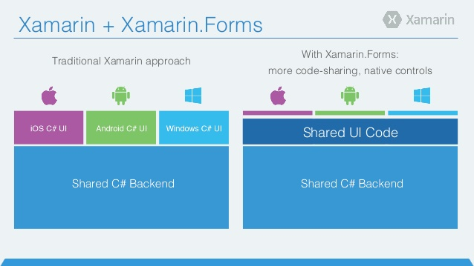
Xamarin.Forms

Slide 20
Platforms covered
Android API 15+
IOS 6.1+
Windows Phone 8.1+
Windows 8.1 Tablet/Desktop
Windows 10 Universal Apps

Slide 21
Prerequisites
Basic C#
XAML (only if you want to design UI in XAML)
Have basic idea about how views look on devices and which kind of view is required in which case.

Slide 22
XAML
XAML—the eXtensible Application Markup Language—allows developers to define user interfaces in Xamarin.Forms applications using markup rather than code.

Slide 23
Xamarin Studio Walkthrough

Slide 24
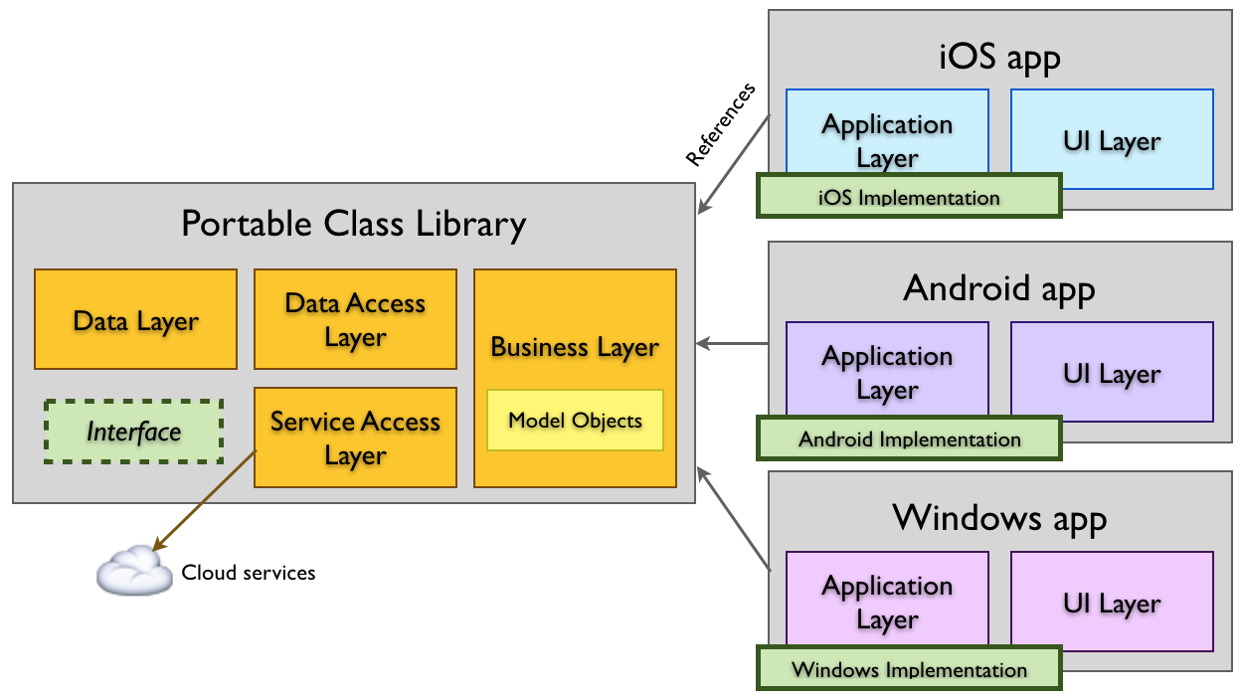
Portable Class Libraries

Slide 25
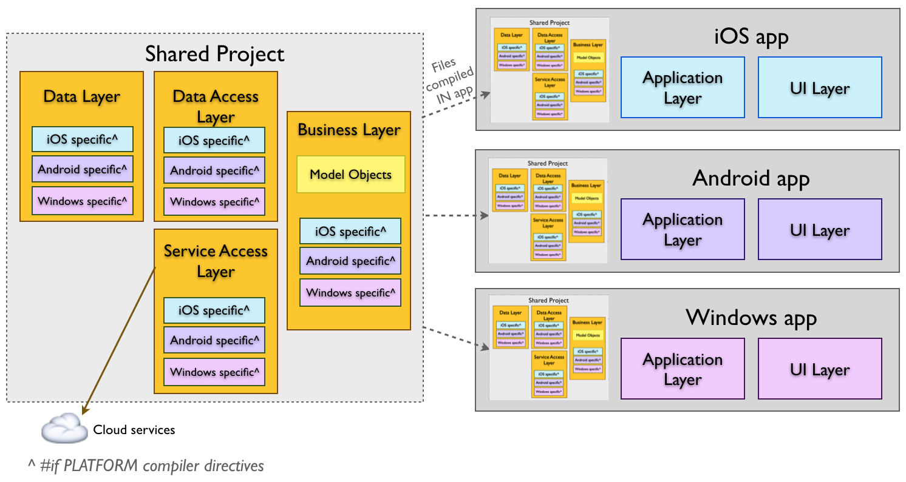
Shared Library

Slide 26
Xamarin.Forms
There are four main control groups used to create the user interface of a Xamarin.Forms application:
Pages
Layouts
Views
Cells

Slide 27
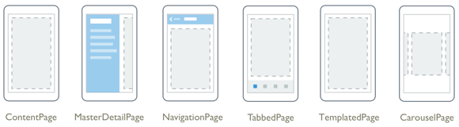
Xamarin.Forms Pages
Xamarin.Forms Pages represent cross-platform mobile app screens.
Notes:
https://developer.xamarin.com/guides/xamarin-forms/controls/pages/

Slide 28
Demo

Slide 29
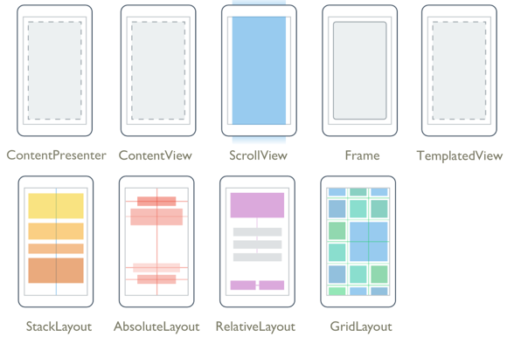
Xamarin.Forms Layouts
Xamarin.Forms Layouts are used to compose user interface controls into logical structures.
Notes:
https://developer.xamarin.com/guides/xamarin-forms/controls/layouts/

Slide 30
Demo

Slide 31
Xamarin.Forms Views
Xamarin.Forms views are the building blocks of cross-platform mobile user interfaces.
Some examples of Views:
Button
Entry
Label
ListView
Etc….

Slide 32
Xamarin.Forms Cells
Xamarin.Forms cells can be added to ListViews and TableViews.
A Cell is a specialized element used for items in a table or list
Cells are elements designed to be added to ListView or TableView controls.
it just describes a template for creating a visual element

Slide 33
Demo
Notes:
Async Await

Slide 34
Xamarin.Forms is best for
Data entry apps
Prototypes and proofs-of-concept
Apps that require little platform-specific functionality
Apps where code sharing is more important than custom UI

Slide 35
Xamarin.Native
vs
Xamarin.Forms
Na

Slide 36
Xamarin.Native vs Xamarin.Forms
Xamarin.Forms | Xamarin.Native
UI Layer is also shared | UI Layer is not shared
Suitable for MVP | Forms preferred for MVP despite you can create using Xamarin.Native also
Not Suitable for heavy UI based App | Good choice for heavy UI based App
Code sharing is main focus | Pixel perfect native UI widget is main focus
Plain learning curve | Comparatively steep learning curve
Fast development | Comparatively slow development
Low cost | Relatively high cost
Note: Xamarin.Forms also create completely native app

Slide 37
Pros and Cons
Xamarin.Forms

Slide 38
Pros and Cons Xamarin.Forms
Pros | Cons
Build native UI for all three platforms with single code base. | Not preferred for UI heavy Apps
Launch MVP (Minimum Viable Product) app to major platform quickly. | UI will not be same in All platform but will be as per guidelines
Highest possible code sharing around 90+ %. | Not preferred to achieve pixel perfect UI
Active community | Not All Widget or Native functionality is available
Active community
Microsoft owned ☺

Slide 39
Q & A

Slide 40


Slide 41
Demo Repository
https://github.com/dinkar19121991/XamarinMeetup

Slide 42
References
https://blog.talentica.com/2017/01/25/why-xamarin-is-awesome/
https://blog.talentica.com/2017/01/27/1397/
https://developer.xamarin.com/guides/xamarin-forms/
https://www.xamarin.com/customers

