Slide 1



CAMPUS SNACKS AND FRUITFUL FINDS
Bagongon, Angelica G.
Baguinang, Lenie L.
Comajig, Deanne Marie F.
Omictin, Rashel B.
Ragpala, Jessa Mia B.

Slide 2

INTRODUCTION
The university campus is a whirlwind of activity, demanding energy and focus from students navigating their academic and social lives. To meet this need, we present “Campus Snacks and Fruitful Finds,” an innovative online platform designed to make a diverse range of snacks and fresh fruits accessible and convenient for our busy campus community. By connecting students, faculty, and staff with a wide variety of tasty treats and healthy fruits.

Slide 3
INTRODUCTION
Campus Snacks and Fruitful Finds offers a quick and easy way to satisfy cravings. Our platform features an extensive selection of options, from snacks, pastry, drinks, and fruits, ensuring there’s something for everyone. Whether you’re between study sessions, studying late at the library, or enjoying a break with friends, our service is designed to fit seamlessly into your lifestyle. With a friendly e-commerce system, we provide an efficient, user-friendly experience for ordering and receiving delicious options. Plus, our commitment to quality means you can enjoy fresh, flavorful choices delivered directly to you.

Slide 4
Objectives
To help students and faculties to order snacks and fruits easier.
To provide variety of chips, fruits, pastries, and drinks on campus.
To help students and staffs for convenient payment.
To provide a quick and hassle free purchasement of snacks and fruits.
To improve and enhance campus life.

Slide 5
Scope and Delimitation
The Campus Snacks and Fruitful Finds system is an ordering platform that aims to enhance the student experience by providing convenient access to snacks and fruits at various locations across campus. While it provides a simple way to place orders, its current functionality is severely limited by its lack of essential features, hindering its user experience and potential for growth.

Slide 6
Scope and Delimitation
Scope:
Basic Ordering: The system allows users to browse a limited selection of products and place orders for delivery. This is the primary function of the system, but it lacks the features necessary for a robust and user-friendly experience.
Cash on Delivery: The system relies solely on cash on delivery, which may be convenient for some users but limits options for online payment methods.
Campus-Specific: The system's focus on campus snacks suggests a targeted audience within a specific geographical area

Slide 7
Scope and Delimitation
Limitations:
Manual Operations: The absence of a "select all" button, checkboxes, and other features requires users to manually select each item, making bulk orders tedious and prone to errors.
Limited Product Information: The system lacks product descriptions and details leaving users with minimal information to make informed decisions about their purchases. This deficiency can lead to dissatisfaction and uncertainty about the quality and nature of the products.
No Notifications: The system lacks any notification system for order confirmations, updates, or other important information. This can lead to confusion and dissatisfaction among users who may not be aware of the status of their orders.
Limited Payment Options: The system's reliance on cash on delivery limits its potential customer base and restricts its ability to cater to users who prefer online payment methods.

Slide 8
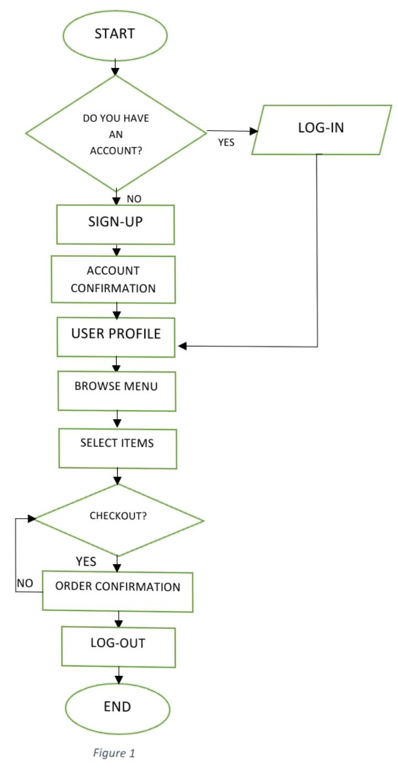
FLOWCHART
USER
The process begins with the user entering the system. The system then asks if the user has an existing account. If yes, the user logs in using their valid credentials, and if no, the user is directed to create a new account through the sign-up process. If a new account was created, the system confirms the account details. The user can then view and enter the user profile where the user can explore different options. The user can browse through different menus available and can select items to their shopping cart. The user proceeds to the checkout page where the user reviews their order details, and if they want to proceed to payment or if the user wants to continue browsing menus. Upon successful payment, the system generates an order confirmation to the user. The user can log out of their account whenever they want and the process concludes with the user logging out of the system.

Slide 9
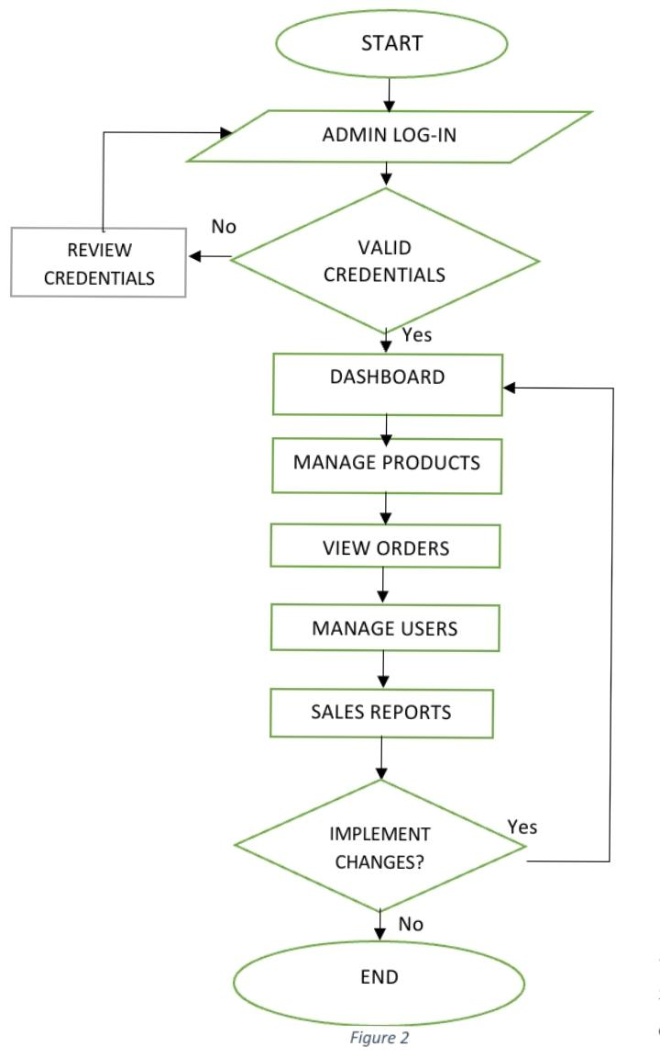
FLOWCHART
The process begins with the ‘Admin Log-In’. Once the admin attempts to log in, the system checks whether the credentials provided are valid. - If the ‘credentials are not valid’, the admin is asked to review credentials, until correct credentials are entered. - If the ‘credentials are valid’, the admin is granted access to the ‘Dashboard’. The dashboard serves as the central hub from which various administrative tasks can be managed. From the dashboard, the admin has several options. First, ‘Manage Products’, the admin can add, remove, or update products within the system. Second, ‘View Orders’, the admin can view the list of orders placed by customers, along with relevant details. Third, ‘Manage Users’, the admin can oversee user accounts, modifying user information, or deleting users. Lastly, ‘Sales Reports’, the admin can create reports based on various metrics or data points within the system. After performing any of the above tasks, the system asks whether the admin wants to ‘implement changes’. If ‘no changes are needed’, then process ends and If the ‘admin decides to implement changes’, the admin may continue managing the platform to implement changes. The process is then complete, leading to the End of the session.

Slide 10
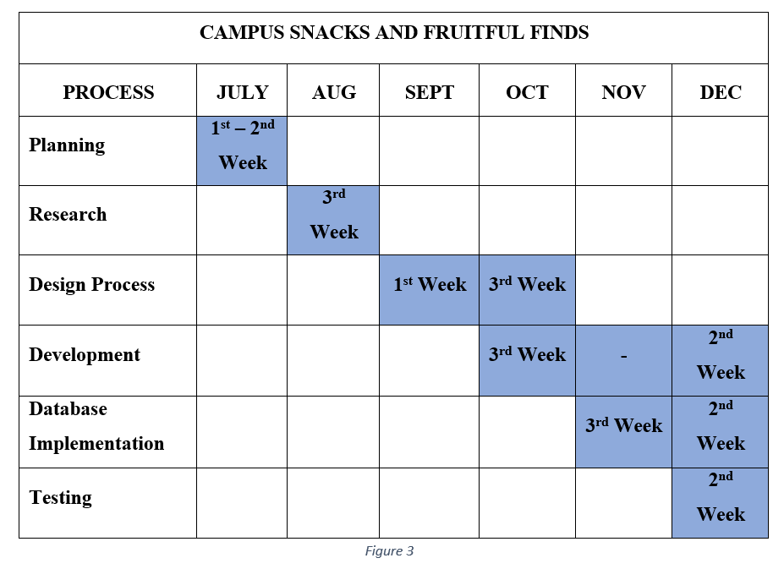
GANTT CHART

Slide 11
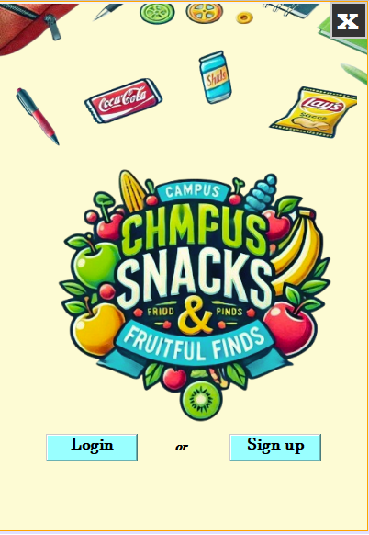
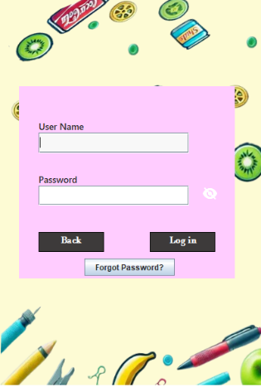
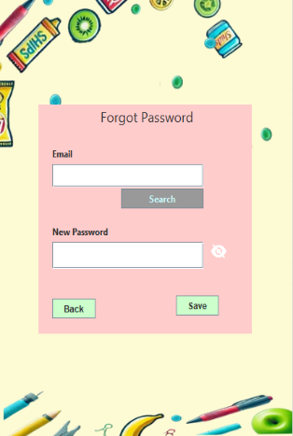
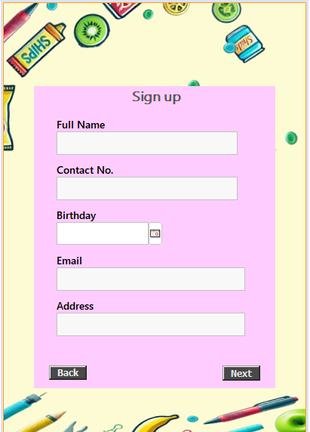
SYSTEM DESIGN
USERS UI

Slide 12
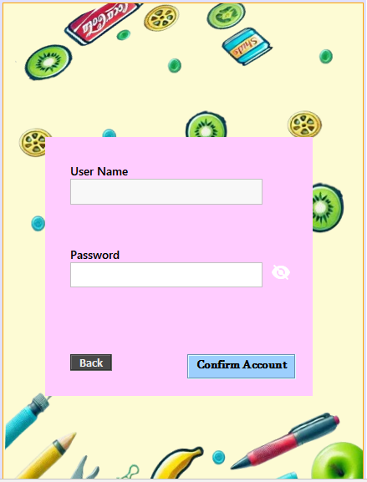
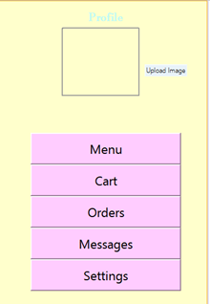
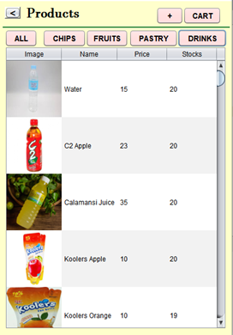
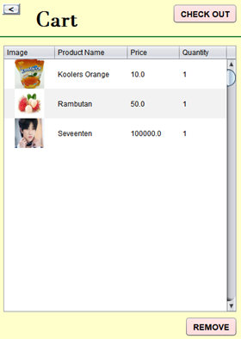
SYSTEM DESIGN
USERS UI

Slide 13
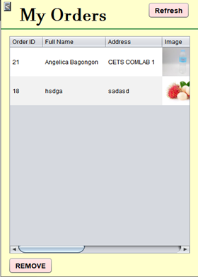
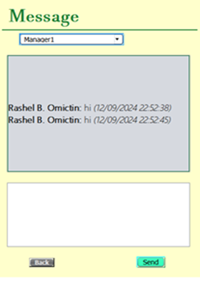
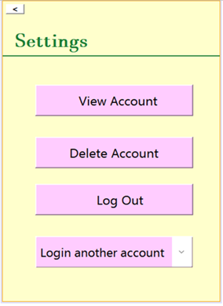
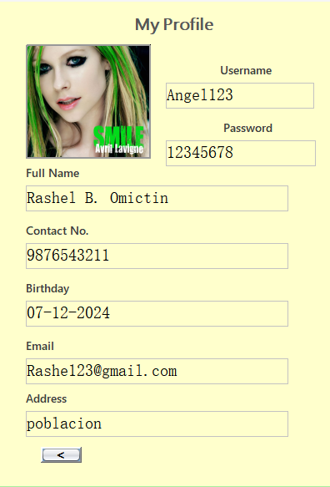
SYSTEM DESIGN
USERS UI

Slide 14
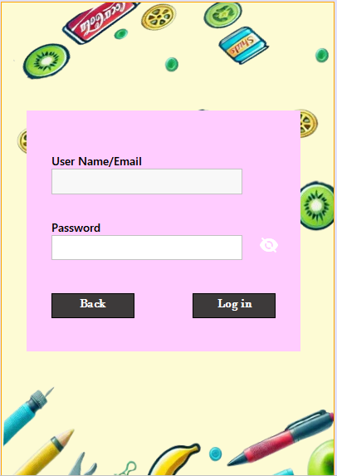
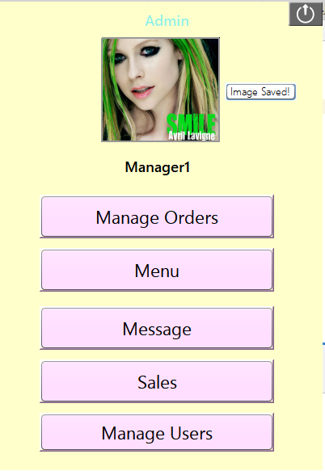
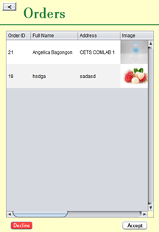
SYSTEM DESIGN
ADMIN UI

Slide 15
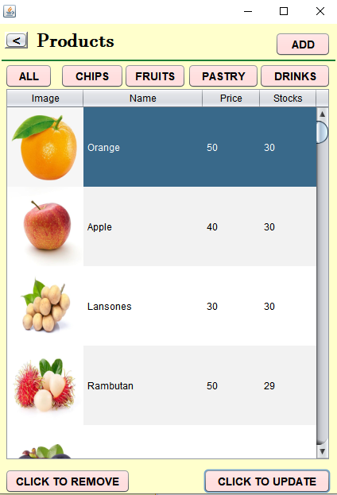
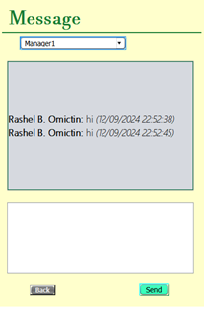
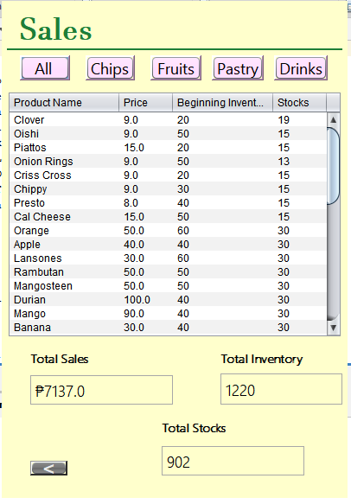
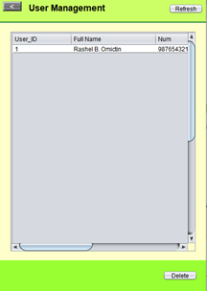
SYSTEM DESIGN
ADMIN UI

Slide 16
CONCLUSION
To conclude, “Campus Snacks and Fruitful Finds" is an online platform designed to provide the university community with easy access to a wide range of snacks and fresh fruits. The app aims to modernize campus dining by offering convenient, efficient, and healthy options that fit seamlessly into the busy lives of students, faculty, and staff. It also improves the campus dining experience by introducing ordering, COD payment option, and a feedback system through messaging. This will enhance convenience, reduce wait times, and offer valuable insights into user preferences. The key features are, menu browsing and ordering, order management, account management, feedback and reviews, analytics and reporting, platform management.
This application will improve campus dining operations, enhance user satisfaction, and promote healthier eating choices, while providing administrators with insights to improve services. In the end, this platform will create a better, more convenient, and healthier dining experience for everyone on campus.

Slide 17
RECOMMENDATION
To enhance the user experience and expand the system's capabilities, several improvements are crucial:
Implement Automation: Introduce features like "select all," checkboxes, and automated order processing to streamline operations and reduce manual effort.
Enhance Product Information: Provide detailed descriptions, images, and specifications for each product to enable informed purchasing decisions.
Add Notification System: Integrate a notification system to inform users about order confirmations, updates, and other important information.
Explore Online Payment Options: Consider integrating online payment gateways to offer users a wider range of payment options.
Search Bar: This enable users to filter products. This can help users find products faster and more accurately.
By addressing these limitations and implementing necessary improvements, "Campus Snacks and Fruitful Finds" can become a more user-friendly and efficient platform, expanding its reach and catering to a wider audience.

