Slide 1

Discrete Diffusion Models
Nils Strand
August 22, 2024

Slide 2
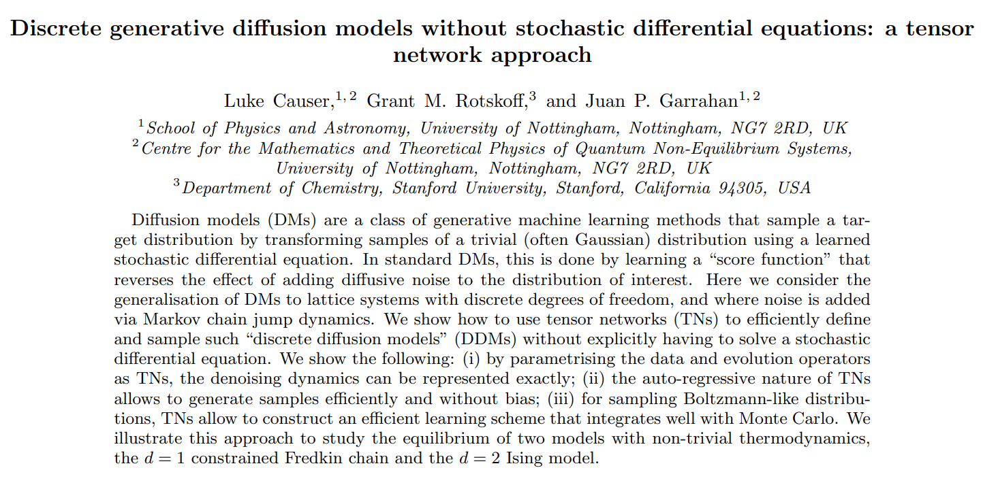

Slide 3
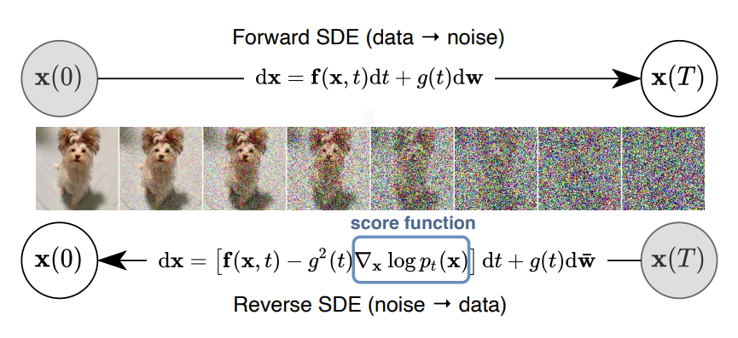
Score-based generative modeling
Y. Song et al. 2021 arXiv:2011.13456

Slide 4
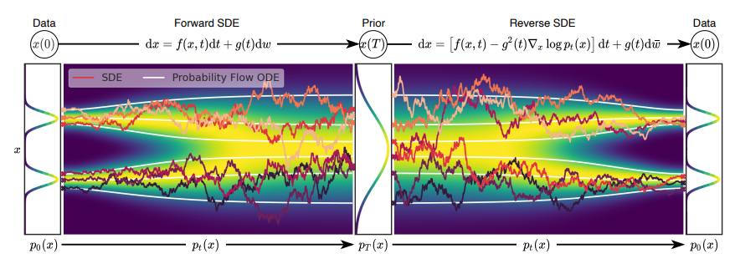

Score-based generative modeling
Score function
Y. Song et al. 2021 arXiv:2011.13456

Slide 5
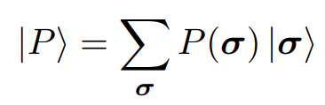
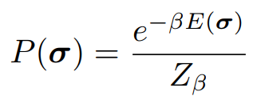
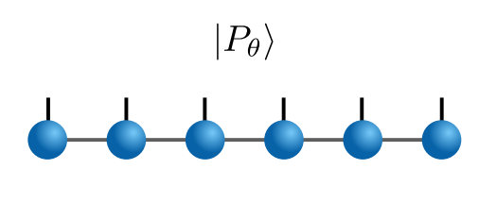
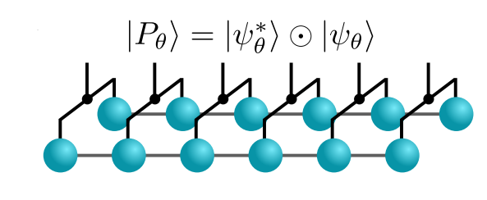

Discrete distributions as tensor trains
Target equilibrium distribution
Can force all probability values to be positive:
L. Causer, G. M. Rotskoff, J. P. Garrahan 2024 arXiv:2407.11133

Slide 6
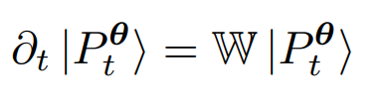
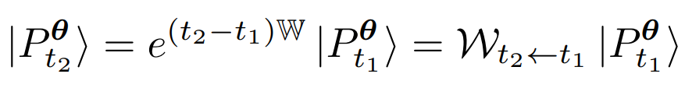
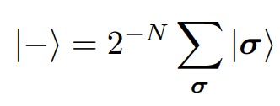

Tensor-based noising dynamics
Master equation
Finite-time propagator (“semi-group operator”)
Uniform distribution (“flat state”)
L. Causer, G. M. Rotskoff, J. P. Garrahan 2024 arXiv:2407.11133

Slide 7
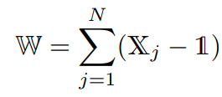

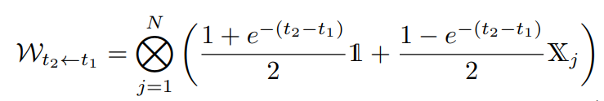
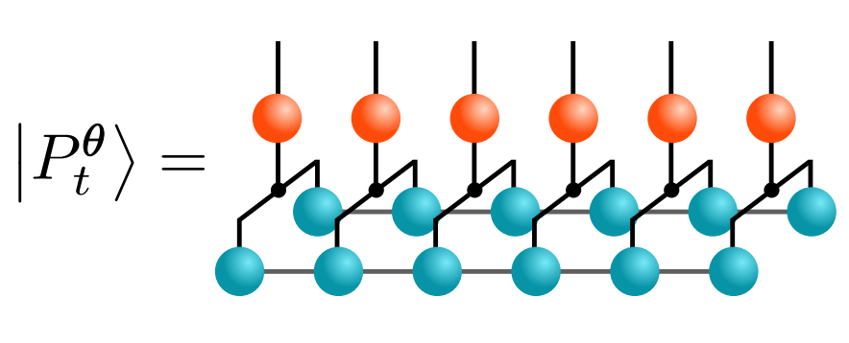
Tensor-based noising dynamics
Generator (non-interacting single spin flips)
Exact operator for noising dynamics
Rank-1 matrix product operator (MPO)
L. Causer, G. M. Rotskoff, J. P. Garrahan 2024 arXiv:2407.11133

Slide 8
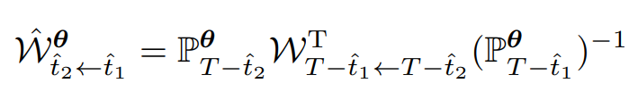
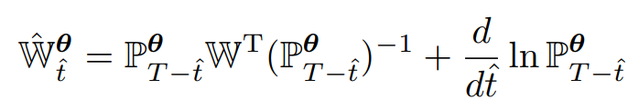

Tensor-based denoising dynamics
Diagonal operator
Explicit denoising difficult because P⁻¹ is not easily representable as a tensor network!
L. Causer, G. M. Rotskoff, J. P. Garrahan 2024 arXiv:2407.11133

Slide 9
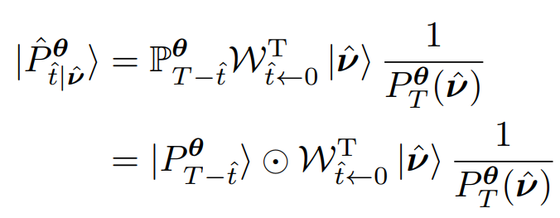
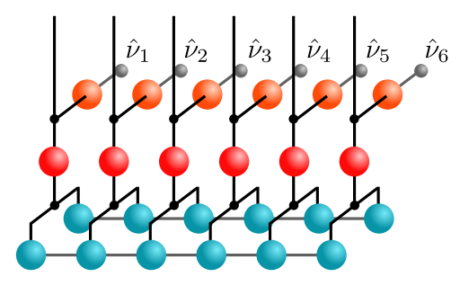

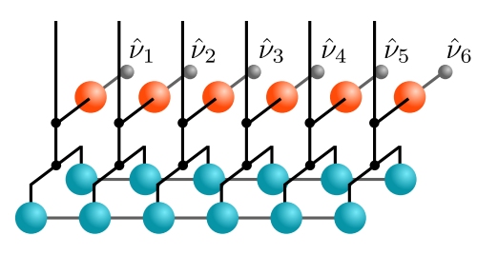
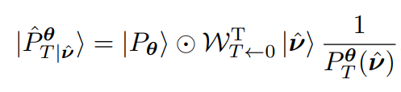
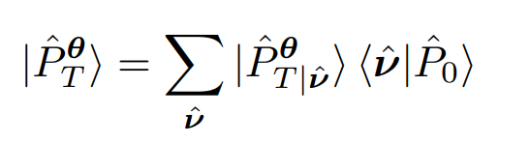
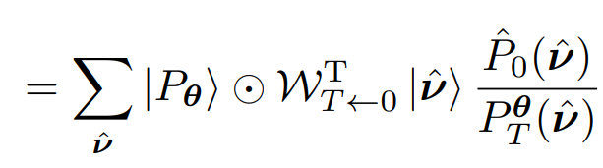
Tensor-based denoising dynamics
Evolution for a full time T
Final denoising probability vector
Not in TN form! Not easy to compute this!
L. Causer, G. M. Rotskoff, J. P. Garrahan 2024 arXiv:2407.11133

Slide 10
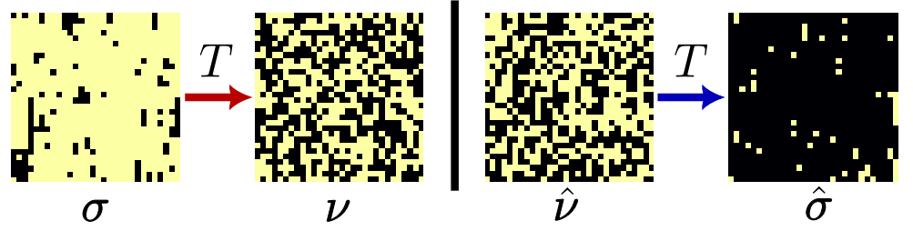
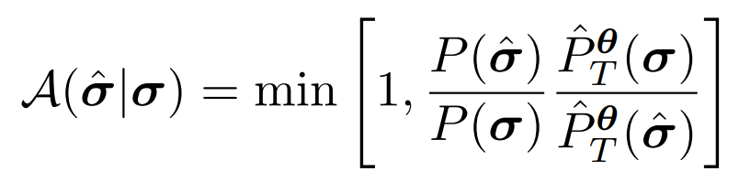
Disconnected update
Start denoising protocol from flat state
Naïve Metropolis acceptance rule
L. Causer, G. M. Rotskoff, J. P. Garrahan 2024 arXiv:2407.11133

Slide 11
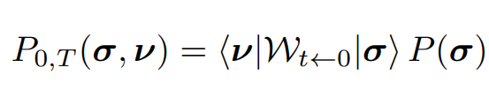

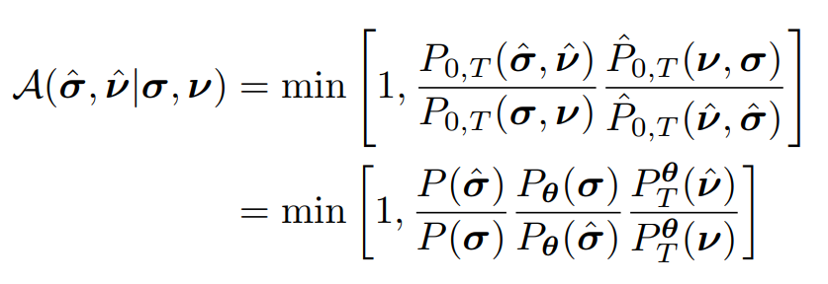
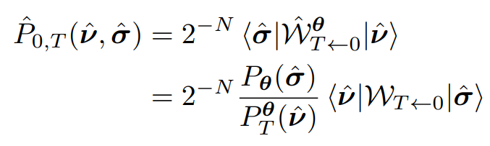
Disconnected update
Instead of just generating new final configuration, generate both start and end configurations simultaneously.
Flat state
Obtained from analytic energy function
L. Causer, G. M. Rotskoff, J. P. Garrahan 2024 arXiv:2407.11133

Slide 12
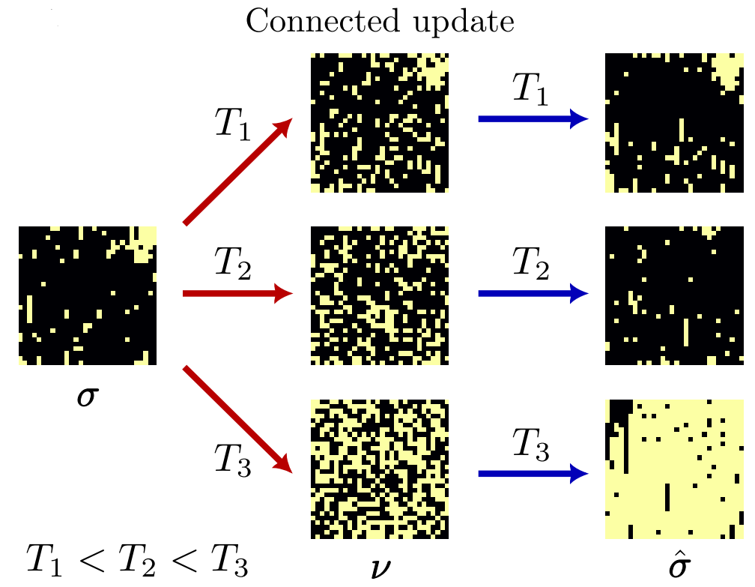
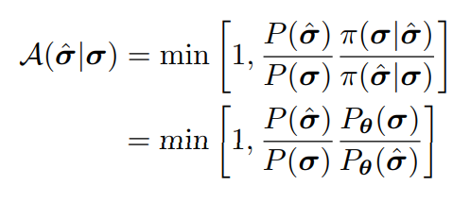
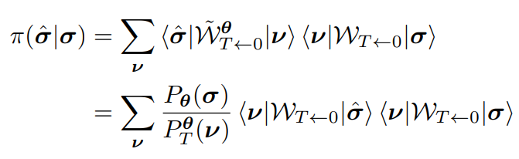
Connected update
Evolve using noising protocol for time T, then evolve latest distribution for another time T using denoising protocol.
L. Causer, G. M. Rotskoff, J. P. Garrahan 2024 arXiv:2407.11133

Slide 13
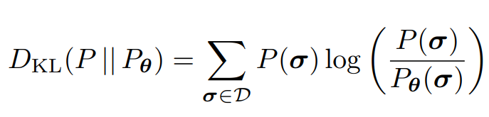


Using MCMC to improve the distribution
Minimize Kullback—Leibler divergence
This is useful only if we know the exact distribution in TT form
Negative log-likelihood (cost function)
Initialize rank 1 TT, set initial T to be small.
Then run multiple replicas to obtain an empirical average of the loss.
Periodically, update the TT using DMRG-based gradient descent, gradually increase rank, and gradually increase T (based on acceptance probability).
L. Causer, G. M. Rotskoff, J. P. Garrahan 2024 arXiv:2407.11133

Slide 14
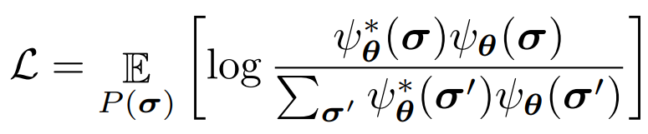
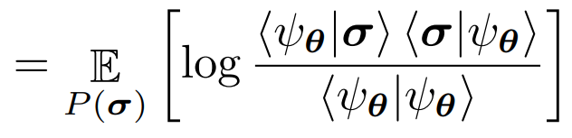
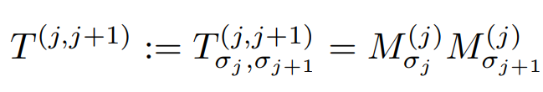
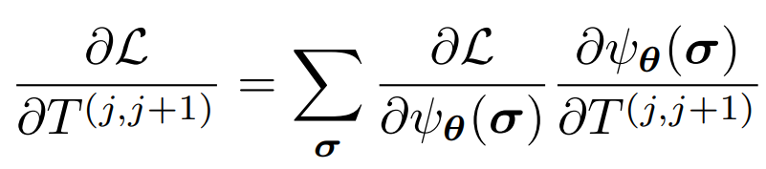
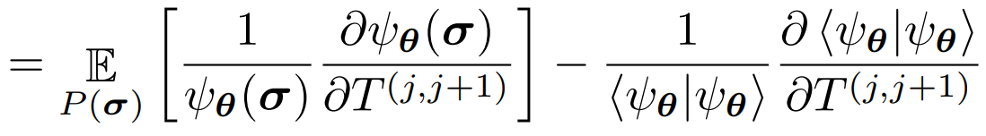
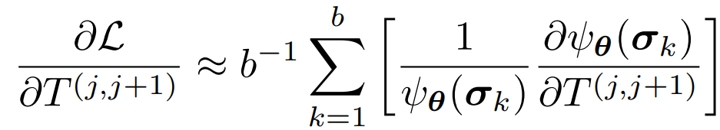
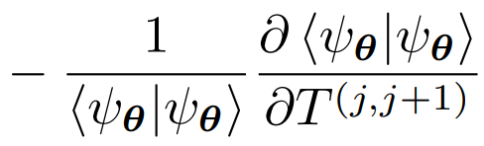
DMRG-gradient descent
“Bond tensor”
L. Causer, G. M. Rotskoff, J. P. Garrahan 2024 arXiv:2407.11133

Slide 15
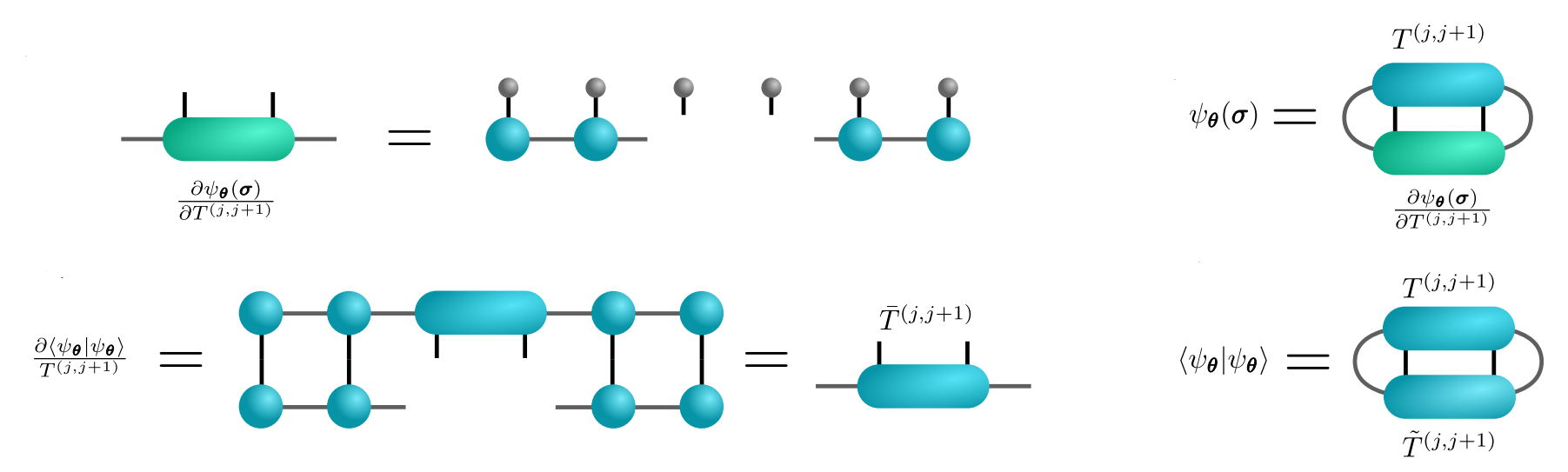
DMRG-gradient descent
L. Causer, G. M. Rotskoff, J. P. Garrahan 2024 arXiv:2407.11133

Slide 16
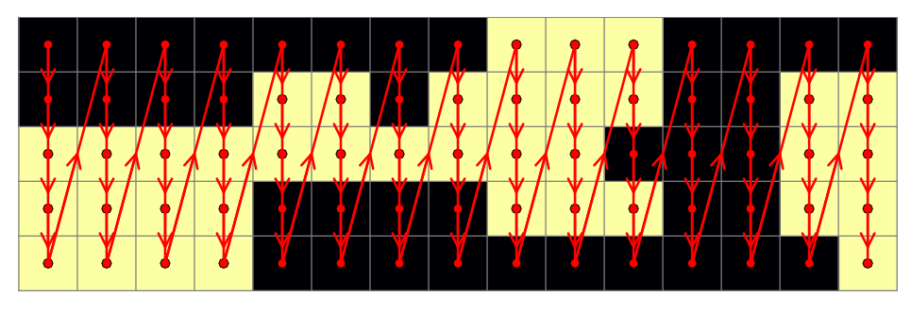
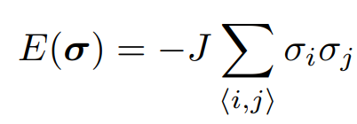
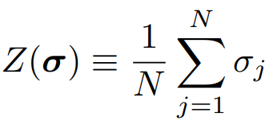
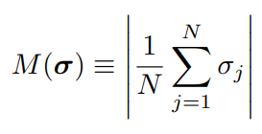
2D Ising model
Total magnetization
L. Causer, G. M. Rotskoff, J. P. Garrahan 2024 arXiv:2407.11133

Slide 17
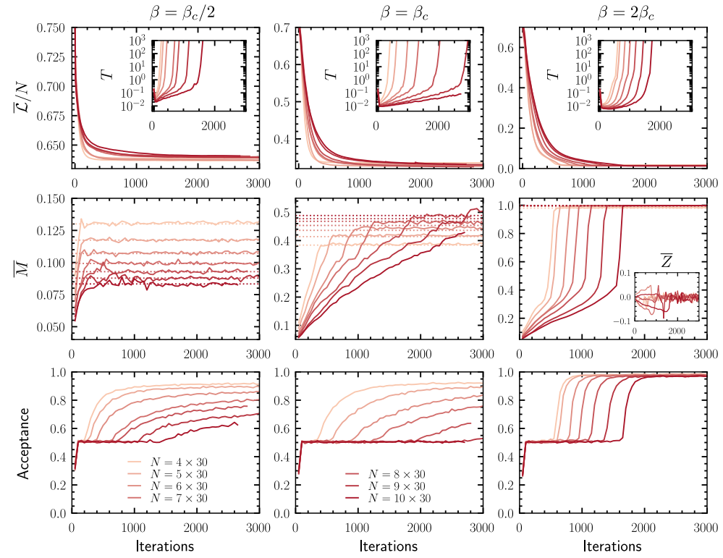
2D Ising model
L. Causer, G. M. Rotskoff, J. P. Garrahan 2024 arXiv:2407.11133

