Slide 1

Generative Modeling with Tensor Networks
Nils Strand
August 1, 2024

Slide 2
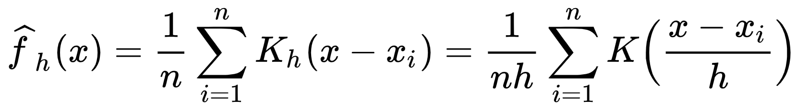
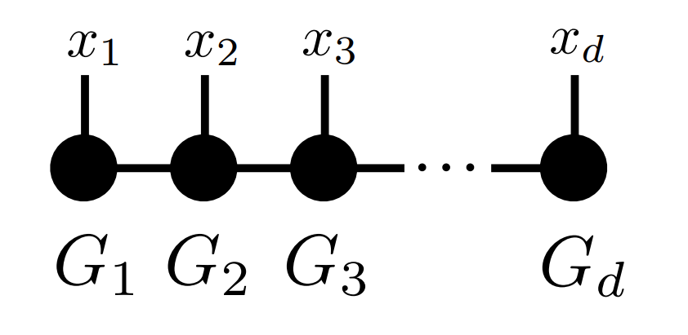
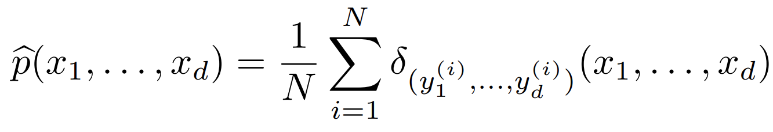
Density estimation: background
Kernel density estimation
Non-parametric method for estimating probability density functions
Curse of dimensionality: typically intractable for D>2
How can one represent a high-dimensional PDF more compactly?
One possible solution: tensor networks!
Empirical distribution
Y. Hur et al. 2023 Appl. Comput. Harmon. Anal. 67 101575

Slide 3


History of tensor networks (DMRG)
Matrix product ansatz
P. Helms, U. Ray, G. K.-L. Chan 2019 PRE 100 022101

Slide 4
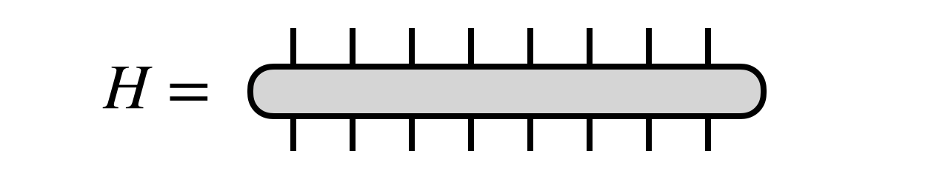
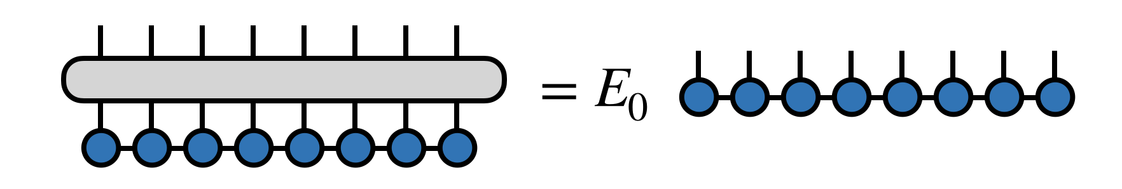
History of tensor networks (DMRG)
Operator H acting in Hilbert space consisting of product of N smaller Hilbert spaces
“Ground state energy”
We want the dominant eigenvector of H in the form of a tensor train

Slide 5
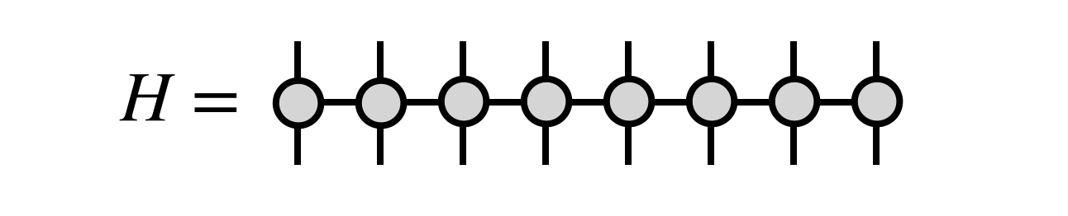
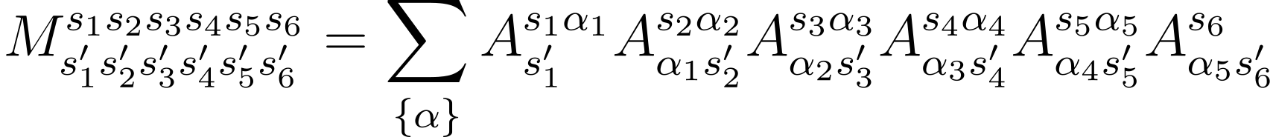
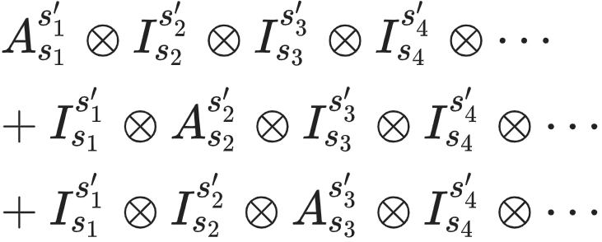
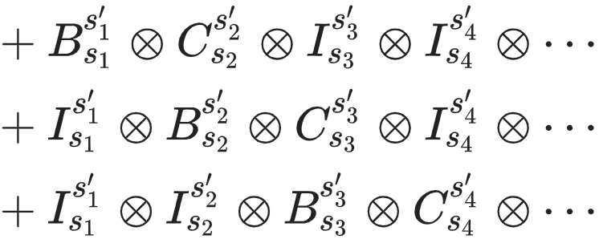
History of tensor networks (DMRG)
Matrix product operator
Single site terms
Two-site terms (nearest-neighbor)

Slide 6
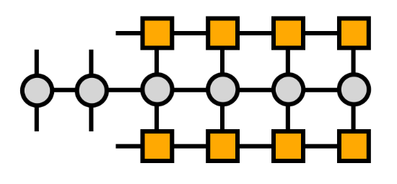
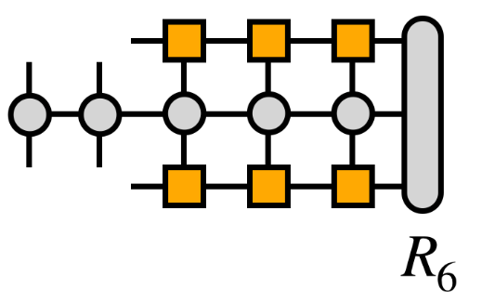
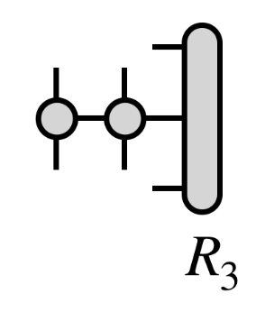
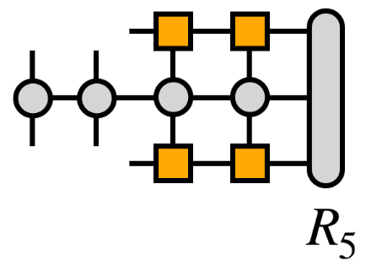
History of tensor networks (DMRG)
Compute and store environment tensors

Slide 7
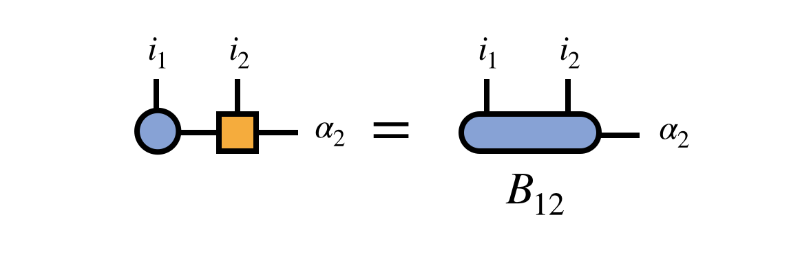
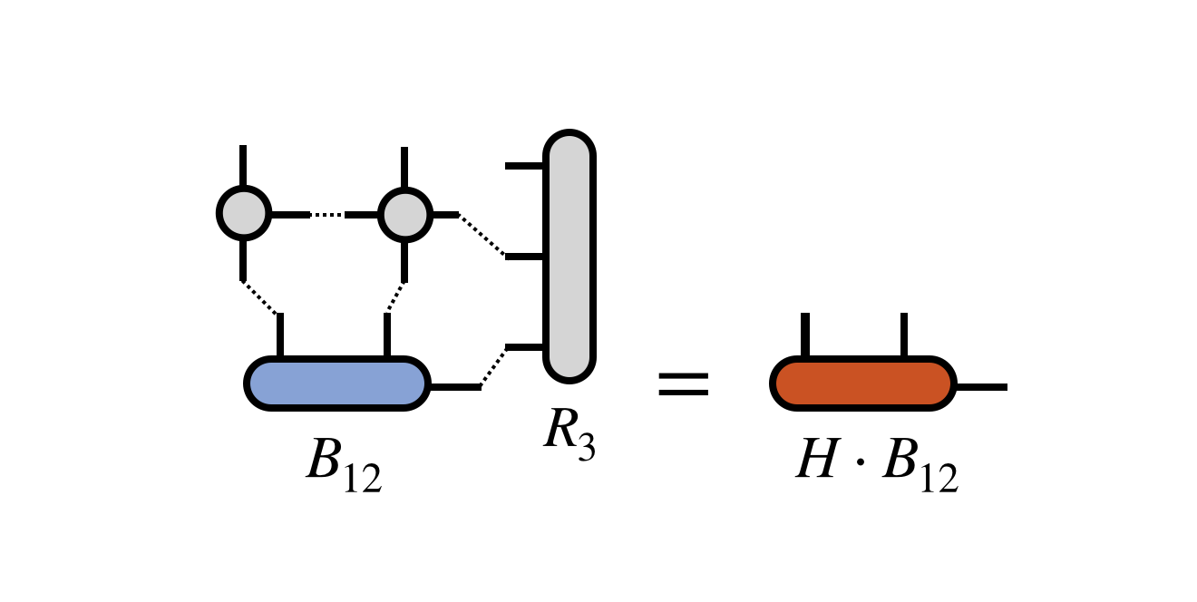
History of tensor networks (DMRG)
Two-site optimization
“Bond tensor”
Combining indices results in a square matrix
After computing the MPO and environment tensors, B₁₂ is optimized via standard eigensolver techniques (e.g. Davidson/Lanczos if Hermitian).
We seek the dominant eigenvector (corresponding to the top eigenvalue).
Action of operator on B₁₂

Slide 8
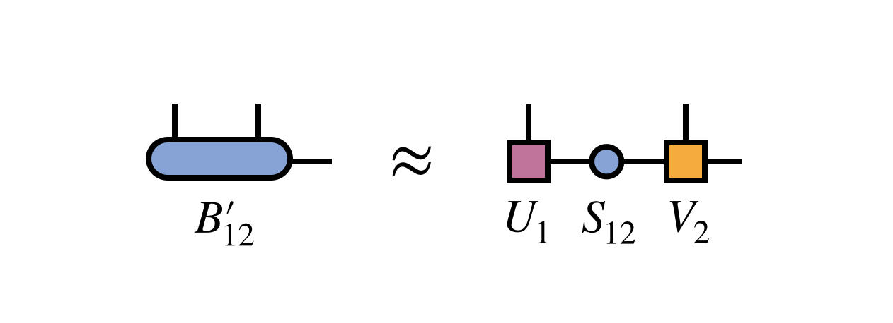
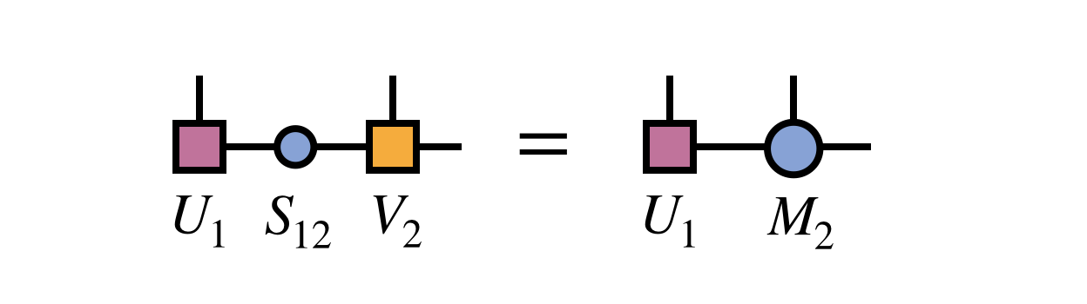
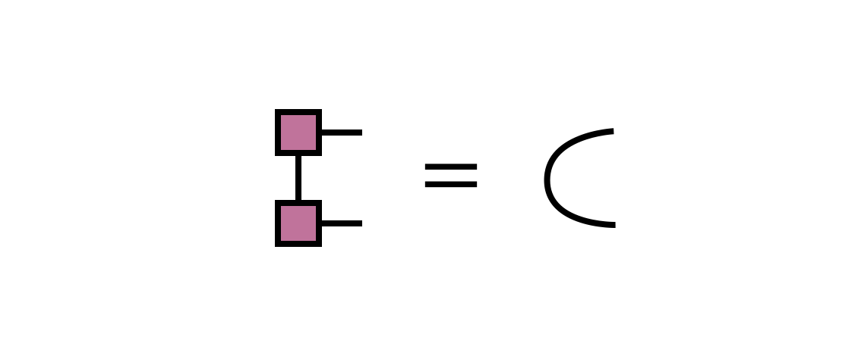
History of tensor networks (DMRG)
The result is an improved bond tensor B₁₂’ which more closely approximates the dominant eigenvector of H one is seeking.
Next, the tensor train is optimally restored via a singular value decomposition (SVD).
Keep at most m singular values

Slide 9
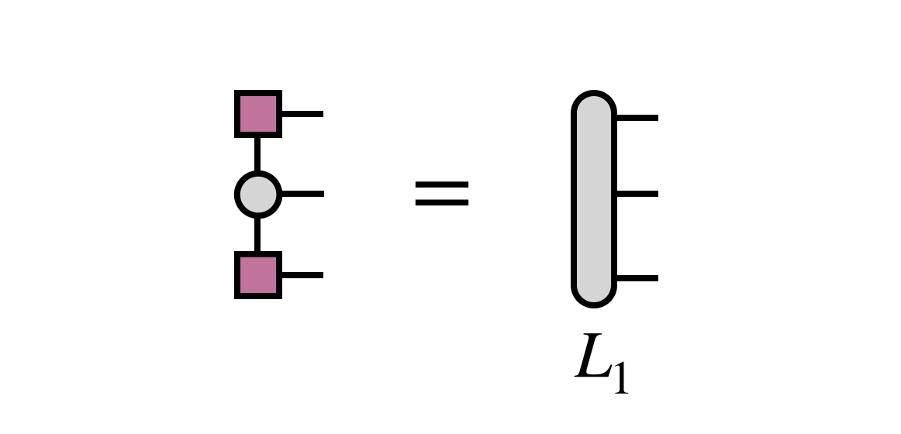
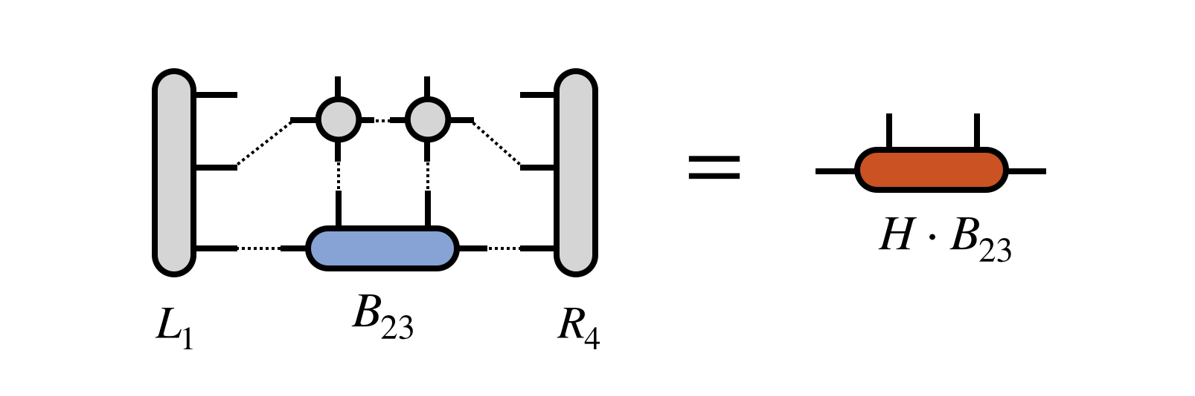
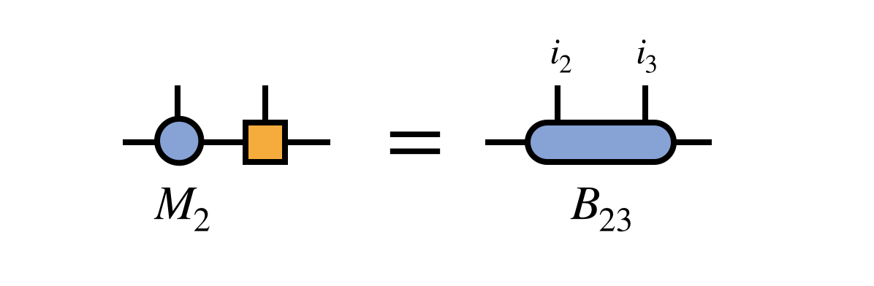
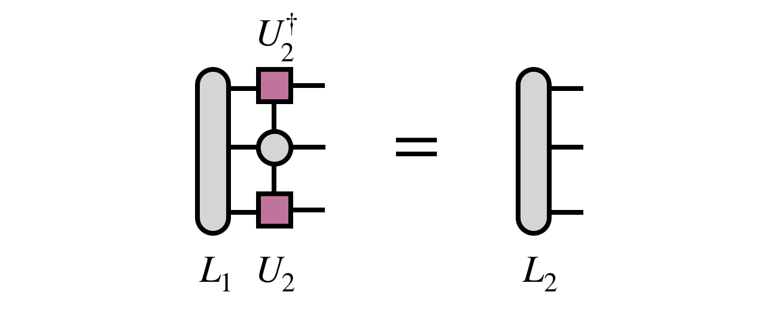
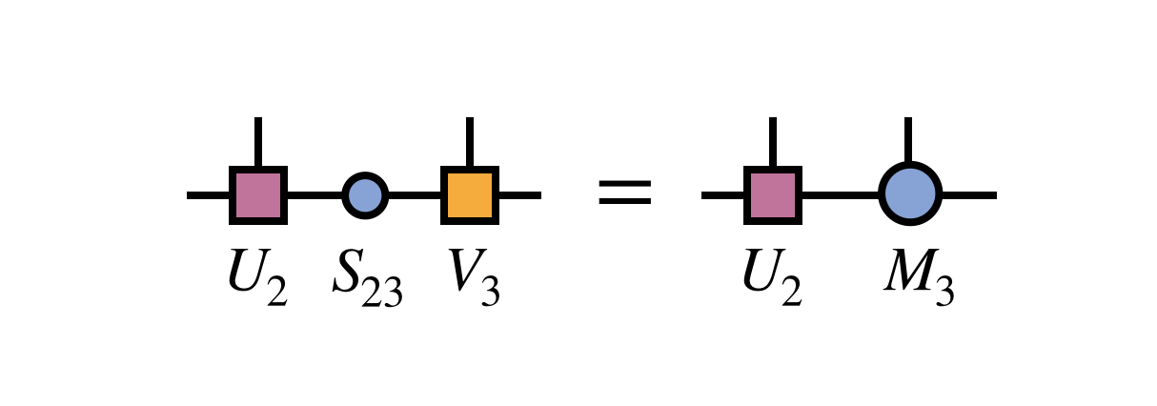
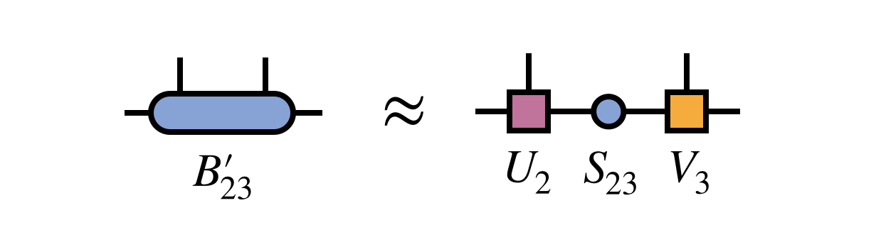
History of tensor networks (DMRG)
Contract adjacent MPS tensors
Compute left environment tensor
Compute dominant eigenvector of effective operator
Perform SVD and truncate
Compute next environment tensor

Slide 10
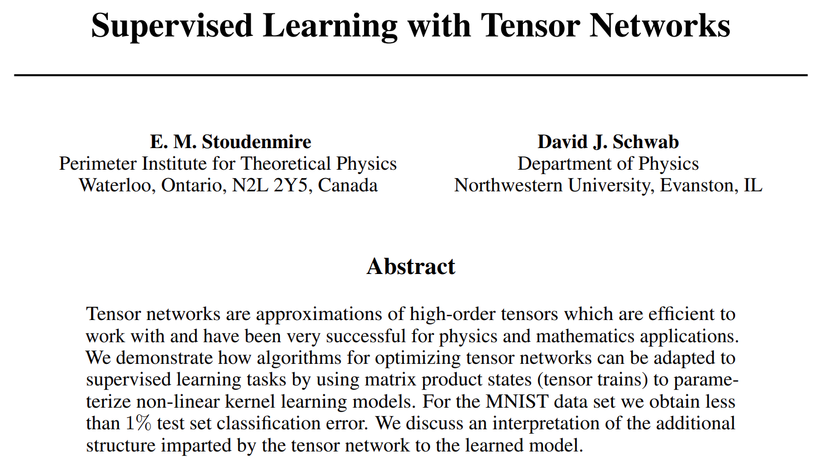
Can DMRG be used for machine learning?

Slide 11

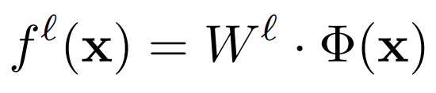
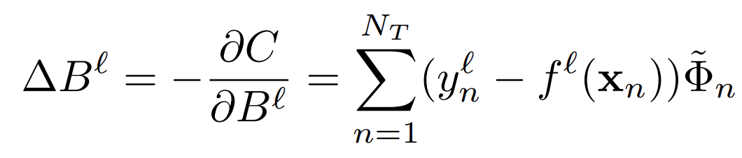
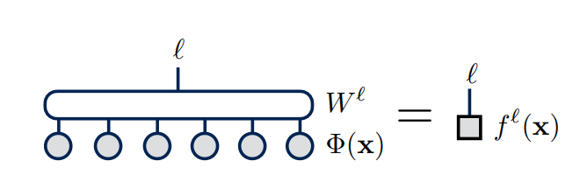
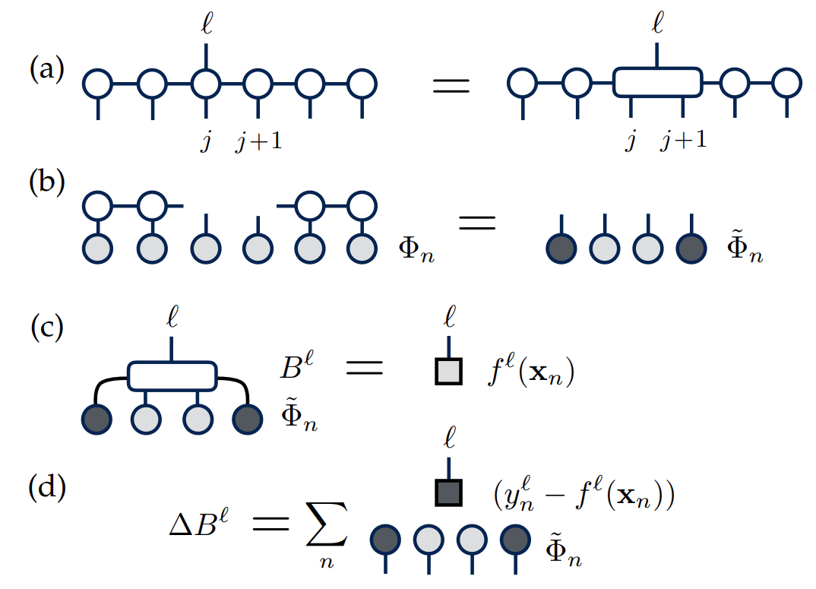
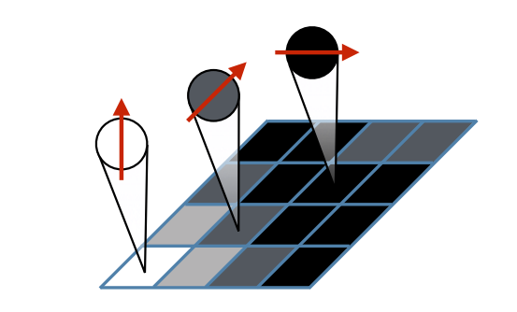
Can DMRG be used for machine learning?
Natural link between tensor decomposition and non-linear kernel learning (mapping of input vectors into high-dimensional space)
Cost function
Gradient update
E. M. Stoudenmire, D. J. Schwab 2016 NeurIPS

Slide 12
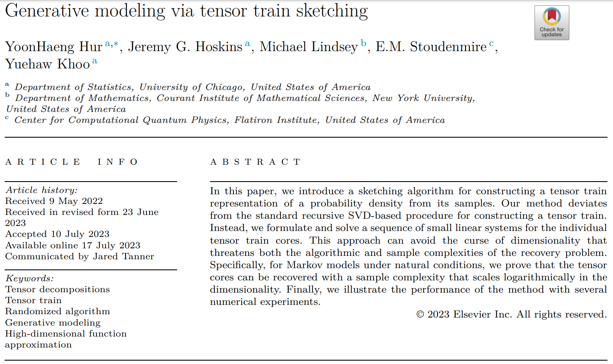
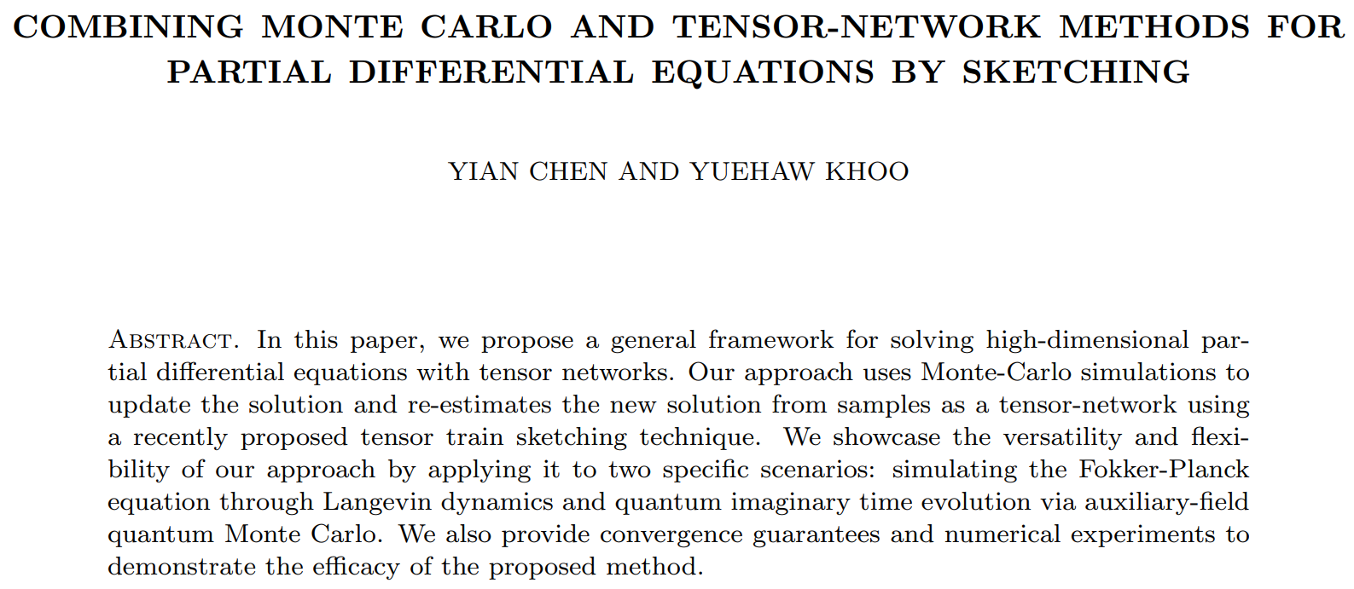

Slide 13
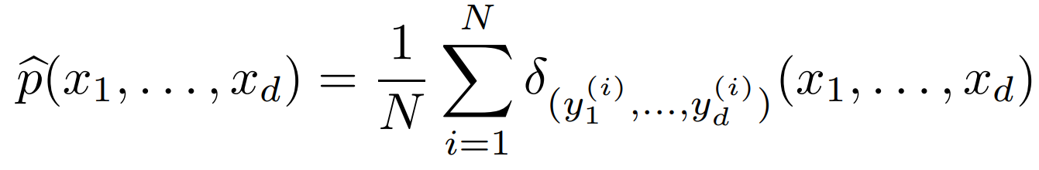
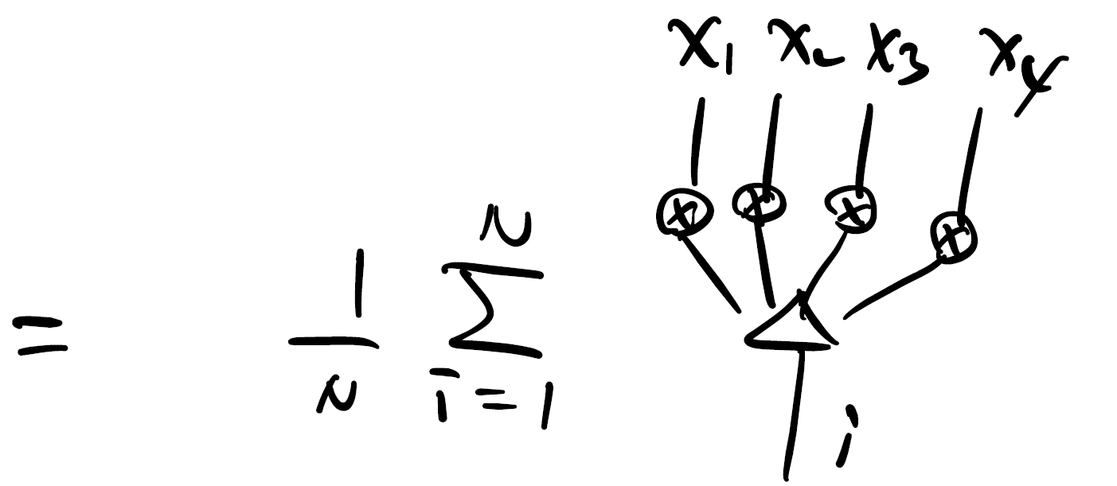
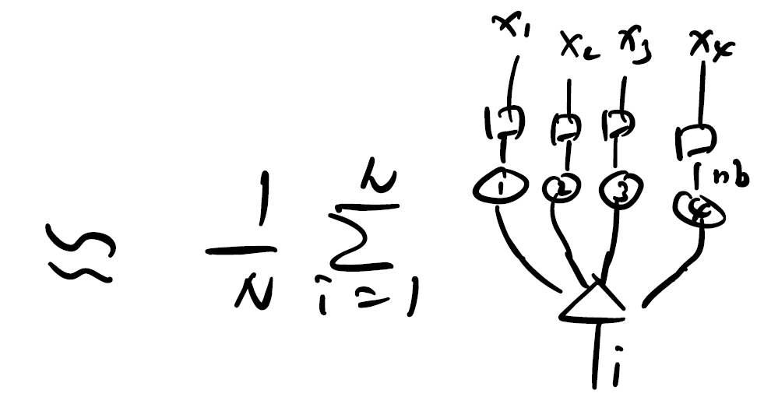
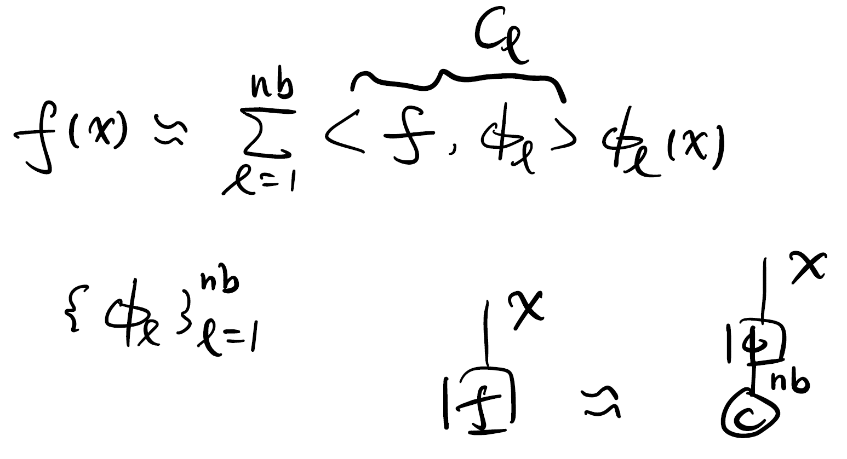
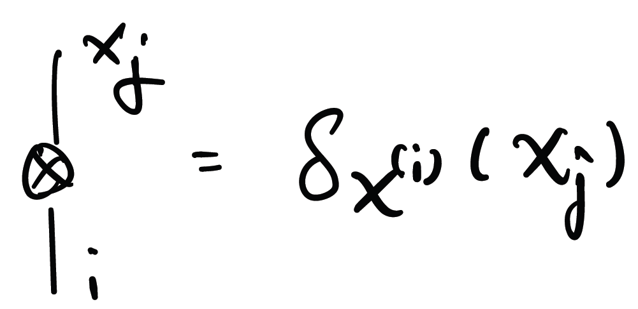
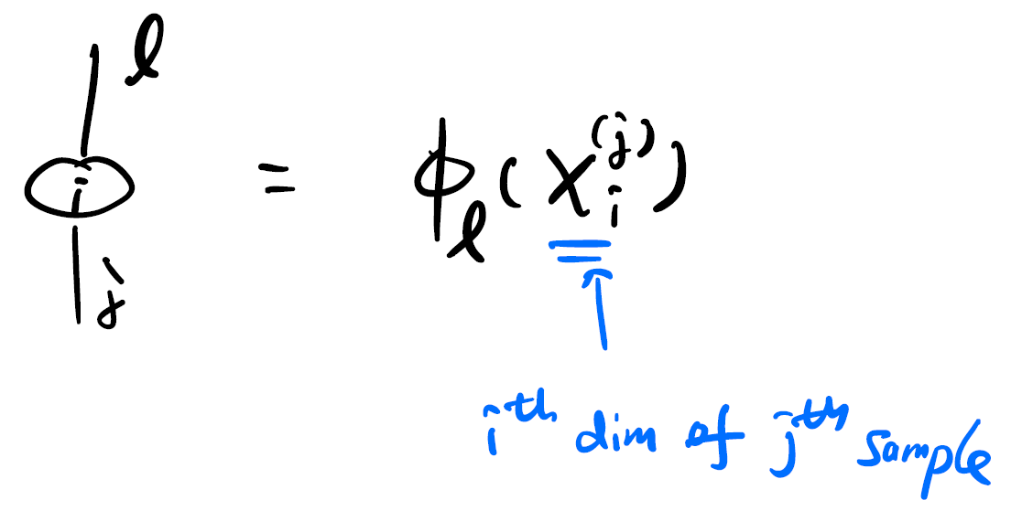
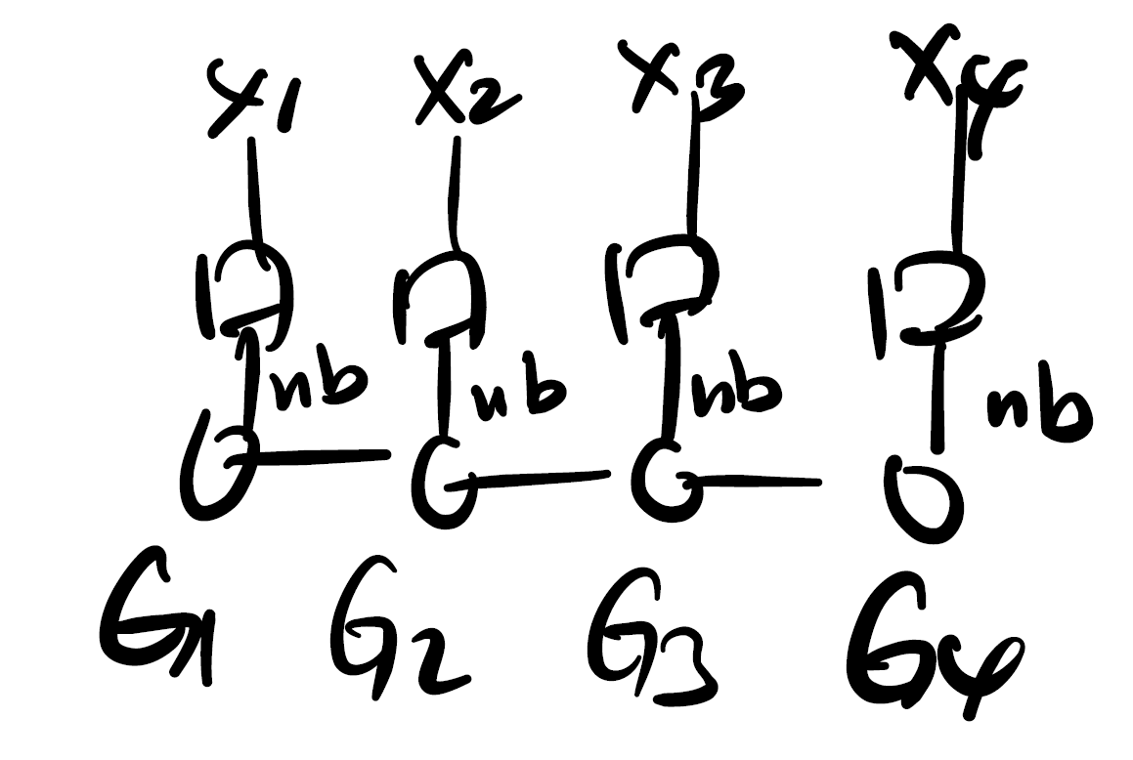
Tensor train sketching
Empirical distribution
Orthonormal basis expansion
As drawn, this is intractable!
Ultimate goal: find tensor cores G₁, G₂,…,G_{d} such that the resulting TT optimally captures the empirical distribution
Y. Hur et al. 2023 Appl. Comput. Harmon. Anal. 67 101575

Slide 14
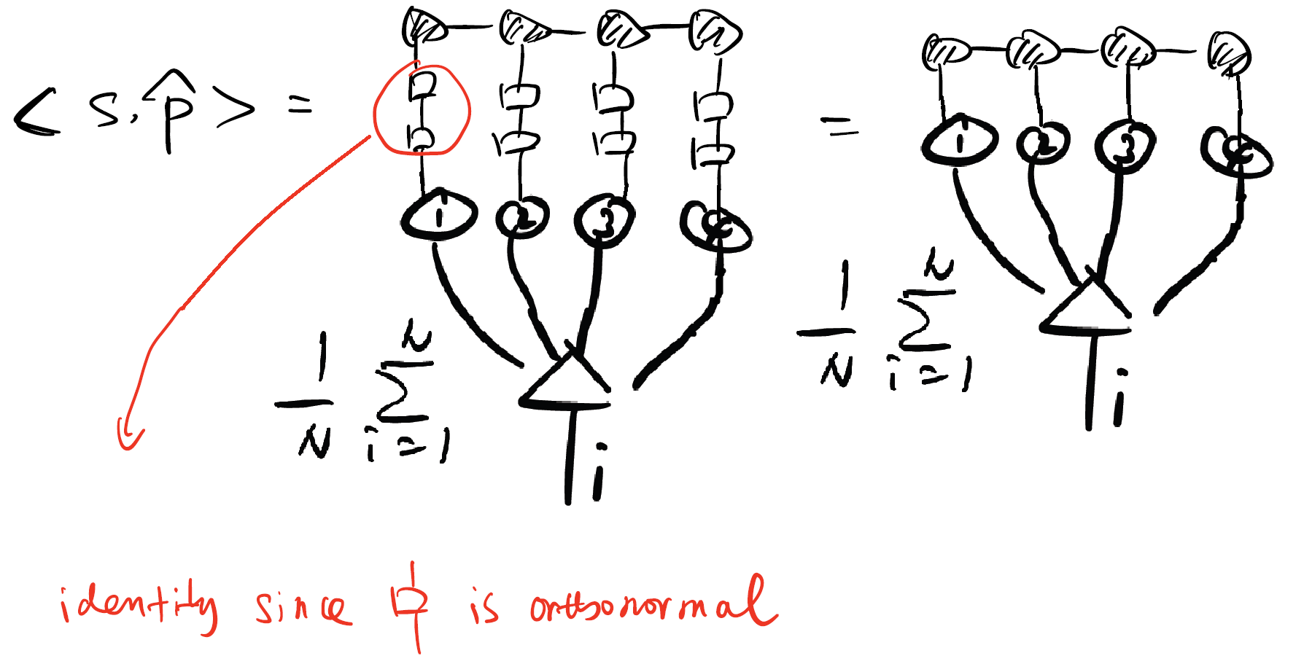
Tensor train sketching
Dimensionality of problem can be reduced with the help of sketch functions
Y. Hur et al. 2023 Appl. Comput. Harmon. Anal. 67 101575

Slide 15
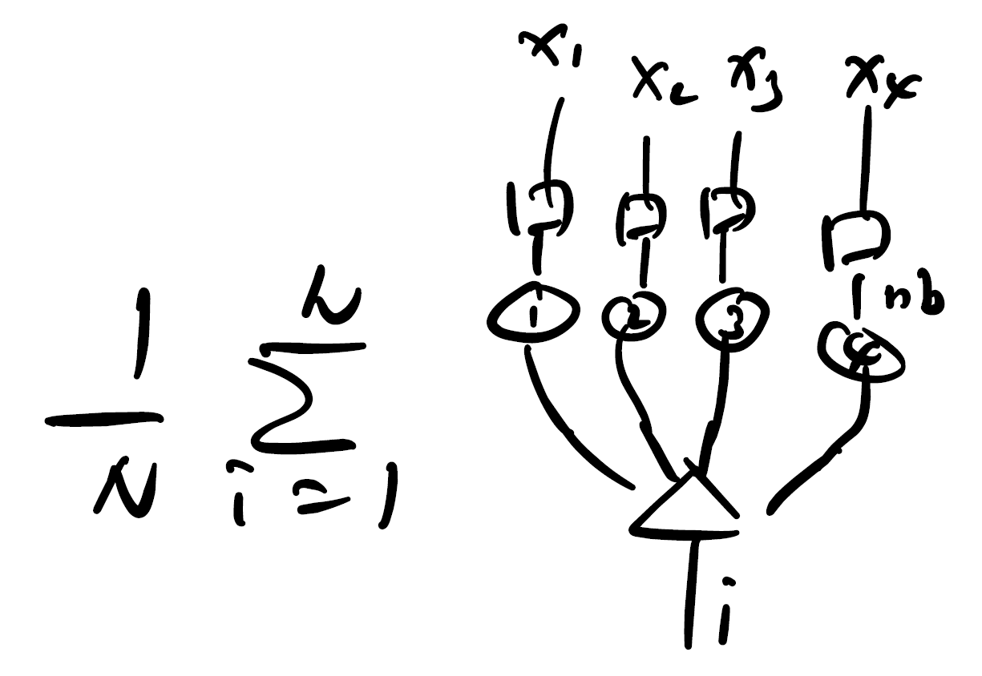
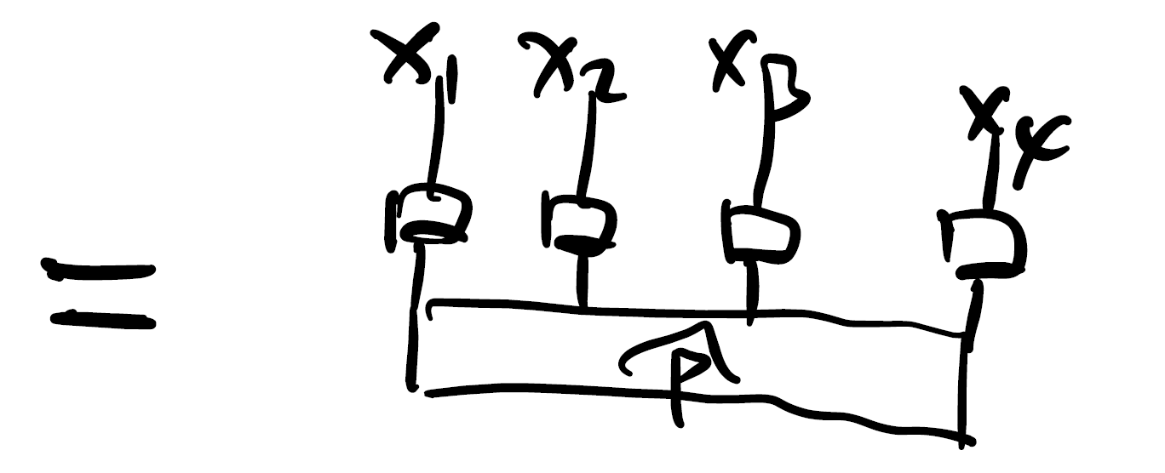
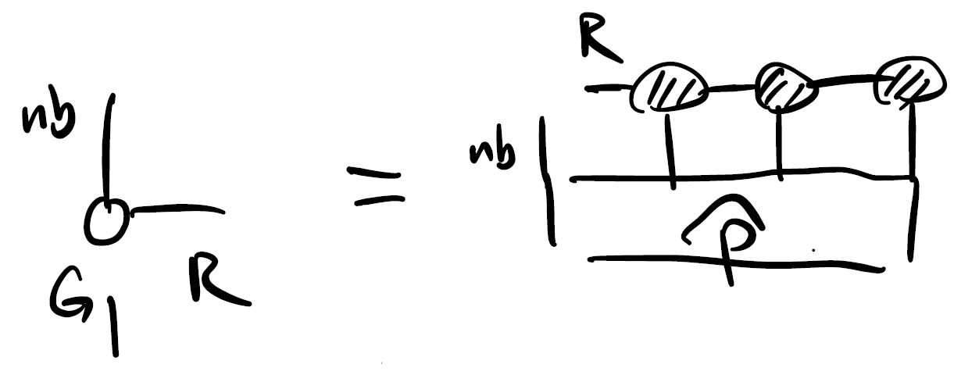

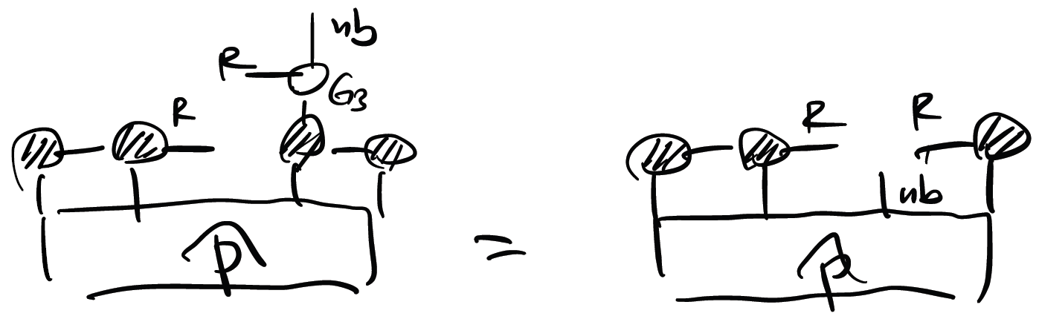
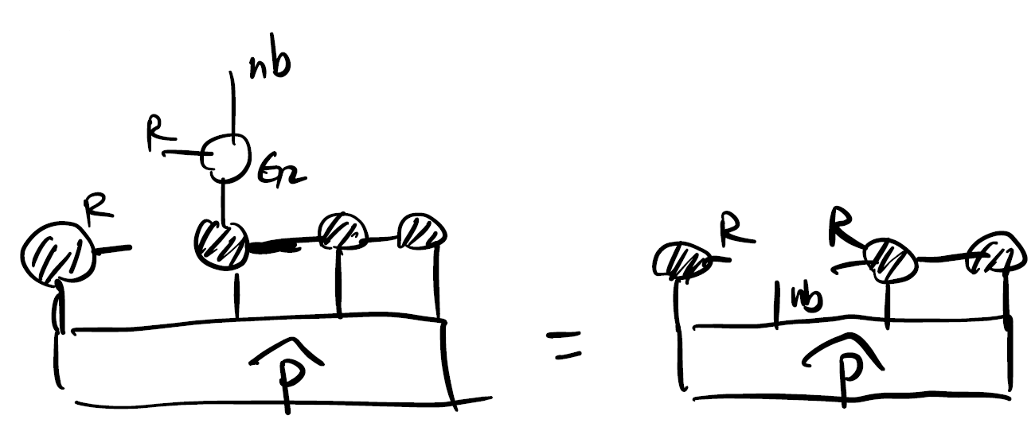
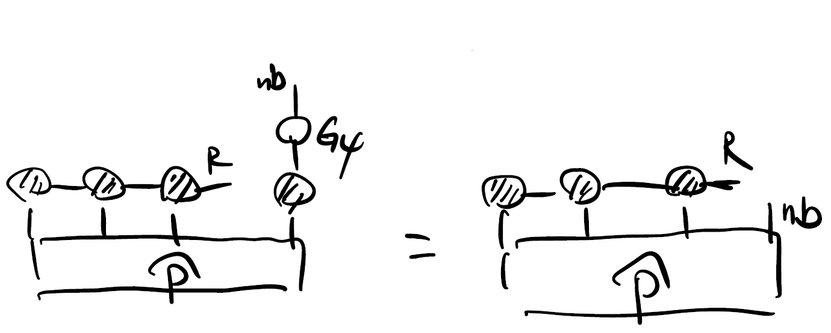


Tensor train sketching
Core #1:
Core #3:
Core #2:
Core #4:
Y. Hur et al. 2023 Appl. Comput. Harmon. Anal. 67 101575

Slide 16
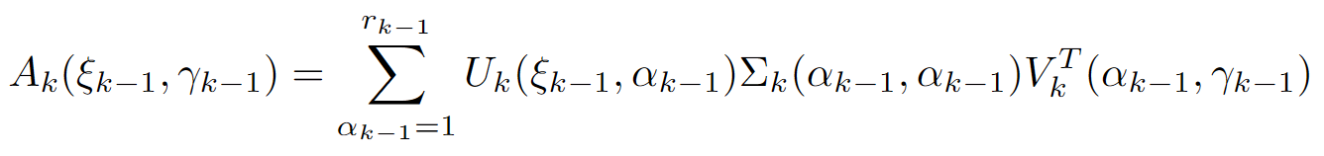
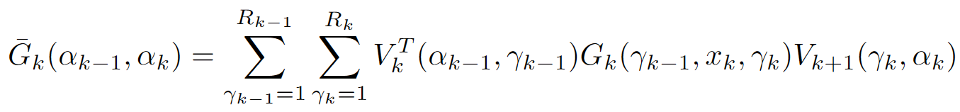
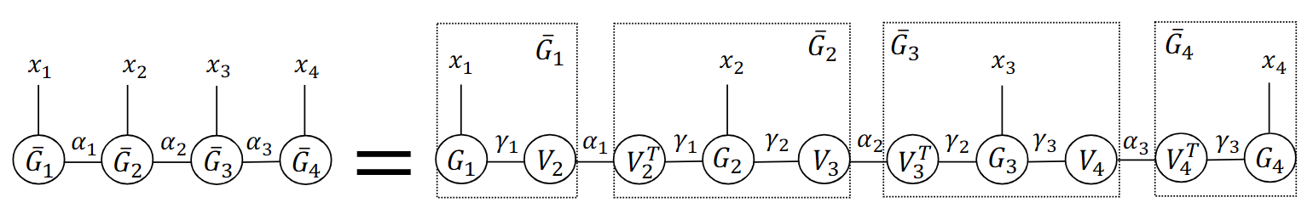
Tensor train sketching
Trimming step: singular value decomposition
Necessary to avoid “overfitting”
Y. Hur et al. 2023 Appl. Comput. Harmon. Anal. 67 101575

Slide 17
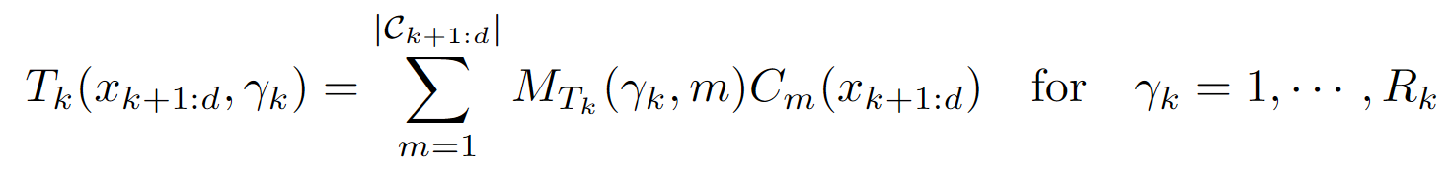




Tensor train sketching
The sketch functions must be carefully constructed!
l-cluster basis is a key ingredient:
A good sketch function could consist of a random linear combination of all l-cluster basis.
Univariate basis functions
Random (e.g., Gaussian) matrix
S. Yang et al. 2024 In Preparation

Slide 18




Tensor train sketching
Ginzburg-Landau distribution
Discretized density
Relative l² error
Y. Hur et al. 2023 Appl. Comput. Harmon. Anal. 67 101575

Slide 19

Biasing simulations via sketching
S. Yang et al. 2024 In Preparation

Slide 20

Biasing simulations via sketching
Ginzburg-Landau distribution
10-dimensional
S. Yang et al. 2024 In Preparation

Slide 21



Biasing simulations via sketching
Ginzburg-Landau distribution
Need to use collective variables:
1000-dimensional!
8-dimensional
S. Yang et al. 2024 In Preparation

Slide 22


Recommended resources
Why use Julia?
Fast
Intuitive programming
Just-in-time (JIT) compilation
Why use ITensor?
Fast (implemented with BLAS/LAPACK support)
Intuitive programming (convenient tensor indexing)
Many algorithms optimally implemented (e.g., SVD, DMRG)

Slide 23

Getting set up with Julia and ITensor

Slide 24


Getting set up with Julia and ITensor

Slide 25


Basic ITensor operations

Slide 26

Basic ITensor operations

Slide 27

Basic ITensor operations
Notice the ordering of the indices does not matter!

Slide 28

Sample TT-Sketch code

