Slide 1
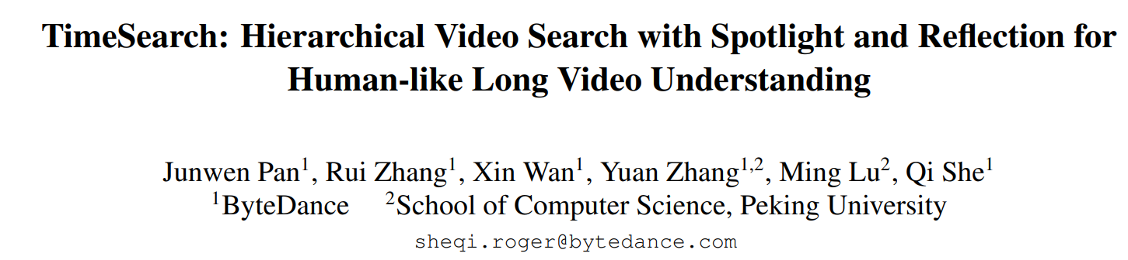
Presenter Jinyong Kim

Slide 2
Introduction.
Recent LVLM works struggle to encode long videos due to the large number of frames involved.
Related works
Token pruning
Spatial pooling
Memory bank
But, it is inevitable to avoid loss of visual information.

Slide 3
Introduction.
Recent LVLM works struggle to encode long videos due to the large number of frames involved.
Related works
Token pruning
Spatial pooling
Memory bank
But, it is inevitable to avoid loss of visual information.
Proposed
Based on human cognitive strategies, we proposed TimeSearch.
Hierarchical temporal search framework
Find spotlight scenes in the video related with query .
By self-reflection, model outputs confidence scores to evaluate which scene can be spotlight.

Slide 4
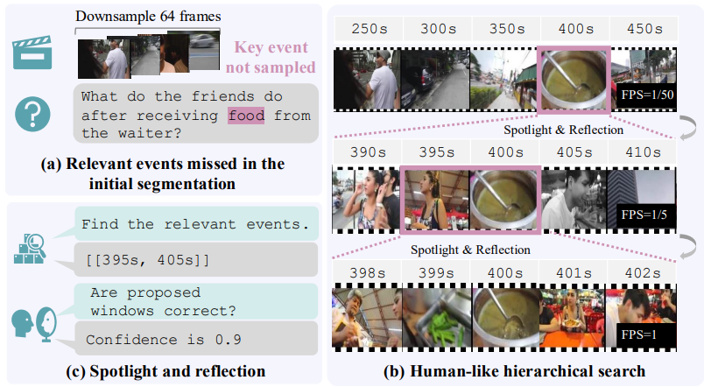
Introduction.

Slide 5
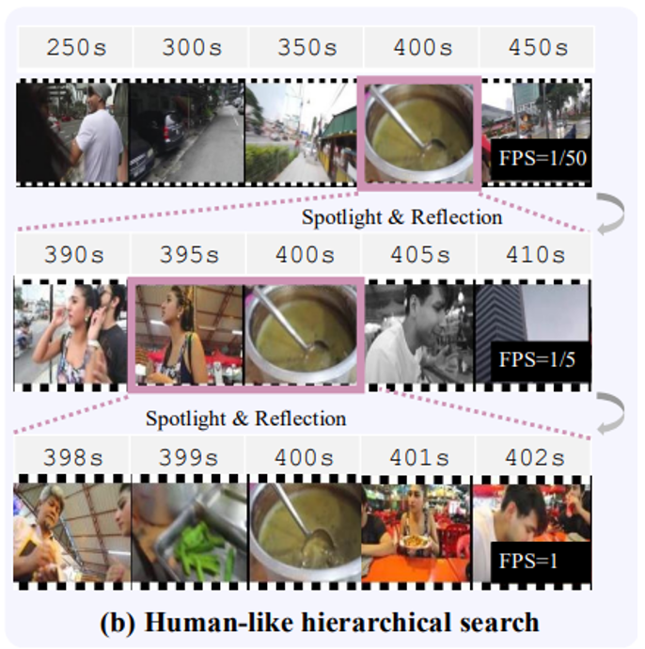
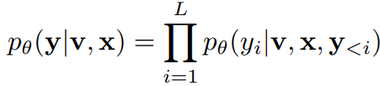
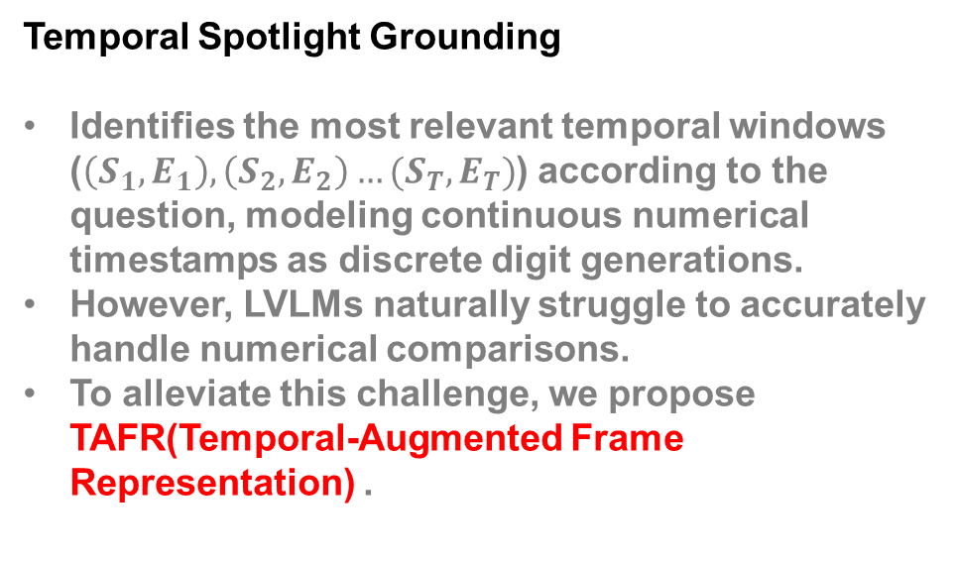
Methodology
$$y :t ext answer, v :video, x :text question$$
Temporal Spotlight Grounding
Identifies the most relevant temporal windows ($\left(S_{1},E_{1}\right),\left(S_{2},E_{2}\right)…(S_{T},E_{T})$) according to the question, modeling continuous numerical timestamps as discrete digit generations.
However, LVLMs naturally struggle to accurately handle numerical comparisons.
To alleviate this challenge, we propose TAFR(Temporal-Augmented Frame Representation) .

Slide 6
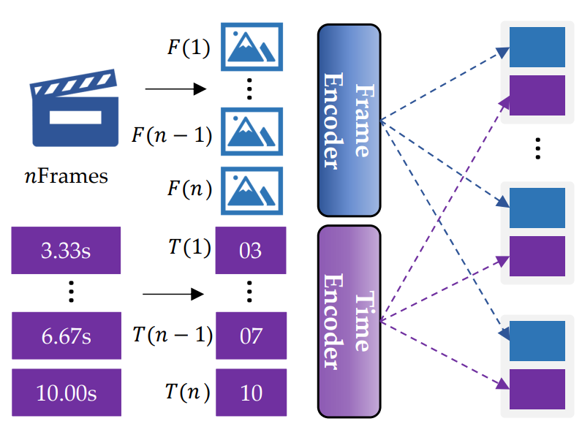
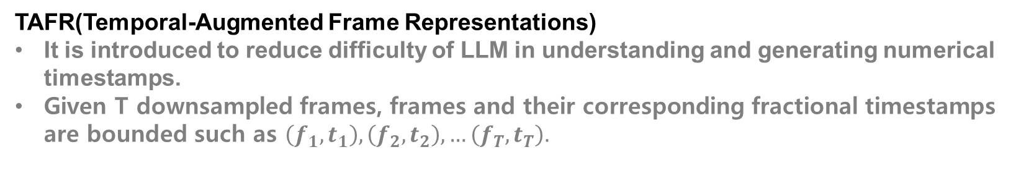
Methodology
TAFR(Temporal-Augmented Frame Representations)
It is introduced to reduce difficulty of LLM in understanding and generating numerical timestamps.
Given T downsampled frames, frames and their corresponding fractional timestamps are bounded such as $\left(f_{1},t_{1}\right),\left(f_{2},t_{2}\right), …\left(f_{T},t_{T}\right).$

Slide 7
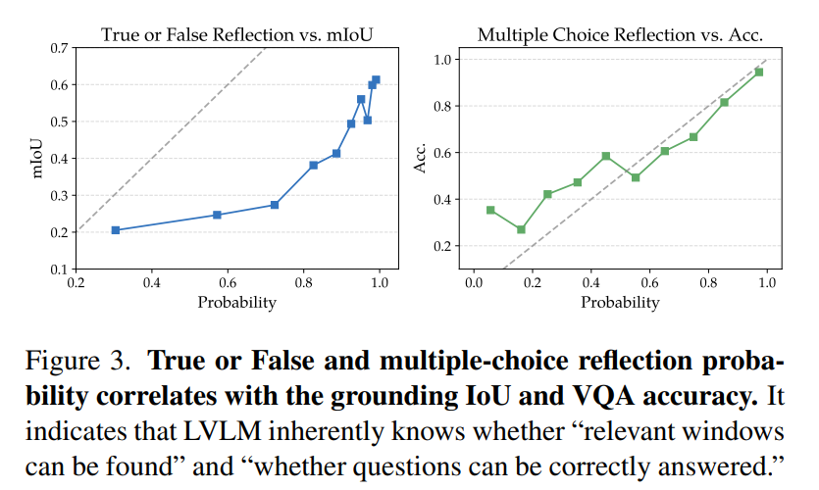

Methodology
True/False reflection confidence
Multi-choice reflection confidence
TSR(Temporal Spotlight Reflection)
LLMs can evaluate the correctness of their predictions through self-reflection mechanisms.
The calibration confirms that LVLMs can produce reliable reflection scores.

Slide 8
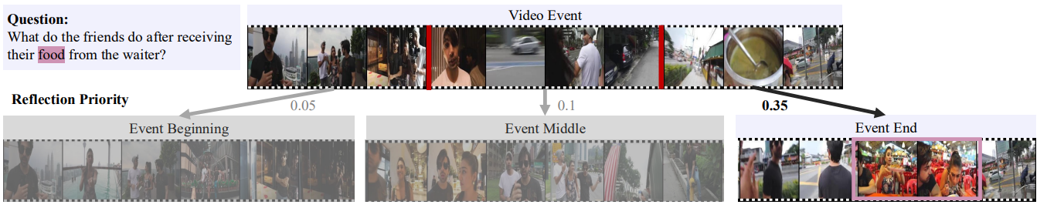
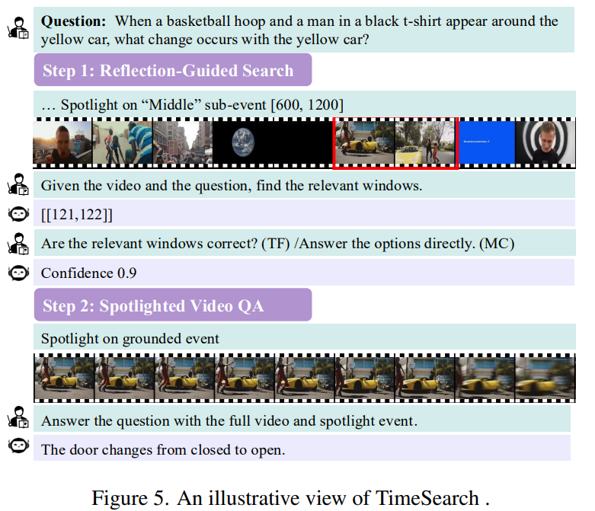
Methodology
Reflection-Guided Hierarchical Search

Slide 9
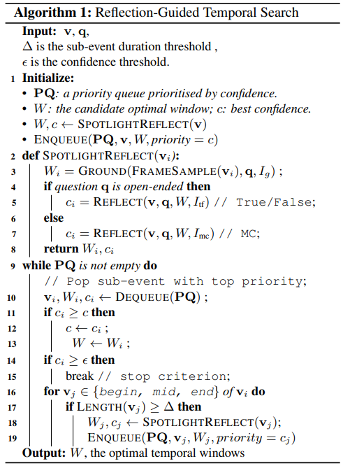
Methodology
Reflection-Guided Hierarchical Search

Slide 10
Methodology
Reflection-Guided Hierarchical Search

Slide 11
Methodology
Reflection-Guided Hierarchical Search

Slide 12
Methodology
Reflection-Guided Hierarchical Search

Slide 13
Methodology
Reflection-Guided Hierarchical Search

Slide 14
Methodology
Reflection-Guided Hierarchical Search
Priority Queue
Low Confidence score
High Confidence score
Video, Spotlight windows, priority = Confidence score

Slide 15
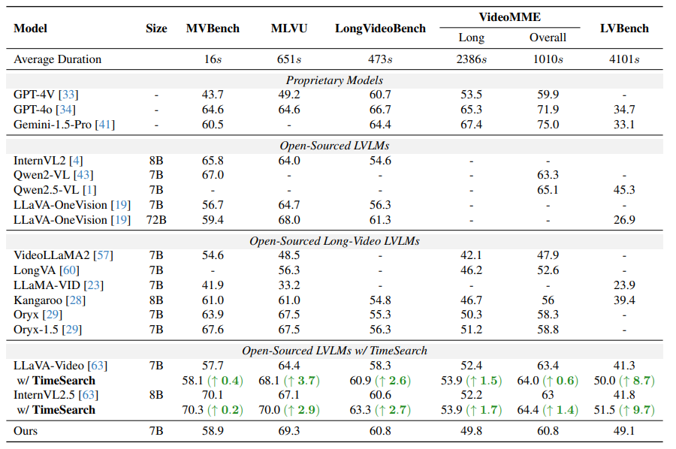
Experiments
Implementation Details
number of global frames: 64
number of spotlight frames: 16
Instruction Tuning
LLaVa-Video Archituecture
128 A100 Gpus
LoRA with a rank of 32

Slide 16
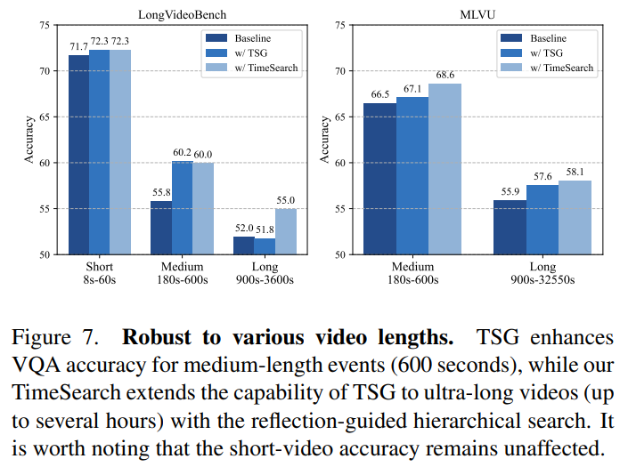
Experiments

Slide 17
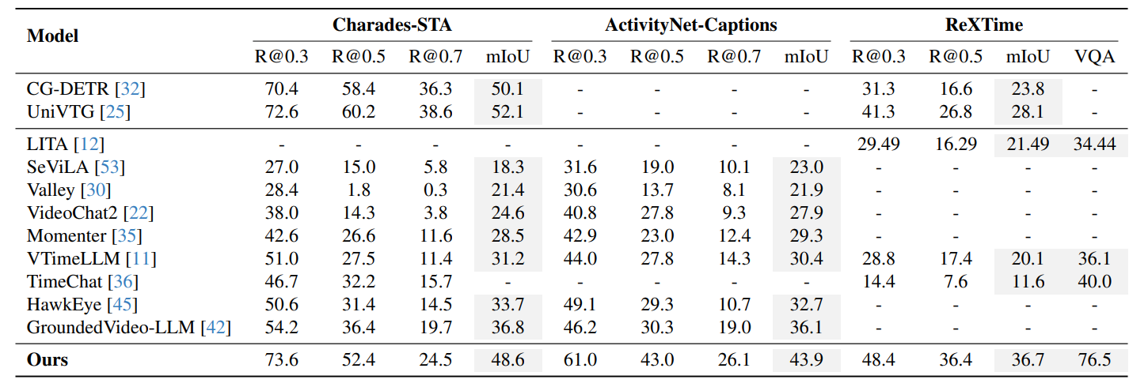
Experiments

Slide 18
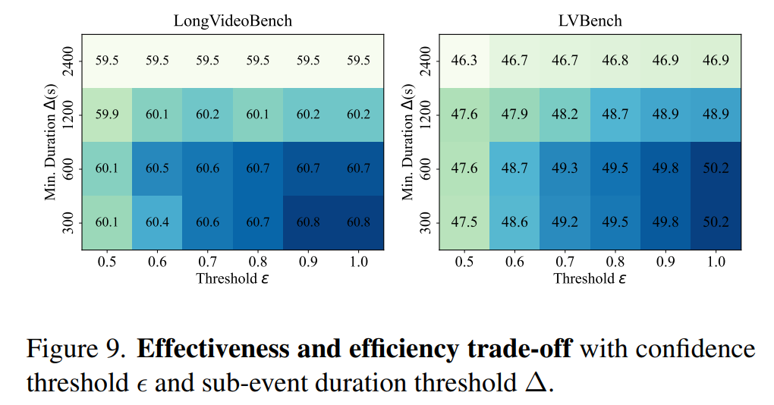
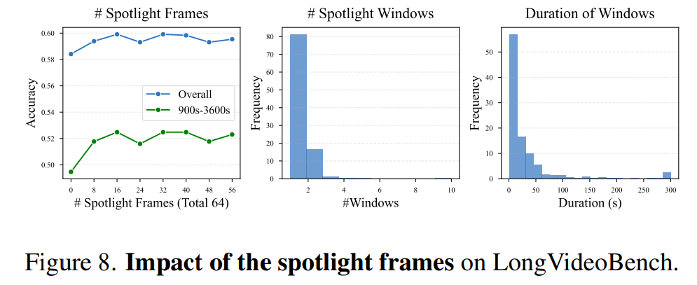
Experiments
Ablation study
Spotlight + global Frames = 64
16 is an optimal number of spotlight frames setting
The histogram of spotlight window counts reveals that most examples require only one or two spotlight windows.
Spotlight duration histogram indicates that a majority of spotlighted events are relatively short(under 50 seconds)
Higher threshold and lower duration improve accuracy.

