Slide 1
SANCTUARY WATCH
Coral Reef Watch
data design choices for ONMS
Internal discussion Sanctuary Watch Team
Notes:
Discussion draft. Purpose: choose the geographic meaning and outputs for a reproducible monthly SST workflow. The three approaches answer different questions. Examples come from the existing pilot outputs, with NOAA source links on the relevant slides.

Slide 2
SANCTUARY WATCH / DESIGN DISCUSSION
What do we want to publish? Options:
Monthly data package
CSV files with documented units, coverage, source dates and a reproducible script.
A chart for each sanctuary
An interactive HTML figure for WordPress / Graphic Data, with a simple location map inset.
An optional all-stations page
A landing page to compare locations and download data from one place (potential pages implementation).
Coral Reef Watch / Team discussion / 9 October 2026
02
Notes:
Proposed deliverables

Slide 3
SANCTUARY WATCH / DESIGN DISCUSSION
Three options answer different questions
Approach | Geographic meaning | Best fit
1 Regional station | NOAA reef region A stress-based daily selection | Regional heat-stress context
2 Named reef pixels | A fixed set of NOAA site locations | Site histories and a selected-site average
3 ONMS boundary | All eligible grid centers inside each unit | A sanctuary-wide SST indicator
The label on the chart should identify the footprint and statistic.
Coral Reef Watch / Team discussion / 9 October 2026
03
Notes:
https://coralreefwatch.noaa.gov/product/vs/description.php
https://coralreefwatch.noaa.gov/product/vs_single_pixel_dev/fgb.php
https://oceanwatch.pifsc.noaa.gov/erddap/griddap/CRW_sst_v3_1_monthly.html
https://www.fisheries.noaa.gov/inport/item/37245

Slide 4
SANCTUARY WATCH / DESIGN DISCUSSION
Option 1: NOAA regional station
Workflow chart from NOAA data / January 1985–September 2026
Why use it?
A small NOAA file. SST follows the region’s daily 90th-percentile HotSpot. (currently what American Samoa appears to use)
The selected pixel can move. The header coordinate marks the region. This series is not an area mean but one pixel.
NOAA regional page
Data file
Method and field definitions
Coral Reef Watch / Team discussion / 9 October 2026
04
Notes:
Sources (checked 8–9 October 2026):
https://coralreefwatch.noaa.gov/product/vs/data/flower_garden.txt
https://coralreefwatch.noaa.gov/product/vs/description.php

Slide 5
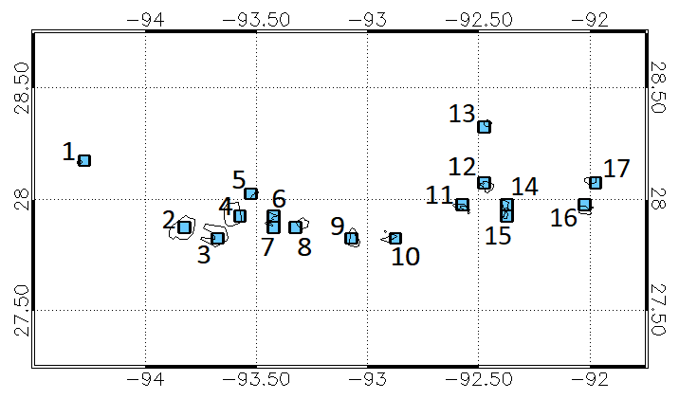
SANCTUARY WATCH / DESIGN DISCUSSION
Option 2: named reef pixels
https://coralreefwatch.noaa.gov/product/vs_single_pixel_dev/fgb.php
Flower Garden Banks
17 named locations in our pilot. Each file represents a fixed 5 km pixel.
Examples on NOAA’s map
1 Stetson Bank
2 West Flower Garden Bank
4 East Flower Garden Bank
NOAA labels this product experimental.
NOAA site list and location map
Coral Reef Watch / Team discussion / 9 October 2026
05
Notes:
NOAA figure from its Flower Garden Banks single-pixel page.
Sources (checked 8–9 October 2026):
https://coralreefwatch.noaa.gov/product/vs_single_pixel_dev/fgb.php
https://coralreefwatch.noaa.gov/product/vs_single_pixel_dev/site_maps/site_map_fgb.png

Slide 6
SANCTUARY WATCH / DESIGN DISCUSSION
Individual sites plus a selected-site average
Workflow chart from NOAA data / January 1985–November 2025
Average definition
Equal weight per unique pixel. All 17 sites must have complete monthly data.
Update check
FGB pilot: through Nov 2025.
USVI pilot: through Sep 2026.
Check source freshness before publishing.
NOAA FGB sites
NOAA USVI sites
Coral Reef Watch / Team discussion / 9 October 2026
06
Notes:
Could build out pixel level summaries as well as site wide average at ONMS locations (not available at all locations)
Sources (checked 8–9 October 2026):
https://coralreefwatch.noaa.gov/product/vs_single_pixel_dev/fgb.php
https://coralreefwatch.noaa.gov/product/vs_single_pixel_exp/usvi.php

Slide 7
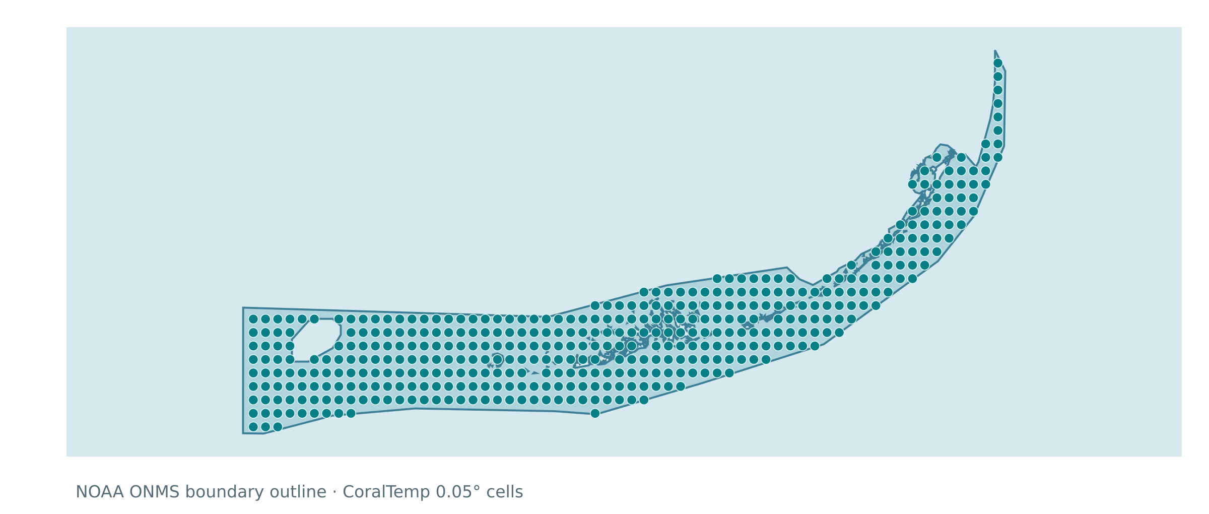
SANCTUARY WATCH / DESIGN DISCUSSION
Tentative option 3: all cells within ONMS boundaries
~416 grid centers
414 provide valid monthly SST in the included pilot record.
Includes eligible open water as well as reef areas. Boundary version and cell-selection rule become part of the method. NOAA does not use this
Actual station coordinates. Workflow display boundary includes interior exclusions.
NOAA boundary metadata
Coral Reef Watch / Team discussion / 9 October 2026
07
Notes:
Pilot map derives from onms-fknms-graphicdata-embed/data/map_footprint.json. It contains 416 native 0.05-degree cell centers selected using the detailed boundary, excluding holes. This static export executes drawMap() from figure_only.html with its embedded map data. It retains all 134 display rings, including interior exclusions. The display outline is simplified and is not used for selection. Coordinates plotted in latitude/longitude. 414 of 416 cells have valid monthly SST in the included record (99.5% by count). This is coverage of selected cells, not a measured fraction of sanctuary area. Confirm the boundary version and revised sanctuary limits before production. NOAA boundary metadata is linked for provenance.
Sources (checked 8–9 October 2026):
https://www.fisheries.noaa.gov/inport/item/37245
https://oceanwatch.pifsc.noaa.gov/erddap/griddap/CRW_sst_v3_1_monthly.html

Slide 8
SANCTUARY WATCH / DESIGN DISCUSSION
A sanctuary-wide SST history is feasible but data intensive
Method in the pilot
Monthly CoralTemp rasters, averaged across valid cells with cosine(latitude) weights.
NOAA CoralTemp monthly raster source
Coral Reef Watch / Team discussion / 9 October 2026
08
Notes:
Actual 500-month pilot series from onms-fknms-sst/data/sst_monthly.csv. Each month averages valid native CoralTemp grid cells whose centers lie inside the boundary, weighted by cosine(latitude), an approximate area weight for the regular grid. The chart plots mean_sst_c directly in degrees Celsius. No statistical trend or attribution is claimed by the figure. Raster access substantially reduced pull time in the pilot. Exact fractional-cell overlap weighting would be a separate design choice. The pilot also exports unweighted spatial p10 and p90, which describe cell spread rather than uncertainty in the mean.
Sources (checked 8–9 October 2026):
https://oceanwatch.pifsc.noaa.gov/erddap/griddap/CRW_sst_v3_1_monthly.html
https://www.fisheries.noaa.gov/inport/item/37245

Slide 9
SANCTUARY WATCH / DESIGN DISCUSSION
The metric needs output decision
Metric | Proposed monthly output | Interpretation to preserve
SST | Monthly mean in °C | Typical surface temperature
SST anomaly | Monthly departure in °C | Name the baseline and method
Bleaching heat stress | Site / region DHW peak, with daily context available | Keep NOAA’s metric definition and alert rules visible
Averaging site DHW peaks can hide the most stressed location.
An SST threshold depends on local climatology. Monthly SST alone cannot assign a daily alert.
NOAA SST, HotSpot and DHW methodology
Coral Reef Watch / Team discussion / 9 October 2026
09
Notes:
Degree Heating Weeks, in °C-weeks. NOAA uses a location-specific maximum monthly mean climatology, with an SST bleaching threshold of MMM + 1°C. Daily alerts also depend on contemporaneous HotSpot and DHW. A monthly mean SST cannot reproduce those daily conditions. The named-site pilot calculates each site’s monthly maximum DHW. Its average of site maxima is descriptive only, since the maxima may occur on different days. Recommended presentation choice: preserve site peaks and the official regional metric separately, with exact labels. Existing CRW station pages may still show the heritage alert scale, according to NOAA’s USVI page notice. For implementation, consult the current global methodology.
Sources (checked 8–9 October 2026):
https://coralreefwatch.noaa.gov/product/5km/methodology.php
https://coralreefwatch.noaa.gov/product/vs_single_pixel_exp/usvi.php

Slide 10
SANCTUARY WATCH / DESIGN DISCUSSION
Decisions for the team
Decision | Discussion prompt
Primary product | CSV + embed, a page of all stations, or both?
Primary geography | Regional context, named sites, or the ONMS footprint?
Averaging and gaps | Which members, averaging approach?
Metrics and history | SST only, anomaly, and/or heat stress? Which baseline?
Maintenance | Who owns review, hosting and failed monthly updates?
Proposed next step: compare all three approaches for one sanctuary over the same months.
Coral Reef Watch / Team discussion / 9 October 2026
11
Notes:
The next step is a proposed validation exercise

Slide 11
SANCTUARY WATCH / DESIGN DISCUSSION
NOAA sources and example provenance
Regional station catalog
U.S. Virgin Islands named pixels
coralreefwatch.noaa.gov/product/vs/data.php
coralreefwatch.noaa.gov/product/vs_single_pixel_exp/usvi.php
Regional calculation and data fields
CoralTemp monthly rasters
coralreefwatch.noaa.gov/product/vs/description.php
oceanwatch.pifsc.noaa.gov/erddap/griddap/CRW_sst_v3_1_monthly.html
Flower Garden Banks regional data
ONMS boundary metadata
coralreefwatch.noaa.gov/product/vs/data/flower_garden.txt
www.fisheries.noaa.gov/inport/item/37245
Flower Garden Banks named pixels
SST and bleaching heat-stress methods
coralreefwatch.noaa.gov/product/vs_single_pixel_dev/fgb.php
coralreefwatch.noaa.gov/product/5km/methodology.php
Figures use NOAA data and pilot outputs. Detailed processing notes accompany each slide.
Coral Reef Watch / Team discussion / 9 October 2026
12
Notes:
FIGURE AUDIT, 9 October 2026: Slide 5 image bytes match the downloaded NOAA PNG. All 501 regional monthly SST values, 1,473 named-site / average SST values, and 500 FKNMS SST means agree with independent calculations within 0.00005°C, consistent with four-decimal output rounding. All 416 map coordinates match stations.csv. The map in this revision uses the existing workflow renderer, including all display rings. The FKNMS series was checked against retained per-cell cache data; this audit does not claim the boundary is the latest legal extent. Every title on this slide is a clickable source link. Figure provenance: regional chart derives from the linked FGB ASCII file, retrieved 8 October 2026. Site chart derives from the named-site pilot CSV outputs. Site map is the NOAA original PNG linked in slide 5 notes. Boundary map and SST chart derive from the Florida Keys pilot output files, with data through August 2026. Date ranges differ by source and are explicit in the deck.
Sources (checked 8–9 October 2026):
https://coralreefwatch.noaa.gov/product/vs/description.php
https://coralreefwatch.noaa.gov/product/vs/gauges/flower_garden.php
https://coralreefwatch.noaa.gov/product/vs/data/flower_garden.txt
https://coralreefwatch.noaa.gov/product/vs_single_pixel_dev/fgb.php
https://coralreefwatch.noaa.gov/product/vs_single_pixel_exp/usvi.php
https://coralreefwatch.noaa.gov/product/vs_single_pixel_dev/site_maps/site_map_fgb.png
https://oceanwatch.pifsc.noaa.gov/erddap/griddap/CRW_sst_v3_1_monthly.html
https://www.fisheries.noaa.gov/inport/item/37245
https://coralreefwatch.noaa.gov/product/5km/methodology.php
https://coralreefwatch.noaa.gov/product/vs/data.php

Slide 12
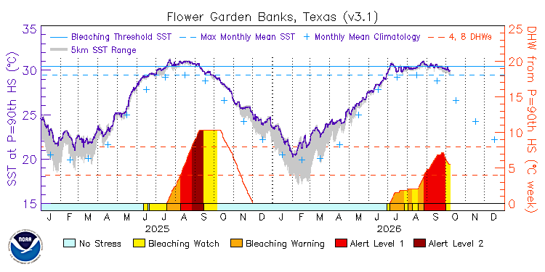
APPENDIX / ORIGINAL NOAA FIGURES
NOAA example: regional daily series
NOAA original PNG, unchanged / Downloaded 9 October 2026
NOAA source page
Original image file
Coral Reef Watch / Team discussion / 9 October 2026
13
Notes:
Original NOAA PNG embedded without cropping or changes to data or labels. Resized proportionally for display. 2025–2026 regional figure. This is a daily NOAA plot, distinct from our monthly workflow charts, and its displayed years differ. NOAA reports that these station images still use the heritage alert scale. The source URL for the regional current figure can change over time; this deck retains the downloaded 9 October 2026 snapshot. Original file SHA-256: 934fcc6abe06ad7af135b8069fc5972dd0fd602f1397aacf7623a75c46cd3cbf
Sources (checked 8–9 October 2026):
https://coralreefwatch.noaa.gov/product/vs/gauges/flower_garden.php
https://coralreefwatch.noaa.gov/data/vs/ts_figures/ts_2yr/current/current_ts_flower_garden.png

Slide 13
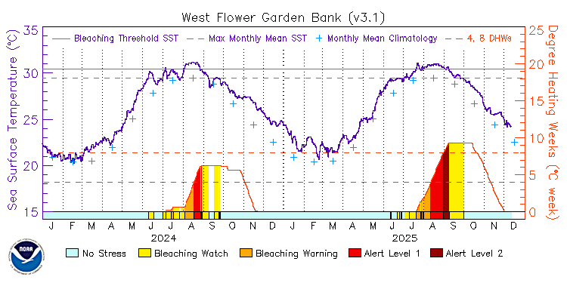
APPENDIX / ORIGINAL NOAA FIGURES
NOAA example: West Flower Garden Bank
NOAA original PNG, unchanged / Downloaded 9 October 2026
NOAA source page
Original image file
Coral Reef Watch / Team discussion / 9 October 2026
14
Notes:
Original NOAA PNG embedded without cropping or changes to data or labels. Resized proportionally for display. 2024–2025 single-pixel figure. This is a daily NOAA plot, distinct from our monthly workflow charts, and its displayed years differ. NOAA reports that these station images still use the heritage alert scale. The source URL for the regional current figure can change over time; this deck retains the downloaded 9 October 2026 snapshot. Original file SHA-256: b60bfb4587b4ccbf00dd4c0d0b89416b89014303e3e823f7b0c460a4aef8be8c
Sources (checked 8–9 October 2026):
https://coralreefwatch.noaa.gov/product/vs_single_pixel_dev/fgb.php
https://coralreefwatch.noaa.gov/product/vs_single_pixel_dev/ts_figures/ts_2yr/2024_2025/2024_2025_ts_AtlanticOcean_Caribbean_FlowerGardenBanks_WestFlowerGardenBank.png

