Slide 1

Website Traffic
Analysis.
When analyzing website traffic, it's crucial to go beyond traditional
methods. Incorporating machine learning models can provide insights into
future traffic trends and user behavior patterns

Slide 2

Topics Covered in this
Presentation
Jupyter Notebook Interface.
Enhanced analysis.
Data Extraction with Jupyter Notebook.
Visualization with Python Libraries.
Using Machine Learning Algorithms.
Conclusion.

Slide 3

Enhancing Analysis with Data
Extraction and Cognos Analytics
Data Extraction
Cognos Analytics
Efficiently extract relevant data for analysis.
Utilize Cognos Analytics for comprehensive
visualization and reporting.For the easy
understanding for the visualizer.
Extracting the data and used for more
enhanced problems.

Slide 4
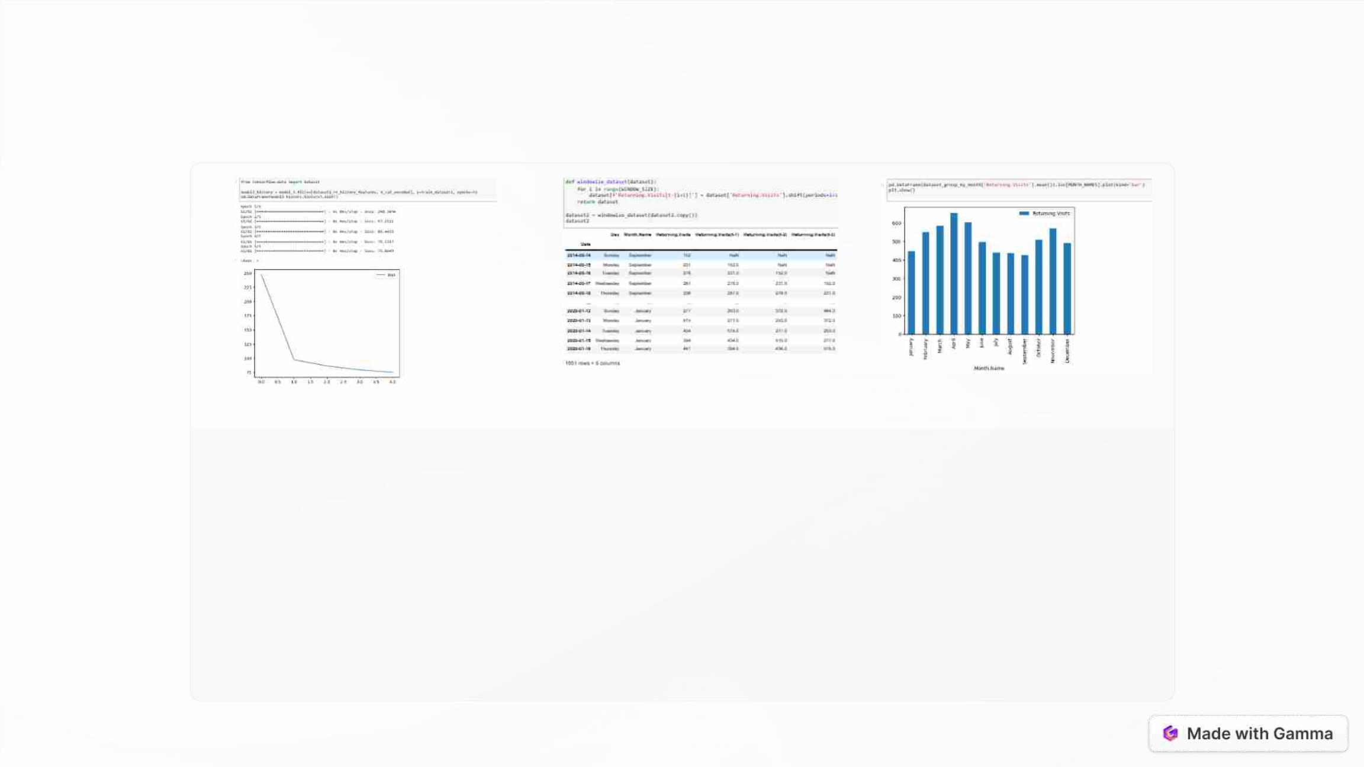
Jupyter Notebook Interface.
Machine Learning
Algorithms in Jupyter
Notebook.
Executing Code in
Jupyter Notebook.
Visualizing Data in
Jupyter Notebook.
Showcasing the
Witness the step-by-step
execution of code snippets
within the Jupyter Notebook
environment.
Demonstrating the power
of data visualization using
Jupyter Notebook's
implementation of KNN, CNN,
and Gradient Descent
algorithms in Jupyter Notebook.
interactive capabilities.

Slide 5
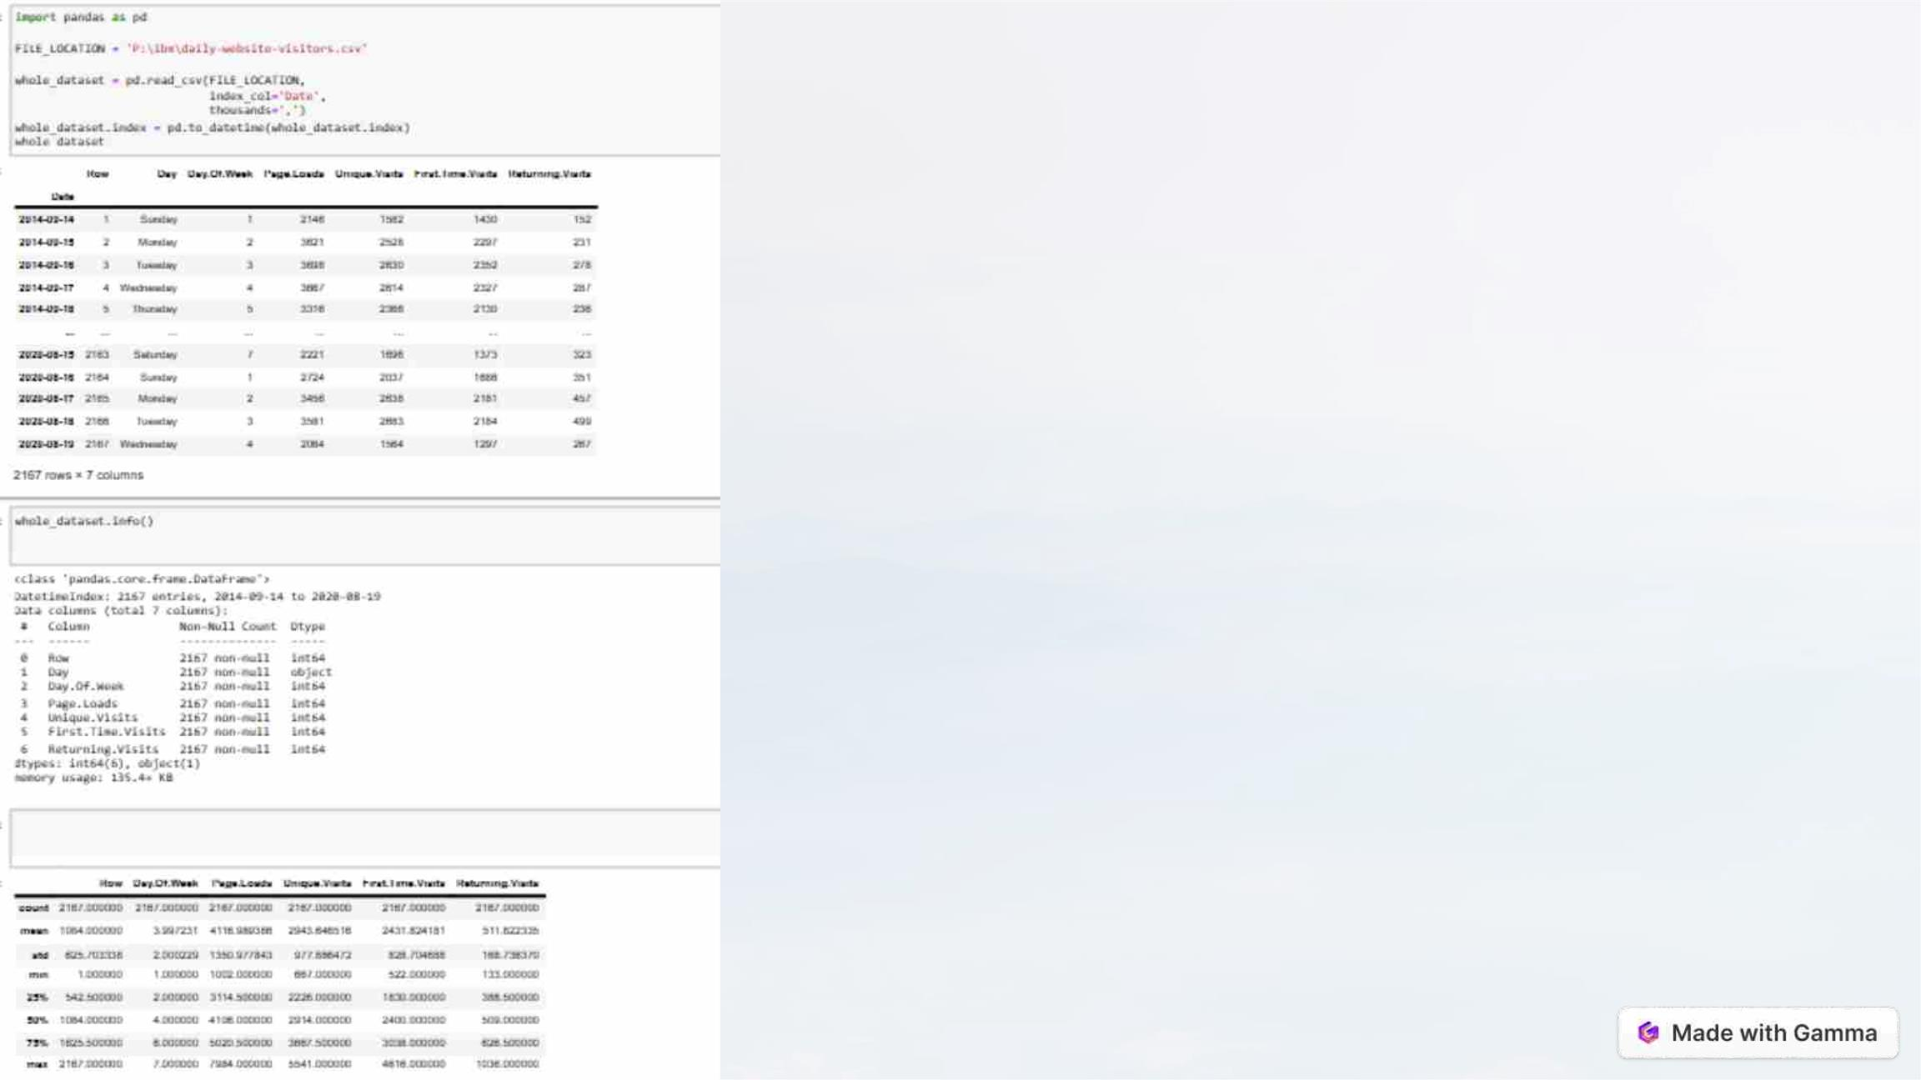
Data Extraction with
Jupyter Notebook.
Jupyter Notebook is widely used to extract data due to its high flexibility
and user-friendly interface. For this project, we utilized Jupyter notebook
to extract data from CSV files. Jupyter Notebook is an open-source web
application that allows you to create and share documents that contain
live code, equations, visualizations, and narrative text. It is a popular tool
among data scientists, researchers, and educators for interactive
computing and data analysis.

Slide 6

Visualization with NumPy,
Pandas and Matplotlib.
In this section, we will demonstrate how NumPy and Pandas Data Frame
were used for effective data visualization. NumPy, Pandas, and Matplotlib
are three popular Python libraries that are often used together to handle
and visualize data effectively.

Slide 7
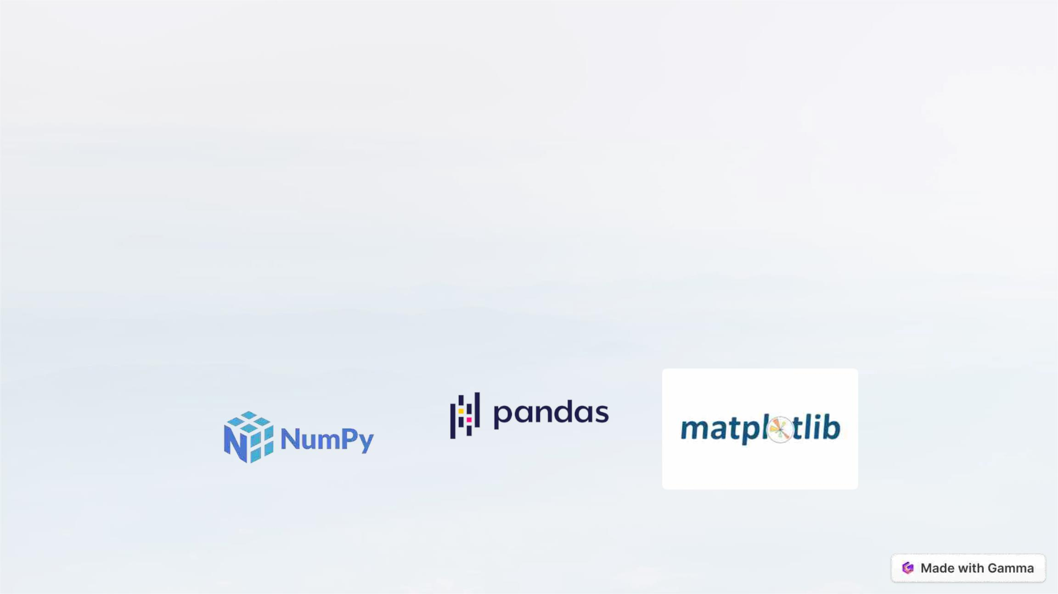
Numpy, Pandas, and Matplotlib.
Numpy
Pandas
Matplotlib
Numpy used for the
Efficiently analyze and
manipulate data using the
Pandas library.It provides
easy-to-use data structures
and functions for working with
structured data, such as
spreadsheets, databases,
and CSV files.
Matplotlib is a popular Python
library for creating static,
animated, and interactive
visualizations in 2D and 3D. It
provides charts, plots,
numerical access to the
content of the given data.It
provides support for working
with large, multi-dimensional
arrays and matrices of data,
along with a collection of
mathematical functions to
operate on these arrays.
graphs, and figures, making it
a fundamental tool for data
visualization and scientific
plotting

Slide 8
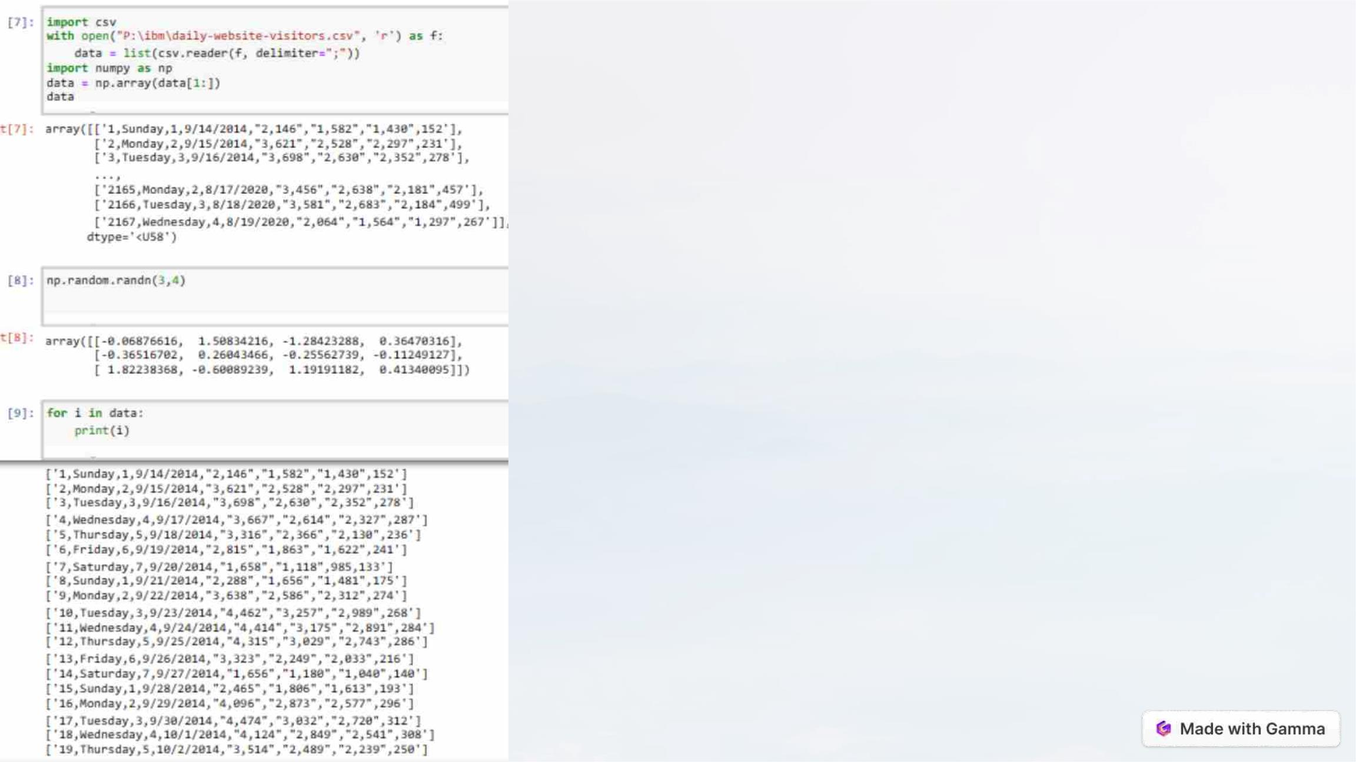
NumPy
1. Multidimensional Arrays: NumPy's core data structure is the
ndarray (n-dimensional array).
2. Data Types: NumPy provides a wide range of data types,
including integers, floating-point numbers, complex numbers, and
more. You can specify the data type when creating an array, which
is particularly useful for numerical precision.
3. Array Operations: NumPy offers a vast array of mathematical,
logical, and statistical functions that operate on arrays. This
includes basic operations like addition, subtraction, multiplication,
and more advanced functions like matrix multiplication, statistical
analysis, and FFT (Fast Fourier Transform).

Slide 9
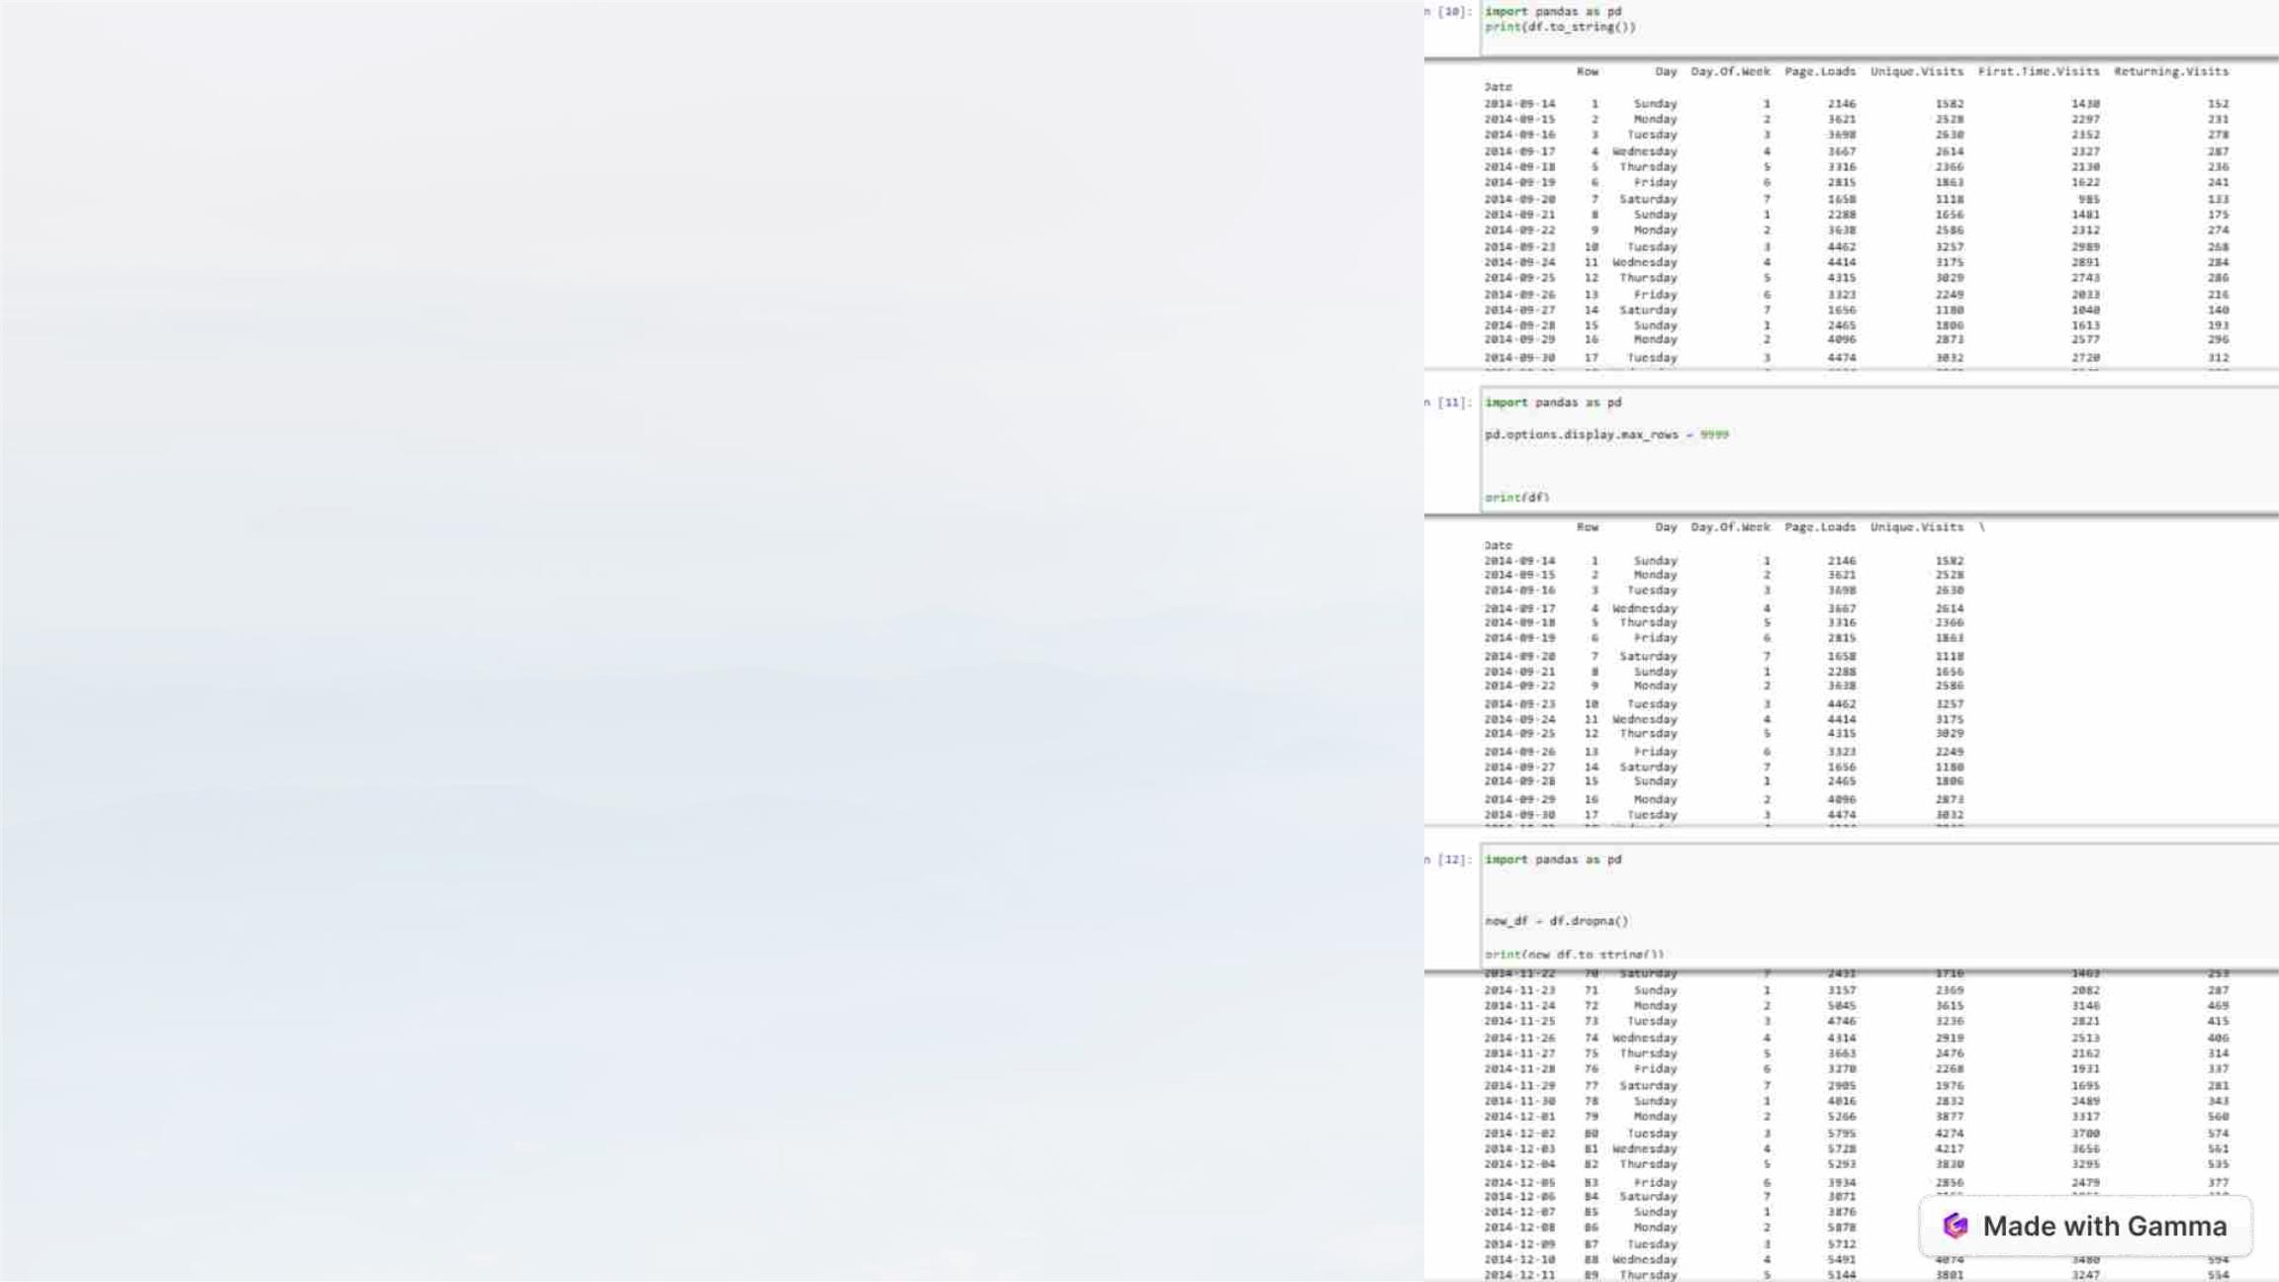
Pandas
1. DataFrame and Series: Pandas introduces two primary data
structures:DataFrame: A two-dimensional, tabular data structure
that resembles a spreadsheet. It consists of rows and columns.
Series: A one-dimensional array-like object that represents a
single column or row of data.
2. Data Cleaning: Pandas offers tools for data cleaning and
preprocessing, including handling missing data, filtering, sorting,
and merging datasets.
3. Data Analysis: It provides a wide range of functions for data
analysis, including descriptive statistics, aggregation, and groupby
operations. You can easily calculate statistics and perform
calculations on your data.

Slide 10
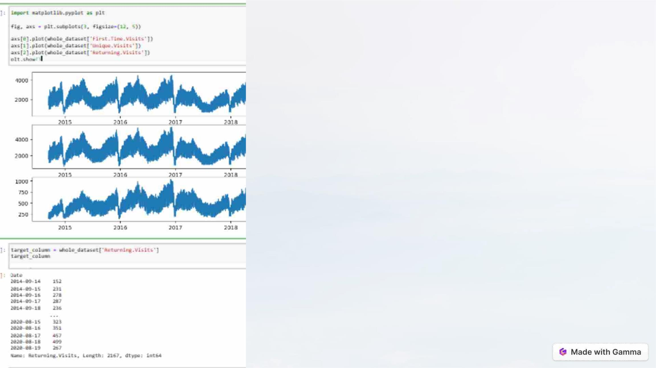
Matplotlib
1. Versatile Plotting: Matplotlib allows you to create a wide variety of
plots, including line plots, scatter plots, bar plots, histograms, pie
charts, error bars, heatmaps, and more.
2. Object-Oriented Interface: Matplotlib provides both a state-based
interface (similar to MATLAB) and an object-oriented interface. The
object-oriented interface is more flexible and powerful, making it
suitable for complex and customized visualizations.
3. Publication-Quality Output: Matplotlib produces high-quality,
publication-ready figures and supports various file formats for
saving your plots, including PNG, PDF, SVG, and more.

Slide 11
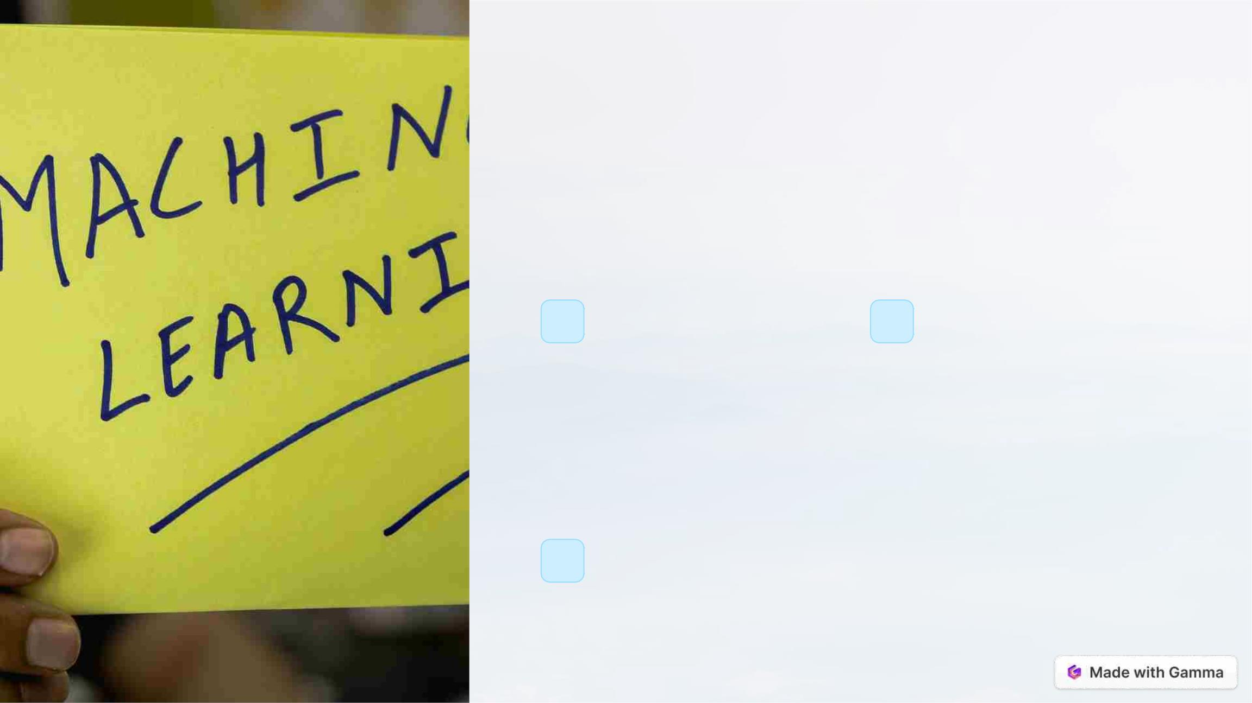
Machine Learning
Algorithms for Advanced
Analysis
1
K-Nearest
Neighbors (KNN)
2
Convolutional
Neural Networks
(CNN)
A versatile algorithm for
classification and
Ideal for image
classification and
recognition
regression tasks
3
Gradient Descent
An optimization algorithm widely used in machine learning

Slide 12
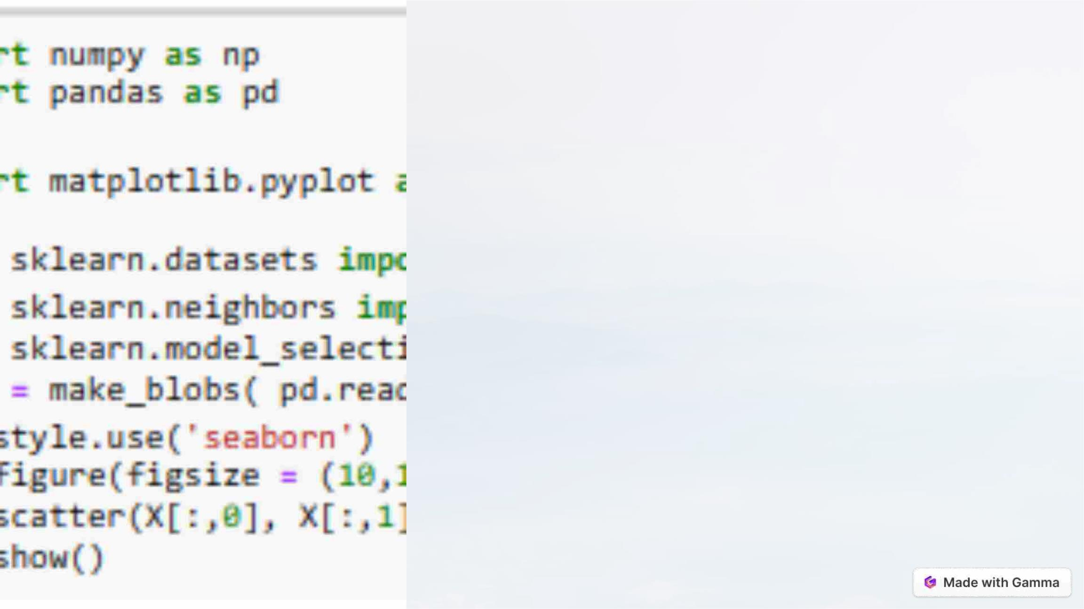
K-Nearest Neighbors (KNN)
Algorithm
The K-Nearest Neighbors (KNN) algorithm is a supervised machine
learning algorithm used for classification and regression tasks. It is a
simple yet powerful algorithm that is based on the principle of similarity,
assuming that similar data points tend to have similar outcomes.

Slide 13
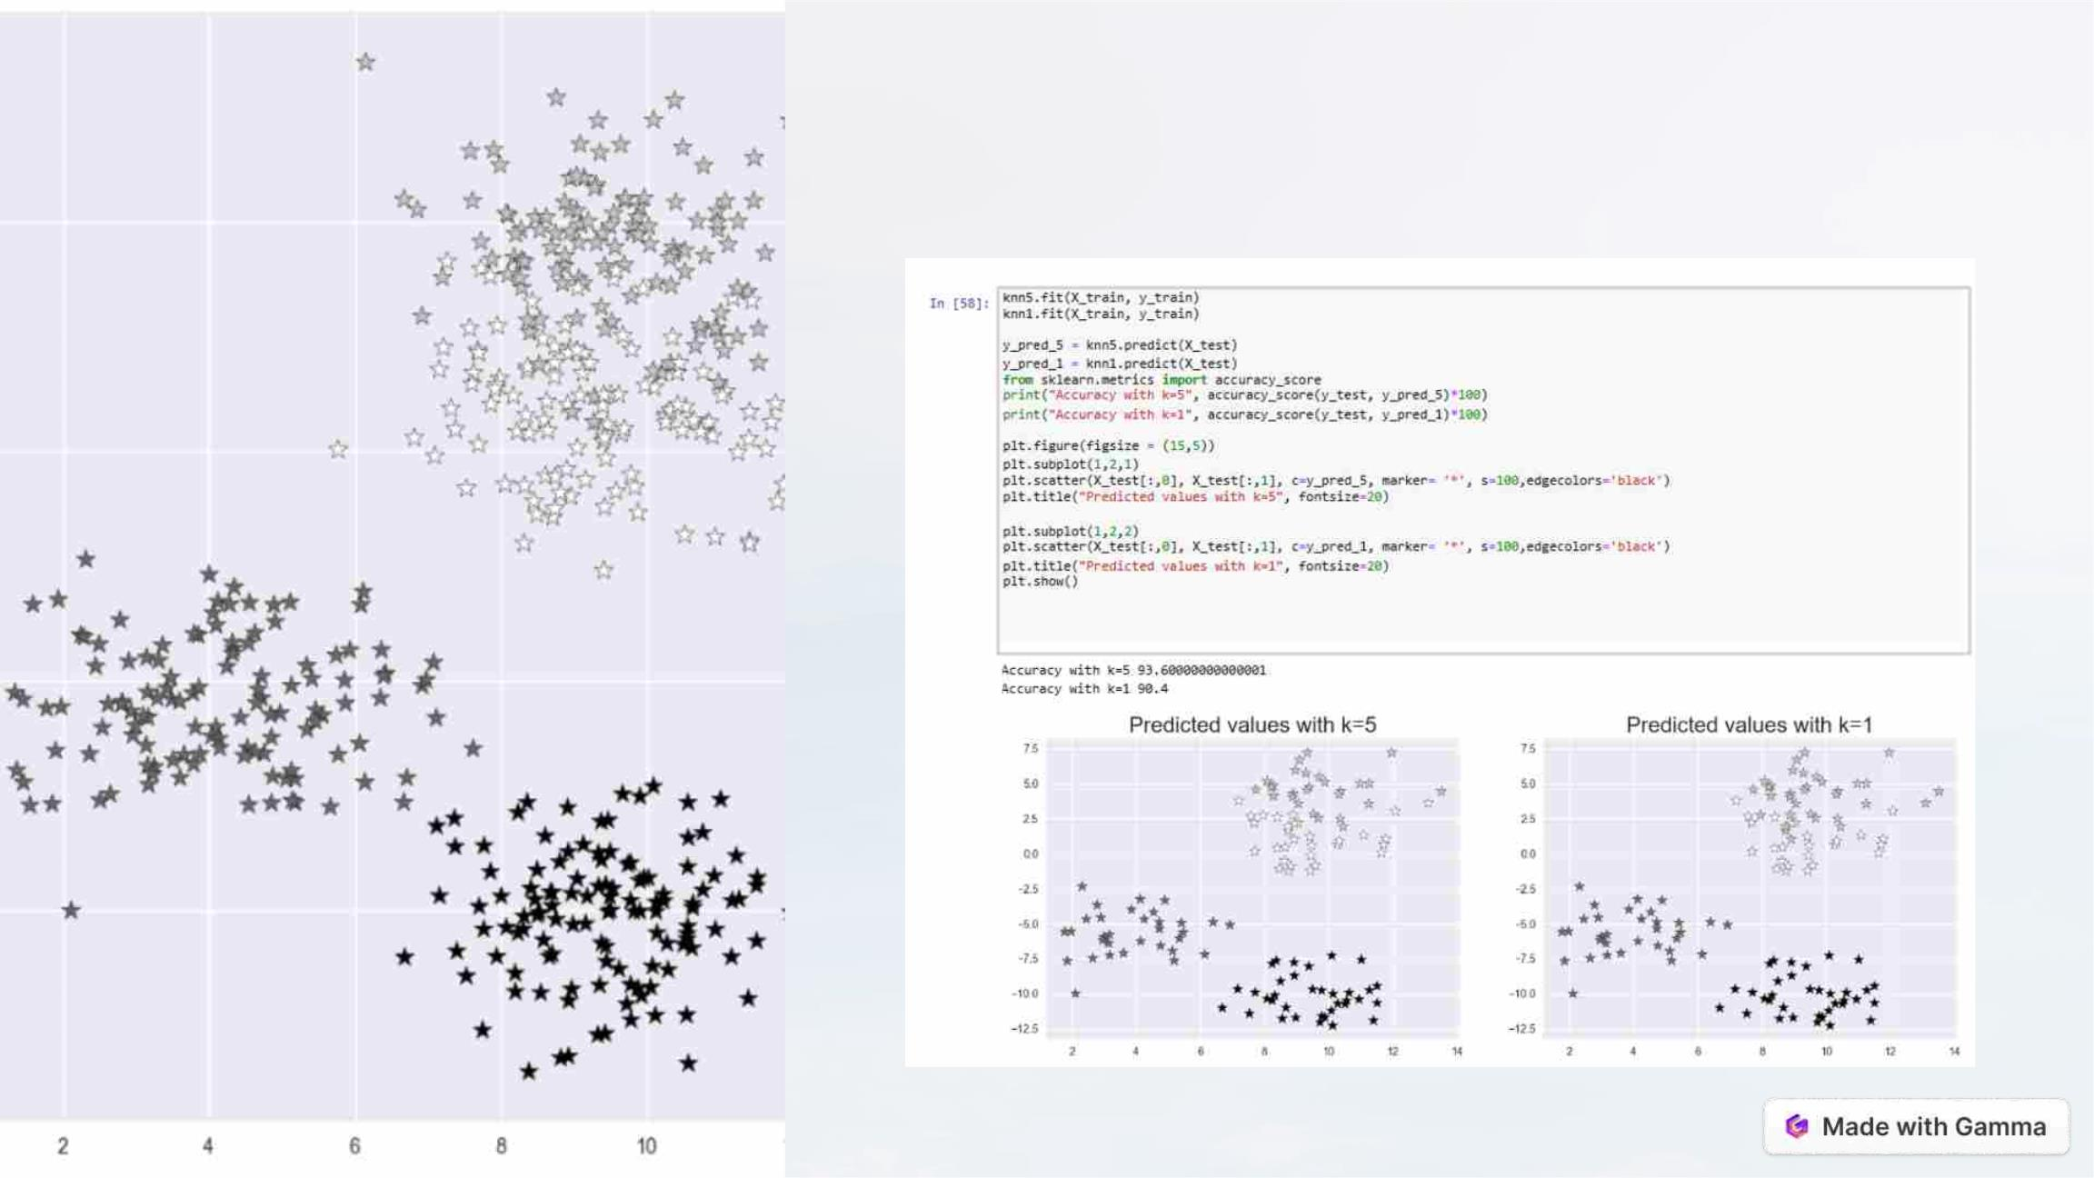
KNN visualization.

Slide 14
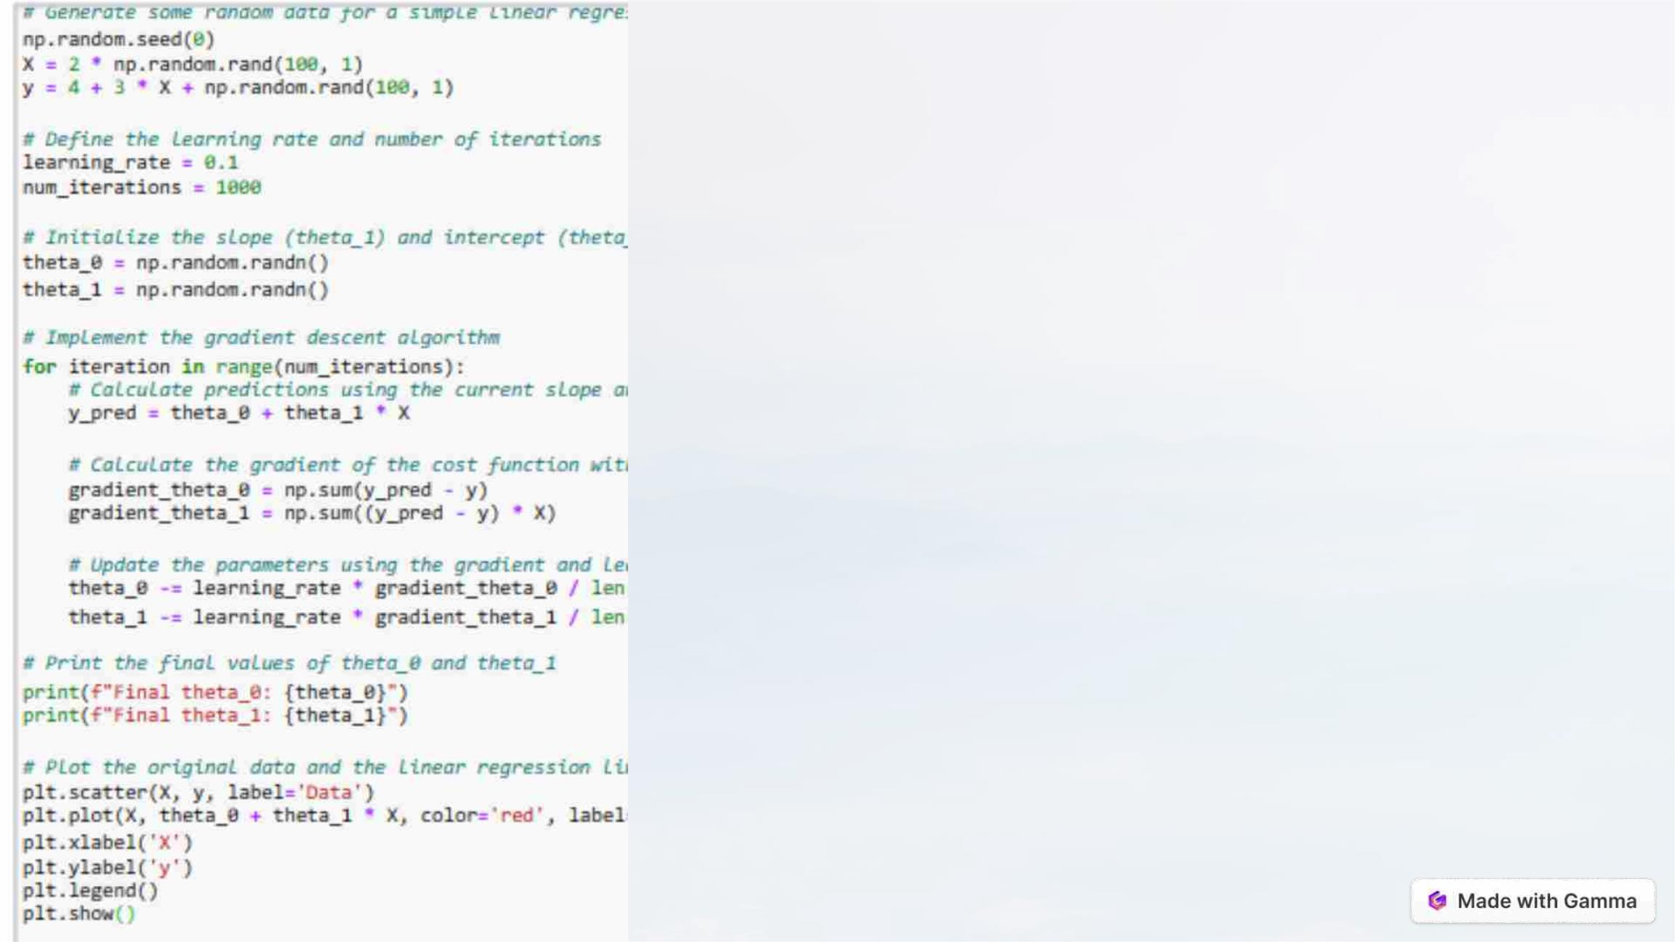
Convolutional Neural
Networks (CNN)
1.Convolutional Operation: CNNs derive their name from the key
operation they employ: convolution. The convolution operation helps
identify patterns, edges, and textures within the data.
2.Feature Hierarchy: CNNs are designed to automatically learn
hierarchical representations of features. Lower layers typically capture
simple features like edges and colors, while higher layers progressively
recognize more complex structures and object parts.
3.Activation Functions: Activation functions like ReLU (Rectified Linear
Unit) introduce non-linearity into the network. This non-linearity is crucial
for the network to model complex relationships in the data.

Slide 15
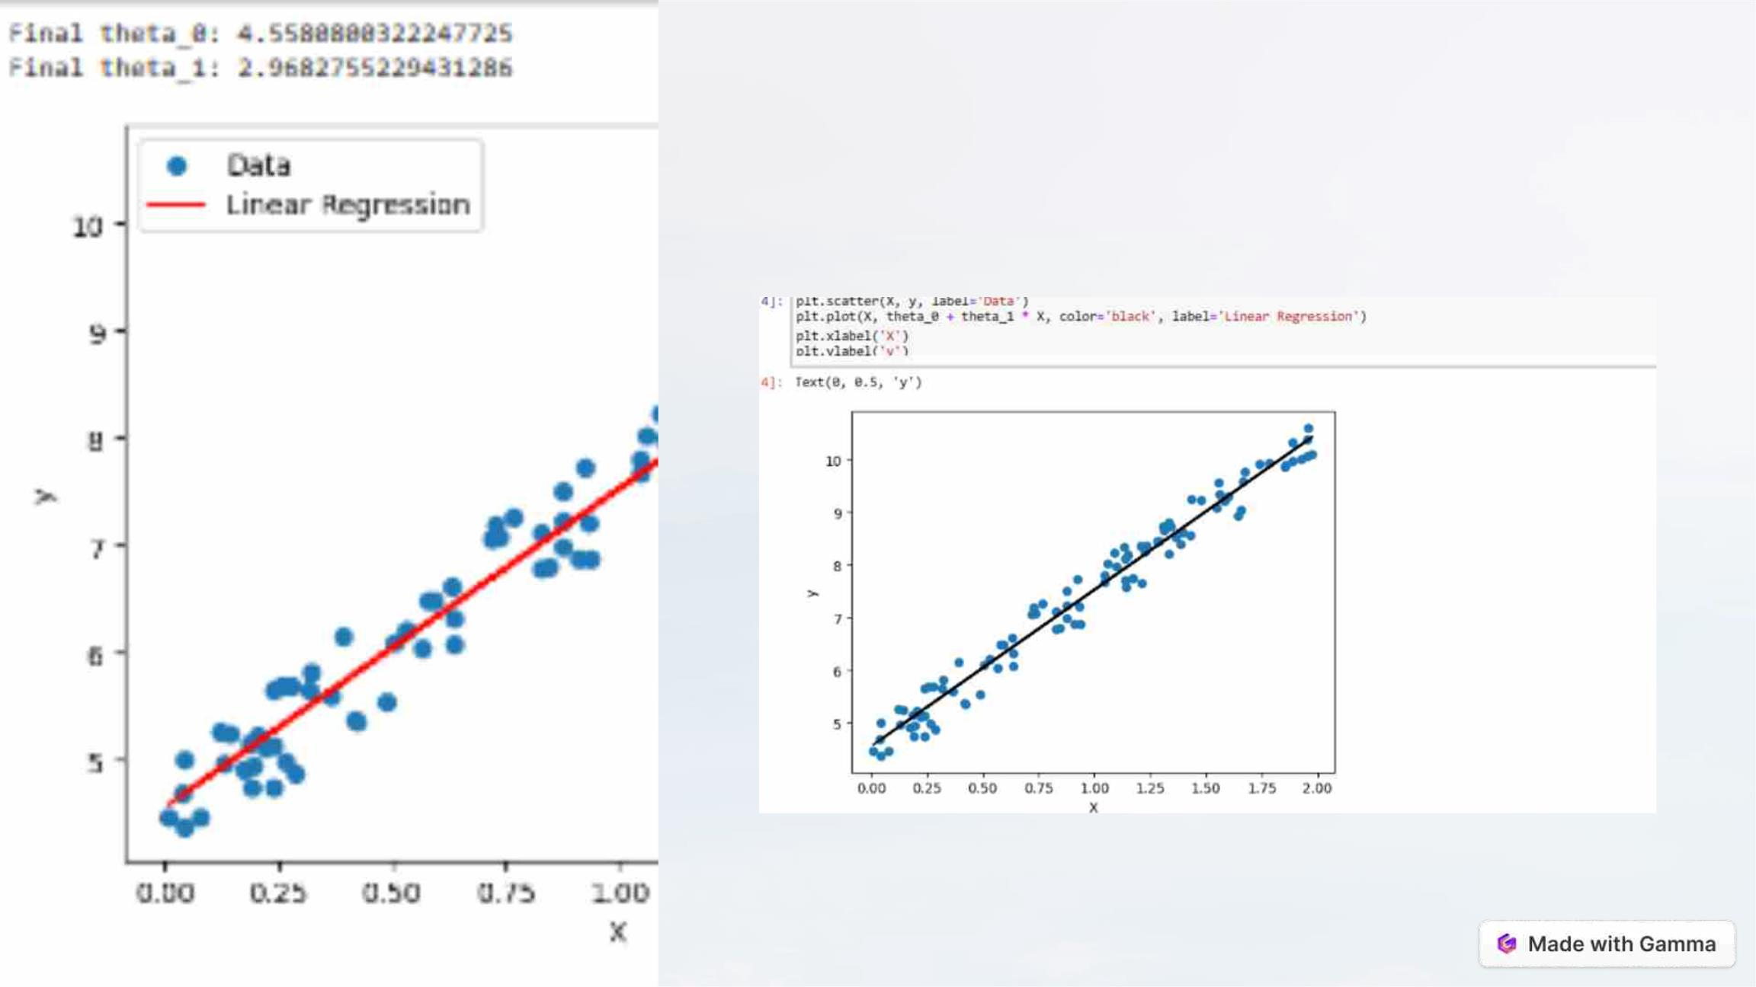
CNN visualization.

Slide 16
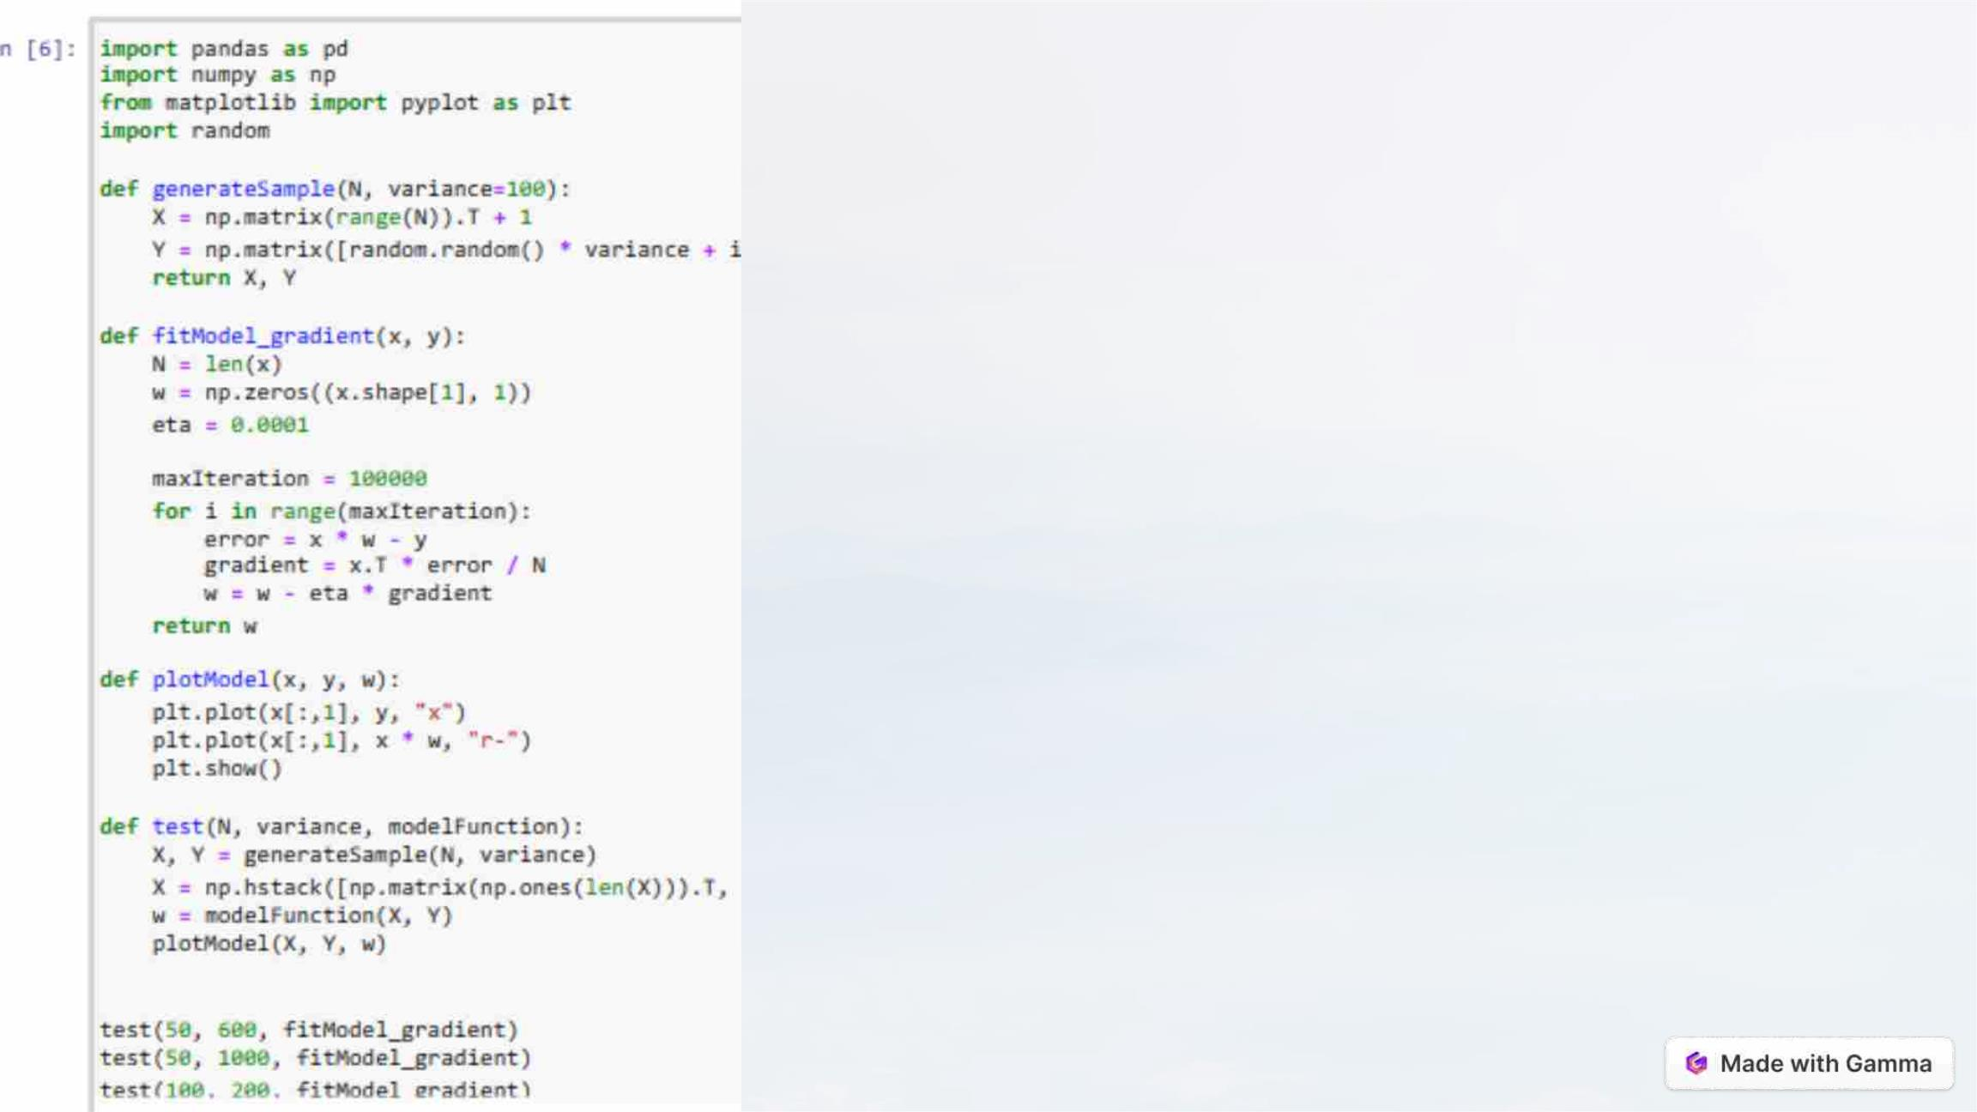
GRADIENT DESCENT.
1. Initialization: The process starts with an initial guess for the
model parameters. These parameters determine the model's
output, and the goal is to adjust them to minimize the cost function.
2. Computing the Gradient: The gradient of the cost function with
respect to the model parameters is computed. It provides
information about how the cost function changes as each
parameter is modified.
3. Iterative Process: Steps 2 and 3 are repeated iteratively. The goal
is to keep adjusting the parameters in the direction that reduces
the cost function until a minimum (or a local minimum) is reached.

Slide 17
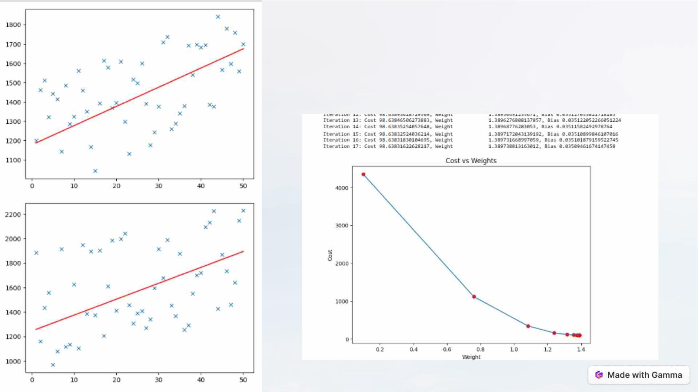
GRADIENT DESCENT
visualization.

Slide 18

Conclusion.
By leveraging machine learning models, data extraction techniques, and
powerful analytic tools, website traffic analysis can reach new heights.
The combination of Python, Pandas, Matplotlib, and various machine
learning algorithms opens up endless possibilities for understanding and
predicting user behavior. Stay ahead of the competition and make
informed decisions for your online presence.

