Slide 1
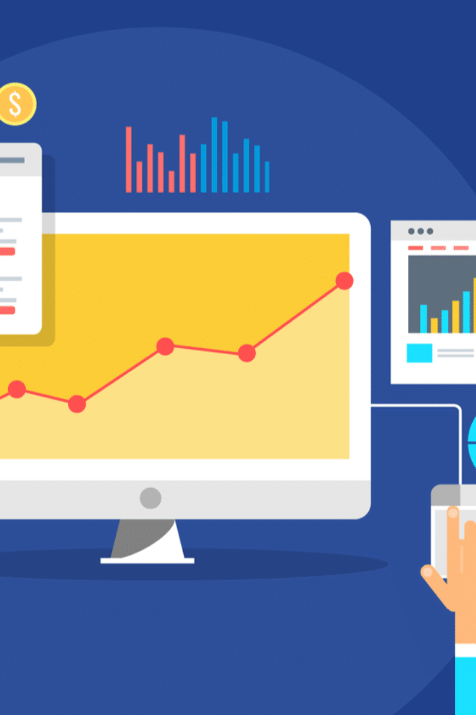
Website Traffic Analyzing Data.
Website traffic analysis is the process of collecting, analyzing, and interpreting data on how visitors engage with a website. It offers profound insights into user behavior, traffic sources, and the effectiveness of web content. By harnessing the power of web analytics tools and services, businesses and website owners can make informed decisions to enhance user experience, boost conversions, and tailor their online presence to meet the ever-evolving demands of the digital landscape. In this exploration of website traffic analysis, we will delve into the key components, metrics, and benefits of this practice, shedding light on how it empowers digital strategies and decision-making in the modern online ecosystem.

Slide 2

Defining Analysis Objectives
1
Data exploration and visualization
Data exploration and visualization is the process of analyzing and understanding data through graphical representations. It involves summarizing key statistics, identifying trends, and uncovering patterns within datasets.
2
Supervised learning-regression
Supervised learning regression is a machine learning technique where the goal is to predict a continuous output variable based on input data. It involves training a model on a labeled dataset, where each data point is associated with a target value.

Slide 3
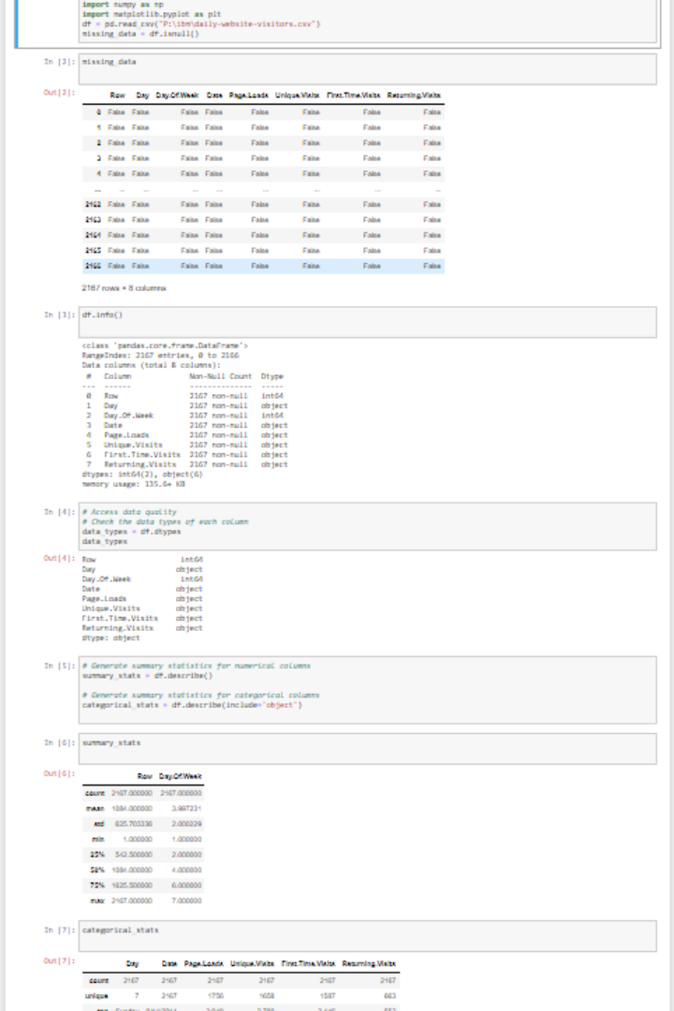
Data exploration and visualization
1
Data exploration and visualization
This process aids in identifying patterns, making informed decisions, and ultimately deriving valuable insights from data. Effective data exploration and visualization are essential for both descriptive and exploratory data analysis, supporting data-driven decision-making.

Slide 4
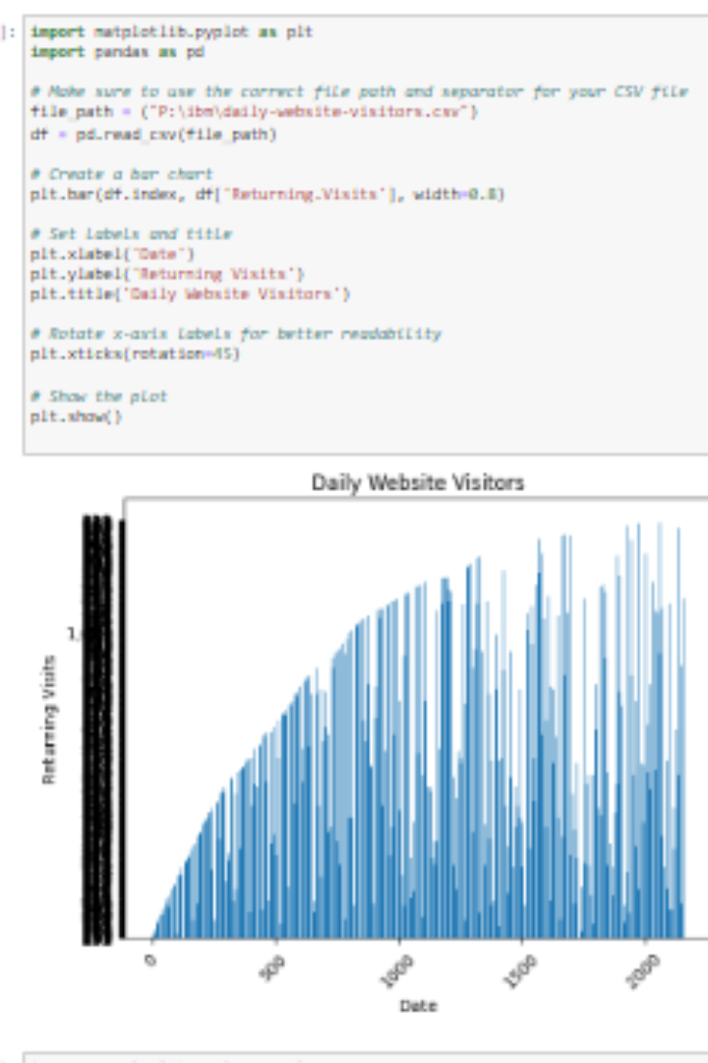
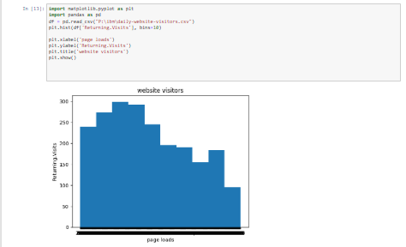
Visualization
Visualization is the process of creating mental or graphical representations of data, concepts, or ideas. It helps convey complex information in a more accessible and understandable format. Through visual elements like charts, graphs, diagrams, and images, visualization enhances comprehension and aids decision-making. It plays a crucial role in fields such as data analysis, scientific research, and design.

Slide 5

Supervised learning
Supervised learning is a type of machine learning where an algorithm learns from a labeled dataset. It involves the training of a model to make predictions or classifications based on input data and corresponding output labels. The goal is to generalize from the training data and accurately predict or classify new, unseen data. It requires a clear distinction between input features and target labels, making it suitable for tasks like regression and classification. Supervised learning algorithms include decision trees, support vector machines, and neural networks.
Regression vs Classification
Regression differs from classification in that it deals with predicting continuous numerical values. In classification, the goal is to assign data points to predefined categories or classes. In contrast, regression focuses on estimating a value, making it well-suited for tasks like predicting prices, temperatures, or other real-valued quantities.

Slide 6
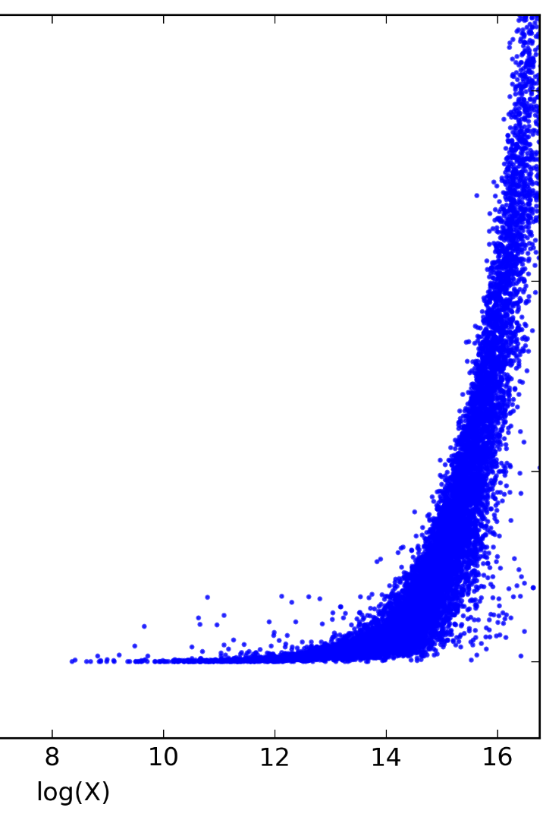
Regression
Regression learning is a supervised machine learning technique used to predict continuous numeric values. It involves analyzing the relationship between input features and a target variable. The goal is to find a mathematical function or model that best represents this relationship. Common regression algorithms include linear regression, polynomial regression, and decision tree regression. The performance of a regression model is typically assessed using metrics such as Mean Squared Error (MSE) or Root Mean Squared Error (RMSE). Regression is widely applied in various fields, including economics, finance, and science, to make predictions, estimate trends, and understand the impact of variables on a continuous outcome. It is distinct from classification, which deals with categorical outcomes.
In this regression we perform the linear operation or regression.

Slide 7
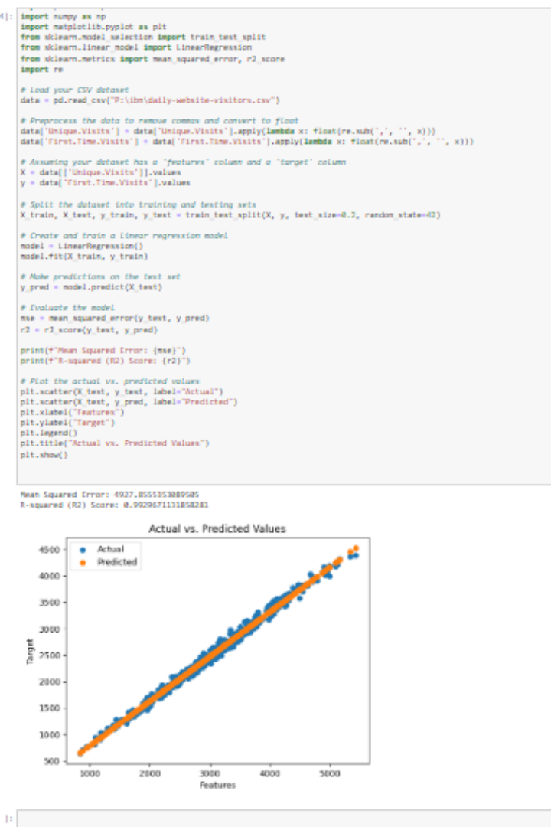
Linear regression
Linear regression is a statistical method used to model the relationship between a dependent variable and one or more independent variables. It assumes a linear relationship, meaning changes in the independent variables lead to proportional changes in the dependent variable. The model aims to find the best-fitting line, often represented as y = mx + b, where "y" is the dependent variable, "x" is the independent variable, "m" is the slope, and "b" is the intercept. The model minimizes the sum of squared differences between the predicted and actual values (the least squares method). Linear regression can be used for prediction, understanding relationships between variables, and identifying trends. It has limitations, such as sensitivity to outliers and the assumption of linearity. Extensions like multiple linear regression handle multiple independent variables, and it's widely applied in fields like economics, finance, and data analysis.

Slide 8
Flowchart
Exploration
Data exploration is the process of analyzing and visualizing data to gain insights and understand its characteristics, patterns, and potential relationships
visualization
Visualization is the use of graphical or other sensory representations to convey information or data in a way that is easily understood at a glance.
Regression
Regression is a statistical technique used to model and analyze the relationship between a dependent variable and one or more independent variables.
Linear Regression
Linear regression is a statistical method for modeling the relationship between a dependent variable and one or more independent variables by fitting a linear equation to the observed data.

Slide 9

Conclusion
In conclusion, the project successfully achieved its objectives by analyzing website traffic data to uncover valuable insights into user behavior, popular pages, and traffic sources. By defining clear analysis goals, collecting and visualizing data with IBM Cognos, and integrating Python for advanced analysis, website owners are now equipped with a powerful tool to enhance the user experience and make data-driven decisions for their site's improvement. This project provides a comprehensive framework for optimizing website performance and ensuring a more engaging online experience for visitors.

