Slide 1
MOBILE DEVELOPMENT
ANDROID AND IOS

Slide 2
MOBILE DEVELOPMENT - NATIVE
Android:
Development Tools: Familiarity with Android Studio and the use of Java or Kotlin.
App Lifecycle and UI Design: Understanding Android-specific design guidelines and the lifecycle of an Android app.
iOS:
Development Tools: Using Xcode with Swift (or Objective-C) for app development.
Design Principles: Adhering to iOS design standards and managing app lifecycle events.
Notes:
Teacher Notes:
Android: Demonstrate creating a “Hello World” app in Android Studio using Kotlin, then walk through the Android Activity lifecycle (onCreate, onPause, onDestroy).
iOS: Show an Xcode SwiftUI project, emphasizing the App lifecycle and the Swift Package Manager for dependencies.
Discuss platform design guidelines (Material for Android, Human Interface for iOS) and why adhering to them improves UX.
Resources:
Android Developers – App Fundamentals
Apple Developer – App Architecture
Additional Reading:
Android Programming: The Big Nerd Ranch Guide by Bill Phillips & Chris Stewart
iOS Programming: The Big Nerd Ranch Guide by Christian Keur & Aaron Hillegass

Slide 3
MOBILE DEVELOPMENT – CROSS-PLATFORM
Developing natively for both Android and iOS can be time-consuming and resource-intensive. Cross-platform development allows you to use a unified codebase to reduce costs, accelerate development, and improve maintainability — without sacrificing performance or user experience.
Building apps for multiple platforms from a single codebase offers several key benefits: ✅ Faster time-to-market with reduced development effort. ✅ Lower development and maintenance costs. ✅ Consistent user experience across platforms. ✅ Ability to leverage native features using plugins and APIs. ✅ Easier updates and feature rollouts.
Notes:
Teacher Notes:
Compare costs and timelines for maintaining two native codebases vs. one cross‑platform codebase.
Highlight real‑world examples: how Airbnb transitioned from native to React Native for faster feature delivery.
Resources:
Microsoft – Cross-platform Mobile Development Overview
Smashing Magazine – “Cross‑Platform Mobile App Development: Pros and Cons”

Slide 4
MOBILE DEVELOPMENT – CROSS-PLATFORM
Unified Codebase
Instead of maintaining two separate codebases for Android (Java/Kotlin) and iOS (Objective-C/Swift), cross-platform frameworks enable developers to write code once and run it on both platforms.
✅ Example:
Write a login feature in React Native → Works on both iOS and Android
Shared business logic, network requests, and data handling
Consistent behavior across platforms
Consistency
Maintaining a consistent UI and user experience across platforms is critical for user retention and satisfaction.
✅ Example:
Material Design components on Android → Cupertino components on iOS
Cross-platform frameworks automatically adapt UI to platform guidelines
Platform-specific gestures (like swiping or haptic feedback) handled by the framework
Notes:
Teacher Notes:
. 🌐 Overview of Cross-Platform Development
Cross-platform development allows developers to build mobile applications using a single codebase and deploy them on multiple platforms (Android, iOS). This reduces development effort and ensures consistency in functionality and user experience.
🔎 Unified Codebase
Instead of maintaining two separate codebases for Android (Java/Kotlin) and iOS (Objective-C/Swift), cross-platform frameworks enable developers to write code once and run it on both platforms.
Use a code demo: write a simple login screen in React Native and show it running on Android emulator and iOS simulator from the same code.
Explain how shared business logic (e.g., API calls) resides in a single JS module.
Resources:
React Native – Getting Started
Expo – React Native Tools
Additional Reading:
Learning React Native by Bonnie Eisenman
React Native in Action by Nader Dabit

Slide 5
React Native – Getting Started
Expo – React Native Tools
Learning React Native by Bonnie Eisenman
React Native in Action by Nader Dabit
Microsoft – Cross-platform Mobile Development Overview
Smashing Magazine – “Cross‑Platform Mobile App Development: Pros and Cons”

Slide 6
MOBILE DEVELOPMENT – TOOLS
Apache Cordova
Language: HTML, CSS, JavaScript
Approach: Wraps a web app in a native container using WebView
Plugins: Allows access to native device features (camera, GPS)
✅ Advantages:
Familiar web technologies
Large ecosystem of plugins
⚠️ Considerations:
Web-based approach → Lower performance than native
UI elements may not feel "native"
Shared business logic, network requests, and data handling
Consistent behavior across platforms
Notes:
Teacher Notes:
Demo installing Cordova CLI (npm install -g cordova), creating a project (cordova create), and adding platforms (cordova platform add android).
Show how to access device features (camera, geolocation) via plugins (cordova plugin add cordova-plugin-camera).
Resources:
Apache Cordova – Getting Started Guide
GitHub – Apache Cordova Plugins
Additional Reading:
Apache Cordova in Action by Raymond Camden & John Wargo
PhoneGap Essentials by John M. Wargo

Slide 7
MOBILE DEVELOPMENT – TOOLS
React Native
Language: JavaScript + React
Approach: Uses native components and a JavaScript bridge
Hot Reload: Fast updates without rebuilding the app
✅ Advantages:
High performance → Close to native
Strong community and third-party libraries
Reusable UI components
⚠️ Considerations:
Complex animations and UI may require native modules
Learning curve for handling state and props
Notes:
Teacher Notes:
Demo installing Cordova CLI (npm install -g cordova), creating a project (cordova create), and adding platforms (cordova platform add android).
Show how to access device features (camera, geolocation) via plugins (cordova plugin add cordova-plugin-camera).
Resources:
Apache Cordova – Getting Started Guide
GitHub – Apache Cordova Plugins
Additional Reading:
Apache Cordova in Action by Raymond Camden & John Wargo
PhoneGap Essentials by John M. Wargo

Slide 8
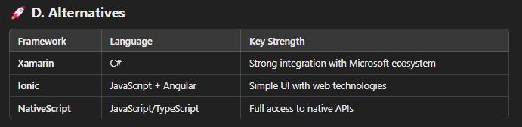
MOBILE DEVELOPMENT – TOOLS
Flutter
Language: Dart
Approach: Uses a custom rendering engine for building UI
Hot Reload: Fast updates without full rebuild
✅ Advantages:
High performance → Compiles to native code
Highly customizable UI with widgets
Growing community and strong Google support
⚠️ Considerations:
Dart is less familiar to most developers
Larger app size compared to other frameworks
Notes:
Teacher Notes:
Show a flutter create demo, run on emulator, then edit a widget and see hot reload.
Explain the widget tree concept and how Flutter’s custom rendering bypasses native UI components for full control.
Resources:
Flutter – Get Started
Dart – Language Tour
Additional Reading:
Flutter in Action by Eric Windmill
Beginning Flutter: A Hands On Guide to App Development by Marco L. Napoli

Slide 9
Flutter – Get Started
Dart – Language Tour
Flutter in Action by Eric Windmill
Beginning Flutter: A Hands On Guide to App Development by Marco L. Napoli
Apache Cordova – Getting Started Guide
GitHub – Apache Cordova Plugins
Apache Cordova in Action by Raymond Camden & John Wargo
PhoneGap Essentials by John M. Wargo

Slide 10
MOBILE DEVELOPMENT – FINAL EXERCISE
Pack and Deploy Your Classroom Management App with Apache Cordova ✅ Install Apache Cordova Set up Cordova on your machine to package your HTML, CSS, and JavaScript files into a mobile-ready application. ✅ Prepare Your Web Project Make sure your project folder is well-structured and includes all necessary files (HTML, CSS, JS). ✅ Build the Mobile App Use Cordova commands to build your project for Android or iOS, creating native app packages. ✅ Test on Real Devices Install the generated app files on your phone or emulator to see your classroom management tool in action.
👉 This will let you experience your project on real devices and share it with others—taking your classroom management app to the next level! 😎
https://cordova.apache.org/
Notes:
Teacher Notes:
Provide a live walkthrough packaging the Classroom Management web app via Cordova: cordova build android and deploying to a device.
Emphasize testing on both Android and iOS emulators or real devices and debugging via remote WebView inspector.
Resources:
Apache Cordova – Debugging Guide
Android – Debug WebView on Android Devices

Slide 11
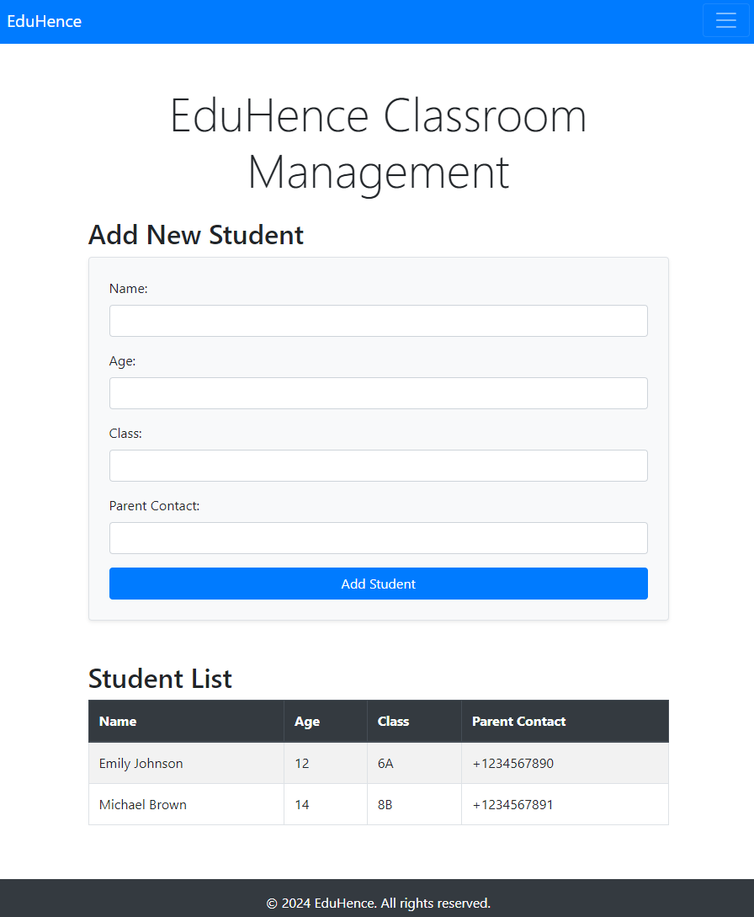
MOBILE DEVELOPMENT – FINAL EXERCISE
Notes:
Teacher Notes:
Provide a live walkthrough packaging the Classroom Management web app via Cordova: cordova build android and deploying to a device.
Emphasize testing on both Android and iOS emulators or real devices and debugging via remote WebView inspector.
Resources:
Apache Cordova – Debugging Guide
Android – Debug WebView on Android Devices

