Slide 1
SOFTWARE DEVELOPMENT LIFE CYCLE
SDLC in Project Management

Slide 2
SDLC
🔹 SDLC provides a systematic framework for planning, building, testing, and deploying software while aligning with business goals and user needs. By integrating SDLC into project management practices, teams can minimize risks, optimize resource allocation, and ensure the delivery of high-quality products on time and within budget.
Software development is complex, involving multiple stakeholders, dynamic requirements, and tight deadlines. A structured approach like SDLC helps to: ✅ Reduce development risks ✅ Improve product quality ✅ Increase customer satisfaction ✅ Ensure better cost and time management ✅ Align business goals with technical execution

Slide 3
SDLC – PHASES
Planning
In the planning phase, the goal is to define the project’s goals, scope, and resource requirements.
Goal: Create an intuitive, scalable collaborative learning platform.
Scope:
Develop student-teacher collaboration tools (chat, video calls, file sharing).
Create interactive learning modules.
Implement data privacy and secure login features.
Resources:
Development Team (Front-end, Back-end, QA)
Cloud Infrastructure
Data Security Consultants
Timeline:
MVP within 4 months
Full-featured product within 12 months

Slide 4
SDLC – PHASES
Requirements Analysis
Identify the functional and non-functional requirements based on stakeholder needs.
Functional Requirements:
Real-time chat and video call support.
Secure login for students, teachers, and administrators.
Assignment submission and grading system.
Non-Functional Requirements:
Scalability – Must support 100,000+ simultaneous users.
Data privacy – Must comply with GDPR.
99.9% uptime.
Stakeholders:
Students – Ease of use, quick navigation.
Teachers – Gradebook, assignment tracking.
Admins – User management and system reporting.

Slide 5
SDLC – PHASES
Design
Design the architecture, data models, and user interfaces for Eduhance.
Data Model:
User Table (id, name, role, email)
Course Table (course id, name, teacher id)
Chat Table (chat id, user id, message)
System Architecture:
Microservices architecture – Separate modules for chat, grading, and login.
Cloud-based infrastructure (AWS or Azure).
UI/UX Design:
Clean, responsive design.
Mobile-first approach for accessibility.

Slide 6
SDLC – PHASES
Implementation
Convert the design into working code.
Backend: Node.js + Express.js + PostgreSQL
Frontend: React.js + Redux
Authentication: OAuth + JWT
Real-time communication: WebSockets
Infrastructure: Docker + Kubernetes for containerization

Slide 7
SDLC – PHASES
Testing
Ensure that the system works as expected through rigorous testing.
Unit Testing: Test individual modules (chat, login).
Integration Testing: Test API connections between front-end and back-end.
Performance Testing: Ensure platform can handle 100,000+ concurrent users.
Security Testing: Test for SQL injection, CSRF, and XSS vulnerabilities.
User Acceptance Testing (UAT): Gather teacher and student feedback.

Slide 8
SDLC – PHASES
Deployment
Release the product into a live environment.
Deploy using AWS Elastic Beanstalk for scalability.
Set up automatic failover and load balancing.
Blue/Green deployment to minimize downtime.

Slide 9
SDLC – PHASES
Maintenance
Monitor system performance and apply updates as needed.
Monitor server load and response times.
Roll out feature updates based on feedback.
Improve security as new threats emerge.

Slide 10
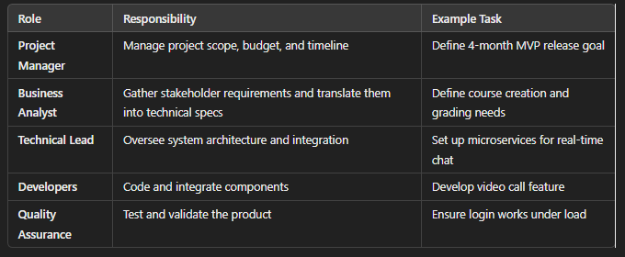
SDLC – ROLES AND METHODOLOGIES
Project Methodologies
Waterfall:
Fixed scope, sequential phases.
Used for backend architecture development.
Agile:
Flexible, iterative cycles.
Used for frontend development and user feedback loops.
Hybrid:
Combination of Agile and Waterfall.
Used for balancing flexibility and structure.

