Slide 1
MOBILE DEVELOPMENT
ANDROID AND IOS

Slide 2
MOBILE DEVELOPMENT - NATIVE
Android:
Development Tools: Familiarity with Android Studio and the use of Java or Kotlin.
App Lifecycle and UI Design: Understanding Android-specific design guidelines and the lifecycle of an Android app.
iOS:
Development Tools: Using Xcode with Swift (or Objective-C) for app development.
Design Principles: Adhering to iOS design standards and managing app lifecycle events.

Slide 3
MOBILE DEVELOPMENT – CROSS-PLATFORM
Developing natively for both Android and iOS can be time-consuming and resource-intensive. Cross-platform development allows you to use a unified codebase to reduce costs, accelerate development, and improve maintainability — without sacrificing performance or user experience.
Building apps for multiple platforms from a single codebase offers several key benefits: ✅ Faster time-to-market with reduced development effort. ✅ Lower development and maintenance costs. ✅ Consistent user experience across platforms. ✅ Ability to leverage native features using plugins and APIs. ✅ Easier updates and feature rollouts.

Slide 4
MOBILE DEVELOPMENT – CROSS-PLATFORM
Unified Codebase
Instead of maintaining two separate codebases for Android (Java/Kotlin) and iOS (Objective-C/Swift), cross-platform frameworks enable developers to write code once and run it on both platforms.
✅ Example:
Write a login feature in React Native → Works on both iOS and Android
Shared business logic, network requests, and data handling
Consistent behavior across platforms
Consistency
Maintaining a consistent UI and user experience across platforms is critical for user retention and satisfaction.
✅ Example:
Material Design components on Android → Cupertino components on iOS
Cross-platform frameworks automatically adapt UI to platform guidelines
Platform-specific gestures (like swiping or haptic feedback) handled by the framework
Notes:
1. 🌐 Overview of Cross-Platform Development
Cross-platform development allows developers to build mobile applications using a single codebase and deploy them on multiple platforms (Android, iOS). This reduces development effort and ensures consistency in functionality and user experience.
🔎 Unified Codebase
Instead of maintaining two separate codebases for Android (Java/Kotlin) and iOS (Objective-C/Swift), cross-platform frameworks enable developers to write code once and run it on both platforms.
✅ Example:
Write a login feature in React Native → Works on both iOS and Android
Shared business logic, network requests, and data handling
Consistent behavior across platforms
🎯 Consistency
Maintaining a consistent UI and user experience across platforms is critical for user retention and satisfaction.
✅ Example:
Material Design components on Android → Cupertino components on iOS
Cross-platform frameworks automatically adapt UI to platform guidelines
Platform-specific gestures (like swiping or haptic feedback) handled by the framework

Slide 5
MOBILE DEVELOPMENT – TOOLS
Apache Cordova
Language: HTML, CSS, JavaScript
Approach: Wraps a web app in a native container using WebView
Plugins: Allows access to native device features (camera, GPS)
✅ Advantages:
Familiar web technologies
Large ecosystem of plugins
⚠️ Considerations:
Web-based approach → Lower performance than native
UI elements may not feel "native"
Shared business logic, network requests, and data handling
Consistent behavior across platforms
React Native
Language: JavaScript + React
Approach: Uses native components and a JavaScript bridge
Hot Reload: Fast updates without rebuilding the app
✅ Advantages:
High performance → Close to native
Strong community and third-party libraries
Reusable UI components
⚠️ Considerations:
Complex animations and UI may require native modules
Learning curve for handling state and props
Notes:
1. 🌐 Overview of Cross-Platform Development
Cross-platform development allows developers to build mobile applications using a single codebase and deploy them on multiple platforms (Android, iOS). This reduces development effort and ensures consistency in functionality and user experience.
🔎 Unified Codebase
Instead of maintaining two separate codebases for Android (Java/Kotlin) and iOS (Objective-C/Swift), cross-platform frameworks enable developers to write code once and run it on both platforms.
✅ Example:
Write a login feature in React Native → Works on both iOS and Android
Shared business logic, network requests, and data handling
Consistent behavior across platforms
🎯 Consistency
Maintaining a consistent UI and user experience across platforms is critical for user retention and satisfaction.
✅ Example:
Material Design components on Android → Cupertino components on iOS
Cross-platform frameworks automatically adapt UI to platform guidelines
Platform-specific gestures (like swiping or haptic feedback) handled by the framework

Slide 6
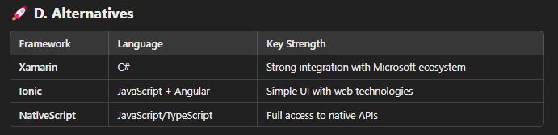
MOBILE DEVELOPMENT – TOOLS
Flutter
Language: Dart
Approach: Uses a custom rendering engine for building UI
Hot Reload: Fast updates without full rebuild
✅ Advantages:
High performance → Compiles to native code
Highly customizable UI with widgets
Growing community and strong Google support
⚠️ Considerations:
Dart is less familiar to most developers
Larger app size compared to other frameworks
Notes:
1. 🌐 Overview of Cross-Platform Development
Cross-platform development allows developers to build mobile applications using a single codebase and deploy them on multiple platforms (Android, iOS). This reduces development effort and ensures consistency in functionality and user experience.
🔎 Unified Codebase
Instead of maintaining two separate codebases for Android (Java/Kotlin) and iOS (Objective-C/Swift), cross-platform frameworks enable developers to write code once and run it on both platforms.
✅ Example:
Write a login feature in React Native → Works on both iOS and Android
Shared business logic, network requests, and data handling
Consistent behavior across platforms
🎯 Consistency
Maintaining a consistent UI and user experience across platforms is critical for user retention and satisfaction.
✅ Example:
Material Design components on Android → Cupertino components on iOS
Cross-platform frameworks automatically adapt UI to platform guidelines
Platform-specific gestures (like swiping or haptic feedback) handled by the framework

Slide 7
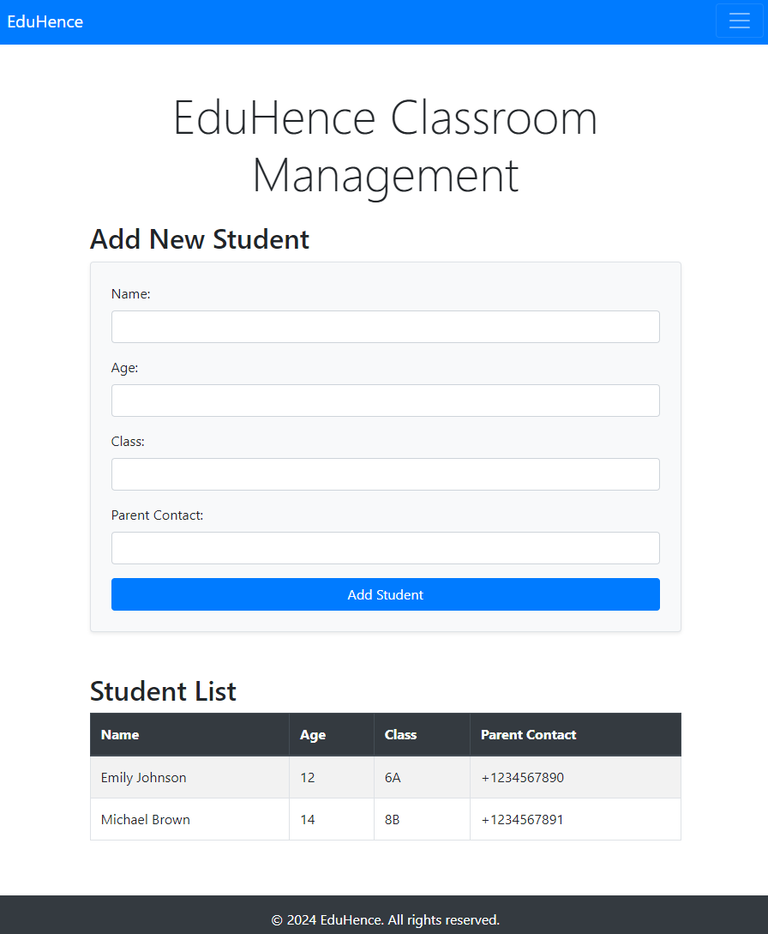
MOBILE DEVELOPMENT – FINAL EXERCISE
Pack and Deploy Your Classroom Management App with Apache Cordova ✅ Install Apache Cordova Set up Cordova on your machine to package your HTML, CSS, and JavaScript files into a mobile-ready application. ✅ Prepare Your Web Project Make sure your project folder is well-structured and includes all necessary files (HTML, CSS, JS). ✅ Build the Mobile App Use Cordova commands to build your project for Android or iOS, creating native app packages. ✅ Test on Real Devices Install the generated app files on your phone or emulator to see your classroom management tool in action.
👉 This will let you experience your project on real devices and share it with others—taking your classroom management app to the next level! 😎
https://cordova.apache.org/

