Slide 1
SECURITY AND PRIVACY
Data Security and Privacy

Slide 2
SECURITY AND PRIVACY
🔹 Cyberattacks, data breaches, and privacy violations are becoming more frequent and more sophisticated — making it essential for businesses and individuals to implement strong security and privacy practices
🔹 Modern organizations rely heavily on data — from customer information to proprietary business strategies. Without adequate security and privacy controls, sensitive data can be exposed to threats like hacking, unauthorized access, or accidental disclosure.
✅ Consequences of Poor Security and Privacy Practices:
Data Breaches – Exposure of customer or business data
Financial Loss – Fines, penalties, and lawsuits
Reputation Damage – Loss of customer trust and brand value
Operational Disruption – Downtime caused by attacks or misconfigurations

Slide 3
SECURITY AND PRIVACY
🔹 Cyberattacks, data breaches, and privacy violations are becoming more frequent and more sophisticated — making it essential for businesses and individuals to implement strong security and privacy practices
🔹 Modern organizations rely heavily on data — from customer information to proprietary business strategies. Without adequate security and privacy controls, sensitive data can be exposed to threats like hacking, unauthorized access, or accidental disclosure.
✅ Consequences of Poor Security and Privacy Practices:
Data Breaches – Exposure of customer or business data
Financial Loss – Fines, penalties, and lawsuits
Reputation Damage – Loss of customer trust and brand value
Operational Disruption – Downtime caused by attacks or misconfigurations

Slide 4
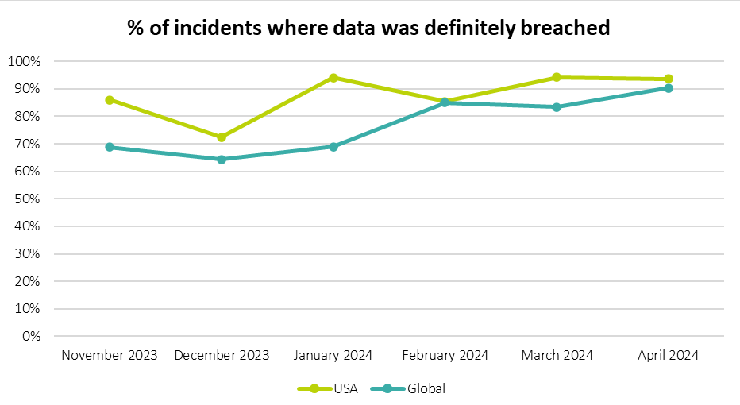
SECURITY AND PRIVACY

Slide 5
SECURITY AND PRIVACY - BASICS
The three core pillars of information security are:
Confidentiality
Ensuring that data is only accessible to authorized parties.
Example: Encrypting customer credit card details to prevent exposure.
Integrity
Ensuring that data remains accurate and unchanged during transmission and storage.
Example: Using hashing to verify that downloaded files are not corrupted.
Availability
Ensuring that data is accessible when needed.
Example: Implementing failover systems to maintain access during outages.

Slide 6
SECURITY AND PRIVACY - BASICS
The three core pillars of information security are:
Confidentiality
Ensuring that data is only accessible to authorized parties.
Example: Encrypting customer credit card details to prevent exposure.
Integrity
Ensuring that data remains accurate and unchanged during transmission and storage.
Example: Using hashing to verify that downloaded files are not corrupted.
Availability
Ensuring that data is accessible when needed.
Example: Implementing failover systems to maintain access during outages.

Slide 7
SECURITY AND PRIVACY - BASICS
Organizations must define:
Who is responsible for data protection (Data Protection Officer or equivalent).
How data is collected, processed, and stored (Data Flow Documentation).
How data breaches will be reported and handled (Incident Response Plan).
Example: A healthcare provider should have documented policies for handling patient records and notifying affected parties in case of a breach.

Slide 8
SECURITY AND PRIVACY - ENCRYPTION
Encryption protects data from unauthorized access during transmission and storage.
Symmetric Encryption
Same key is used for both encryption and decryption.
Example: AES (Advanced Encryption Standard)
✅ Fast and efficient
❌ If the key is compromised, the data is vulnerable
Asymmetric Encryption
Uses a pair of keys:
Public key – Used for encryption
Private key – Used for decryption
Example: RSA (Rivest–Shamir–Adleman)
✅ Secure even if public key is exposed
❌ Slower than symmetric encryption
Hybrid Encryption
Combines symmetric and asymmetric encryption.
Example: HTTPS uses asymmetric encryption to establish a connection, then symmetric encryption to transmit data.

Slide 9
SECURITY AND PRIVACY - HASHING
Converts data into a fixed-size value (hash) to verify integrity.
One-way process — data cannot be recovered from the hash.
Example: SHA-256 (Secure Hash Algorithm)
✅ Ensures that data has not been altered
✅ Used for storing passwords securely
Example: Websites store a hash of the password instead of the actual password — even if the hash is exposed, the password remains secure.

Slide 10
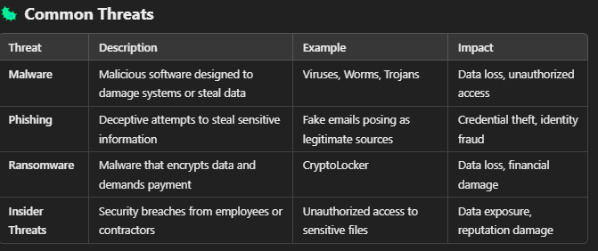
SECURITY AND PRIVACY - THREATS
✅ Firewalls – Block unauthorized access to networks. ✅ Intrusion Detection/Prevention Systems (IDS/IPS) – Monitor and block malicious traffic. ✅ Antivirus and Antimalware – Detect and remove malicious software. ✅ Access Controls – Use role-based access and multi-factor authentication (MFA). ✅ Data Loss Prevention (DLP) – Prevent data from being transferred or copied without permission.

Slide 11
SECURITY AND PRIVACY - THREATS
✅ Firewalls – Block unauthorized access to networks. ✅ Intrusion Detection/Prevention Systems (IDS/IPS) – Monitor and block malicious traffic. ✅ Antivirus and Antimalware – Detect and remove malicious software. ✅ Access Controls – Use role-based access and multi-factor authentication (MFA). ✅ Data Loss Prevention (DLP) – Prevent data from being transferred or copied without permission.
Regular Software Updates and Patch Management
Security patches address known vulnerabilities.
Example: Updating an operating system to fix an exploit.
✅ Reduces exposure to known threats

Slide 12
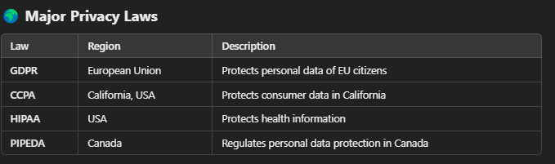
SECURITY AND PRIVACY - LAWS AND REGULATIONS
Compliance Requirements
Data Protection Impact Assessments (DPIA)
Evaluate risks associated with data processing.
Implementing Policies and Procedures
Define how data is collected, stored, and protected.
Outline breach notification protocols.
Regular Audits and Monitoring
Perform internal audits and vulnerability assessments.
Ensure systems meet compliance requirements.
Example of a GDPR Breach Penalty
In 2019, British Airways was fined £183 million for failing to protect customer data due to security vulnerabilities.

