Slide 1
SECURITY AND PRIVACY
Data Security and Privacy

Slide 2
SUMMARY
Key security principles:
Confidentiality: Protect data from unauthorized access (e.g., encryption).
Integrity: Ensure data isn’t altered (e.g., hashing).
Availability: Keep data accessible when needed.
Core tools & practices:
Encryption:
Symmetric: Same key (e.g., AES).
Asymmetric: Key pairs (e.g., RSA).
Hybrid: Combines both (e.g., HTTPS).
Hashing: One-way checks for integrity (e.g., SHA-256).
Security measures: Firewalls, IDS/IPS, antivirus, access controls, DLP.
Compliance & regulations:
GDPR and other laws mandate data protection, impact assessments, breach notification, audits, and documented policies.
Example: British Airways fined £183 million for GDPR violations.

Slide 3
SECURITY AND PRIVACY
Cyberattacks, data breaches, and privacy violations are becoming more frequent and more sophisticated — making it essential for businesses and individuals to implement strong security and privacy practices
Modern organizations rely heavily on data, from customer information to proprietary business strategies. Without adequate security and privacy controls, sensitive data can be exposed to threats like hacking, unauthorized access, or accidental disclosure.
Consequences of Poor Security and Privacy Practices:
- Data Breaches – Exposure of customer or business data
- Financial Loss – Fines, penalties, and lawsuits
- Reputation Damage – Loss of customer trust and brand value
- Operational Disruption – Downtime caused by attacks or misconfigurations
Notes:
Teacher Notes:
Start with a discussion on real-world examples (recent high-profile breaches) to illustrate how lack of security can affect organizations both financially and reputationally.
Emphasize the role of cybersecurity awareness in all departments of an organization.
Explain why security and privacy are not just IT issues but are central to corporate governance and risk management.
Resources:
A basic primer video or interactive module on cybersecurity fundamentals from organizations such as NIST or SANS Institute.
Infographics or news articles that highlight trends in cyberattacks and breaches.
Additional Reading:
“Cybersecurity 101” articles or introductory chapters from textbooks like Cybersecurity and Cyberwar: What Everyone Needs to Know by P. W. Singer and Allan Friedman.

Slide 4
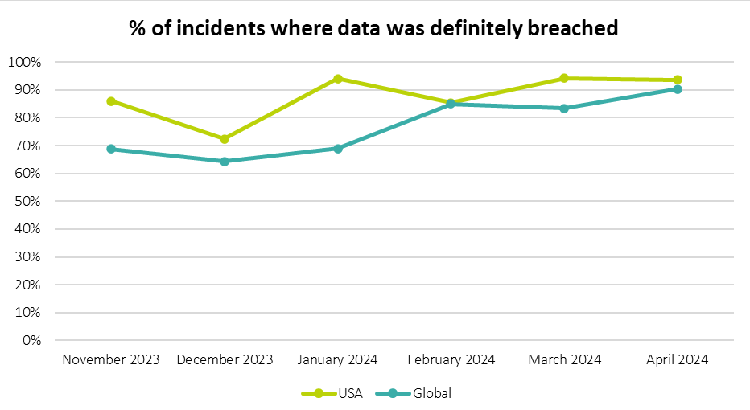
SECURITY AND PRIVACY
https://www.researchgate.net/
Notes:
Teacher Notes:
Walk through each element of the CIA triad with practical examples. For instance, explain how encryption (for confidentiality), digital signatures (for integrity), and redundant systems (for availability) each play a role.
Consider using a short in-class activity where students classify different security scenarios under the correct pillar.
Resources:
Official documents or guides on the CIA model from reputable bodies such as NIST’s Cybersecurity Framework.
Online interactive tools or simulations that visually demonstrate the principles of confidentiality, integrity, and availability.
Additional Reading:
Articles or textbook chapters discussing the evolution of the CIA triad and its application in modern networks.

Slide 5
SECURITY AND PRIVACY - BASICS
The three core pillars of information security are:
Confidentiality
- Ensuring that data is only accessible to authorized parties.
- Example: Encrypting customer credit card details to prevent exposure.
Integrity
- Ensuring that data remains accurate and unchanged during transmission and storage.
- Example: Using hashing to verify that downloaded files are not corrupted.
- Availability
- Ensuring that data is accessible when needed.
- Example: Implementing failover systems to maintain access during outages.
Notes:
Teacher Notes:
Detail the importance of assigning clear roles for data protection. Discuss how documentation (policies, procedures, incident response plans) is critical to managing risks.
Provide a walk-through of a typical incident response lifecycle and review case studies from sectors like healthcare or finance.
Resources:
Templates or best-practice guides for data protection policies and incident response plans from sites such as SANS Institute or government cybersecurity agencies.
Checklists or flowcharts that illustrate the process of data handling and breach reporting.
Additional Reading:
Whitepapers on building an effective incident response plan or case studies analyzing data breach impacts in regulated sectors.

Slide 6
SECURITY AND PRIVACY - BASICS
Organizations must define:
- Who is responsible for data protection (Data Protection Officer or equivalent).
- How data is collected, processed, and stored (Data Flow Documentation).
- How data breaches will be reported and handled (Incident Response Plan).
Example: A healthcare provider should have documented policies for handling patient records and notifying affected parties in case of a breach.
Notes:
Teacher Notes:
Detail the importance of assigning clear roles for data protection. Discuss how documentation (policies, procedures, incident response plans) is critical to managing risks.
Provide a walk-through of a typical incident response lifecycle and review case studies from sectors like healthcare or finance.
Resources:
Templates or best-practice guides for data protection policies and incident response plans from sites such as SANS Institute or government cybersecurity agencies.
Checklists or flowcharts that illustrate the process of data handling and breach reporting.
Additional Reading (if applicable):
Whitepapers on building an effective incident response plan or case studies analyzing data breach impacts in regulated sectors.

Slide 7
SECURITY AND PRIVACY - ENCRYPTION
Encryption protects data from unauthorized access during transmission and storage.
Symmetric Encryption
- Same key is used for both encryption and decryption.
- Example: AES (Advanced Encryption Standard)
- Fast and efficient
- If the key is compromised, the data is vulnerable
Asymmetric Encryption
Uses a pair of keys:
- Public key – Used for encryption
- Private key – Used for decryption
Example: RSA (Rivest–Shamir–Adleman)
- Secure even if public key is exposed
- Slower than symmetric encryption
Notes:
Teacher Notes:
Differentiate between the speed and efficiency of symmetric encryption versus the enhanced security (at the cost of speed) provided by asymmetric encryption.
Consider including a live demonstration or a simplified diagram that illustrates how public and private keys work together.
Resources:
Beginner-friendly online tutorials like “Crypto101” that clearly explain the basics of cryptography.
Interactive encryption tools or simulations available on educational websites to visualize encryption processes in real time.
Additional Reading (if applicable):
Articles or research papers discussing recent developments in encryption standards and the evolving security landscape regarding encryption practices.

Slide 8
SECURITY AND PRIVACY - ENCRYPTION
Encryption protects data from unauthorized access during transmission and storage.
Hybrid Encryption
- Combines symmetric and asymmetric encryption.
- Example: HTTPS uses asymmetric encryption to establish a connection, then symmetric encryption to transmit data.
Notes:
Teacher Notes:
Differentiate between the speed and efficiency of symmetric encryption versus the enhanced security (at the cost of speed) provided by asymmetric encryption.
Consider including a live demonstration or a simplified diagram that illustrates how public and private keys work together.
Resources:
Beginner-friendly online tutorials like “Crypto101” that clearly explain the basics of cryptography.
Interactive encryption tools or simulations available on educational websites to visualize encryption processes in real time.
Additional Reading (if applicable):
Articles or research papers discussing recent developments in encryption standards and the evolving security landscape regarding encryption practices.

Slide 9
SECURITY AND PRIVACY - HASHING
- Converts data into a fixed-size value (hash) to verify integrity.
- One-way process — data cannot be recovered from the hash.
- Example: SHA-256 (Secure Hash Algorithm)
- Ensures that data has not been altered
- Used for storing passwords securely
- Example: Websites store a hash of the password instead of the actual password — even if the hash is exposed, the password remains secure.
Notes:
Teacher Notes:
Illustrate the concept of a one-way function by comparing hashing with reversible encryption.
Discuss why salting passwords is necessary to prevent attacks (e.g., rainbow tables).
Use real-world examples of how compromised hash functions in legacy systems led to security breaches.
Resources:
OWASP guidelines on secure password storage and hashing best practices.
Online demos that allow students to see how different inputs yield unique hashes.
Additional Reading (if applicable):
In-depth articles that analyze modern hash functions versus older, vulnerable ones, plus comparisons and recommendations for best practices.

Slide 10
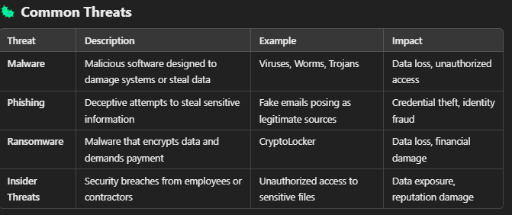
SECURITY AND PRIVACY - THREATS
- Firewalls – Block unauthorized access to networks. - Intrusion Detection/Prevention Systems (IDS/IPS) – Monitor and block malicious traffic. - Antivirus and Antimalware – Detect and remove malicious software. - Access Controls – Use role-based access and multi-factor authentication (MFA). - Data Loss Prevention (DLP) – Prevent data from being transferred or copied without permission.
Notes:
Teacher Notes:
Discuss the role of each security measure and how they complement each other to form a layered defense.
Introduce a discussion on emerging threats and how traditional measures need to evolve (e.g., next-generation firewalls, behavioral analysis in IDS).
Consider a case study analysis of a security breach that failed due to a lapse in one or more of these defenses.
Resources:
Whitepapers and technical briefings from cybersecurity firms that outline current threat landscapes.
Videos or recorded webinars that explore the functioning of firewalls and IDS/IPS in depth.
Additional Reading (if applicable):
Up-to-date research articles or industry reports on cyber threats and defenses—this can help spark advanced discussions on evolving security trends.

Slide 11
SECURITY AND PRIVACY - LAWS AND REGULATIONS
Compliance Requirements
Data Protection Impact Assessments (DPIA)
- Evaluate risks associated with data processing.
Implementing Policies and Procedures
- Define how data is collected, stored, and protected.
- Outline breach notification protocols.
Regular Audits and Monitoring
- Perform internal audits and vulnerability assessments.
- Ensure systems meet compliance requirements.
Notes:
Teacher Notes:
Outline the key components of legal frameworks like GDPR and how they enforce accountability through fines and public scrutiny.
Explain the importance of regular audits and continuous monitoring in maintaining compliance.
Discuss the global impact of such regulations and how organizations adapt their security practices accordingly.
Resources:
Official GDPR documentation and guidelines available from European data protection authorities.
Online courses or webinars on compliance, available from platforms like Coursera or edX, that focus on real-world applications.
Additional Reading (if applicable):
Detailed case studies or legal analyses on high-profile data breaches, including critical evaluations of the British Airways case, and resources on setting up robust compliance frameworks.

Slide 12
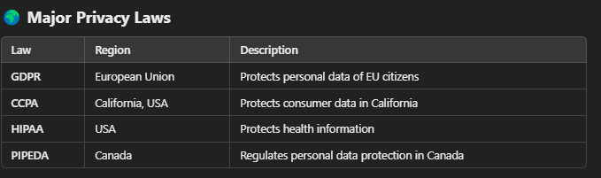
SECURITY AND PRIVACY - LAWS AND REGULATIONS
Example of a GDPR Breach Penalty
In 2019, British Airways was fined £183 million for failing to protect customer data due to security vulnerabilities.
Notes:
Teacher Notes:
Outline the key components of legal frameworks like GDPR and how they enforce accountability through fines and public scrutiny.
Explain the importance of regular audits and continuous monitoring in maintaining compliance.
Discuss the global impact of such regulations and how organizations adapt their security practices accordingly.
Resources:
Official GDPR documentation and guidelines available from European data protection authorities.
Online courses or webinars on compliance, available from platforms like Coursera or edX, that focus on real-world applications.
Additional Reading (if applicable):
Detailed case studies or legal analyses on high-profile data breaches, including critical evaluations of the British Airways case, and resources on setting up robust compliance frameworks.

Slide 13
EU GDPR Portal
European Data Protection Board (EDPB) Guidelines
Coursera – General Data Protection Regulation (GDPR)
Symantec Internet Security Threat Report
Cisco – Firewalls Explained (Video)
Crypto101
Khan Academy – Cryptography
Cipher Tools (Practical Cryptography)
CrypTool Online
SANS Security Policy Templates
NIST Computer Security Resource Center
ICO Data Breach Response Checklist (UK)
GDPR.eu – Breach Notification Guidelines

Slide 14
https://www.eugdpr.org/
https://edpb.europa.eu/our-work-tools/our-documents/guidelines-recommendations-best-practices_en
https://www.coursera.org/learn/general-data-protection-regulation
https://www.edx.org/course/eu-general-data-protection-regulation-gdpr
https://symantec-enterprise-blogs.security.com/
https://www.paloaltonetworks.com/resources/whitepapers
https://www.youtube.com/watch?v=Oqj3R6VtVnA
https://www.sans.org/webcasts/
https://www.khanacademy.org/computing/computer-science/cryptography
https://practicalcryptographyinpython.com/crypto-tools/cipher-tools/

