Slide 1
HTML-introduction
Basic of the HTML files

Slide 2
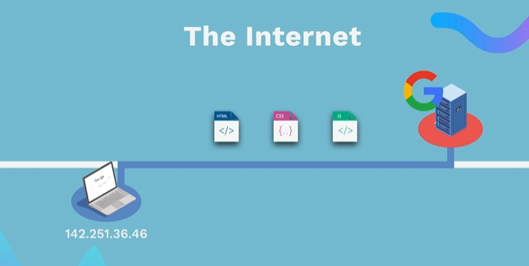
HOW WEBSITES WORK
👉 HTML (Content) - The structure of a web page (text, images, buttons). 👉 CSS (Styles) - Defines the layout (colors, fonts, arrangement of elements). 👉 JavaScript (Functionality)- Adds interactivity (click events, animations, form validation). The browser interprets and displays these files to display the web page.

Slide 3
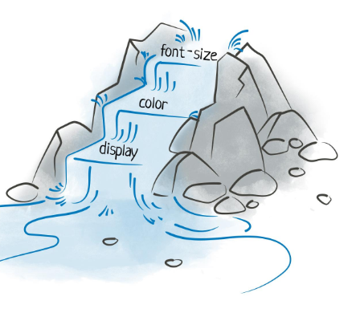
CSS
CSS is an acronym for Cascading Style Sheets. 💡 What do you mean by "cascading"? 👉 Let's imagine a waterfall – water flows from one level to another. 👉 Also, CSS styles are applied from the most general to the most specific rules. 👉 This allows for design control and flexibility. Tables).

Slide 4
CSS
🎨 CSS transforms plain HTML into an attractive design! 🔹 No CSS – sites are plain, black and white, and boring.
🔹 With CSS – we can change: 🎨 Colors 🔤 Fonts 🖼 Background images 📏 Arrangement and size of elements ✨ Animations and effects

