Slide 1
HTML-introduction
Basic of the HTML files

Slide 2
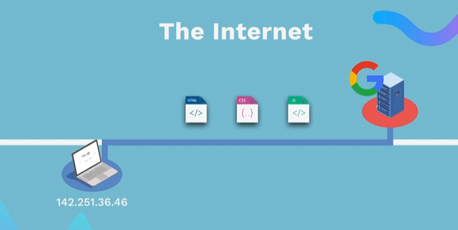
HOW WEBSITES WORK
👉 HTML (Content) - The structure of a web page (text, images, buttons). 👉 CSS (Styles) - Defines the layout (colors, fonts, arrangement of elements). 👉 JavaScript (Functionality)- Adds interactivity (click events, animations, form validation). The browser interprets and displays these files to display the web page.

Slide 3
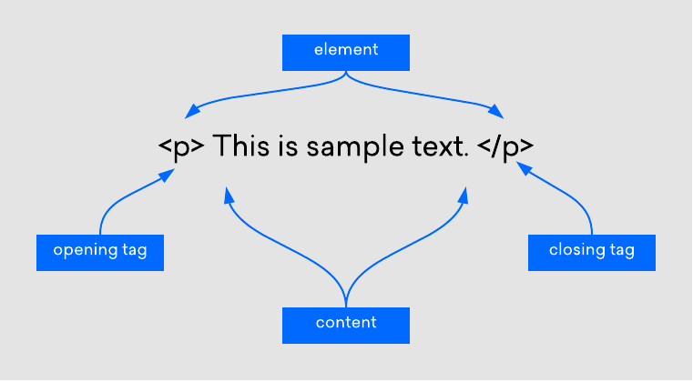



HTML
💡 Unlike CSS or JavaScript, a website can only exist with an HTML file 👉 Markup language: Similar to editorial markup in manuscripts (bold, underline, etc.) 👉 HTML uses tags to structure content

Slide 4


HTML TITLES

Slide 5
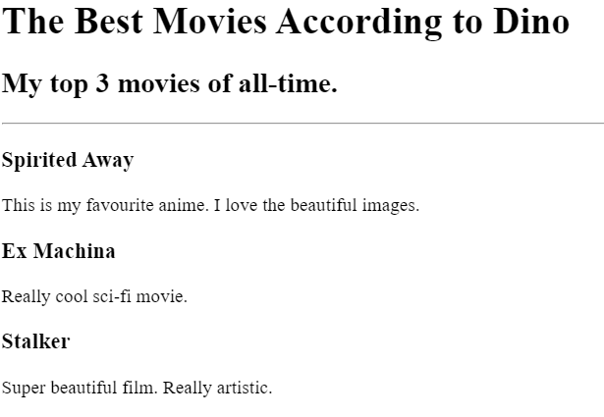
HTML TITLES
EXERCISE 1
💡 Instaliraj u VS code i koristi Live Preview plugin za pregled promjena u stvarnom vremenu 👉 Rekreiraj sliku

