Slide 1
CSS
Website stylization

Slide 2
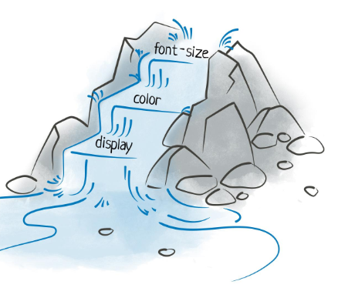
CSS
CSS is an acronym for Cascading Style Sheets. 💡 What do you mean by "cascading"? 👉 Let's imagine a waterfall – water flows from one level to another. 👉 Also, CSS styles are applied from the most general to the most specific rules. 👉 This allows for design control and flexibility. Tables).

Slide 3
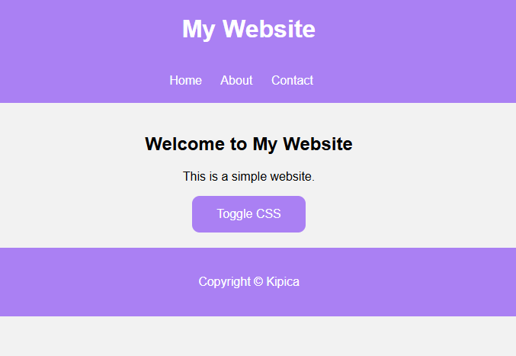
CSS
🎨 CSS transforms plain HTML into an attractive design! 🔹 No CSS – sites are plain, black and white, and boring.
🔹 With CSS – we can change: 🎨 Colors 🔤 Fonts 🖼 Background images 📏 Arrangement and size of elements ✨ Animations and effects

Slide 4

CSS-INLINE CSS
👉 Suitable when you want to quickly change the style of only one element
Problem with Inline CSS 🔹 Difficult to maintain 🔹 Not practical for multiple elements 🔹 It is not used often, except for quick changes
Notes:
https://dinoduvnjak.github.io/css-toogle/
https://developer.mozilla.org/en-US/docs/MDN/Guides

