Slide 1
SHIFT4IT
Shifting the paradygm for women in IT sector​

Slide 2
Measuring performance and preventing failure

Slide 3
Summary
4.1 How to measure performance (2.5 hours)
4.2 How to avoid failure (2.5 hours)
4.3 Reconciling Waterfall and Agile (2.5 hours)
Notes:
Facilitator notes
Introduce Unit 4 and frame it as the "control & sustainability" part of Agile PM: using metrics to understand delivery, spotting risks early, and improving continuously.
Walk through the three sections:
Metrics and measurement tools (what to track and how to read charts)
Why Agile fails (organizational causes and change management)
Hybrid / reconciling Agile & Waterfall (practical coexistence)

Slide 4
Introduction
This training module focuses on the control and sustainability side of Agile project management: how to track performance, interpret what metrics really mean, and use them to continuously improve outcomes.
You will first explore how to measure performance in Agile environments, starting from velocity as a key indicator of delivery capability and forecasting. The module then introduces the most commonly used visual tools showing what each one reveals about workflow speed, bottlenecks, scope creep, and predictability.
Notes:
Facilitator notes
Set expectations: learners will not just learn charts, but also how to avoid metric misuse and how to connect measurement to improvement.
Paraphrase the slide into a simple narrative:
We measure delivery capability (velocity, cycle time, predictability).
We visualize flow to see bottlenecks and scope changes.
We use the evidence in retrospectives to improve.
Stress that metrics are tools for improvement, not surveillance.
Highlight that interpretation matters more than the metric itself.

Slide 5
Introduction
The second part addresses why Agile initiatives often struggle, shifting the focus from tools to organisational reality. You will analyse typical causes of failure and distinguish between Agile adoption (using practices) and Agile transformation (changing organisational culture).
Finally, the module supports practical decision-making in real projects by showing how to reconcile Agile and Waterfall when stakeholders still require traditional planning artifacts.
Notes:
Facilitator notes
Learners may fear metrics will be used for control. Reassure: in Agile, metrics serve the team and the system, not individual surveillance.
Stress that metrics without culture do not create change.
Highlight the link between measurement → feedback → improvement.
Reinforce that Waterfall vs Agile is not a binary choice.

Slide 6
Introduction
At the end of this module, you will be able to:
Understand key performance metrics used in Agile environments
Identify and apply appropriate measurement tools and techniques
Discuss the importance of continuous improvement and feedback loops
Understand the concept of risk in an Agile context
Identify different types of risks in Agile projects
Distinguish between Waterfall and Agile methodologies
Identify the strengths and weaknesses of each methodology

Slide 7
How to measure performance
Notes:
Facilitator notes
Additional resources
https://www.atlassian.com/agile/project-management/metrics

Slide 8
Velocity: the key metric
Velocity: measure of the amount of work a team manages to complete during a single cycle/sprint.
It is calculated for each cycle, summing up the effort (in hours or points) expended to complete the 'done' cards.
Notes:
Facilitator notes
Define velocity as a "team-level" measure of completed work per sprint/cycle, used mainly for forecasting.
Emphasize:
Velocity is historical evidence, not a goal.
It only works if "Done" is consistent and work units are comparable.
Use averages/trends over several sprints, not single-sprint fluctuations.
Additional resources
https://www.izenbridge.com/blog/velocity-in-agile-scrum/
https://www.atlassian.com/agile/project-management/velocity-scrum

Slide 9
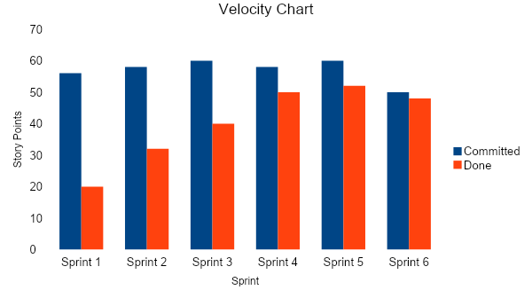
Velocity chart
Shows workﬂow speed and team workload per sprint.
Allows you to do forecasts for the future.
Source: Adrian Baker - DZone (https://dzone.com/articles/variance-the-heartbeat-of-agile-metrics)
Notes:
Facilitator notes
Common misconception to address: velocity is not a productivity score for individuals; using it that way leads to gaming and lower quality.
Additional resources
https://axify.io/blog/velocity-chart
https://nextagile.ai/blogs/agile/velocity-chart-in-agile/

Slide 10
Velocity chart
Requirements:
Definition of work units (effort) for each task and duration of sprints.
Continuous communication between team members on completed/to-be-completed tasks.
At the end of each sprint, analysis of the number of completed work units.
Note: An actual velocity lower than the estimated one may denote:
FF too high
Optimistic estimates
Tip: to increase team velocity, start the retrospective from the 'blocked' cards.

Slide 11
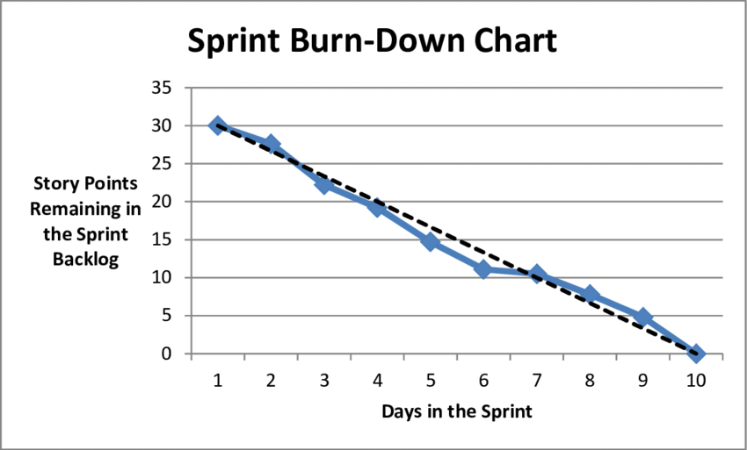
Burndown chart
Graphical representation of the work required to complete a project.
Usually the remaining work (or backlog) is indicated on the vertical axis and the time on the horizontal axis.
The diagram represents a time series of tasks to be completed.
It is useful for predicting when the work will be completed.
Source: Timothy A. Chick - ResearchGate (https://www.researchgate.net/figure/Sample-Release-Burn-Up-Chart_fig7_266049888)
Notes:
Facilitator notes
Explain burndown charts as a way to visualize remaining work over time and detect risk early.
Clarify axes (work remaining vs time) and what patterns mean:
Steady downward line → healthy progress.
Flat segments → blockers/no completion.
Upward bumps → scope added or rework.
Additional resources
https://www.projectmanager.com/blog/burndown-chart-what-is-it
https://www.zenhub.com/blog-posts/tracking-sprint-progress-with-scrum-burndown-charts

Slide 12
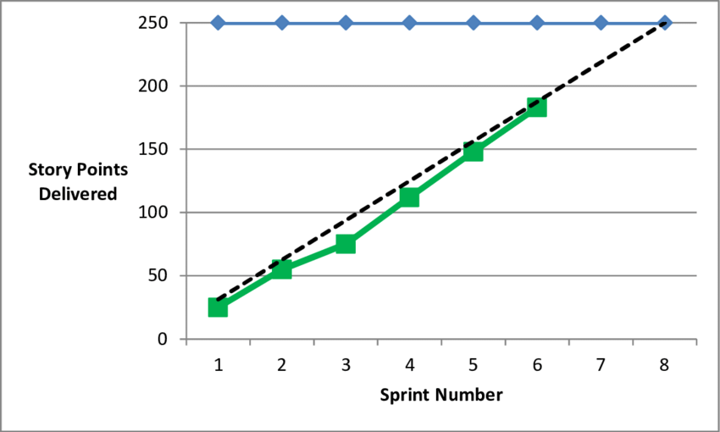
Burnup chart
Are there alternatives to the unedifying ‘flat’ burndown charts? The burnup charts.
Burnup charts answer the opposite question: how much work has been completed?
Whereas a Burndown chart should always tend downwards, an ideal Burnup chart moves upwards
But why don't we like burnup charts?
They have no predictive utility
They do not push velocity up (I do not know how much effort is left to finish the job, so I do not 'speed up')
Source: Timothy A. Chick - ResearchGate (https://www.researchgate.net/figure/Sample-Release-Burn-Up-Chart_fig7_266049888)
Notes:
Facilitator notes
Explain burnup as the "mirror" of burndown: it shows completed work and can make scope changes more visible.
Emphasize:
Burnup rises as work is completed.
When scope changes, a second line (total scope) is often used to show the moving target.
If the slide critiques predictive utility, discuss when burnup is still useful: communicating progress and making scope creep explicit.
Additional resources
https://www.projectmanagement.com/blog-post/40731/burndown-vs-burnup-chart#_
https://clickup.com/blog/burnup-chart-vs-burndown-chart/?utm_source=google&utm_medium=cpc&utm_campaign=gs_cpc_emea-eea_nnc_nb_trial_all-devices_troas_lp_x_all-departments_x_project-management-agile_v2&utm_content=all-countries_kw-target_text_x_all-features_all-use-cases_agile-software-development&utm_term=agile%20development&utm_creative=757775424637_product1_rsa&utm_custom1=&utm_custom2=&utm_lptheme=&utm_lpmod=&utm_mt=p&gad_source=1&gad_campaignid=22660917507&gbraid=0AAAAACR5vILcJmFtajy_tDrQkdY-jnze3&gclid=Cj0KCQiA49XMBhDRARIsAOOKJHYf8efy6kK5kRGrewpvG4A-izeihBH4XfAiEUSpllUWrPGbdXhqnXgaAusREALw_wcB

Slide 13
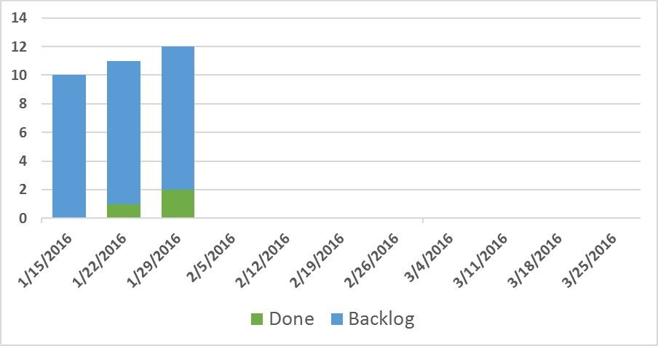
Cumulative Flow Diagram (CFD)
Advantages:
Exceeds the limits of Burndown and Burnup
Adds some extra data
Displays data in a better way
Promotes more robust decision-making processes
Source: Ken Furlong (https://www.excella.com/insights/burndown-chart-vs-cumulative-flow-diagram-cfd)
Notes:
Facilitator notes
Teach CFD as a flow diagnostic tool: it shows how work accumulates in each state over time.
Key messages to emphasize:
CFD helps see bottlenecks earlier than burndown.
It supports robust decisions (where to add help, where to limit intake).
Additional resources
https://www.excella.com/insights/burndown-chart-vs-cumulative-flow-diagram-cfd
https://kanbantool.com/cumulative-flow-diagram

Slide 14
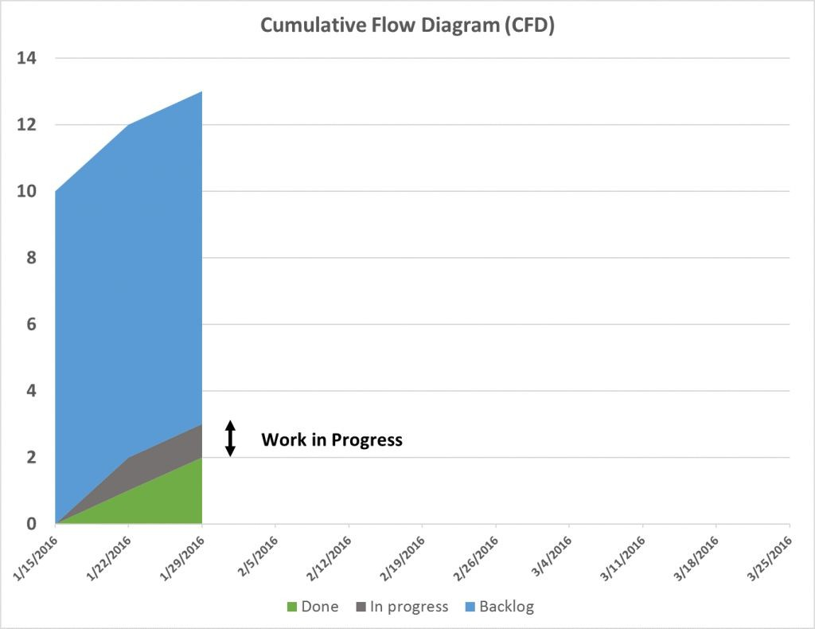
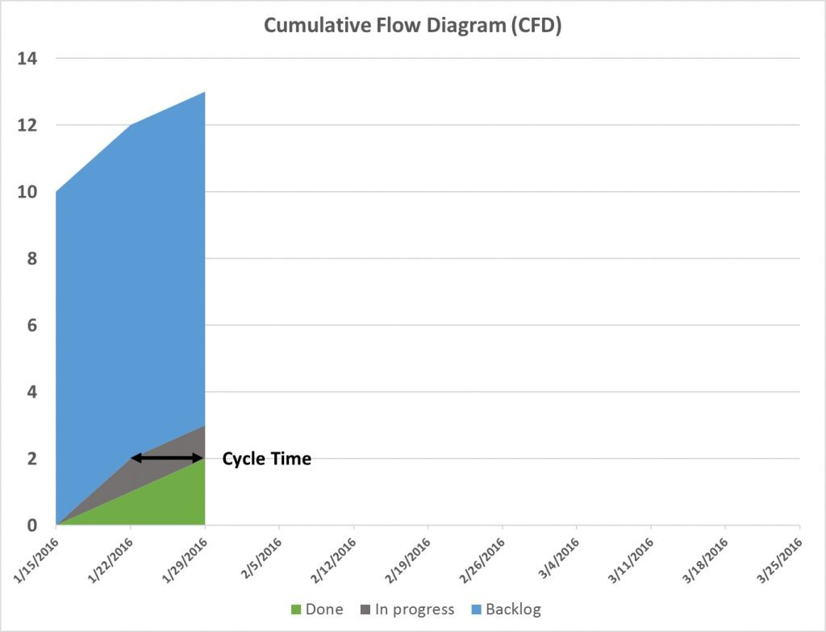
Cumulative Flow Diagram (CFD)
Source: Ken Furlong (https://www.excella.com/insights/burndown-chart-vs-cumulative-flow-diagram-cfd)
Notes:
Facilitator notes
We are now visualizing the amount of Work In Progress (WIP) at each interval. WIP is a critical concept in lean and agile thinking and focusing on it can dramatically improve a team’s ability to produce. The vertical height of each band is the amount of items (WIP) in that stage.
CFD also expose our average cycle time (the amount of time it takes, on average, for an item to get from one stage to another. Cycle time is often a critical measure of success since downstream stakeholders or customers often put a very high premium on responsiveness, i.e., how long it takes from the moment they submit a request to the moment it is fulfilled.
Additional resources
https://www.youtube.com/watch?v=t8zUD6UrzXU

Slide 15
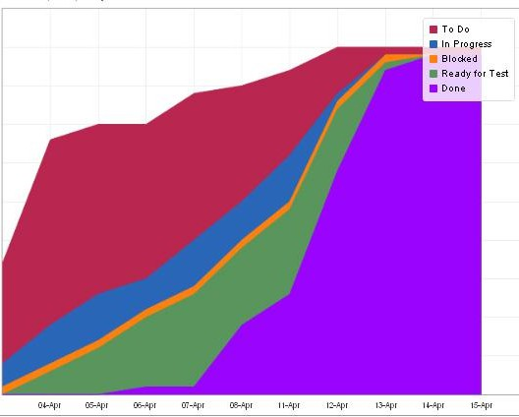
Cumulative Flow Diagram (CFD)
A CFD can have as many 'coloured bands' as there are states into which the process is divided (the columns of our board)
Source: Ken Furlong (https://www.excella.com/insights/burndown-chart-vs-cumulative-flow-diagram-cfd)
Notes:
Facilitator notes
Explain colored bands as workflow stages. The key interpretation is the *width* of each band:
Widening band → bottleneck forming,
Stable bands → balanced flow,
Narrowing → clearing backlog.
Key messages to emphasize:
CFD helps see bottlenecks earlier than burndown.
It supports robust decisions (where to add help, where to limit intake).

Slide 16
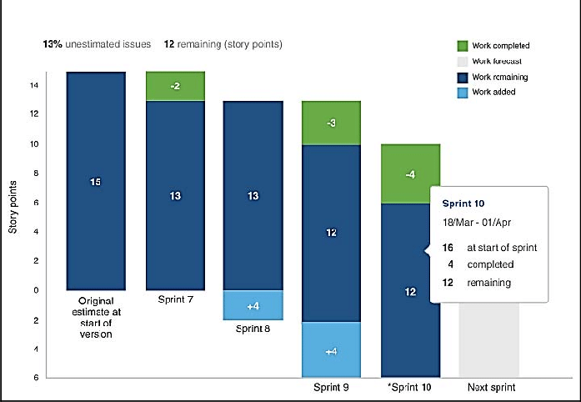
Epic and release burndown
Track project progress over different sprints, highlighting the ﬂow of work and any rework within an epic or version (even spread over several sprints)
Scope creep: adding new requirements to an already defined project
Source: Wael Mohsen – ResearchGate (https://www.researchgate.net/figure/Epic-and-release-burndown_fig2_321741375)
Notes:
Facilitator notes
Explain burndown charts as a way to visualize remaining work over time and detect risk early.
Additional resources
https://linearb.io/blog/release-burndown-chart
https://appfire.com/resources/blog/why-epic-burndowns-are-important

Slide 17
Epic and release burndown
Note: If scope creep between several epic is a problem during the sprint, it is a natural consequence of Agile development (the client can decide to accept or not accept the work done based on what emerges during the project)
Source: Wael Mohsen – ResearchGate (https://www.researchgate.net/figure/Epic-and-release-burndown_fig2_321741375)
Notes:
Facilitator notes
Burndown is most useful when scope is reasonably stable within a sprint; otherwise it will look "messy" and can demotivate.
Additional resource
https://www.ube.ac.uk/whats-happening/articles/scope-creep/

Slide 18
Control chart
It highlights the cycle time of the cards, i.e. the time between 'doing' and 'done'.
In an ideal situation, all cards/issues should be below the red line (average cycle time)
In general:
Short cycle time → High productivity.
Constant cycle time → predictable delivery times.
The ideal situation is therefore to have teams with short cycle times and constant cycle times.
Notes:
Facilitator notes
Introduce control charts as a way to monitor cycle time (how long items take from start to finish).
Explain what "good" looks like:
Short cycle time → faster delivery
Consistent cycle time → predictability
Additional resources
https://leanagiletools.com/control-chart/
https://medium.com/design-bootcamp/agile-lesson-17-control-charts-what-they-are-and-how-to-spot-the-trouble-early-402d649abd35

Slide 19
Other metrics
Quality
No. of reported defects (during the project, after release, from outside the team)
No. of customers submitting support requests
% coverage of tests carried out automatically
Frequency, Speed and Diﬃculty of releases
Notes:
Facilitator notes
Broaden beyond speed: quality and reliability matter, otherwise ‘faster’ becomes ‘faster rework’.
Explain a balanced view:
Quality indicators (defects, support requests, test coverage)
Delivery indicators (release frequency, lead time)
Difficulty indicators (deployment pain, rollback frequency)
Encourage teams to pick a small set of metrics that answer specific questions; too many metrics dilute focus.
Additional resources
https://axify.io/blog/agile-metrics

Slide 20
Other metrics
Metrics are only one step in the process of building a team culture.
They provide evidence of the team's performance and measurable objectives for its members but it is important to be able to collect feedback during retrospectives to increase the team's confidence, the quality of products/services and speed of execution of activities.
Both quantitative and qualitative data are needed to drive change!

Slide 21
How to avoid failure

Slide 22
How to avoid failure
Agile offers benefits ranging from more engaged employees to higher performance, but not so fast.
Why do Agile adoption projects often fail?
Notes:
Facilitator notes
Transition from tools to organizational reality: Agile fails more often due to culture and leadership than due to boards and ceremonies.
Frame the discussion as ‘risk prevention’: if we know common failure patterns, we can proactively mitigate them.
Additional resources
https://www.scrum.org/resources/blog/why-agile-transformations-sometimes-fail

Slide 23
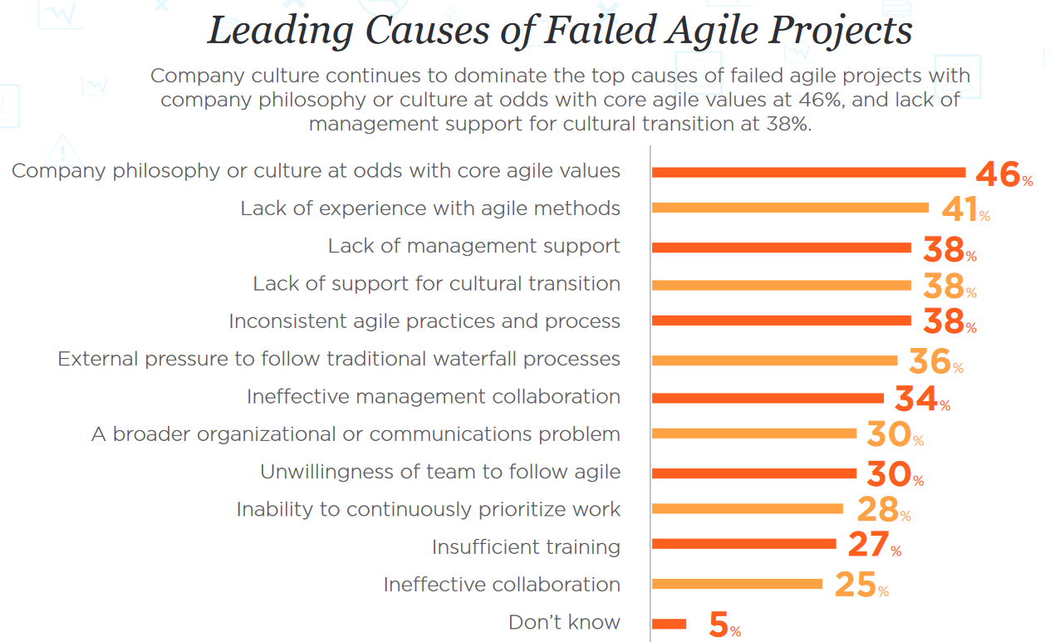
Typical causes of failure
A study conducted on more than 4,000 individuals highlighted the main causes of Agile failure.
Source: Adam M. Sandman (https://www.inflectra.com/Ideas/Whitepaper/Agile-Transformation-Failure-Due-To-Management-Debt.aspx)
Notes:
Facilitator notes
Ask learners: ”Which theme is most risky, and what would be a first mitigation step?”
Additional resources
https://www.inflectra.com/Ideas/Whitepaper/Agile-Transformation-Failure-Due-To-Management-Debt.aspx
https://premieragile.com/why-agile-transformations-fail/
https://www.youtube.com/watch?v=4uB7z5ol-T0
https://docs.broadcom.com/doc/recognizing-the-twelve-failure-modes-in-agile-transformation

Slide 24
Typical causes of failure
1. Contrasting organisational culture
Understanding that agile impacts organisational values and facilitating transformation is the first step towards wider adoption of agile
2. Lack of experience with the method
Investing in solid training in basic agile techniques and coaching for their correct application is money well spent
Notes:
Facilitator notes
Don’t rush the list. Cluster causes into themes:
Culture & leadership
Capability & training
Interfaces with non-Agile parts of the organization
Communication and team dynamics

Slide 25
Typical causes of failure
3. Poor support in cultural transition
Tangible and active involvement of all management is crucial for cultural transformation
4. External pressure to Waterfall
Especially in large organisations, in order to facilitate coexistence between Agile and Waterfall teams, it is useful to involve people 'outside' Agile in meetings and to agree on mutual 'interfaces' for exchanging information

Slide 26
Typical causes of failure
5. Organisational and/or communicational issues
The effectiveness of Agile depends on a broad and deep acquisition of values and principles at organisational level
6. Team reluctance
Occurs when team members fear losing identity or control
7. Insufficient training
Ensure that all those involved (including leaders) receive solid training on Agile

Slide 27
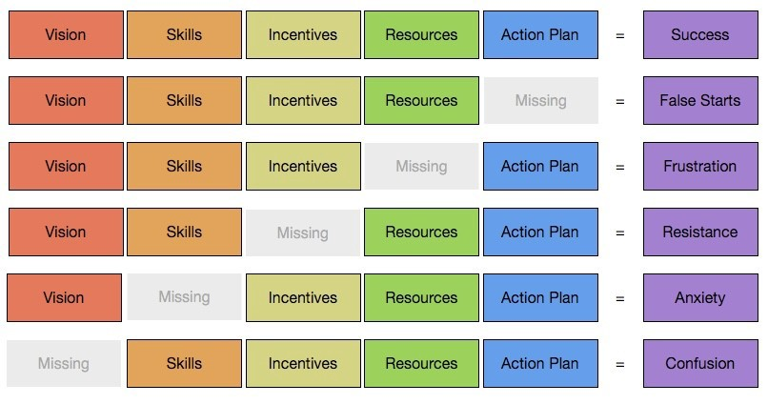
A model for change management
Source: Willem Hoek (https://whoek.com/b/knoster_managing-change.html)
Notes:
Facilitator notes
Provide a simple change-management lens: when key ingredients are missing, change outcomes fail.
Walk through the model and translate it:
Vision (why)
Skills (how)
Incentives (motivation)
Resources (capacity)
Action plan (steps)
Missing any element creates predictable failure models!
Additional resources
https://whoek.com/b/knoster_managing-change.html
https://agilityportal.io/blog/knoster-model-for-change?tmpl=component&print=1&format=print

Slide 28
Agile adoption vs Agile transformation
Agile adoption: use of tools and techniques in line with Agile principles.
Agile transformation: process of evolution of the culture and nature of the organisation.
Notes:
Facilitator notes
Clarify the difference between doing Agile practices and becoming an Agile organization.
Use simple definitions:
Adoption → using tools/ceremonies aligned with Agile principles.
Transformation → changing culture, structures, incentives, and decision-making.
Additional resources
https://www.agilesherpas.com/blog/agile-transformation-vs-agile-adoption

Slide 29
Agile adoption vs Agile transformation
 | ADOPTION | TRANSFORMATION
Answers the question | What do we do? | Who are we?
Emphasis on | Practices | Values and principles
Speed of change | Fast | Slow
Time horizon | Short period | Long Period
Impact on results (productivity) | 100% | 300%
Changes in organisational structure | Few or none | Significant
Changes in organisational culture | At most localised | Broad-spectrum
Source: chart produced by EGInA Srl (https://www.egina.eu/)
Notes:
Facilitator notes
Key messages to emphasize:
Adoption without transformation often plateaus.
Transformation requires leadership, patience, and systemic change.
Additional resources
https://www.agilityarabia.com/blog/agile-adoption-vs-agile-transformation-are-you-truly-embracing-agility
https://www.youtube.com/watch?v=w3YmH9_KNDQ

Slide 30
Reconciling Waterfall and Agile

Slide 31
Creating the Gantt from cards
Regardless of the approach taken, we are often asked to produce a project Gantt. With respect to Agile, we can try to do this by starting with the very cards on the board.
Notes:
Facilitator notes
Emphasize:
A Gantt can be derived from backlog items and dependencies.
It should be updated as evidence changes (not treated as a fixed promise).
The goal is transparency: use the Gantt to communicate at macro level, and the board/backlog for day-to-day delivery.

Slide 32
A digital tool: TeamGantt
TeamGantt is a digital tool that allows you to:
create, share, update Gantt
reorganise tasks
display all projects in one view
manage resources, control budget and make sure to avoid overload
create reports
check progress against plan and make projections
list tasks and schedule them
track activities
Notes:
Facilitator notes
Introduce a digital tool example for Gantt planning and portfolio visibility.
Focus less on the brand, more on capabilities: sharing, updating, resource management, reporting, projections.
Additional resources
https://www.teamgantt.com/
https://www.youtube.com/watch?v=P1H8-OYuGkY

Slide 33
A digital tool: OpenProject
OpenProject is a project management digital tool that allows you to:
create product and sprint backlogs
estimate activities in story points
use card templates
create burndown charts
track 'impediments' for sprints
assign and prioritise activities
display activities on calendar or board
Notes:
Facilitator notes
Provide an example of a tool that supports both Agile artifacts (backlogs, points, burndown) and more traditional PM views.
Connect features to needs: backlog management, estimation, burndown, impediment tracking, calendar/board views.
Additional resources
https://www.openproject.org/
https://www.youtube.com/watch?v=HloYka2zB8I

Slide 34
Monitor progress with sprint goals
How to monitor the progress of activities?
Define Sprint Goals (max 3 or 5) and ask the PM to indicate the % achievement of each one.
Sprint Goals: sub-goals corresponding to sets of cards (≈ Epic)
Notes:
Facilitator notes
Explain Sprint Goals as mini-milestones (often aligned with epics). Tracking % completion is a communication device - not a precision metric.
Encourage 3–5 Sprint Goals max to keep focus and avoid turning it into a bureaucratic report.
Additional resources
https://www.scrum.org/resources/what-sprint-goal
https://www.mountaingoatsoftware.com/blog/the-sprint-goal-what-it-is-and-how-it-can-help

Slide 35
Monitor progress with sprint goals
Use Agile as a tool for the micro-management of the team (also in waterfall projects):
Organise team work by weekly sprints and hold regular meetings (1 planning and 1 retrospective)!
Keep the team's velocity under control
Use goals as milestones and evaluate overall progress by % of their completion

Slide 36
Scrum of scrums
How to apply Agile to projects involving many people?
Scrum of scrums (general meaning): technique for applying Agile to large organisations.
Scrum of scrums (specific meaning): meeting held regularly between the MS of each team to share information.
Notes:
Facilitator notes
Introduce coordination patterns for multiple teams.
Define:
General meaning: scaling Scrum via cross-team coordination.
Specific meaning: regular meeting of Scrum Masters to share dependencies and impediments.
Scrum of Scrums is not a status meeting; it is for managing cross-team dependencies.
Additional resources
https://www.scrumalliance.org/glossary/scrum-of-scrums
https://echometerapp.com/en/scrum-of-scrums/
https://www.atlassian.com/agile/scrum/scrum-of-scrums

Slide 37
Scrum of scrums
Two levels different:
Corporate scrum of scrum (all Scrum Masters of all products)
Product scrum (all Scrum Masters of a specific product)

Slide 38
Product/project scrum
30-minute meeting, once a week where:
Each MS describes what the team did last week, what it will do in the current week and what obstacles it foresees
MS share issues that affect all teams (e.g. related to integration)
Notes:
Facilitator notes
Emphasize agenda:
What happened,
What’s next,
Blockers/dependencies,
Integration risks.
Keep it short and action-oriented; capture decisions and owners.

Slide 39
Corporate scrum
15-30 minute plenary meeting, perhaps once a week where:
All team members receive news from the management (e.g. about upcoming events of a general nature)
"Round-robin': in turn, one member reports what their team did last week, what they will do in the present week, and what problems they foresee
Anyone else is free to add information or ask questions
Note: Intersperse the meetings, allowing those who must to participate in more than one meeting
Notes:
Facilitator notes
Clarify it’s for information sharing and alignment, not detailed problem-solving.
If it becomes too long, split into smaller relevant forums.

Slide 40
Multiple Scrums
What happens when several teams work on the same project?
In general, the rule applies: more members = more complications.
That is why it is essential to understand
how many teams to use
how to allocate people between teams
Notes:
Facilitator notes
Explain why scaling increases coordination complexity and why team structure matters.
Reinforce the principle: more people → more communication paths → more friction. Therefore, design teams intentionally.
Additional resources
https://www.agilesocks.com/splitting-multiple-scrum-teams/h.

Slide 41
Multiple Scrums
As a rule, it is preferable not to have teams larger than 9 persons in order to avoid:
Long meeting (>15 min)
People who don’t know what others do
Distractions
Tight deadlines to resolve unforeseen issues

Slide 42
Multiple Scrums
Is it enough to split up the larger teams?
The idea of splitting the team can only be effective if:
The team has experience with Agile
The roadmap can be subdivided (without compromising the output)
Beware of virtual teams! By observing whether and how members interact, one can see the existence of 'virtual teams'.

Slide 43
Multiple Scrums
What to do instead if several teams are working on the same project?
1. Synchronising Sprints
Advantages:
Shared meetings
A single moment to redefine teams (between sprints)
Fewer administrative tasks
Notes:
Facilitator notes
Additional resources
https://attico.io/insights/synchronized-sprints
https://medium.com/leadership-forge/when-to-synchronize-sprints-9606c3d7e55b

Slide 44
Multiple Scrums
2. Appoint a Team Lead (Scrum Master of all teams)
The Team Lead decides on the composition of the teams and their changes between several sprints.
Note: before any change to the team, do not underestimate the so-called 'team gel' (bonds created by working in a team)
What about part-time members? In general, a few full-time people are better than a larger team of part-time members

Slide 45
Multiple Scrums
How to maintain the balance between planned and emerging activities?
One solution is to create 2 types of teams:
Scrum Team
Fire Team
Scrum Team: under the guidance of the PM carries out activities trying to prevent emergencies.
Fire Team: support team dedicated to resolving emergencies and protecting against other disruptive elements

Slide 46
Multiple Scrums
How to manage geographically distributed teams?
If the effectiveness of Agile depends a lot on the intensive and direct collaboration of the team it is necessary that this can also be done remotely, enabling members to:
working at the same time
participate in daily meetings
have direct, spontaneous and immediate contacts
have visibility of the board, the backlog and access to all useful information (e.g. diagrams)

Slide 47
Multiple Scrums
How to do it?
Conference room with workstation(s) equipped with connection, webcam, microphone, collaboration software
Remote windows: screens placed in each location showing other members and/or project progress data
If possible, it is preferable to have one dispersed team rather than several 'co-located' teams

Slide 48
Multiple Scrums
Which tools should be used to manage multiple Scrums?
Create a 'To Do List' board where, at each sprint, you move (or copy) cards from your personal boards
Create a 'board repository' to store project materials, resources (and cards) common to all members
If useful, create automatisms for recurring card movements (e.g. with Zapier or Butler)

Slide 49
Scrum master checklist
At the beginning of each Sprint:
After Sprint planning, create a Sprint information document (estimated speed, team size, duration, etc.), print it out and hang it on the team's most prominent wall.
Send an e-mail to all stakeholders announcing that the new sprint has started (include the objective of the sprint and a link to the information document).
Update the information document with the sprint statistics.
Notes:
Facilitator notes
Provide a practical operational checklist to keep Scrum running smoothly.
Use it as a reference, not as a rigid procedure. Highlight a few critical habits:
Communicate sprint start and goal
Keep backlog hygiene
Keep burndown/board up to date
Ensure impediments are surfaced
Ask learners which checklist item would create the biggest improvement.
Additional resources
https://www.scrumexpert.com/resources/scrummaster-checklists/

Slide 50
Scrum master checklist
Every day:
Ensure that the Daily Scrum is started and finished on time.
Ensure that cards are added/removed from the backlog only when necessary and that the PM is informed.
Ensure that the sprint backlog and burndown are kept up to date by the team.
Ensure that problems are resolved or reported to the PM.

Slide 51
Scrum master checklist
At the end of each Sprint:
Make a demo of the Sprint open to everyone and announcing it 1-2 days in advance.
Do a retrospective of the Sprint with the whole team and the PM.
Update the Sprint statistics document. Add the actual speed and key points from the retrospective.

Slide 52
ADDITIONAL READING
ONLINE RESOURCES
Agile Transformation: What It Is and Why It Fails - Explains adoption vs transformation and common organisational failure patterns. https://www.mckinsey.com/capabilities/people-and-organizational-performance/our-insights/the-journey-to-an-agile-organization
Agile Fluency Model - A framework for understanding different levels of Agile maturity and sustainability. https://www.agilefluency.org/

Slide 53
ADDITIONAL READING
Disciplined Agile Toolkit - Practical guidance for hybrid approaches when organisations still demand traditional artifacts. https://www.pmi.org/disciplined-agile

Slide 54
ADDITIONAL READING
BOOKS
“Actionable Agile Metrics for Predictability” - Daniel S. Vacanti The best book for metrics like cycle time, CFD, forecasting, and avoiding metric misuse.
“Accelerate” - Nicole Forsgren, Jez Humble, Gene Kim Strong evidence-based view of performance, delivery speed, and quality metrics.
“The Phoenix Project” - Gene Kim, Kevin Behr, George Spafford A story-based book that makes bottlenecks, flow, and organisational failure very easy to grasp.

Slide 55
RESOURCES
“Campus Agile Project Management” course – Fraticelli F., Ferranti P.
Disciplined Agile (PMI) - https://www.pmi.org/disciplined-agile
Agile Metrics Overview - https://www.atlassian.com/agile/project-management/metrics
Understanding Agile Metrics - https://plan.io/blog/burndown-chart-and-agile-metrics/
Agile Metrics - https://aida.mitre.org/agile/agile-metrics/

Slide 56
RESOURCES
Building Agile Metrics Right - https://www.ijtrd.com/papers/IJTRD28553.pdf
Agile Metrics Summary - https://www.slideshare.net/slideshow/agile-metrics-50873631/50873631
How to Measure Performance in Agile - https://arxiv.org/pdf/2407.06357.pdf

