Slide 1
Metrics
Notes:
📌 Objective: Introduction to key metrics and their role in digital marketing analysis.
🔹 Why is this important?
Understanding website traffic and user behavior is essential for optimizing digital performance.
"You can’t improve what you don’t measure" – data-driven decisions help businesses grow.
Analytics tools are more than just counters; they provide deep insights into visitor behavior.
🔗 Additional Resources:
Google Analytics Official Guide: Google Analytics Support

Slide 2
Summary
Tracking tags
Tracking Solutions
Analytic tools
GA4 Demo Accounts
Exercices

Slide 3

How many marketing tracking tags can you find on the lolaliza.com homepage?
Source : https://www.lolaliza.com/
Notes:
Slide 2-4: Tracking Tags on Websites – Duration : 15 minutes
📌 Objective: Identifying marketing tracking tags on different websites.
🔹 Why is this important?
Websites use multiple tracking tags to collect user data for marketing and analytics.
Understanding how many and which tags are present helps assess tracking intensity.
Some companies use minimal tracking, while others have extensive data collection strategies.
🔗 Additional Resources:
Chrome Extension to check tracking: Ghostery
Online tag scanners: Tag Inspector

Slide 4
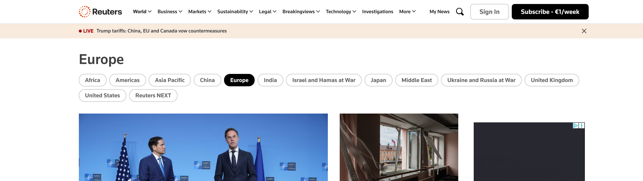
How many marketing tracking tags can you find on the https://www.reuters.com/ homepage?
Source: https://www.reuters.com/ homepage
Notes:
Take any website after first verifying that there are numerous trackers installed.

Slide 5
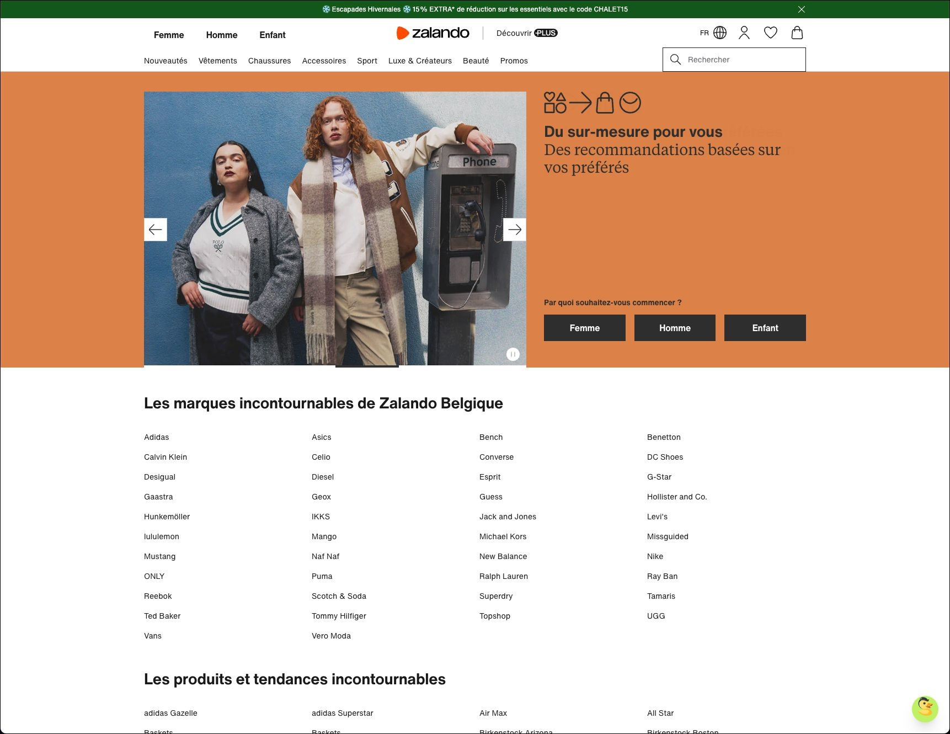
How many tracking tags can you find on the Zalando homepage?
Source : https://www.zalando.be/?_rfl=nl
Notes:
Take any website after first verifying that there are numerous trackers installed.

Slide 6















Tracking solutions
Source : Google images
Notes:
There are many tracking solutions available.

Slide 7


Tracking solutions
+200
Source : Google images
Notes:
In 2024, there were more than 200

Slide 8
Analytics are tools for measuring and analyzing website traffic
They're not just a counter for visitor numbers, but truly powerful marketing tools for analyzing and understanding what visitors do on a site.
YOU CAN'T IMPROVE WHAT YOU DON'T MEASURE
GOOD DATA IS THE FOUNDATION FOR MAKING SMART DECISIONS.
DATA WITHOUT CONTEXT IS MEANINGLESS...
Notes:
Tracking tools are a strategic lever in marketing and user experience.

Slide 9
Analytics tools present trends
These are not 100% accurate tools!
Tracking 100% of data is impossible (Data Integrity problem)
User leaves page too soon
The user uses AdBlockers
User blocks JS and code is not integrated in no script
There is a JS error in the page
Google Consent is enabled and the user has not accepted or refused cookies (analytics storage or Ad storage)
Sampling or thresholding
Notes:
📌 Objective: Understanding why analytics data may not be 100% accurate.
🔹 Common Data Gaps:
Users leave the page before tracking is triggered.
Ad blockers prevent analytics scripts from loading.
Users disable JavaScript or refuse cookie consent.
Sampling and thresholding limit data collection in large datasets.
🔹 Why is this important?
Helps analysts recognize discrepancies and adjust strategies accordingly.
Emphasizes the need for multi-source data validation.

Slide 10


Sampling vs Threshold
Source : https://from.ncl.ac.uk/can-innovative-statistical-analysis-support-rare-disease-clinical-trials
Notes:
Sampling is a method that allows Google Analytics to generate reports by examining only a representative portion of the data, rather than querying the entire dataset. This approach allows Google to be efficient in compute costs, but this can lead to situations where it is provided an approximate value instead of the exact value.
Data Thresholding allows Google to withhold data in situations where the algorithm detects a potential risk of identifying a real-world person by their demographics or interests, such as age, gender, location, etc. Data threshold is meant to protect user privacy. In Google Analytics 4 (GA4), standard reports do not generally face data thresholds. However, for specific reports, especially those involving sensitive user demographics like age and gender, GA4 does apply data thresholds.

Slide 11
Google Analytics is the Leader Analytics
52% Sites around the world are tracked with Google Analytic
Facebook > 18
Hotjar > 3% of sales
Yandex > 3% of sales
Matombo > 3% of sales
Is it really free ?
Ex: From : (for 25 million vents per month), 50.000€ PER YEAR!... & you have to go through an agency, which will also charge a fee
It is estimated that 10% of budgets should be devoted to monitoring the actions carried out and learning from them.
IT'S NO LONGER A Hobby, IT'S A BUSINESS
Notes:
*When things are free and too good to be true, it's usually because, in the end, you're the product... It's sometimes better to find out about the different terms and conditions of a free solution, and especially about data sharing. In your Analytics account, you will find a checkbox (often checked without reading) that states the following:
You share your Google Analytics data with us to help us improve our products and services. Share your Google Analytics data with Google to help us improve our products and services. If you enable this setting, Google Analytics will be able to provide the best possible intelligence and insight services, improve spam detection services that benefit all products and users, and offer enhanced reporting on demographics and interests (if Google signals are enabled). products and users, and offer enhanced reporting on demographics and interests (if Google Signals are enabled). If you disable this option, data may still be transmitted to other Google products associated with your property. To view or modify your settings, go to the product association section of each property. 🔹 Key Insights:
Google Analytics dominates with 52% market share.
Facebook, Hotjar, and Yandex have niche usage.
Some advanced analytics tools require paid subscriptions and agency support.
🔹 Why is this important?
Businesses must choose analytics tools based on needs and budget.
Paid tools offer more customization but require investment.

Slide 12
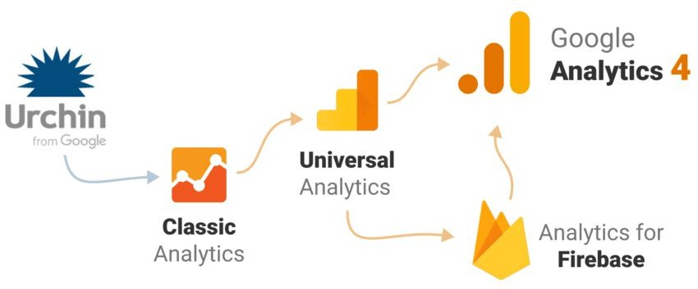
Google Analytics history
Source : https://www.culturehive.co.uk/digital-heritage-hub/resource/engagement/getting-started-with-google-analytics-4/
Notes:
Today, we're talking about Google Analytics 4. It's the latest version of analytics offered by Google. It's a blend between the classic universal analytics and Firebase analytics. Now, everything is interconnected within one tool. This tool also replaces Google's Data Manager.

Slide 13


Google Analytics history
UTM_SOURCE
UTM
Urchin
Tracking Module
UTM_MEDIUM
UTM_CAMPAIGN
UTM_TERM
UTM_CONTENT
Source : https://avanza.justia.com/historia-de-google-analytics/ images
Notes:
Key Takeaways:
UTM (Urchin Tracking Module) allows businesses to track marketing campaign performance.
Different UTM parameters include:
utm_source: Identifies traffic origin (e.g., Google, Facebook).
utm_medium: Specifies the type of traffic (e.g., email, social, CPC).
utm_campaign: Tracks specific marketing campaigns.
GA has evolved significantly, moving towards Google Analytics 4 (GA4).
🔹 Why is this important?
Helps marketers analyze ROI from different traffic sources.
Provides deeper insights into campaign effectiveness.

Slide 14

GA installation
<!-- Google tag (gtag.js) -->
<script async src="https://www.googletagmanager.com/gtag/js?id=G-ABC123XY Z"></script>
<script>
window.dataLayer = window.dataLayer || []; function gtag(){dataLayer.push(arguments);} gtag('js', new Date());
Your pages
Google script gtag.js
Notes:
Key Takeaways:
GA4 script (gtag.js) must be added to web pages.
Data is processed with a 72-hour delay for complex insights.
GA4 focuses on event-based tracking rather than session-based.
🔹 Why is this important?
Understanding implementation helps ensure accurate data collection.
Event-driven analytics provide more granular user behavior insights.
🔗 Additional Resources:
GA4 Measurement Protocol

Slide 15

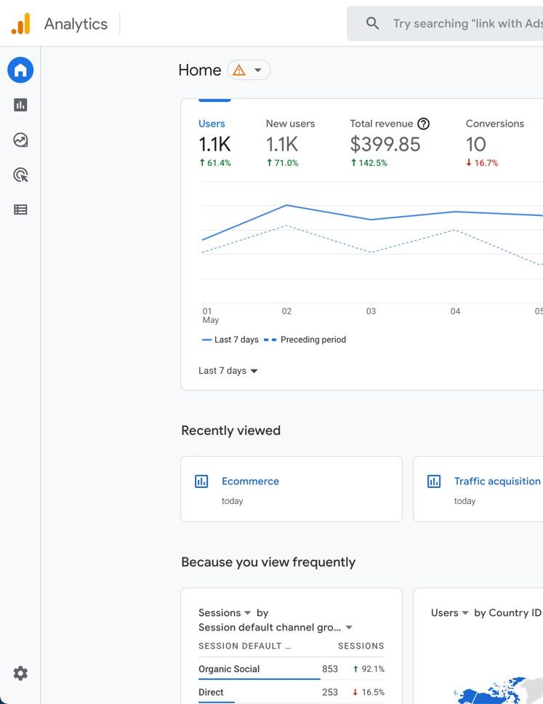



GA installation
Your pages
Google server
*Data Processing
Framework
Google script gtag.js
Google takes 72 hours to process complex data
Source : Google images en JEMS
Notes:
The installation of Google Analytics is done through a script added to your pages, which is then processed by Google's servers. After that, the data is analyzed and available on a dashboard.

Slide 16
Google Analytics 4 protocol
https://analytics.google.com/g/collect?v=2&tid=G-ABC1 23XYZ&gtm=2oe540&_p=870956342&_z=ccd.tbB&gcs=G1 11&cid=1495324351.1650350633&ul=en&sr=1728x1117&_s= 3&uid=70&sid=1652021896&sct=23&seg=1&dr=https%3a%2 f%2fgoogle.com&dl=https%3A%2F%2Fdomaine.com%2Ffr %2F&dt=titre%20de%20la%20page&en=page_view&up.cr m_id=70&up.user_id=70
Notes:
Here's an example of the Google Analytics protocol. The interesting part isn't the link itself, but seeing what makes up the link, with various elements that we'll discuss later.

Slide 17
Google Analytics 4 protocol
sid=1652077808
sct=25
seg=1
dl=https://domaine.com/fr
dr=https://www.google.com
dt=Page title
en=page_view
_ss=1
up.crm_id=70
up.user_id=70
Session Id
Session Count
Session Engagement (1=true)
Document Location
Document Referrer
Document Title
Event Name
Session Start
User Property
User Property
Notes:
Here is the breakdown of the protocol elements. On the left column, we have the elements, and on the right column, we have the explanation of each element.

Slide 18

Over 120 possible parameters
All Google Analytics information is stored in a cookie on your computer (browser).
On YOUR domain name...
or on the doubleclick domain name (e.g. remarketing)
Source https://www.facebook.com/photo.php?fbid=536161219876672&set=a.357162984443164&id=100064069172152
Notes:
These elements or parameters allow for a hundred or more combinations.

Slide 19
GDPR compliance
What is GDPR?
The General Data Protection Regulation (GDPR) is an EU law effective since May 2018.
It aims to protect personal data and privacy of EU citizens.
Key principles include: data minimization, explicit user consent, transparency, and the right to be forgotten.
Applies to any organization processing EU user data, regardless of location.
Google Analytics & GDPR Compliance Issues
Data transfers to the US: GA may send user data to US servers, where EU-level protection does not apply.
Use of unique identifiers and IP tracking can still be considered personal data under GDPR.
Consent requirements: GA requires prior, explicit user consent to be lawful.
EU regulators (e.g. CNIL) have ruled GA usage non-compliant without strong safeguards.
Notes:
“GDPR is an EU regulation that protects personal data and requires explicit user consent before collecting or processing it.
The issue with Google Analytics is mainly about data being sent to the US and the use of identifiers that can be considered personal.
Without proper safeguards and clear consent, using GA can be seen as non-compliant by EU regulators like the CNIL.”

Slide 20
Personal identifying information
Any information that could identify a single person, even if encrypted, cannot be imported into Google Analytics.
The GDPR requires Prior consent
For example : 122.195.25.144
Notes:
This explains what personal data is, like an IP address, and what the GDPR regulation entails.

Slide 21
What is consent?
The consent you are required to provide for the insertion or reading of "non-functional" cookies and other similar technologies must, in order to be valid, meet the general conditions of lawfulness of consent as set out in the RGPD.
Your consent must be obtained prior to the insertion or reading of cookies.
Your consent must be informed
Your consent is valid only if you can exercise a real choice
Your consent must be specific
You must be able to withdraw your consent
Notes:
Here, I explain what consent means in the context of GDPR legislation.

Slide 22
Pros and Cons
Pros
You comply with GDPR laws
Users are protected
Cons : If users refuse,
you have no tracking info
No traffic sources
No links to paid ads
No conversion tracking
You can't compare periods easily
Notes:
Here, we explain the implications of explicit consent on the quality of tracked data.

Slide 23
Take a random site and check if it's GDPR compliant for your EU country
15' + Debrief
Use Chrome
Addon : https://chromewebstore.google.com/detail/analytics-debugger/ilnpmccnfdjdjjikgkefkcegefikecdc
Addon : https://chromewebstore.google.com/detail/editthiscookie-v3/ojfebgpkimhlhcblbalbfjblapadhbol
Notes:
The goal of the exercise is to spend 15 minutes using two Chrome add-ons to check if a website complies with European legislation.

Slide 24
Consent: technical considerations
Google Consent Status (G1xx)
Value | Meaning
G100 | Consent for both ad_storage and analytics_storage is denied.
G110 | Consent is granted for ad_storage and denied for analytics_storage.
G101 | Consent is denied for ad_storage and granted for analytics_storage.
G111 | Consent for both ad_storage and analytics_storage is granted.
G1-- | The site did not require consent for ad_storage or analytics_storage.
Notes:
As part of the Google Analytics protocol, this explains the technical aspects of consent and its impact on tracking.

Slide 25
Let's Practice in GA4 Demo accounts
Access to Google GA4 demo account
https://support.google.com/analytics/answer/10993011?hl=en
For
Google Merch Shop https://shop.merch.google/
Notes:
Here's an introduction to Google's demo case, which is available to everyone and involves the analytics of Google's online store.

Slide 26
Demo
In the Google DEMO account (GA4), get the following information (about September 2024):
How many new users are there this month?
The number of tablet purchases?
How many sessions were generated by Organic Search?
Which product was the most popular?
What is the URL of the first page of the session?
Most popular (after the homepage)?
Looking at the traffic, what's the most popular source of traffic?
What is the revenue of the product with the best add-to-cart rate per view?
Which browser (and version) has a problematic engagement rate?
Notes:
Learners are asked to find the various metrics listed on the slide in the demo Google account. - duration: 15 minutes

Slide 27
Setting goals
100% of events can become conversions
MIC = Micro-conversions are all actions by your users that lead to a macro-conversion.
MAC = Macro conversions are all actions taken by your users that earn you a profit.
Notes:
Here we introduce the concept of goals in Google Analytics.

Slide 28
Events in GA4 specific to ecommerce
Event
click
Trigger condition
Every time a user clicks on a link to a domain other than the current one.
When a user clicks on a link to a file
Each time the page loads or the active site changes the state of the browsing history.
The first time a user accesses the bottom of each page, i.e. when a vertical depth of 90% becomes visible.
When a user interacts with the application or website.
When the application is running in the foreground or the web page is active for at least one second.
When the video ends.
When video playback time exceeds 10%, 25%, 50% and 75%.
When video playback starts.
Each time a user performs a search on the site (this action is indicated by the presence of a URL query parameter).
file_download page_view
scroll
session_start user_engagement
video_complete video_progress video_start view_search_results
Notes:
Key Takeaways:
Events like add_to_cart, purchase, and refund provide deep insights.
GA4 allows up to 500 custom events and 50 event dimensions.
🔹 Why is this important?
Helps track user behavior beyond simple page views.
Businesses can measure and optimize conversion rates effectively.
🔗 Additional Resources:
GA4 Event Reference

Slide 29
Events in GA4 specific to ecommerce
Event generate_lead view_item_list view_item view_promotion select_item select_promotion add_to_wishlist add_to_cart view_cart remove_from_cart begin_checkout add_payment_info add_shipping_info
purchase
refund
Trigger condition
A user sends a form or a request for information.
A user consults a list of items/offers.
A user consults an element.
A promotion is presented to a user.
A user selects an item from a list.
A user selects a promotion.
A user adds items to a wish list.
A user adds items to the shopping cart.
A user consults his basket.
A user deletes items from the basket.
A user starts the settlement process.
A user sends his payment information. A user sends his delivery information.
A user makes a purchase.
A refund is issued.
Notes:
List of e-commerce-specific events in Google Analytics

Slide 30
Events in GA4 specific to ecommerce
Event ad_impression earn_virtual_currency
join_group
login purchase
refund search select_content
share sign_up spend_virtual_currency
tutorial_begin tutorial_complete
Trigger condition
A user sees a print ad. (Application only)
A user earns virtual currency (coins, credits, tokens, etc.).
A user joins a group (to assess its popularity).
A user logs in.
A user makes a purchase.
A user receives a refund.
A user searches your content.
A user selects content.
A user shares content.
A user registers (to evaluate the popularity of each registration method).
A user spends virtual currency (coins, credits, tokens, etc.).
A user starts a tutorial.
A user follows an entire tutorial.
Notes:
Continuation of the list.

Slide 31
Events in GA4 specific to games
earn_virtual_currency event
join_group level_end level_start level_up post_score select_content
spend_virtual_currency
tutorial_begin tutorial_complete unlock_achievement
Trigger condition
A user earns virtual currency (coins, credits, tokens, etc.).
A user joins a group to assess its popularity.
A user completes a level in the game.
A user starts a new level in the game.
A user moves up to the next level in the game.
A user publishes his score.
A user selects content.
A user spends virtual currency (coins, credits, tokens, etc.).
A user starts a tutorial.
A user follows an entire tutorial.
A user unlocks a success.
Notes:
List of game-specific events in Google Analytics.

Slide 32
500 custom events
25 parameters per event
25 User Properties per property
DIMENSIONS are the visitor (or his visit)
METRICS account for the visitor's actions.
Custom Dim & Metrics
50 customized event dimensions
50 custom metrics per property
25 customized, user-oriented dimensions
Notes:
https://support.google.com/analytics/table/13948007?visit_id=638753942898755878-2040512900&rd=2 Explanations for creating custom events using different parameters and properties. You can show the link below to learners if there's interest.

Slide 33

Traffic sources
Direct traffic is by default... you can't do anything with it...
Source : https://masoffer.com/xu-huong-affiliate-marketing-2016/
Notes:
🔹 Key Takeaways:
Direct traffic is untrackable by default.
UTM parameters can override traffic source for campaign tracking.
Attribution models (last-click, first-click, data-driven) affect reporting.
🔹 Why is this important?
Businesses must use the right attribution model for accurate ROI analysis.
🔗 Additional Resources:
Google Attribution Models

Slide 34
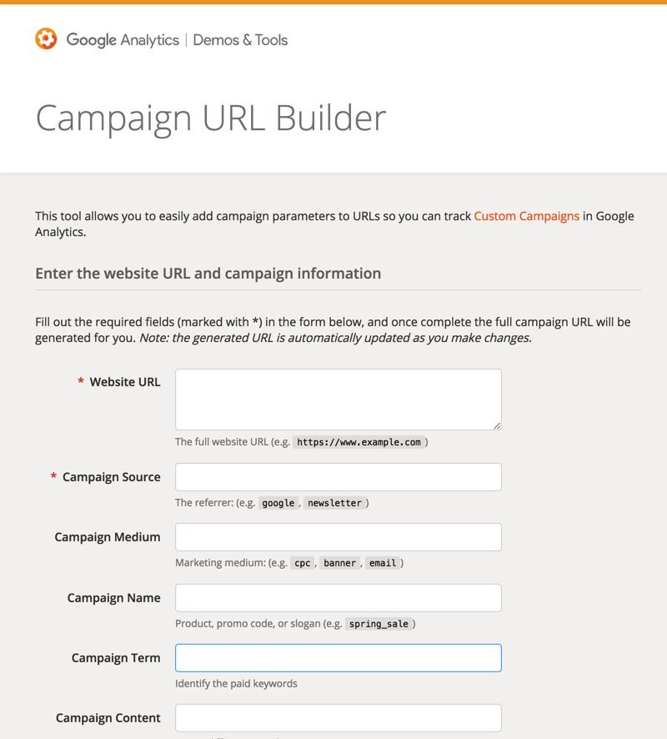
Custom Source (campaigns)
When you want to force a source on a url (a click) you can use the URL constructor.
It automatically adds UTM parameters to the final url. These parameters overwrite the actual source.
Source: https://fingerspitz.nl/blog/google-analytics-acquisitie-rapporten/
Notes:
You can create customized tracking when running marketing campaigns. Here, we explain how to properly track a campaign click, for instance, using the Campaign URL Builder. https://ga-dev-tools.google/campaign-url-builder/

Slide 35
Time commitment
How does it work?
When a user starts a new session, Google Analytics begins recording the duration of the session (in milliseconds). The duration is sent to Analytics when one of the following events occurs:
User moves application screen in background
The user exits the application screen or web page (via For example, the user closes the tab, window or application; the user navigates to another screen or page).
The site or application freezes
The duration is sent in a engagement_time_msec parameter and added to the next event collected.
Notes:
Introduction to the concept of time in Google Analytics.

Slide 36
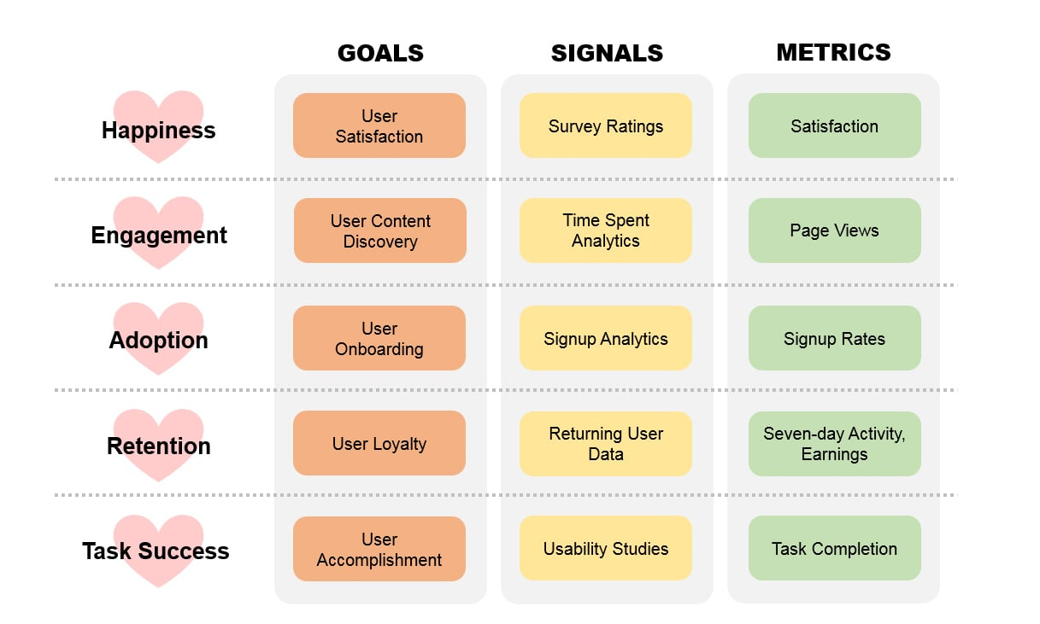
HEART Framework
Source: https://www.heartframework.com/
Notes:
https://www.heartframework.com/ 📌 Objective: The HEART Framework is a user experience (UX) measurement methodology developed by Google’s UX research team. It helps businesses assess and improve their digital products based on key user experience metrics.
What does HEART stand for?
The framework is divided into five key dimensions of user experience:
Happiness – Measures user satisfaction and perception.
📊 Examples: Net Promoter Score (NPS), customer satisfaction surveys, app store ratings.
❓ Why it matters? Happy users are more likely to return and recommend your product.
Engagement – Measures how actively users interact with the product.
📊 Examples: Session duration, pages per visit, interaction frequency.
❓ Why it matters? Higher engagement often indicates a better user experience.
Adoption – Tracks how many users start using the product.
📊 Examples: New signups, first-time logins, downloads.
❓ Why it matters? Adoption rate reflects the product’s appeal and onboarding effectiveness.
Retention – Measures how many users return over time.
📊 Examples: Customer churn rate, repeat visits, subscription renewals.
❓ Why it matters? High retention signals a strong value proposition and user loyalty.
Task Success – Assesses how efficiently users complete key tasks.
📊 Examples: Conversion rates, form completion rates, error rates.
❓ Why it matters? A smooth task flow leads to better user satisfaction and higher conversions.
Why Use the HEART Framework?
✅ Provides a structured way to measure UX effectiveness. ✅ Helps align UX goals with business objectives. ✅ Encourages data-driven decision-making. ✅ Applicable to websites, apps, and digital products.
How to Implement HEART in Google Analytics?
💡 Happiness → Surveys & NPS
Use Google Forms or Hotjar to collect user feedback.
💡 Engagement → Session Metrics
Track time on site, bounce rate, and event tracking in GA4.
💡 Adoption → Funnel Analysis
Use GA4 events to track sign-ups and onboarding completion.
💡 Retention → User Cohorts
Use GA4 cohort reports to track returning visitors over time.
💡 Task Success → Conversion Tracking
Set up goal tracking for key actions (e.g., purchases, signups).
Additional Resources
🔗 Google’s HEART Framework Overview: HEART Framework 🔗 User-Centered Metrics: Google UX Research

Slide 37
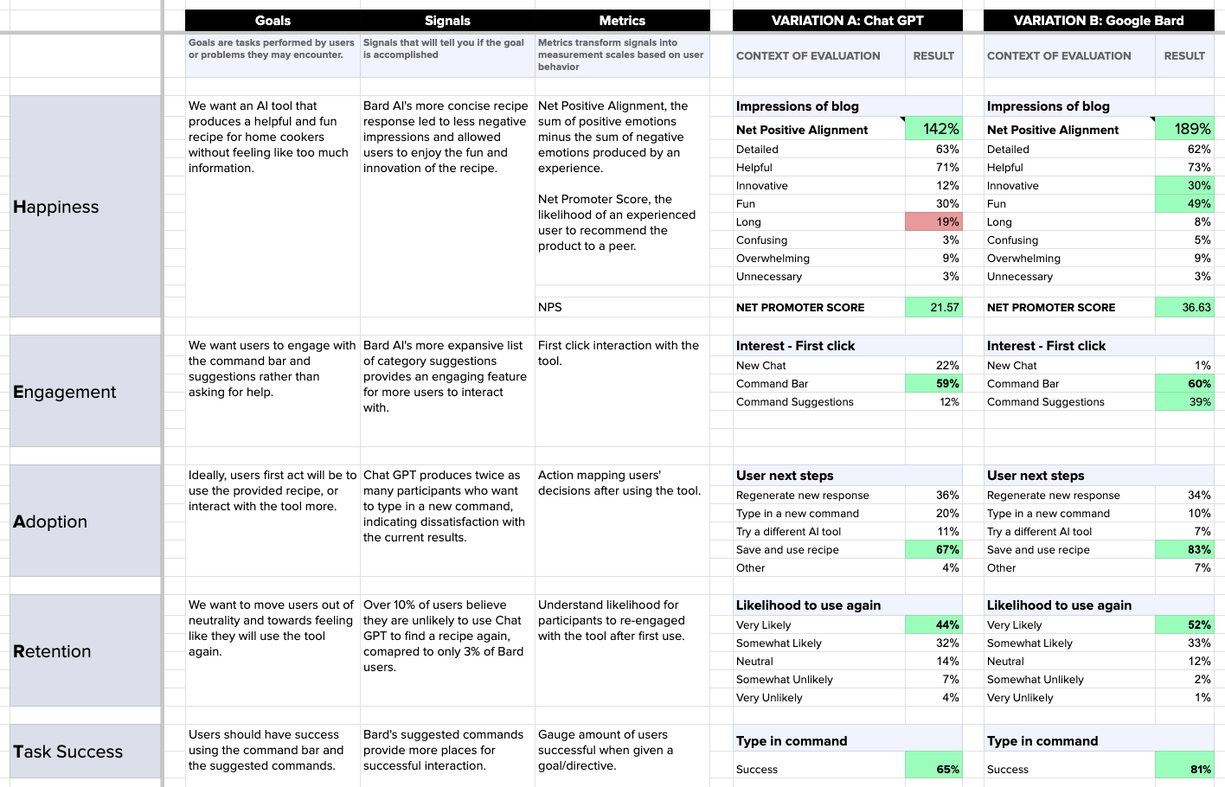
HEART Framework
Notes:
https://www.heartframework.com/ a completed framework card for a client.

Slide 38
Let's Practice in GA4 Demo accounts
Access to Google GA4 demo account
https://support.google.com/analytics/answer/10993011?hl=en
For
Google Merch Shop https://shop.merch.google/
Notes:
A number of exercises follow—to be chosen depending on the time remaining or possibly assigned as homework.
We're revisiting the exercise in Google's demo account on Google's shopping site. - duration 15 to 30 minutes

Slide 39
Exercise alone or in pairs
In the Google DEMO account (GA4),
Product performance analysis with Explore (by September 2024)
Which product category generated the most revenue on the demo site?
Which product has the highest conversion rate?
Identify the pages with the highest engagement rates.
Which traffic channels generate the most new users?
Notes:
https://support.google.com/analytics/answer/6367342?sjid=16769843298055703284-EU#access&zippy=%2Cin-this-article The exercise is now done alone or in pairs, and you need to find slightly more complex metrics.
Duration – 20 minutes

Slide 40
Exercise alone or in pairs
In the Google DEMO account (GA4),
Audience creation
Create an audience of users who have added a product to the shopping cart, but haven't finalized their purchase.
Create an audience of users who have visited a product page without adding it to the shopping cart.
Notes:
Duration: 15 to 30 minutes
https://support.google.com/analytics/answer/6367342?sjid=16769843298055703284-EU#access&zippy=%2Cin-this-article Here, students are asked to create a custom audience in Google Analytics using the demo account.

Slide 41
Exercise alone or in pairs
In the Google DEMO account (GA4),
Creating funnels in explore
Creation of a purchase funnel (from session start to purchase)
How can this funnel be compared to check whether mobiles are as efficient as desktops?
Notes:
https://support.google.com/analytics/answer/6367342?sjid=16769843298055703284-EU#access&zippy=%2Cin-this-article Here, students are asked to create a custom acquisition funnel in the Google Analytics demo account.
Duration: 15 to 30 minutes

Slide 42
Some open discussions
A customer wants to know why sales have fallen over the last 30 days. What do you check?
Conversion tracking is not working properly, how can I identify the problem?
You need to improve the engagement rate on a key page. What do you measure and how?
Notes:
The goal here is to take a few minutes to discuss business challenges and how to transform them into metrics in Analytics. This is an essential role of the Digital Product Manager.

Slide 43
Exercise alone or in pairs
In the Google DEMO account (GA4),
New User Analysis :
Question: From October 1 to 31, 2024, how many new users visited the site?
Goal: Use the acquisition ratio to obtain this metric.
Notes:
https://support.google.com/analytics/answer/6367342?sjid=16769843298055703284-EU#access&zippy=%2Cin-this-article We continue the exercise alone or in pairs to be able to calculate the acquisition rate.
Duration: 5 minutes

Slide 44
Exercise alone or in pairs
In the Google DEMO account (GA4),
Best-performing traffic source :
Question: Between November 1 and 15, 2024, which traffic source generated the most sessions?
Goal: Identify the most efficient source in the acquisition report.
Notes:
https://support.google.com/analytics/answer/6367342?sjid=16769843298055703284-EU#access&zippy=%2Cin-this-article The goal here, in this exercise, is to identify the main traffic sources from a marketing perspective.
Duration: 5 to 10 minutes

Slide 45
Exercise alone or in pairs
In the Google DEMO account (GA4),
Conversion on Add to Cart :
Question: For the period from October 1 to 30, 2024,
how many times has the add_to_cart event been triggered?
Goal: Identify the triggers for a specific e-commerce event.
Notes:
https://support.google.com/analytics/answer/6367342?sjid=16769843298055703284-EU#access&zippy=%2Cin-this-article The goal here is to introduce the concept of adding to the cart and its implications for conversion.
Duration: 5 to 10 minutes

Slide 46
Exercise alone or in pairs
In the Google DEMO account (GA4),
Geographic performance :
Question: Between October 1 and November 15, 2024, which region of the United States generated the most revenue?
Goal: Explore performance by region in geographic reports.
Notes:
https://support.google.com/analytics/answer/6367342?sjid=16769843298055703284-EU#access&zippy=%2Cin-this-article Here, we raise public awareness about the geographical exploration of data, with some warnings regarding the quality of data associated with IP addresses. Duration: 5 to 10 minutes

Slide 47
Exercise alone or in pairs
In the Google DEMO account (GA4),
Question: Between September 1 and 30, 2024, for products added to the shopping cart (add_to_cart), which source of traffic generated the most additions?
Goal: Use "Traffic source" as a secondary dimension in the event report.
Notes:
https://support.google.com/analytics/answer/6367342?sjid=16769843298055703284-EU#access&zippy=%2Cin-this-article optional exercise where we play with a second dimension to achieve more precise traffic and analytics Duration: 5 to 10 minutes

Slide 48
Exercise alone or in pairs
In the Google DEMO account (GA4),
Page performance by device type :
Question: Over the period August 1 to 31, 2024, which page generated the highest click-through rate for users on mobile devices only?
Goal: Apply a filter to isolate mobile devices and analyze page performance.
Notes:
https://support.google.com/analytics/answer/6367342?sjid=16769843298055703284-EU#access&zippy=%2Cin-this-article The purpose of the exercise here is to specifically identify mobile traffic.

Slide 49
Exercise alone or in pairs
In the Google DEMO account (GA4),
Paid Traffic and User Behavior:
Question: Between October 1 and November 15, 2024, for users coming from paid search, how many pages did they visit on average?
Goal: Filter on medium = paid_search and analyze engagement metrics (page views per session).
Notes:
https://support.google.com/analytics/answer/6367342?sjid=16769843298055703284-EU#access&zippy=%2Cin-this-article Here, the concept of paid traffic is introduced through specific filters. Duration: 5 to 10 minutes

Slide 50
Exercise alone or in pairs
In the Google DEMO account (GA4),
Average time per traffic source :
Question: Between August 1 and 31, 2024, which traffic source generated the longest average session duration for French visitors only?
Goal: Filter by country = France and analyze traffic source performance.
Notes:
https://support.google.com/analytics/answer/6367342?sjid=16769843298055703284-EU#access&zippy=%2Cin-this-article The task here is to identify the duration of sessions by geographical area. Duration: 5 to 10 minutes

Slide 51
Exercise alone or in pairs
In the Google DEMO account (GA4),
Conversions by Country and Device Type :
Question: Between September 1 and October 31, 2024, which country recorded the most conversions from tablets?
Goal: Use "Country" and "Device type" as dimensions to analyze conversions
Notes:
https://support.google.com/analytics/answer/6367342?sjid=16769843298055703284-EU#access&zippy=%2Cin-this-article The aim of the exercise here is to raise awareness not only of the geographical dimension but also of the device used by the user to browse the website. Duration: 5 to 10 minutes

Slide 52
Exercise alone or in pairs
In the Google DEMO account (GA4),
Recurring Users by Acquisition Type :
Question: For the month of September 2024, among recurring users, which marketing campaign brought in the highest number of sessions?
Goal: Filter on recurring users and analyze campaigns in acquisition reports.
Notes:
https://support.google.com/analytics/answer/6367342?sjid=16769843298055703284-EU#access&zippy=%2Cin-this-article Focus in this exercise on recurring traffic. Duration: 5 to 10 minutes

Slide 53
Summary
In this lesson, we explored how to quantify and evaluate user experience using data.
You learned the difference between metrics (like task completion rate, time on task, error rate), analytics (tracking user behavior through tools like Google Analytics or Hotjar), and tracking techniques (such as heatmaps, funnels, and event tagging).
The goal is to move beyond assumptions — by collecting real user data, you can make informed design decisions, identify pain points, and measure how your design performs over time.
Key takeaway? What gets measured, gets improved. Use metrics and analytics as your compass to design experiences that truly serve users and meet business goals

Slide 54
https://www.thyngster.com/ga4-measurement-protocol-cheatsheet/
https://www.autoriteprotectiondonnees.be/citoyen/themes/internet/cookies
https://support.google.com/analytics/table/13948007?visit_id=638753942898755878-2040512900&rd=2
https://ga-dev-tools.google/campaign-url-builder/
https://www.heartframework.com/

Slide 55
Additional readings
Google Analytics 4 (GA4) Guide: How It Works and Why It Matters for Your Business - Oxford College of Marketing Blog | Google Analytics 4 (GA4) Guide: How It Works and Why It Matters for Your Business
https://medium.com/kubo/10-crucial-ui-ux-metrics-every-start-up-should-be-tracking-ee6f87af693a | 10 Crucial UI/UX Metrics Every Start-up Should Be Tracking

