Slide 1
Video For Windows
April 12, 2013
Camera Input Setting
Park, Byeongju

Slide 2

Contents
What is VFW?
VFW Setting

Slide 3
What is VFW?
Video For Windows
Video Recording Library
Control of PC Camera

Slide 4
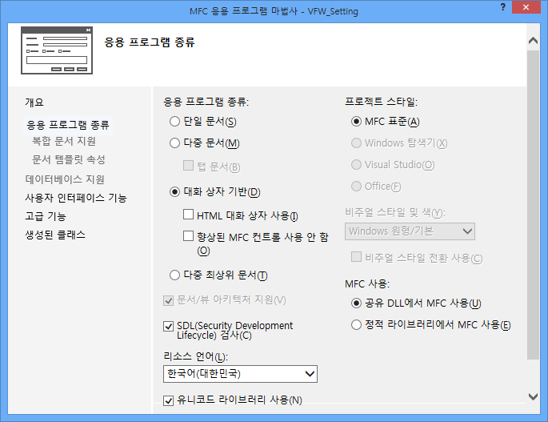
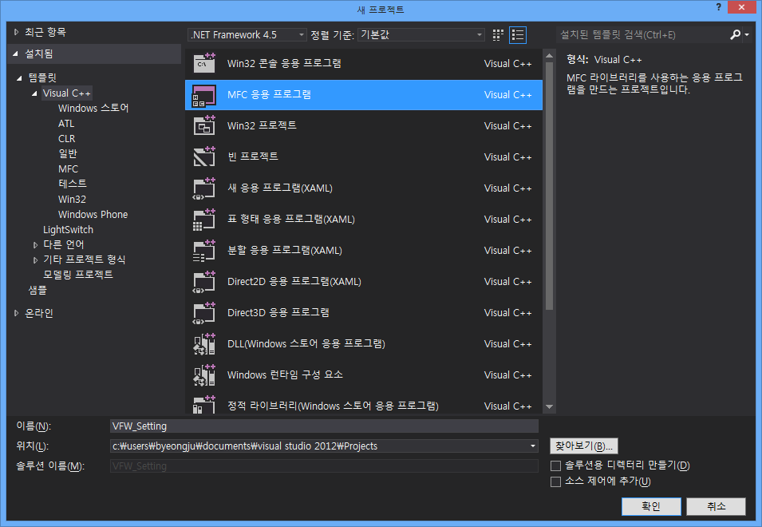
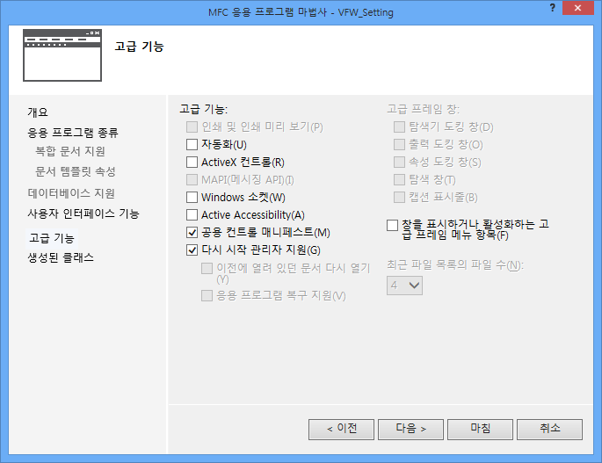

VFW Setting
Based Visual Studio 2005, 2010, 2012
MFC Project
  1. Dialog base
  2. Unchecking radio button [ActiveX Control]
  3. base option except 1, 2.
[2]
[1]
[3]

Slide 5
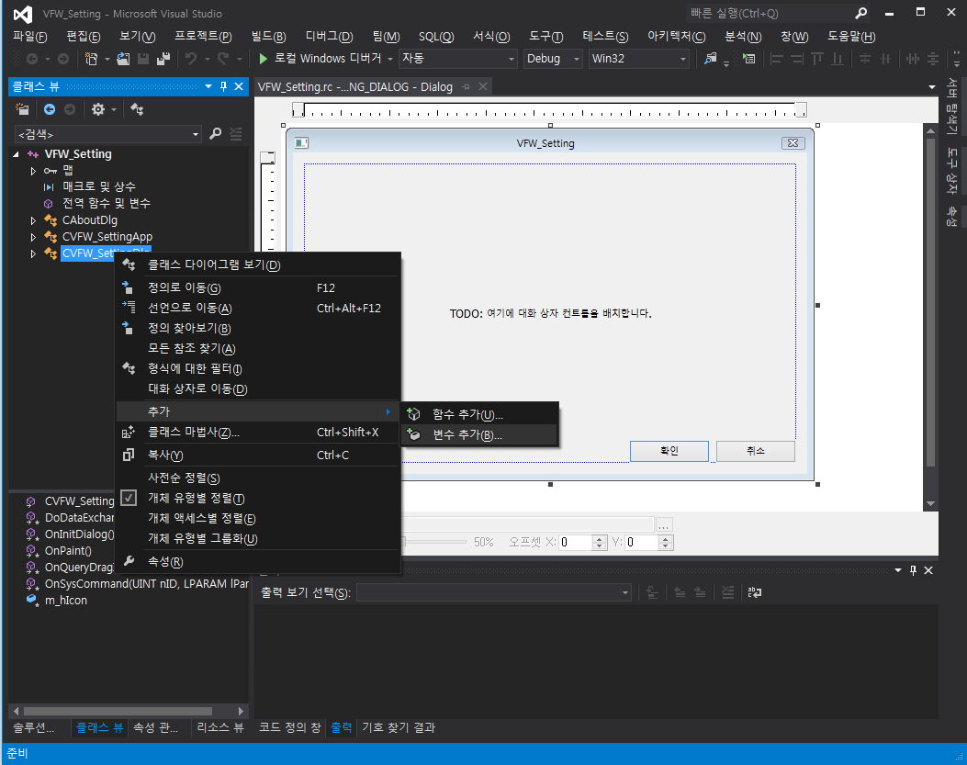
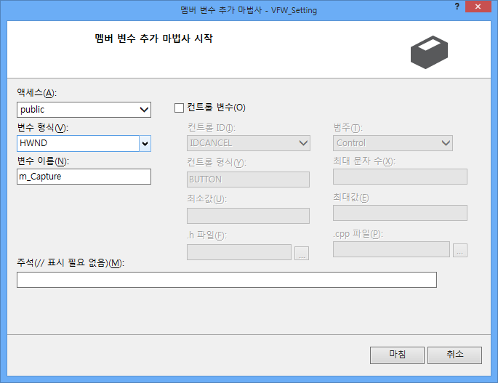
VFW Setting
See project in class view
  Add Member Variable to Dlg

Slide 6
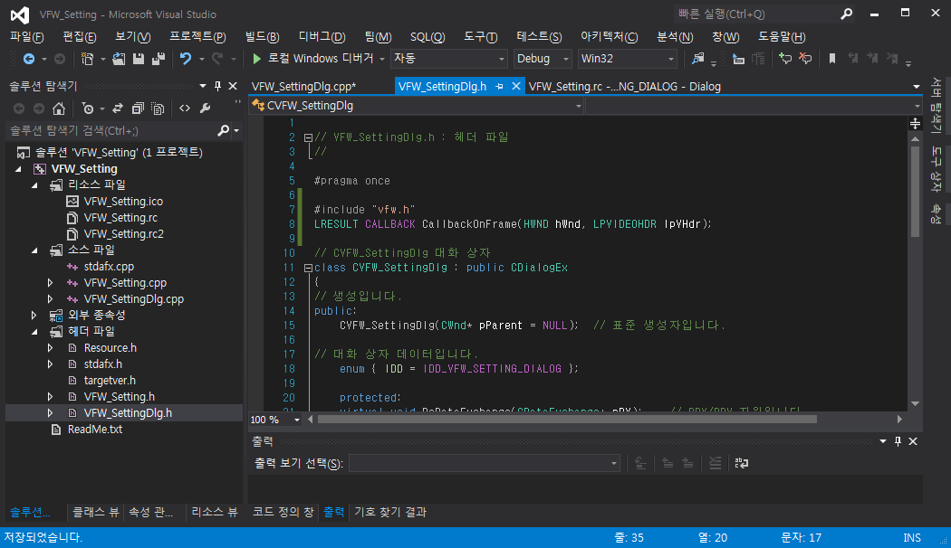

VFW Setting
See project in solution view
  Header Include
    Insert to Dlg.h “#include “vfw.h”
  Declaration Callback Function

Slide 7
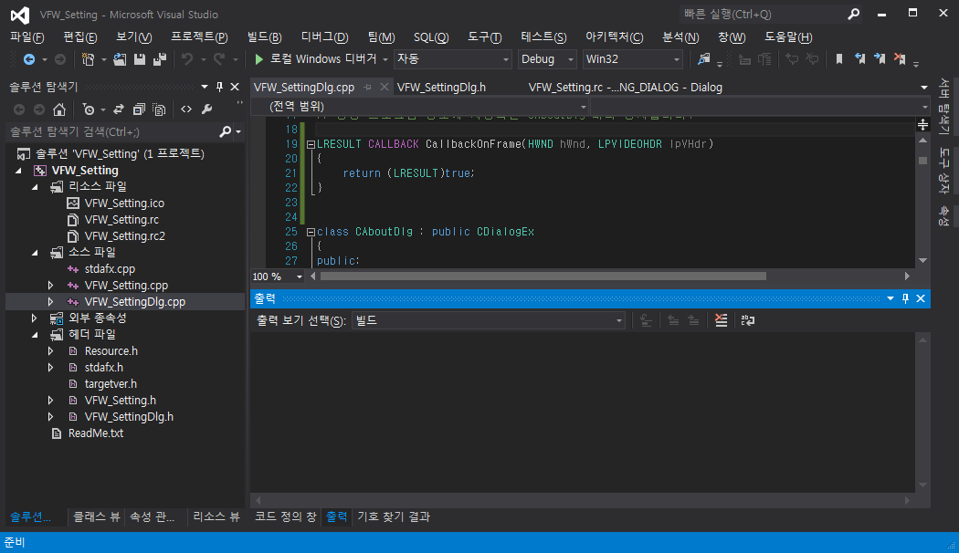
VFW Setting
Implementation Callback Function

Slide 8
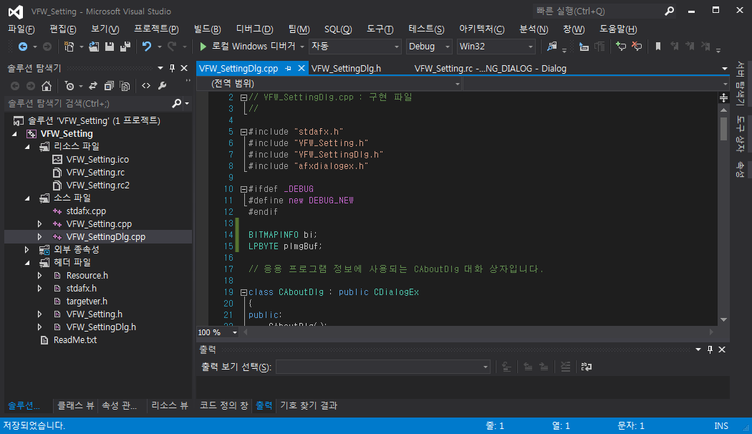
VFW Setting
See project in solution view
  Add local variable (Bitmap Information, BYTE type pointer)

Slide 9
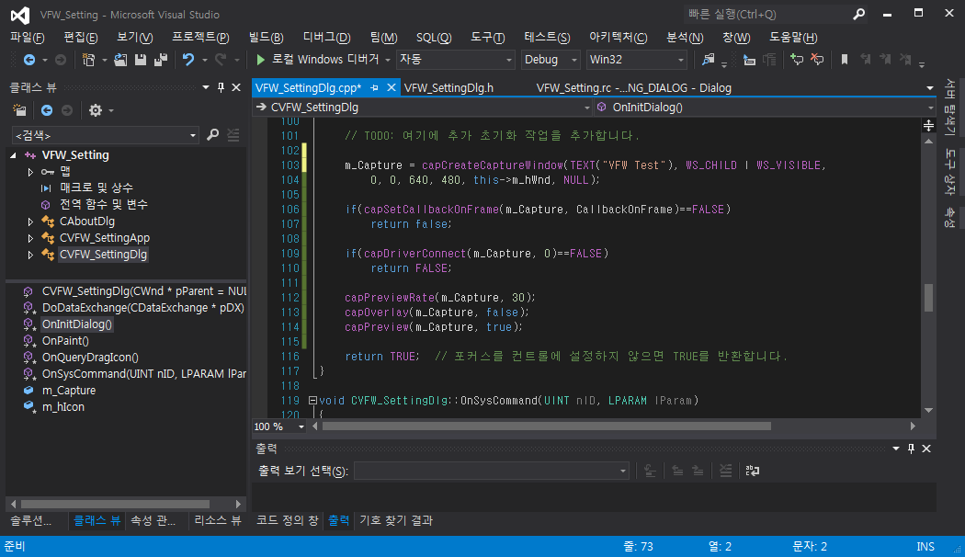
VFW Setting
See project in class view
  In OnInitDialog()

Slide 10
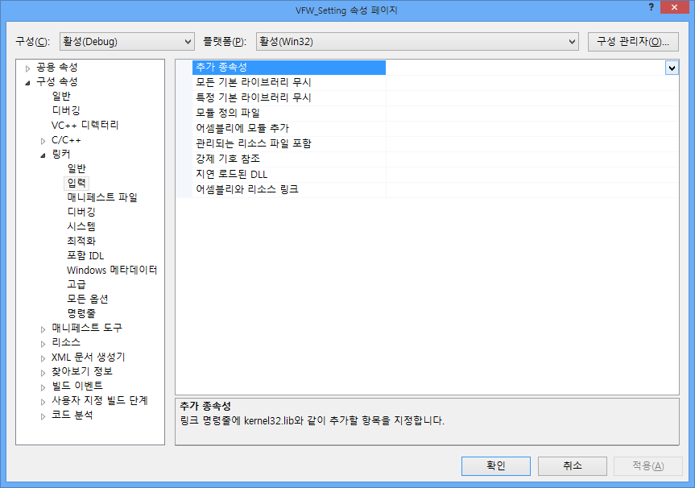
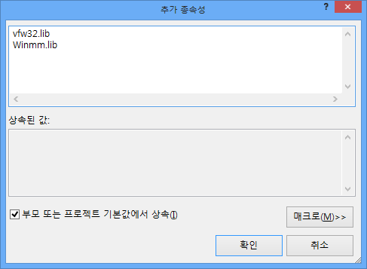
VFW Setting
Library Link (Alt + F7)
  Project property -> Linker -> Input -> Additional Dependencies

Slide 11
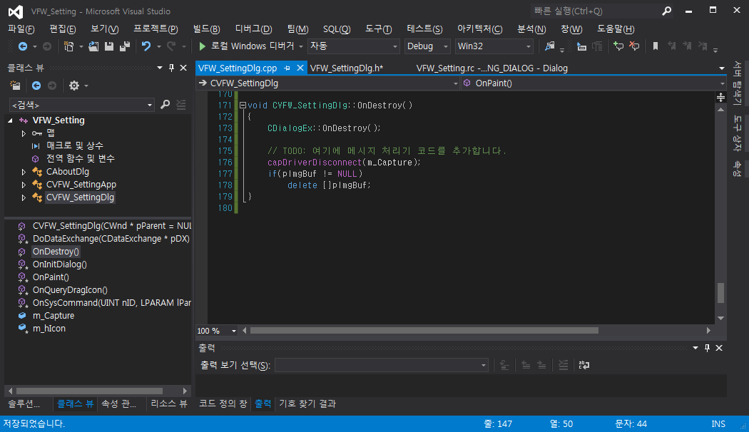
VFW Setting
Disconnetion
  Enroll Message ‘WM_DESTROY’

Slide 12
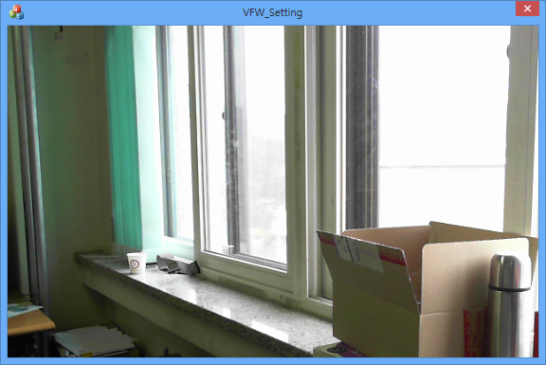
VFW Setting
Execution (Alt+F7)

Slide 13
VFW Setting
B = lpVHdr->lpData[i];
G = lpVHdr->lpData[i+1];
R = lpVHdr->lpData[i+2];

