Slide 1
PHP Super Mario
By: Dino Cajic and Derek Malikian

Slide 2


Purpose
To create a PHP based project
Create a game

Slide 3
Project
Created a Lightweight Custom MVC Framework to handle page requests
Utilized JSON for database access
Created member section
Created two games
Tic-Tac-Toe
Sudoku

Slide 4

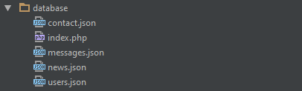
Website Structure

Slide 5
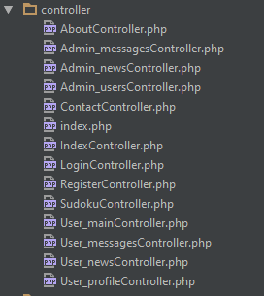
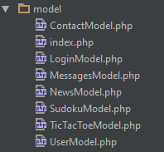
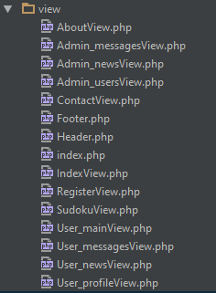
Website Structure

Slide 6
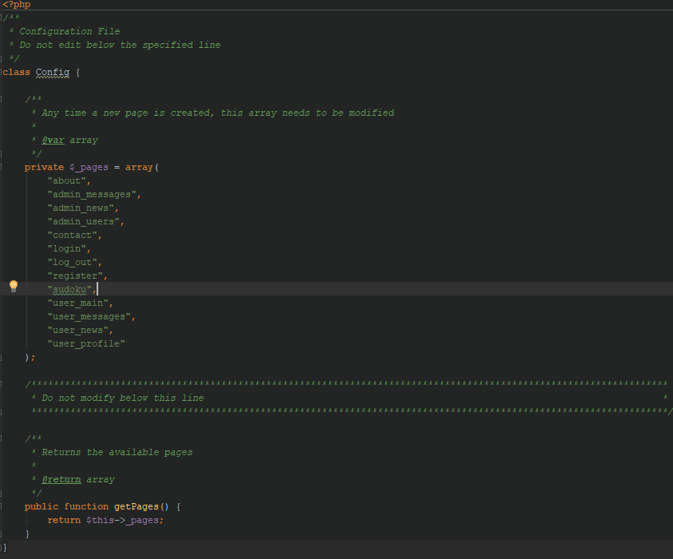
Structure: config.php

Slide 7
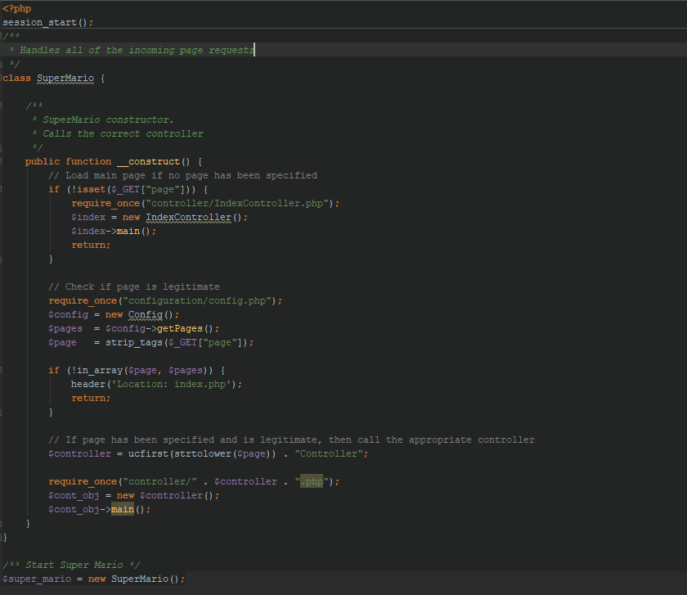
Structure: index.php

Slide 8
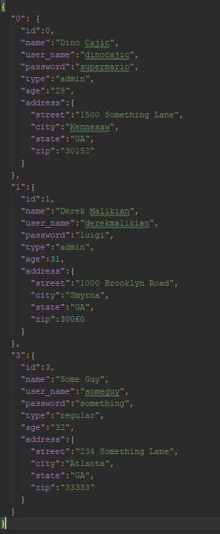
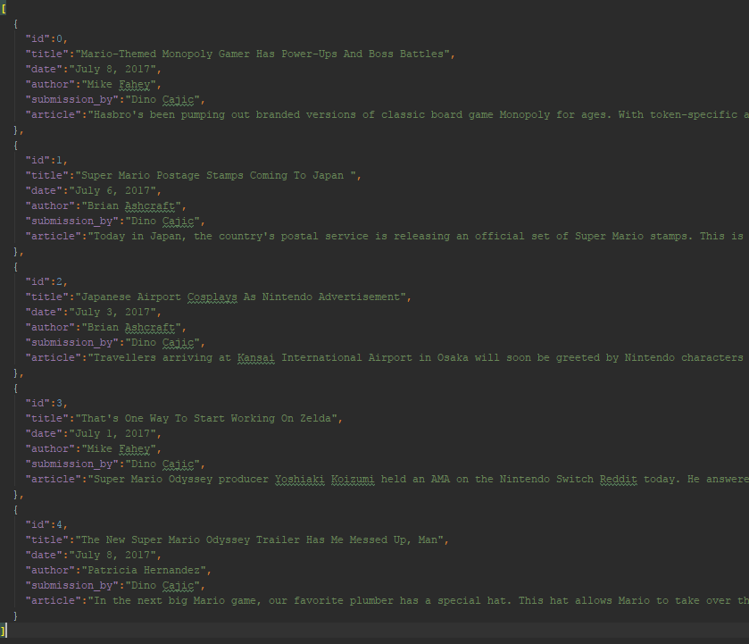
Structure: Database
users.json
news.json

Slide 9
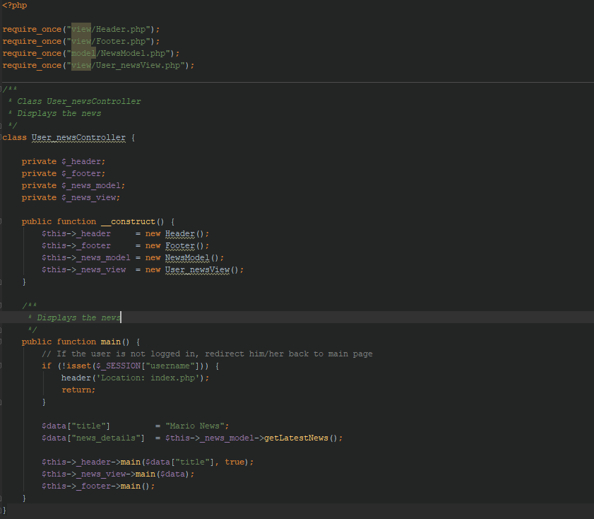
MVC Example: News

Slide 10
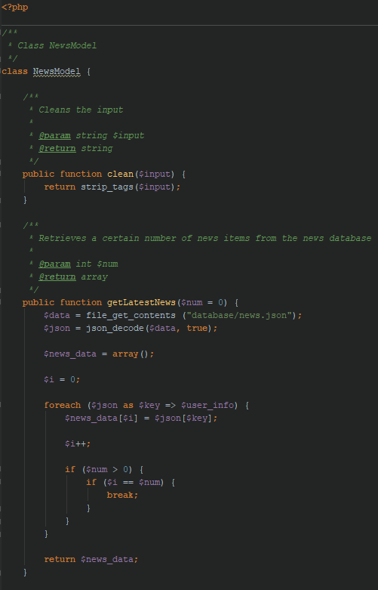
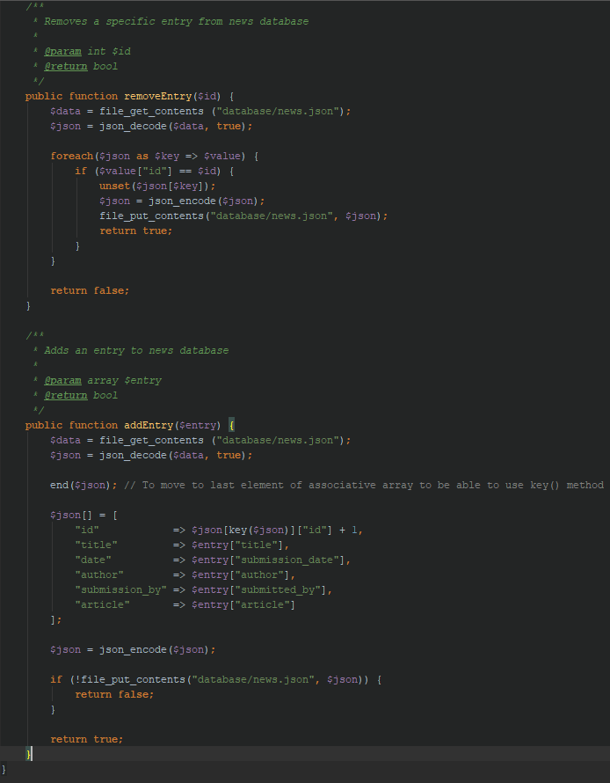
MVC Example: News

Slide 11
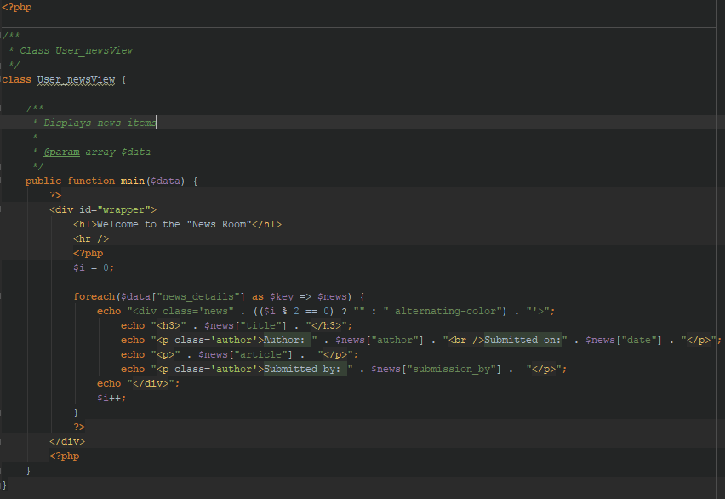
MVC Example: News

Slide 12
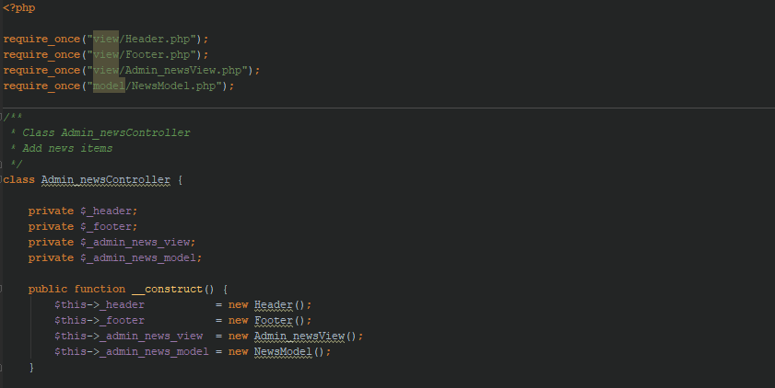
MVC Example: Admin News

Slide 13
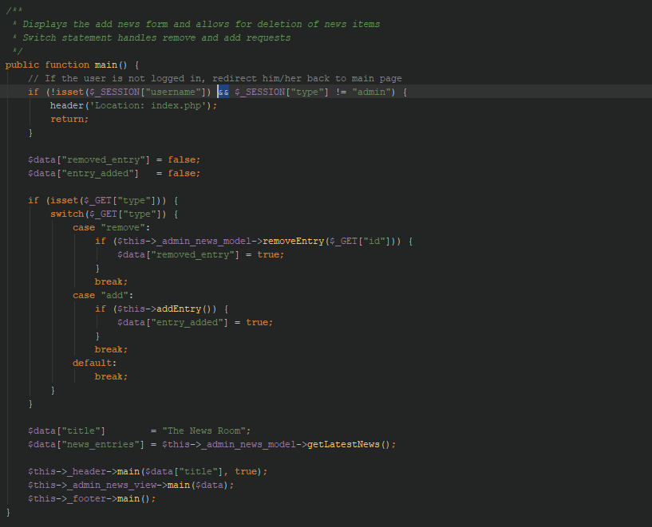
MVC Example: Admin News

Slide 14
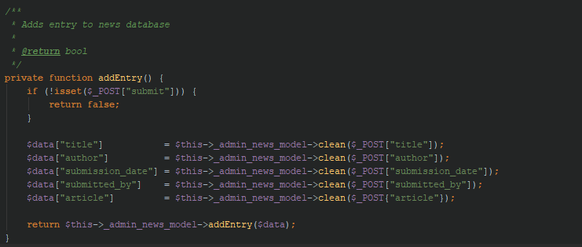
MVC Example: Admin News

Slide 15
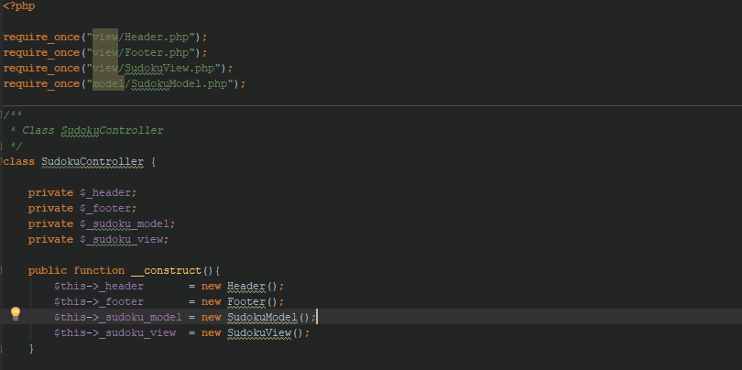
Sudoku: Controller

Slide 16
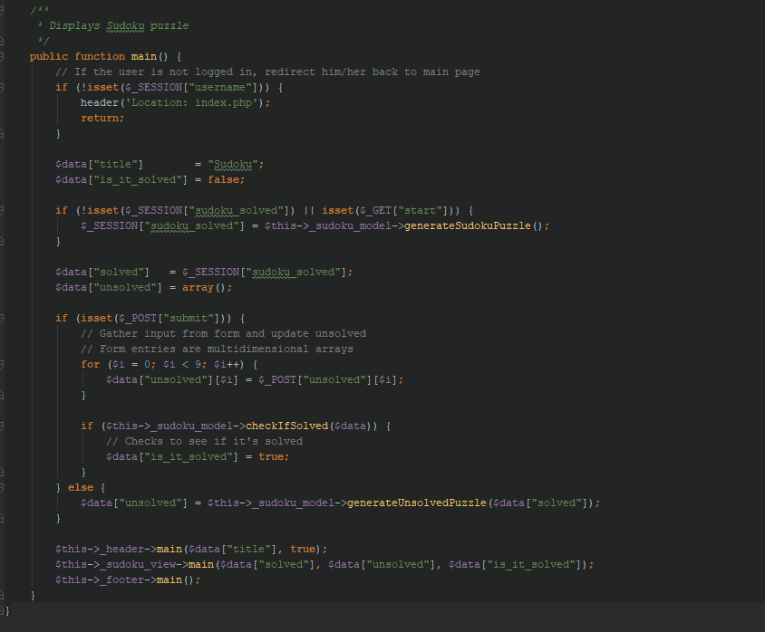
Sudoku: Controller

Slide 17
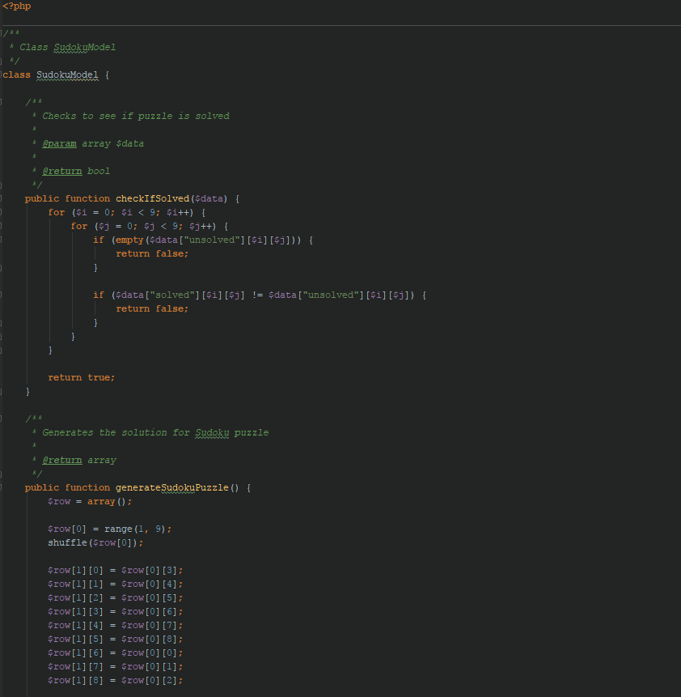
Sudoku: Model

Slide 18
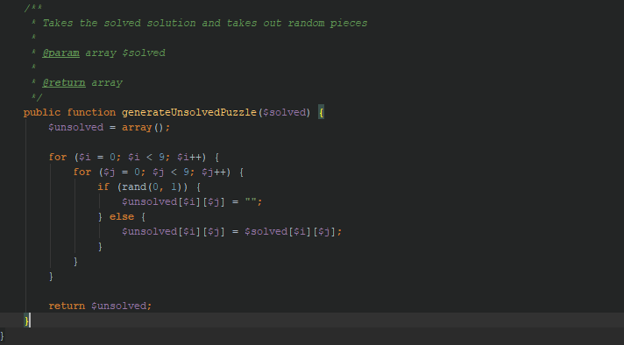
Sudoku: Model

Slide 19
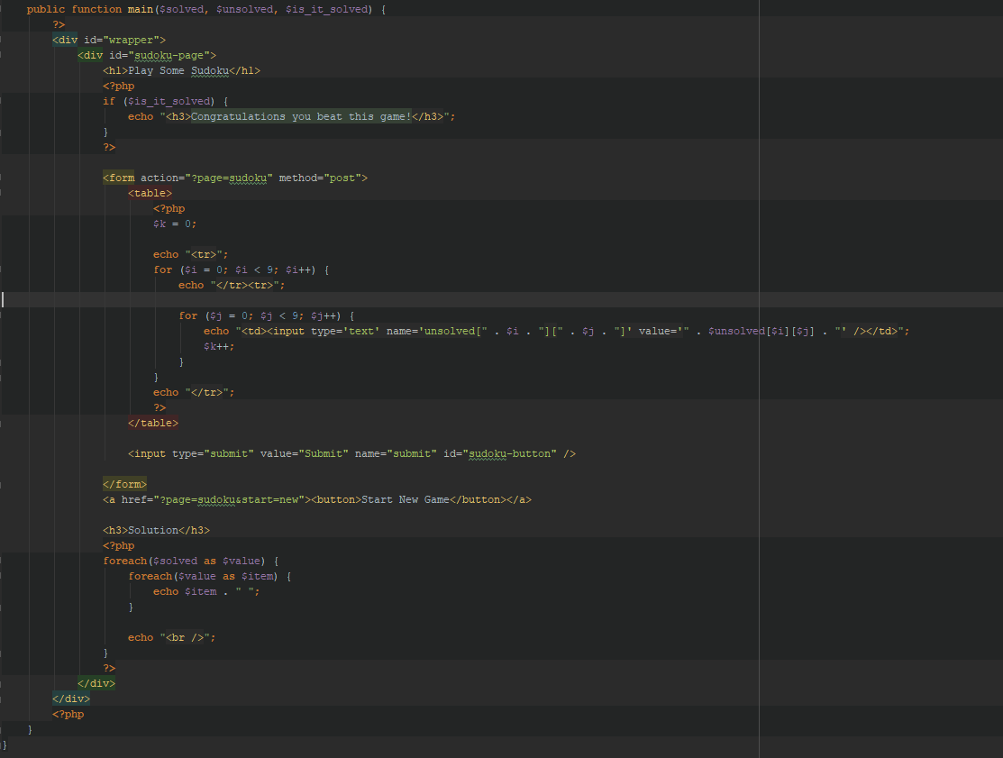
Sudoku: View

Slide 20
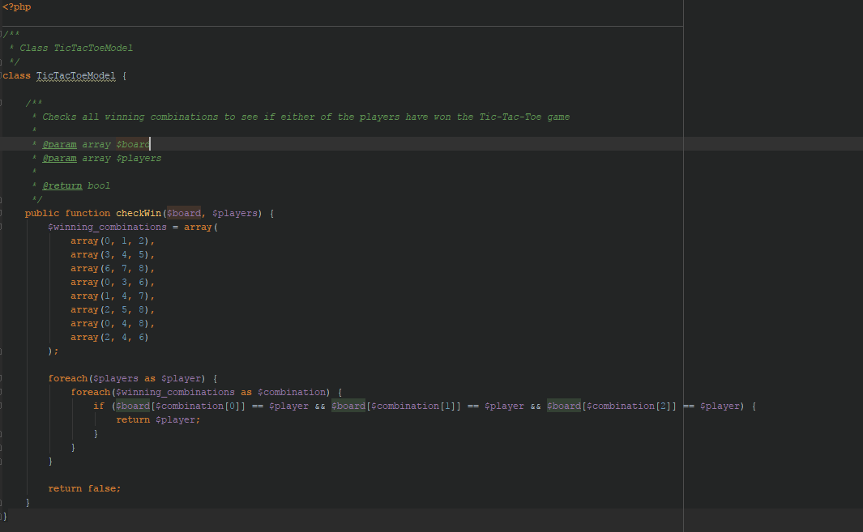
Tic-Tac-Toe: Model

Slide 21
Testing
Tested in Chrome, FireFox and Edge browsers
Sent to others and had them test it on their systems
Computer Systems: Windows, MAC OS and Ubuntu

Slide 22
Difficulties
Database access without a database

Slide 23
Future Possibilities
Incorporate JavaScript to create an actual game of Mario

Slide 24
Project Info
Total Time Spent: 10 hours
Programming Methodology: Extreme Programming

Slide 25
Demo
View Online Demo

